Slide 1
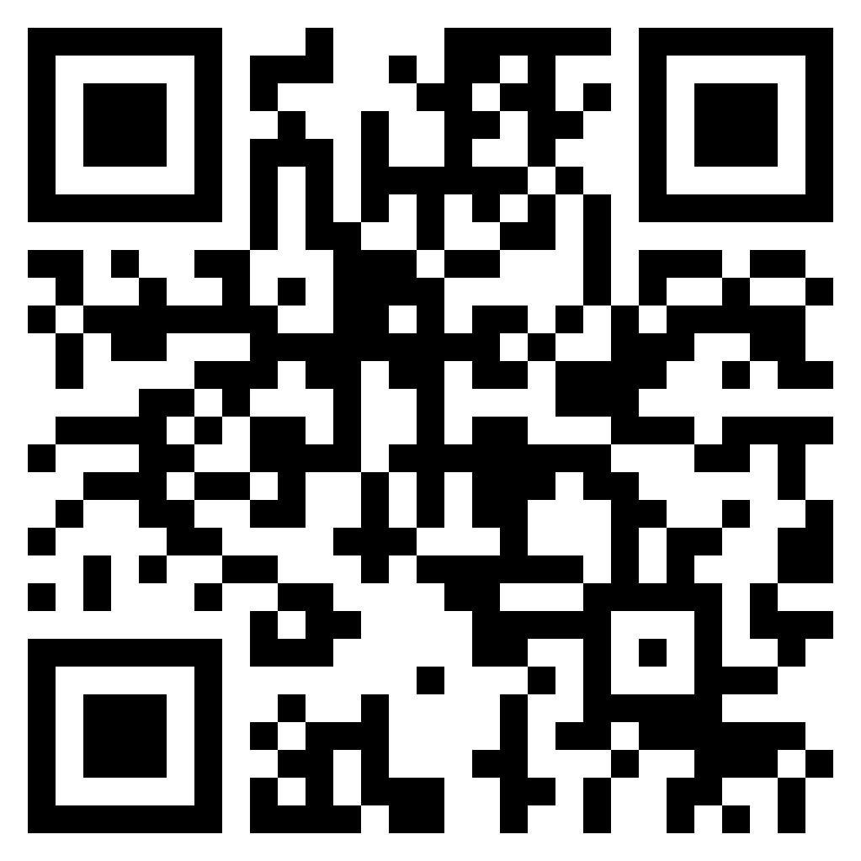
Ascend 2024
Join me at
June 17-20, Las Vegas
#Ascend2024
AscendUsersConference.com

