Slide 2
Current Economic and Marketplace Forecast
Margaret Reid
Vice President and Senior Portfolio Manager, The Private Bank at Union Bank

Slide 3
Global Economy & Capital Markets Update & Considerations for the Year-Ahead
Presented by:
Margaret K. Reid, CFA
Vice President
Senior Portfolio Manager
April 2020
Notes:
As the famous Chinese proverb goes: “may you live in interesting times – thought to be a sign of good fortune…actually a curse…”.
Hard to argue we don’t live in interesting times – jury still our whether good fortune or misfortune.
Last few years, really only enjoying yourself if you enjoy or can ignore the whiplash from swinging “manic/depressive” states of the market. Think the ignore part is key and plays into the advantages of P, C, L/T investment approach vs. not reacting to S/T gyrations..
--------------------
Today, amid all the crosscurrents I want to talk how a P,C/O,L approach can keep us grounded when beset with heightened volatility and unexpected events dislocating markets
Equally important, highlight how we stand to gain from broadening our perspectives, being unreactive, and separating noise from signal.
Taking the time to study market history and economic cycles, investor behavior, and the interplay of the S/R and L/R can provide key insights and direct where your attention should be as we focus on protecting and building wealth for our clients to help meet with long term goals.

Slide 4
Disclosures
Investment management services offered by MUFG Union Bank, N.A. in conjunction with its subsidiary, HighMark Capital Management, an SEC-registered investment adviser. Investments employing managed strategies: • Are NOT deposits or other obligations of, or guaranteed by, the Bank or any Bank affiliate • Are NOT insured by the FDIC or by any other federal government agency • Are subject to investment risks, including possible loss of the principal amount invested.
Some information provided herein was obtained from third party sources deemed to be reliable; MUFG Union Bank and its affiliates make no representations or warranties with respect to the timeliness, accuracy, or completeness of the information provided. Any information provided is subject to change without notice.
Specific securities identified and described do not represent all of the securities purchased, sold or recommended for advisory clients. Do not assume that investments in the securities identified and discussed were or will be profitable.
Indexes are unmanaged, do not incur management fees, costs and expenses and cannot be invested in directly.
The following indexes correspond to the data on slide 6:
1) The S&P 500 Index is a capitalization weighted index of 500 stocks, representing all major industries, designed to measure performance of the broad domestic economy. It reflects the risk/return characteristics of equities in the large cap universe.
2) NASDAQ Composite is a stock market index of the common stocks and similar securities listed on the NASDAQ stock market.
3) The MSCI EAFE Index (Europe, Australasia Europe Australasia, Far East) is a free float-adjusted market capitalization index that is designed to measure developed market equity performance excluding the U.S. market & Canada.
4) MSCI Emerging Markets Index: A free float-adjusted market capitalization index that is designed to measure equity market performance of emerging markets. The MSCI Emerging Markets Index consists of the following 21 emerging market country indices: Brazil, Chile, China, Colombia, Czech Republic, Egypt, Hungary, India, Indonesia, Korea, Malaysia, Mexico, Morocco, Peru, Philippines, Poland, Russia, South Africa, Taiwan, Thailand, and Turkey.
5) The FTSE NAREIT All Equity REITs Index is a free-float adjusted, market capitalization-weighted index of U.S. Equity REITs. Constituents of the Index include all tax-qualified REITs with more than 50 percent of total assets in qualifying real estate assets other than mortgages secured by real property.
6) The Merrill Lynch US High Yield Master II Index (H0A0) is a commonly used benchmark index for high-yield corporate bonds. It is an unmanaged index of U.S. dollar-denominated corporate fixed-income securities bonds publicly issued in the U.S. domestic market..
7) The Barclays U.S. Aggregate Bond Index is composed of U.S. securities in Treasury, Government-Related, Corporate, and Securitized sectors. All securities included in the Index are of investment-grade quality, have at least one year to maturity, and have an outstanding par value of at least $250 million.
8) The BofA Merrill Lynch 1-3 US Year Treasury Index is an unmanaged index that tracks the performance of the direct sovereign debt of the U.S. Government having a maturity of at least one year and less than three years.
9&10) Russell 3000 is a market capitalization weighted equity index maintained by the Russell Investment Group that seeks to be a benchmark of the entire U.S. stock market. More specifically, this index encompasses the 3,000 largest U.S.-traded stocks, in which the underlying companies are all incorporated in the U.S. The Russell 1000 Growth Index measures the performance of the large-cap growth segment of the U.S. equity universe. It includes those Russell 1000 companies with higher price-to-book ratios and higher forecasted growth values. The Russell 1000 Value Index measures the performance of the large-cap value segment of the U.S. equity universe. It includes those Russell 1000 companies with lower price-to-book ratios and lower expected growth values. Russell 2000 Index measures the performance of the small-cap segment of the U.S. equity universe. The Index is a subset of the Russell 3000® Index representing approximately 8% of the total market capitalization of that index. It includes approximately 2,000 of the smallest securities based on a combination of their market cap and current index membership.
11) TWI, Trade Weighted index aka the U.S. Dollar Index which is a geometrically-­averaged calculation of six currencies weighted against the U.S. dollar. The U.S. Dollar Index contains six component currencies: the euro, Japanese yen, British pound, Canadian dollar, Swedish krona and Swiss franc.
Notes:
Let’s talk about philosophy – define what VI means to us. There are certain core principles which are a framework in which we operate and live by each and every day:
PCL –much like discount shoppers we are always in the lookout for the best bargains we can find. The stocks we buy tend to be the mundane, unloved, overlooked, & misunderstood areas in the market. Generally not uncommon for us to take an out of consensus view & be skeptical of conventional wisdom; not only b/c it can be wrong but also b/c by its nature is prob already reflected in mkt prices. We think our CA = ability to “arbitrage” time horizons & evaluate a company under normal/mid-cycle conditions. Thesis largely built on the passage of time, built on normalized conditions so waiting out the cycle . Thankfully, investors overreact to unexpected events & myopia in market & fixation on S/T news/data points produces exploitable opportunities for L/T investors like ourselves. Premise: SR – markets cycle thru states of greed/euphoria & fear/panic which motivate behavior and cause prices to detach from value; however, LR – Fundamentals/BV drives stocks…Simply patiently wait for convergence of S/R & L/R to occur thru the passage of time. Ben Graham: S/R mkt is a voting machine(psy dominant factor); L/R weighing machine(fund/val)
Business Owner – invest with the mindset of being owners of businesses or private investor looking to buy an entire company not owners of shares. Believers in the powers of Compounding(Einstein) and benefits of low turnover. Judge managements ability to be wealth creators as: (1) sound operators; (2) effective capital allocators.
Intrinsic Value – centerpiece of our strategy it too determine what a company is worth and we stay anchored the notion of IV. Before investing, we asking ourselves two simple questions: “what is it worth and what is the share price. As bargain hunters, we seek to buy stocks at a meaningful discount to our est of IV. Take a holistic approach to valuing a company because valuation is part art and part science and involves a high degree of judgment.
MOS – because the future is unpredictable we require a MOS to protect ourselves from adversity. Fixation on what can go wrong and attempt to buy at such a low enough price point below IV that severe loss is improbable. We have found success in investing is highly correlated with mistake avoidance and let forces of compounding work their magic– “aim to win by not losing” using sports analogy– defense wins Superbowlsl. Playing defense here. Low expectations also provide a form of protection as it tends to dampen volatility b/c nobody paying attention. Buffert: rule #1 -don’t lose money, rule #2 – see rule #1. Graham: old saying: take care of downside & the upside takes care of itself. Allows room for error, we assume out judgment is not perfect.
R/R – Now we pull it all together, focus on most attractive opportunities with best asymmetric risk/reward payoffs. Generally seek a 3:1 favorable upside/downside profile for our buy candidates. With respect to risk – many types: market risk, int rate risk, credit risk, currency risk, inflation risk. Define main risk as permanent impairment of capital not temporary price fluctuations in the market or deviations from a benchmark. Next biggest risk = price we pay determines our MOS, the greater the MOS the better. Generally speaking, willing to take on “timing, headline, ” &“volatility” risk; avoid biz risk, B/S risk, Valuation Risk. Stacks deck. Stress downside scenarios for adverse macro econ events, manage position size for inherent risk. Value traps: (1) valuable assets, strong CF yet fails to realize value. Mgmt reinvests/transforms embedded value into something less=classic value destruction from bad capital allocation; (2) misread/misjudge/over est strength of biz, value assets, cf=misjudged.; (3) Stock derates yet fundamentals great/thesis plays out/ult. paid, perception issue/patience
Search for Value – finally, why say VI = “easy to say, hard to do ?” VI is hard – requires patience, discipline, contrarian streak, high threshold for pain, & willingness u/p for short stretches. Most not hard wired to buy/down & sell/up = ag. Human nature. Also, unlike growth companies with exciting & familiar stories/stock movement, value stocks carry stigma rooted in an ongoing problem – something gone wrong, sentiment turned, stock under pressure. Our job to determine whether the problem is temp or perm = handicapping risk. Force to rollup your sleeves, do homework, assess true worth and risks involved and decide whether the right time to invest. Therein lie the difficulty in VI: going against the crowd, conviction in thesis during uncertain times, and doing fundamental research & valuation work to support it. In the end of the we always remind ourselves: good/good vs. bad/bad; it’s the “price you pay” determines whether an investment works out or not = “price conscious”

Slide 5
Disclosures
12) The Bloomberg Commodity Index (BCOM) is a broadly diversified commodity price index distributed by Bloomberg Indexes. The BCOM tracks prices of futures contracts on physical commodities on the commodity markets.
13) WTI is the underlying commodity of the New York Mercantile Exchange's oil futures contracts.
14) The S&P GSCI Gold Index, a sub-index of the S&P GSCI, provides investors with a reliable and publicly available benchmark tracking tracks the COMEX gold future.
Gross domestic product (GDP) is the monetary value of all the finished goods and services produced within a country's borders in a specific time period. Though GDP is usually calculated on an annual basis, it can be calculated on a quarterly basis as well. GDP includes all private and public consumption, government outlays, investments and exports minus imports that occur within a defined territory.
Year over year (YoY,Y/Y) is a method of evaluating two or more measured events to compare the results at one time period with those of a comparable time period on an annualized basis..
Quarter over quarter (QoQ) is a measure of an investment or company's growth from one quarter to the next. The price-earnings ratio (P/E Ratio) is the ratio for valuing a company that measures its current share price relative to its per-share earnings.
Earnings per share (EPS) are a calculation of the company’s profit divided by outstanding shares of common stock.
The price-to-earnings ratio (P/E) is a valuation method used to compare a company's current share price to its per-share earnings.
An emerging market (EM) economy is the economy of a developing nation that is becoming more engaged with global markets as it grows.
A developed or an advanced market (DM) in investing terms is a country that is most developed in terms of its economy and financial markets.
Month-on-month (MoM) growth rates are rates of change expressed with respect to the previous month.
All information in this presentation is pulled as of the most recent quarter unless otherwise stated.
Slides 7,8,9,12,17,18,19 include information sourced from J.P. Morgan Asset Management.
Guide to the Markets – U.S. Data are as of March 30, 2020.

Slide 6
Agenda
A Look at the Market - Past and Present
Taking Pulse of the Economy & Capital Markets Amidst COVID-19
Key Takeaways
Notes:
In terms of what we'll cover today:
…Hope to put market action in the right context, identify key drivers and risk signals out there and think about the range scenarios that could play out in 2020 and beyond.
(Buffet: “the only value of stock forecasters is to make fortune tellers look good…”)
(Lao Tzu: “those with knowledge don’t predict, those who predict down have knowledge…”)
(Yogi Berra: “making prediction is hard, especially about the future…”
… Next, a quick “check-up” on the health of the economy, probe where we might be in the economic cycle, and how might it play out going forward
…Finally, highlight key observations, takeaways and what really matters considering the investment landscape – what are the risks to avoid and where are the investment opportunities to capitalize on in these uncertain times ?

Slide 7
A Look at the Market – Past and Present
Notes:
Before we take stock of markets… start with a cartoon: picture is worth 1000 words(cartoon worth 10K), this one really say it all and sets up our discussion. CB a dominate role this cycle and a symbiotic relationship with markets
And a quote. Sage advice from Ben Graham if willing to listen
“Mr. Market is your servant, not your master...” – Ben Graham, The Intelligent Investor = VI Bible
Point here being: Mr. Market is there to serve you…. Not your guide.
Often can be myopic, emotional, and highly reactive at times. Its doesn’t mean you have to be. Most ofen counterproductive and against you L/T interests. Being disciplined and unreactive in the moment can save you from yourself and allow compounding to work its magic = 8th wonder of the world according to Albert Einstein.
---------
Ben Graham(godfather of VI said “in the S/R mkt is a voting machine(mkt psy/sentiment, 24 news cycle, most recent events dominate) in the long run it is a weighing machine(fundamentals/biz valuation)….”.
Key Message: Mr. Market tends to swing between states of fear and greed. Why it is so critical to have a L/T orientation, grounded in core beliefs/principles and repeatable process to help keep your sanity while the mob is losing their marbles.
A character invented by Ben Graham – viewed as an emotionally disturbed business partner, shows up each day offering you a price to buy or sell your businesses, shows up each day with a new price. Takeaway: You sit back and control whether to accept or decline his offer. The posture of most VI’s.

Slide 8
Capital Markets Review 2019 Market Rally On Reduced Trade Tensions, Central Bank Easing, Fading Recession Fears 2020 Market Correction on COVID-19 Global Outbreak to Recession
A LOOK AT THE MARKET – PAST AND PRESENT
Index Total Returns as of 3/31/2020 | 1Q20 | 1 Year | 3 Year | 5 Year | 10 Year
Large Cap | -19.60% | -6.98% | 5.05% | 6.73% | 10.53%
NASDAQ Composite TR USD | -13.95% | 0.70% | 10.28% | 10.70% | 13.67%
Developed International | -22.83% | -14.38% | -1.80% | -0.62% | 2.72%
Global Emerging Markets | -23.60% | -17.69% | -1.61% | -0.37% | 0.68%
Corporate Non Investment Grade (HY) | -13.12% | -7.44% | 0.55% | 2.67% | 5.50%
All Investment Grade (Intermediate Term) | 3.15% | 8.93% | 4.78% | 3.36% | 3.88%
Taxable Cash | 0.65% | 2.38% | 1.84% | 1.22% | 0.67%
Real Estate Investment Trusts(US) | -28.96% | -23.77% | -4.12% | -1.34% | 6.91%
US Value – US Growth | -12.47% | -17.58% | -13.20% | -8.12% | -5.21%
US Large – US Small | 10.39% | 15.96% | 9.28% | 6.47% | 3.49%
US Dollar | 2.76% | 1.81% | -0.50% | 0.14% | 2.02%
Diversified Commodities | -23.29% | -22.31% | -12.63% | -7.76% | -6.74%
Oil (WTI-West Texas Intermediate) | -66.53% | -65.42% | -25.49% | -23.40% | -19.15%
Gold | 3.60% | 21.34% | 7.64% | 5.43% | 3.11%
Source: Morningstar, Factset as of March 31, 2020. Performance longer than 1-year is annualized. See slide 2 for index definitions.
Notes:
Big Themes/Trades Last Few Years – We like to look back and do a post-mortem on what happened and look ahead and map out the most likely path and potential roadblocks for the economy and markets. Always try to be intellectually honest, ask ourselves whether the drivers of performance rest on a solid foundation and is it sustainable.
The path of least resistance was higher. Banner year, stellar returns across the board. Capital markets appear to be defying the laws of gravity in 2019.
2019 90% of assets made money; 2018 90% of asset classes lost money. Good reminder, returns are lumpy year to year but do smooth out over time.
Unique market, despite a fragile macro backdrop, we saw outsized returns across most asset classes. Virtually every asset class was a winner, and “everyone got a trophy”. Wasn’t a two way street, a rising tide lifted all boats.
Takeaway/Step back: Market appears unstoppable. Drivers thematically: (1) reduced trade tension, synchronized global easing campaign, and fading recession fears propelled risk on animal spirts. Bond market telling you slow growth, deflation, flat curve is a concern, low spreads a concern.
------------
All sectors were positive for the year. Leadership in Tech(accounted for 1/3 of SPX returns), communication services, and financials were the chief outperformers. From a style perspective: Cyclicals outperformed defensives by 3%, Large cap outperformed small cap by 6% for the 3rd straight year, growth outperformed value by 10% continuing a dominant trend this decade. And finally domestic stocks handily outperformed foreign markets.
Treasuries and investment grade bonds were stronger as well both up 14%. The dollar was stronger overall, gaining on the euro but somewhat weaker on the yen. Oil recovered notably from its 2018 low rising more than 34%. Gold was higher, up nearly 18% for the year, registering its best annual performance since 2010.
Weave in 10 year numbers to broaden – returns lumpy year to year but mean revert over time. Powerful

Slide 9
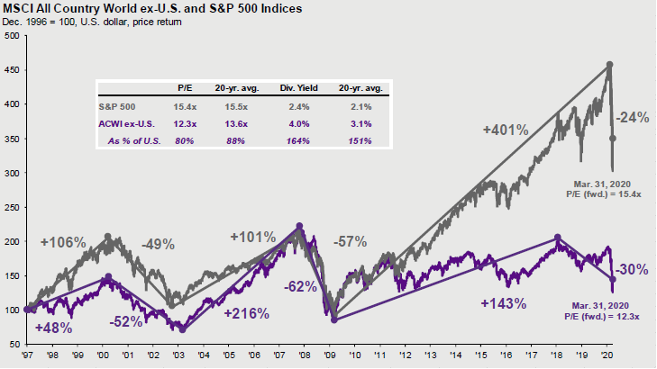
Lookback At Market Cycles Market Leadership Swings Are Common, Asset Prices Outstrip The Economy
A LOOK AT THE MARKET – PAST AND PRESENT
Source: MSCI, Standard & Poor’s, FactSet, See additional disclosures on page 3.
Notes:
Fun to look at market history and cycles to better understand where we are today and perhaps land tomorrow.
This cycle up close to 400% from 3/09 lows of 666 much better than the last 2 cycles. Outsized move 106 months vs 60 avg.
Compare recent highs against prior highs reached in 2007 and 2000, this rally greater than 3x the prior two cycles. 2020, 2010, 2000, 1990.
U.S. 10 years ago probably about 42% of global market cap, today 55%.
Opportunity in DMI and EM given the US outperformance
Until recently, anomaly to reach new highs in stock and bond markets, totally in sync ? Not suppose to happen this way, generally opposite directions. Something dysfunctional. Stock market could be reflecting better econ data, while bonds reacting to global issues and flight to safety and yield/income at any price(YAAP) created disconnect. Felt like everyone was getting a trophy, undeserved perhaps because of CB manipulations.
Increasing concern, asset prices are somewhat untethered from macro economic fundamentals. Financial assets have vastly outstripped growth of the underlying economy, as measured by peak market cap to GDP ratios. Need to digest these gains, have fundamatals catchup to where the market it. When massive gaps like this become this extreme they tend to converge and we don’t know what that will look like. Drivers of equity markets move were not a better macro-economic backdrop or better corporate earnings, both of which are deteriorating but rather optimism around potential trade progress and prospects of a global central bank easing cycle underway. Valuations rich trading back to 18.5x earnings, high end of the historic range and a 20% premium to the long term average level, despite no earnings growth expected in 2019. This move in markets is highly correlated with the expansion of the Fed’s balance sheet, again not fundamentally driven. Not much historical precedent for this, concern it has created an “unstable equilibrium”. Takeaway: we need to see fundamental follow through to support the move higher or risks could build to the downside on a reset of optimistic expectations.

Slide 10
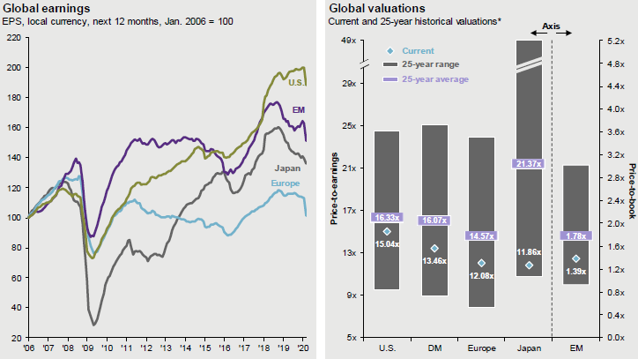
Market Valuations Were Pricing In “Goldilocks” prior to COVID-19 Fundamentals Favored U.S. Markets, While Valuations Favored International Markets
A LOOK AT THE MARKET – PAST AND PRESENT
Source: FactSet, MSCI, Standard & Poor’s, Thomson Reuters, See additional disclosures on page 3.
*Valuations refer to NTMA P/E for Europe, U.S., Japan and developed markets and P/B for emerging markets. Valuation and earnings charts useMSCI indices for all regions/countries, except for the U.S., which is the S&P 500. All indices use IBES aggregate earnings estimates, which may differ from earnings estimates used elsewhere in the book. MSCI Europe includes the eurozone as well as countries not in the currency bloc, such as Norway, Sweden, Switzerland and the UK (which collectively make up 46% of the overall index). Past performance is not a reliable indicator of current and future results.
Notes:
U.S. enjoyed a superior fundamental cycle: our EPS growth, profitability, capital returns, ROIC . Better relative value appears in DMI and EM vs. US
Earnings peaked 3 years ago, just finished a 5 quarter EPS recession from USD and oil price collapse
Likely over-earned this cycle – low interest rates, huge buys backs($900B) financed, low taxes weak ULC(no bargaining power from labor)
EPS set to regrow based on better demand outlook globally, inventory rebuilding, pent up capex cycle, lapping strong USD and energy price collapse as well as prospect of fiscal stimulus, and corporate tax reform
So, how cheap is the market today ? Punch line: not a bargain, high end of historical range, (2) cheap relative to other assets classes; (3) not cheap vs historic, cycle, current EPS or FCF.
Excluding the teck boom markets trading high end of fair value range, unusual for this late in the cycle. Expensive on most measure(P/E, P/B, CAPE, replacement costs), only cheap vs. artificially low inflation and depressed gov and corporate bonds yields New Normal ? Different this time ??? Caution most dangerous works in investing((tulips, Railroads, tech, Nifty 50, Nikkei)
Valuations ahead of fundamentals, need catchup and validate the move up in asset prices. Got in front of skies. Limited P/E expansion potential from here.
My View – wouldn’t bank on “rising tide” continued multiple expansion. Hard to argue with rising inflation, taxes, peaking ISM and peak margins/profitability. Historic precedent suggests best way to make money from here is to get the fundamentals right, value those fundamentals appropriately and smart capital allocation strategies will be the ”winning hand” – i.e. debt reduction, M&A to consolidate excess capacity in industry, dividends , BB.
Scant MOS at these valuation levels, sensitive to shifting rates and unexpected shocks. Only this expensive 10% of the time in history. Really need to get things right beyond what is already “known” and “priced in”.
--------
We believe the risk of a near-term recession is small/no visible excesses. Still, to frame the downside potential to earnings, we looked at all post-WWII recessions. The average earnings decline when eliminating the last two asset bubble recessions was we found the median drop in earnings associated with an economic contraction is 13% - a decline that would weaken, but not destroy, our valuation arguments.

Slide 11
U.S. Economy Long-Term Growth Rates Post Global Financial Crisis, US GDP growth structurally lower.
A LOOK AT THE MARKET – PAST AND PRESENT
GDP
Average: 2.7%
Expansion
Average: 2.3%
Source: FactSet, Bureau of Economic Analysis, See additional disclosures on page 3.
Notes:
Weakest expansion post WW2 era, 2% vs. old trend 3%, long duration 84 months (8+ years) vs. 46 avg(5 years), just closed the output gap(U.S. and Global), and saddled with huge debt load impeding our growth potential. Good news expansion typically don’t die of old age.
Strong Case for Longer Cycle, steady job creation, healthy banking system, no visible excesses to trigger garden variety recession.
Secular stagnation – trapped in a low growth world resistant to monetary policy(DMR/counter-productive)best by low aggregate demand, savings exceed investment, productivity conundrum(.5% per year this cycle vs. 2% norm), aging population causes decline in workforce
Historically, US recessions were about overexpansion , need to redress imbalances, exogenous shocks (consumer or business) followed by a contraction of liquidity—businesses/consumers have strong balance sheets and while the US bank system is extremely well-capitalized today, it is hard to imagine the right impulse exists to create a recession.
Better data and positive surprises recently: global PMIs. confidence, consumer prices, IP, sentiment
Positive View - Self-Sustaining Economic Expansion with fleeting macro risks, fiscal drag abating, wealth effect, pent up demand, banking system healthy(DFAST, CCAR, more IU/S than B/S problems is opposite 2008)
Negative View - Subpar, below trend cycle, economy not firing on all cylinders, labor force contraction, credit transmission weak, labor share income rising/productivity bad ULC up, flat YC bad omen.

Slide 12
Market’s Wall Of Worry Issues Weighing On Investor Psychology And Sentiment, Real Risks Or Perceived Risks?
A LOOK AT THE MARKET – PAST AND PRESENT
The “Wall of Worry”
Trade Wars
Late Innings of the Cycle
COVID-19 Vaccine
U.S Dollar
Strength
Oil Price Shocks
Chinese Slowdown
Climate
Change
Political Dysfunction
‘Brexit’
Middle East Unrest
Election Risk
“In the 20th century, the United States endured two world wars and other traumatic and expensive military conflicts; the Depression; a dozen or so recessions and financial panics; oil shocks; a flu epidemic; and the resignation of a disgraced president. Yet the Dow rose from 66 to 11,497…” – Warren Buffett
Source: Wolfe Research, HighMark Capital Management
Notes:
Overall, there is always a “reason” not to invest. Each year, there has been a host of events and headlines—many of which are serious—that have made investors nervous. While some of these did indeed have a short-term negative market impact, it’s important to keep in mind that historically, the S&P 500 has always recovered to its previous peak. Look there is always something to worry about in the headlines; most of those risks are quickly discounted in the markets. So, it’s to your advantage not to be over-reactive. The out-of-left-field risks that are difficult to fore­cast and prepare for in advance, typically causing the most severe dislocations. But, as we have witnessed from the great financial crises and past market shocks, the economy and markets are highly adaptive and have an uncanny abil­ity to renew themselves over time.
Emotions, Past Experience, Myopia, Cognitive Biases, Unconscious Habits Hijack Our Judgment & Impede Decision Making. As shown, mkt track profits which tack nominal GDP. Natural state to grow, creative destruction to advance.
Question often is asked why do mispriced assets occur ?
Investing lies at the intersection so economics(worth) and psychology(price) based on the S/T S/D of a security. Always seems to be “pockets of inefficiency” in the market to exploit for PCL. Ultimately, capitalism abhors a vacuum and “mispriced securities” creates a “bargain vacuum” that rarely last long. Moreover, investors tend to overreact to unexpected events. Ex” selling on Brexit, Obama/Trump, is a bad decision.
Many factors in force that contribute to the mispricing of stocks some related to style, some psychological, some technical, and some related to the composition of market participants and perhaps the lack of diversify in stock ownership.
So, before you are numerous of categories where “ripe” market inefficiencies can occur and value investors search for opportunity…. Misunderstanding cyclical, secular forces, change, uncertainty, panicked selling, or simply having a variant view from conventional wisdom.. Perhaps technical reasons… program trading, leverage buying/sell hedge funds, quants re-balancing, quarter end window dressing…
Essentially, Looking for bargains in the market that EMT says does not exist….. Real vs. perceived risks are important.
SG Note – 60% of market effectively indexed(10% PASSIVE, 50% BENCHAMRK CENTRIC), so the overriding variable for majority of investors is a company's weigh in the index. Intuitively therefore, the prices can’t fairly reflect fundamental value, which means at any point in time, there will be lots of stocks which are mispriced.
Behavioral Finance is important because it attempts to explain how and why emotions and cognitive errors influence investors, lead to suboptimal/counterproductive behavior and decisions, and can create stock market anomalies such as stock market bubbles and crashes. Left unchecked, subconscious biases, emotions, and past experiences will undermine strategic decision making. There is a powerful tendency to behave in irrational ways as we have built in psychological biases especially to ambiguous, stressful, or uncertain situations.
Because investing is always marked by stress and uncertainty, understanding how emotions interfere with rational choices can make us better decision makers and investors. Important to learn to counter them to minimize mistakes and capture opportunity.
Key to capitalizing on these biases to develop an awareness and effective tools to help resist them. Best weapon against emotional biases – cultivating mindfulness and a disciplined, objective approach to investing. Armed with such tools, we can harness these human emotions to our advantage to avoid pain and capture opportunity
Cyclcial : I/R’s. credit cycle, semi cycle, energy(140 to 25). Mkt can over/under-react; Secular: e-commerce dislocate Bricks, OTT impacts cable bundle, shale energy displace OPEC as swing producer, internet disintermediates newspapers/music – over/under react

Slide 13
Taking Pulse of the Economy & Capital Markets Amidst COVID-19
“If you aren’t confused, you simply don’t understand what is going on…”
– Edward R. Murrow

Slide 14
Prior to COVID-19, Economic Cycle Length Record Breaking
Taking Pulse of the Economy & Capital Markets Amidst COVID-19
Source: BEA, NBER. *Chart assumes current expansion started in July 2009 and continued through December 2019. See additional disclosures on page 3.
Notes:
Long but not strong, lacks the intensity of prior expansion so more runway.
No visible imbalances that would trigger a garden variety recession. Some risks, but natural state of the economy is to grow notwithstanding a policy mistake, exogenous shock or financial crises. Tamed biz cycle, no more inflation risk, inventory overhands rather credit cycle and asset bubbles end the cycle. Consumer, Banks strong.
Of the 11 recessions since WWII, the average recession-related drawdown in the S&P 500® Index was minus -29.5%.
Good news is consumer and services, roughly 70 percent of the econ­omy, continue to grow and are in great shape. We have not seen evidence of a spillover into these two sectors that would force a broader contraction so far. But global corporate fundamentals underwhelming in 2019. Earnings broadly flat globally. Profits flat in the U.S. and Europe, while slightly negative in Asia and Japan. We don’t expect a recession near term, not our base case today, and see further runway for the expansion to continue as the usual imbalances are simply not evident today aside from rich multiples. We think we are gliding back from 3% tax reform stimulated growth to the 2% new normal level most of this expansion. The economy is highly resilient, adaptable and dynamic, expansions typically don’t die of old age.
There are five different ways this expansion could end:
1) A sudden blowup in credit markets. Easy money has resulted in an unprecedented global hunt for yield driven by QE and negative interest rates, see chart below. Easy money pushed a lot of investors into financial assets, and any sudden re-pricing of risks for example in loans, HY, or IG could have serious negative consequences for the economy.
2) The US consumer gets tired. Interest rates on credit cards and auto loans have widened in recent quarters, and delinquency rates for consumer loans have moved higher for the past two years. Combined with recent weakness in consumer spending despite strong job growth and wage growth it is important to watch if these downside risks to consumer spending are intensifying. Under this scenario, the expansion would simply fizzle out.
3) The US trade war intensifies, in particular with Europe. With growth slowing in both the US and Europe the downside risks of an escalated and prolonged trade war are serious for both the US and Europe.
4) Fed credibility is severely damaged. If investors suddenly view the Fed as a politically driven, for example if the Fed becomes a fiscal agent or motivated by the election cycle, it could trigger a decline in the dollar and introduce serious risk premia in US long-term interest rates.
5) China gets a current account deficit. Once China has a current account deficit, the Chinese economy will have to rely on financing from abroad, which opens up downside risks to the RMB and ultimately the risk that China will have to sell FX reserves – US Treasuries – to support their currency. Any increase in US long rates as a result of the rest of the world losing appetite for US Treasuries could also be a potential game stopper for the current expansion.

Slide 15
Coronavirus Epidemic Risk Epidemics Usually Transitory, Markets Recover To Prior Path Rather Swiftly
Taking Pulse of the Economy & Capital Markets Amidst COVID-19
Epidemic
Month End
6-month
% change of S&P
12-month
% change of S&P
HIV/AIDS
June 1981
Pneumonic plague
September 1994
SARS
April 2003
Avian flu
June 2006
Dengue Fever
September 2006
Swine flu
April 2009
Cholera
November 2010
MERS
May 2013
Ebloa
March 2014
Measles/Rubeola
December 2014
Zika
January 2016
Measles/Rubeola
June 2019
N/A
Source: Dow Jones Market Data
Notes:
BASED ON HISTORY, INFLUENZAS HAVE TRANSITORY IMPACT ON WORLD GDP. Uncertainty heightened, hard to predict so markets vulnerable to overreact. Will be demand and supply side shocks, mkt treating transitory issue, looking thru disruption impact. Industries impacted: tourism, transportation, mfg, supply chains, Oil demand(OPEC cuts). Snap back post stabilization.
Mkt assumes: CV contained, temp disruption, V-shaped recovery like SARS, China stimulus and Fed signals risk supports in place
Judging by buoyant equity markets, investors seem relatively comfortable looking through the shock from the coronavirus outbreak in China. And we think this ultimately will prove the right approach: virus outbreaks and other natural disasters tend to cause only temporary disruptions to economic activity, so they should not depress corporate earnings over a prolonged period. But we would emphasize that although the shock from the outbreak will be temporary, it will not be small—in fact, the coronavirus shock may be the largest disaster-related disruption to economic activity in modern times.
Past epidemic episodes have added to volatility, however, they did little change the prevailing course of markets. For example, the S&P gained 31% in 1997 despite combination of Avian flu epidemic, Asian financial crisis, Russian default and LTCM collapse. SARS began to infect thousands in 2003, but S&P still ended the year up 26%. The S&P posted a handful of down days in April 2009 following swine flu deaths, but still gained 9.4% that month.
With the recent outbreak of a new strain of the coronavirus in China, consumption growth in the region could face downward pressure if trips are canceled and travel is curtailed in what is typically an extremely busy travel period around the Chinese New Year. The most prominent risk is that fear of contracting the virus reduces economic activity. The potential hit to global growth could be .25%-.50% if it lasts 6 months while China’s growth could slow from 6% to 5% for 2020.
Historical experience with previous viruses suggest that any hit to economic growth and asset prices will prove short-lived, with a trough in activity typically occurring 1-3 months following the initial outbreak. Sectors impacted most: consumer goods, travel, gaming/hotels. However, once the virus is contained, spending activity and markets tend to snap back to trend growth rates. We believe the impact to be transitory but market valuations may correct and the earnings recovery may be delayed as a result of this new global development.
DD, global supply chains, uncertainty: AAPL 20% revenues and 70% of mfg production footprint
To put it in numbers, we often hear investors make the point that fatalities from the Wuhan coronavirus (which currently total about 1,100) are far smaller than typical annual deaths from the seasonal flu in the Unites States (about 40,000) or especially the world (290,000 to 650,0000). But the short-term economic effects look likely to be very large. For example:
We estimate that the impact of the virus outbreak (really the shutdown of economic activity in China intended to contain the virus) will subtract about 2pp from annualized global GDP growth in Q1 2020. This compares to large hurricanes in the United States, which subtract perhaps 0.2pp from global GDP growth.[1] In other words, the temporary GDP hit from the virus outbreak should be about 10 times as large as the disruptions from a major US hurricane.

Slide 16
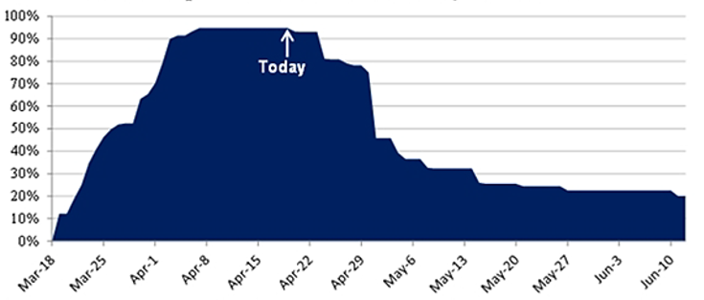
Percent of US Population Under Statewide Stay-at-Home Orders
Taking Pulse of the Economy & Capital Markets Amidst COVID-19
Source: State orders & news reports. Census based on current expirations and subject to change; some states no end date

Slide 17
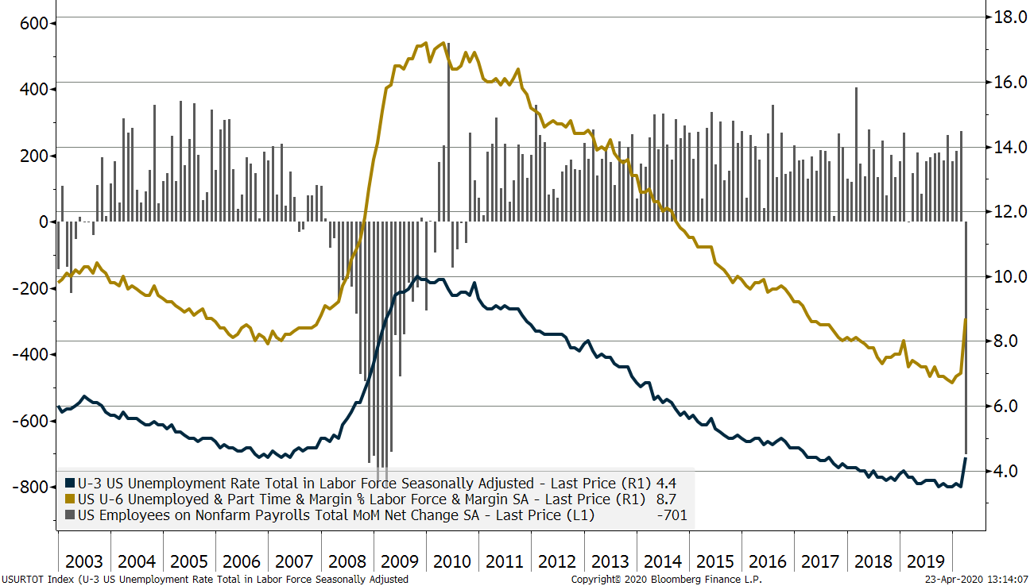
Employment Trends Record Low Unemployment Rate to 2019; COVID-19 Crisis = Extreme Job Losses
Taking Pulse of the Economy & Capital Markets Amidst COVID-19
Source: HighMark Capital Inc., Bloomberg. See additional disclosures on page 3.
Notes:
Lost 9 million jobs in great recession, gained 20 million in recovery. Close to full employment yet 23.5 million Americans 25-54 ,prime working age, out of workforce = tragic
U/E at 3.5% a 50 year low.
Labor force participation rate now improving with discouraged workers and disability coming back into the work force. Was a problem 67 to 63, people dropped out of workforce never before happened in a recovery. 50/50 demographic boomers retiring and skills frictional mismatch, opioids.
Encouraging prime age group 25-54 rebounding, people re-enter workforce. Employment/population ration from 81 to 75 now 79%. Encouraging trend.
Quality of jobs lower this cycle, not high paying construction/mfg but service oriented and part time, millennials difficulty landing jobs.
Unemployment rate near all time lows at <5% but misleading because low participation rate(50% retirement, 50% skills/geographic mismatch, part time jobs, 50 million on food stamps and disability doubling in recovery. Dysfunctional, something not quite right.
Wage growth up to 3.1% YOY = positive, hours worked unchanged
Wages not a problem until it hits 4%.

Slide 18
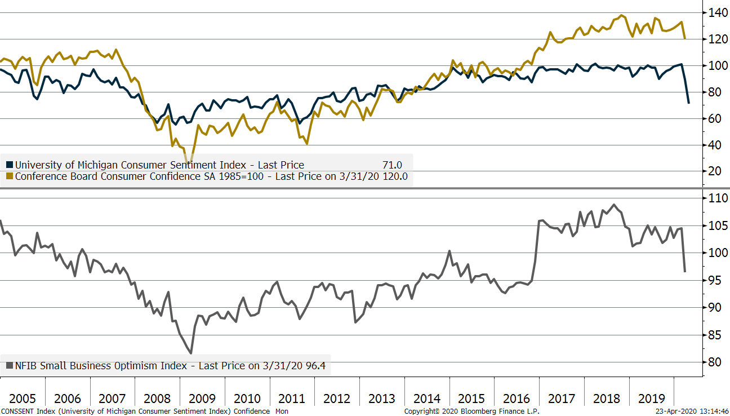
Consumer Considerations Expect Consumer Confidence to Remain Depressed Near-Term
Taking Pulse of the Economy & Capital Markets Amidst COVID-19
Source: HighMark Capital Inc., Bloomberg.
Notes:
Lost 9 million jobs in great recession, gained 20 million in recovery. Close to full employment yet 23.5 million Americans 25-54 ,prime working age, out of workforce = tragic
U/E at 3.5% a 50 year low.
Labor force participation rate now improving with discouraged workers and disability coming back into the work force. Was a problem 67 to 63, people dropped out of workforce never before happened in a recovery. 50/50 demographic boomers retiring and skills frictional mismatch, opioids.
Encouraging prime age group 25-54 rebounding, people re-enter workforce. Employment/population ration from 81 to 75 now 79%. Encouraging trend.
Quality of jobs lower this cycle, not high paying construction/mfg but service oriented and part time, millennials difficulty landing jobs.
Unemployment rate near all time lows at <5% but misleading because low participation rate(50% retirement, 50% skills/geographic mismatch, part time jobs, 50 million on food stamps and disability doubling in recovery. Dysfunctional, something not quite right.
Wage growth up to 3.1% YOY = positive, hours worked unchanged
Wages not a problem until it hits 4%.

Slide 19
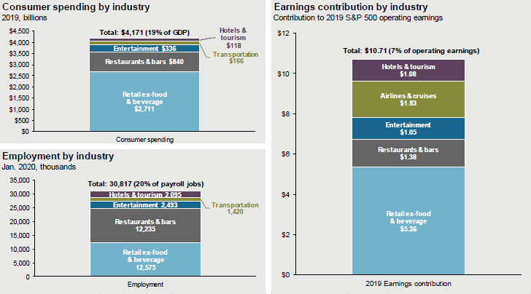
Social Distancing Vulnerability Consumer-Oriented Companies & Industries Most at Risk
Taking Pulse of the Economy & Capital Markets Amidst COVID-19
Source: Bureau of Economic Analysis, Bureau of Labor Statistics, Factset, S&P 500, J.P. Morgan Asset Management. Consumer spending (2019 annual): membership clubs, sports, amusement parks, campgrounds, movies, theaters, museums, libraries, casino gambling, purchased meals and beverages, packaged tours, air and water transportation, hotels and motels, and select retail goods and services. Employment (January 2020): air and water transportation, transit and ground passenger transportation, support activities for air and water transportation, arts, entertainment, recreation, accommodation, food services and drinking places, and retail ex-food and beverage stores. Earnings (2019 operating): hotels restaurants and leisure; airlines; select entertainment and travel booking companies; multiline and specialty retail; and textiles apparel and luxury goods.

Slide 20
US Central Banks Renewed Quantitative Easing on COVID-19 Response
Taking Pulse of the Economy & Capital Markets Amidst COVID-19
Expansion
Source: FactSet, Federal Reserve System
Notes:
CB both player and ref, top 5 banks $16 trillion B/S, never seen anything like this.
Dominant force in markets.
Transition from QE to QT uncharted territory from U.S, BOE, BOC….
$450 Billion reduction in B/S = 100bp FF rate hike, don’t underestimate the powerful effects
---
Big investment controversy. Indeed, Central Banks have played an outsized role this cycle influencing both markets and the economy in unprecedented ways. Fed B/S peaked at $4.5T, fell to $3.75 now again above $4T with repo buying at $100B a month. Lately, we have seen abrupt policy shifts and swift market reactions causing heightened volatility.
Abrupt shift from a defacto tightening bias in 2018 to easing directive in 2019,stunning change in tone from the Fed in a short period
New mantra: patience, flexible, data dependent and in tune with market signals
Critics think Fed is suffering from Stockholm’s syndrome, yielding to the markets temper tantrums, now a slave to the markets whims.
Fed has been a referrer and player on the field most of this cycle, our belief is that the fed should like to go back to just being a referee. However, the market has become addicted to easy credit and liquidity. The Fed need to remove the credit subsidy or risk distorting normal functioning market signals.
In short, we think the Fed is likely on hold for the foreseeable future. In anything, a cut more likely than a hike because of the downside risks to the growth outlook and absence o0f any inflation pressures.

Slide 21
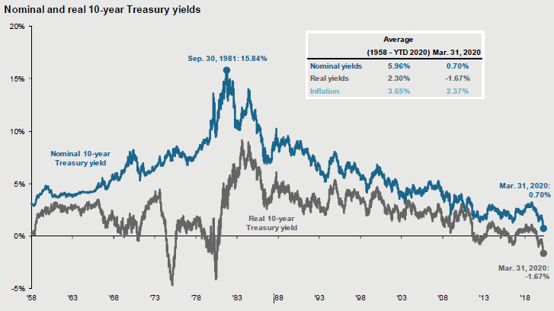
U.S. Interest Rates Favorable Decade For Bonds, Moderate Inflation, Real Yields Below Zero Abnormal
Taking Pulse of the Economy & Capital Markets Amidst COVID-19
Source: BLS, FactSet, Federal Reserve,
A real interest rate is an interest rate that has been adjusted to remove the effects of inflation to reflect the real cost of funds to the borrower and the real yield to the lender or to an investor. A nominal interest rate refers to the interest rate before taking inflation into account
Notes:
Fed “nationalized” yield curve, been hijacked no longer good indicator as a price signal or indicator of risk b/c their intervention in markets along the entire curve. Rates low, implies inflation not a threat. 5-10 year tips = 2.5% Impacting economy/law of unintended consequences: benefits borrowers/hurts savers
Meaning of low rates ? Twlight zone, black hole, upside down. Many crosscurrents and dynamics driving this: Fed/CB rate hike expectations diminished, Massive QE abroad(ECB, BOJ, BOE), Flight to safety amid high uncertainty, carry trade dynamics, record debt driving deflation, Bernanke in Japan floats perpetual bonds = helicopter money, Summers S>I = secular stagnation fallout lack of demand, too much investment last cycle, overinvested, low productivity and adverse demographics(JP, EU China working age population in decline, U.S. slowing)
Law of unintended consequences/Innocent bystanders impacted: savers vs. borrows, challenge for pension returns to match liabilities , insurance company business models, stress in banking system hurts economy(lubricnat0 and confidence. Fed buying treasuries denies Repo market of safe collateral which has a multiplier effect on lending and hurting the Fed’s transmission mechanism. Part of I/B lending and can be pledged many times, source of liquidity.
At some point the backup in rates will be competition for stocks.
Tug of war: nominal GDP pulling up rates vs. German 10 Year from QE abroad pushing down rates; therefore 10 year UST not equal nominal GDP but caught in the middle of opposing forces.
Substitute labor costs for tech/automation = higher margins
Substitute tech for assets = higher ROE from reduced asset intensity(bits fro atoms)
Goods COI been negative last few years, Services CPI +3%
Structural reason for deflation(debt, excess savings>investment pushes down real yeilds, global excess capacity, tech, globalization demographcs) vs Cyclical Reasons Inflation. Tech/AMZN effect: making everyone more efficient. What WMT did to global supply chains in 70/80’s, AMZN doing to middle man(go directly and interact with consumer) cutting him out driving transparency, efficiency, deflationary pressures.
For the past 25 years, we have seen zero inflation in goods and 3% to 4% inflation in services. Goods are things you buy in stores and services are housing, healthcare and education, and the weight to goods in the CPI index is 1/3 and the weight to services is 2/3. Why is inflation so much higher in services than in goods? The answers are more openness to foreign trade holding down goods inflation, higher productivity growth in manufacturing than in services holding down inflation on goods, and higher growth in demand for services as per capita income rises and the population ages. Looking ahead, for higher inflation to become a problem, we either need to see goods inflation move higher, for example because of a significant dollar depreciation, or we need to see even higher inflation in the costs of housing, healthcare, and education.

Slide 22
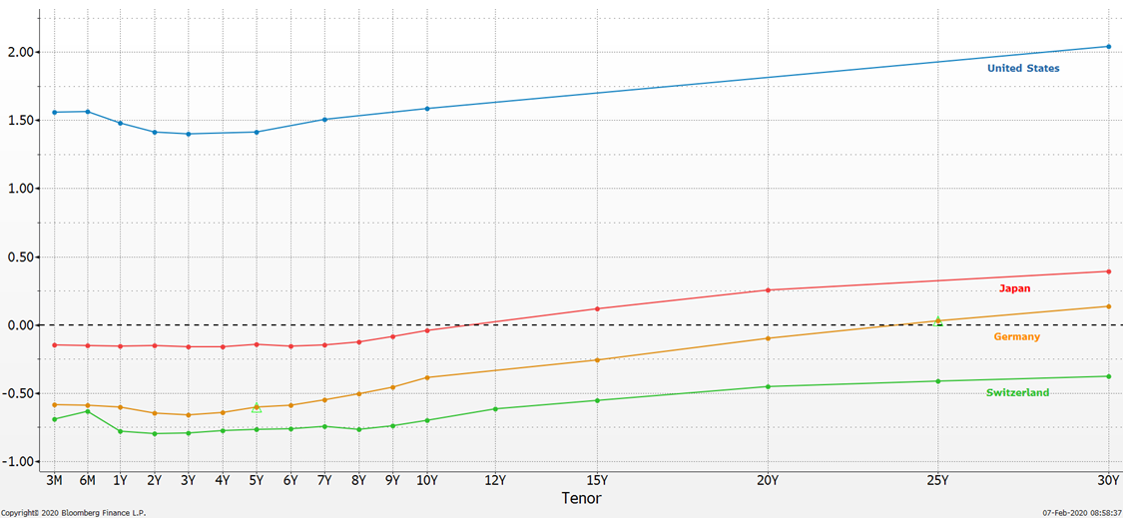
Global Yield Curves Are Flat Negative Interest Rates Distorting Markets, Curve Shape Signals Slower Growth
Taking Pulse of the Economy & Capital Markets Amidst COVID-19
Source; FactSet, Tullett Prebon Information
Notes:
Yields are Flat and Low. Inside of 10 years negative rates for Germany, Japan, and Swiss. $14T (was $17T) negative yielding sovereign at one point down from that peak.
Tsunami of foreign flows into our shores: USD strength, low rates, US-Ger spreads > 2%
Observation: rates are low, yield curves are flat(not a good economic signpost, and many countries YC are negative(JP, Ger, Swiss out 50 years). No inflation. Global sovereign debt: 36% < 0. 80% < 1%.
Zero and negative rate = grapple with this concept, twilight zone, unprecedented, uncharted waters, upending traditional relationships in finance. Harry Markowitz and William Sharpe rolling over in their graves(wait not dead yet). Nobel prize winners MPT, EF(risk vs. reward optimized), CAPM(sources of returns and framework for AA decisions). Premise “risk free rate” = center of the universe and that all asset prices revolved around this rf rate. Now, the unthinkable: discovering what happens when rf is 0 or negative and how asset prices behave. We don’t have a road map for this… better drive slow and careful. Toxic to banking system, didn’t motivate consumption but rather more savings to make up shortfall, didn’t spur growth, and eroded fragile confidence CB knew what they are doing. Counterproductive, make people save more to protect future purchasing power and even opt for less risky assets because little transparency on future returns and risk.
U.S. curve yanked down by gravitational pull by these forces, strongest developed market, positive YC, and strong currency hold value so attractive to foreign buyers. US denominated assets the new rf rate new AAA assets.
----------
Problem - not plain vanilla recession but a credit and consumption binge balance sheet recession 2 simultaneous bubbles: property and credit. Wrong diagnosis, protracted B/S recession
HH debt 133% to 110% yet 75 L/T avg before debt cycle prior 3 decades.; savings 3.5% vs 8% . Avg PCE real 1% last 5 years worst post WW2.
Transmission mechanism is banks, MM broken so no S/D lending/borrowing. Excess liquidity went to commodities, EM, and asset prices(HY, IG, Lev Loans, Farm land, REITS, yield,)
EU outgrew U.S last 2 years yet negative rates and ECB buying 30 billion Euro bonds per month(down from 60B)

Slide 23
Global Debt Overhang Debt Service Obligations Will Impede Growth Potential
Taking Pulse of the Economy & Capital Markets Amidst COVID-19
General government gross debt as % of GDP
2008
2018
%
Germany
UK
Canada
France
US
Italy
Japan
Source: IMF, Haver Analytics, DB Global Research
Source: IMF, World Economic Outlook, October 2019
Notes:
Observations: today aggregate debt levels higher than crises, solved a debt problem with more debt(like curing an alcoholic with another drink). Up $60 trillion in 7 years, 240% to 290% global GDP. U.S. de-lever in consumer, Banks and corps but gov re-levered. Massive leverage increased in China doubled from bottom, EM and EU. Global economy overloaded and overstimulated ?
Japan – canary in the coal mine, highest debt to GDP >500%, deficit 7%, Keynesian dream of borrowing binge and spending yet hasn’t driven growth or inflation and economy is in recession roughly 50% of the time that last 20 years. Helicopter = bigger bazooka, money coming, Bernanke may have driven equity markets to new highs with this leak. Monetize debt, permanent increase money supply and trigger velocity and fiscal response, increase inflation, yen fall and nominal growth accelerate to reflate debt away is hope. Nixon: “all Keynesians now”. R&R: > 90% debt to GDP, growth rate falls by 1/3. from 3 to 2% for U.S.
Concerns about levels of debt and negative interest rates. We solved a debt problem with more debt. All we did is shift the debt from the consumer, mortgages, and the banking system to non-financial corporates and sovereign nations. Excess debt impedes future growth potential because the debt either needs to be paid back thru higher taxes, lower spending, or higher inflation(hidden tax). So we have mortgaged the future to some degree, how much is still unclear but the new normal of 2% U.S. GDP growth from 3% is clear evidence of this. Credit multiplier no longer works…
Debt Overhang – explains weak growth, crowds out productive economy, mortgages future as borrows growth need to pay back eventually.
Principle #1 - America's fiscal problem is a government that is too big and growing too fast. Government spending diverts resources from the productive sector of the economy, regardless of how it is financed. There is real-world evidence that large public sectors sap the private sector's vitality, augmented by lots of academic research on the negative relationship between government spending.
Principle #2 - Entitlements programs are the main drivers of excessive spending. All the long-run forecasts show that the burden of spending is rising because of the so-called mandatory spending programs. Social Security, Medicare, and Medicaid were not designed to keep pace with demographic changes (falling birthrates, increasing longevity), so spending for these program will consume more output.
Principle #3 - Deficits and debt are symptoms of the underlying problem. Government borrowing is not a good idea, but it's primarily bad because it is a way of financing a larger burden of spending. The appropriate analogy is that, just as a person with a brain tumor shouldn't fixate on the accompanying headache, taxpayers paying for a bloated government should pay excessive attention.
Principle #4 - Existing red ink is small compared to the federal government's unfunded liabilities. People fixate on current levels of deficits and debt, which are a measure of all the additional spending financed by red ink. But today's amount of red ink is relatively small compared to unfunded liabilities (i.e., measures of how much future spending will exceed projected revenues).
Principle #5 - A spending cap is the best way to solve America's fiscal problems. Balanced budget rules are better than nothing, but they have a don't control the size and growth of government. Spending caps are the only fiscal rules that have a strong track record, even confirmed by research from the International Monetary Fund and Organization for Economic Cooperation and Development.
Here's one final principle, though I didn't mention it in the interview.
Principle #6 - Increasing taxes will make a bad situation worse. Since government spending is the real fiscal problem, higher taxes, at best, replace debt-financed spending with tax-financed spending. In reality, higher taxes "feed the beast," see Europe.

Slide 24
Election Uncertainty Markets Historically Perform Well In Election Years, Despite Stark Policy Differences
Taking Pulse of the Economy & Capital Markets Amidst COVID-19
Market Performance During Presidential Term
Y/Y% Change in S&P 500 Since 1945
All Presidents
Democrats
Republicans
Year 1
Year 2
Year 3
Year 4
Avg
Source: Cornerstone Macro and Bloomberg
Notes:
Good news and bad news: framers of our constitution made it exceedingly difficult to get this done, need bi-partisan support to govern, three braches and real checks and balances to protect from mob rule on both sides of the aisle. More reason not to jump in and out of markets based on who is president.
President Trump’s biggest weakness is that many voters who might otherwise be inclined to vote for him are turned off by his bad behavior and not respecting democratic norms. We have pushed back against the investor consensus for months that Trump is a heavy favorite to win, because polls show half the country strongly dislikes him for this reason. However, Democrats are making it easier for Trump to make a case to persuadable voters that Democrats are at least as guilty of bad behavior and violating democratic norms as he is. If Trump fights to a draw on this issue, he very likely wins reelection. We have not been shy about highlighting that Trump’s unpresidential conduct has alienated a big chunk of voters, and polls bear that out. We don’t believe Trump is likely to materially improve his behavior and act in a way that will reassure swing voters. But if Trump’s opponents behave in a way that swing voters come to believe “they all behave badly,” then Trump’s biggest vulnerability (by far) could be mitigated and possibly erased. If the two sides fight to a draw on that issue, Trump will be a heavy favorite to win reelection. Each day that passes it seems more like that is what we are watching.
TRUMP NEEDS ABOUT A 48 PERCENT APPROVAL RATING TO WIN THE ELECTORAL COLLEGE. We have found that a president’s approval rating is the rough percentage of the vote a president receives in his re-election. Trump is still at 45 percent and likely needs to get to a 48 percent approval rating in order to win the Electoral College.
As investors we always need to take a dispassionate, objective view of elections and consequences for policies and market impact.
Like Trump or despise him, he has a good economy at his back which has historically been the key determinate of presidential election results.
Incumbent presidents typically lose when recession occur: Ford, Carter, Bush 1.
BS similar to Trump: using establishment disunity to mount an insurgent campaign.

Slide 25
Populism Waves De-Stabilizing Social Cohesion Anti-Establishment, Anti-Globalization, Anti-Elite, Anti-Status Quo Movements
Taking Pulse of the Economy & Capital Markets Amidst COVID-19
As of January 25, 2020
Sources: Congressional Research Service, FT research
Notes:
Surge in populism globally. Seeing anti-establishment, anti-globalization, anti-elite, and anti-status quo movements. Social tensions are rising, cohesion fraying, folks feel left behind and feel betrayed(lack of upward mobility, inequality, high debt levels paid by future generations) . These sorts of waves can produce major policy shifts and have far reaching economic consequences.
Black swan event… The unthinkable: polls, odds, pundits. First showed Breixt 2016, next 2016 election two anti-establishment candidates.
We should have seen this coming: part of a populism wave sweeping the globe: anti-status quo, establishment, elite, globalization, experts/central control… ex: Occupy Wall Street, tea party, Arab spring, Iranian green revolution, Brexit, Trump/Sanders
Not only an unexpected event, market reaction was even more unexpected and shocking.
Understanding Trump – all trying to figure out, is he really this impetuous and reactive ? Obsession with twitter and responding to every attack on him. Master Persuader/Teddy Rooselvt Style/Disrupter in chief/Bull in China shop/WWF and Fake Drama. No filter, not PC gave voice to disenfranchised. Negotiates hard, like banging around. Villains vs. Heroes. Beginning to think his bombastic nature is by design – opening position, not bottom line. Everything is a negotiation/deal and he sees the world as zero sum game with winners and losers. Won’t rip up agreements(NAFTA, NATO) but get better terms/deals. Cabinet posts strong, experienced so reassuring to markets. Not beholden to GOP establishment or lobbyists. Approval rating 37%, disapproval 55% = usual for incoming president. Trump era might be better for mainstreet than wallstreet. Globalization lower rates, goods prices, and raised access to credit.
Effect economy: economy not fully understandable, complex adaptive system. In SR not likely much but with pro-growth policy could nudge us back to our higher potential. Structural forces lurk”: demographics, dent, productivity, capital substitute for labor trends, USD up 25% since 2014. Mkts ahead of themselves pricing in all good stuff/none of bad potential, expectations blown past realities.
Profound implications for policies, mkt and economies.

Slide 26
The Futility Of Market Timing Investors Are Predictably Irrational, Deviating From Long Term Goals Destroys Wealth
Taking Pulse of the Economy & Capital Markets Amidst COVID-19
20-Year Annualized Returns (%) by Asset Class (1998 – 2018)
REITs
Gold
Oil
S&P 500
60/40
40/60
Bonds
EAFE
Homes
Inflation
Average Investor
Source: Dalbar Inc.
Notes:
Reasons u/p: (1) not properly diversified, (2) engaged on market timing/did wrong thing at wrong time piled in at top amid blue sky's, optimism, euphoria and bailed out when markets were fearful and depressed at the lows. Pain 3x that of gains. Powerful tendency to do irrational, counterproductive things even in a 50/50 coin toss.
Thus, his actions/behavioral undermined his wealth creation potential.
Emotions, Past Experience, Myopia, Cognitive Biases, Unconscious Habits Hijack Our Judgment & Impede Decision Making
Behavioral Finance is important because it attempts to explain how and why emotions and cognitive errors influence investors, lead to suboptimal/counterproductive behavior and decisions, and can create stock market anomalies such as stock market bubbles and crashes. Left unchecked, subconscious biases, emotions, and past experiences will undermine strategic decision making. There is a powerful tendency to behave in irrational ways as we have built in psychological biases especially to ambiguous, stressful, or uncertain situations.
Because investing is always marked by stress and uncertainty, understanding how emotions interfere with rational choices can make us better decision makers and investors. Important to learn to counter them to minimize mistakes and capture opportunity.
Key to capitalizing on these biases to develop an awareness and effective tools to help resist them. Best weapon against emotional biases – cultivating mindfulness and a disciplined, objective and goals based approach to investing. Armed with such tools, we can harness these human emotions to our advantage to avoid pain and capture opportunity
Availability Bias
Confirmation Bias
Hindsight Bias
Herding
Loss Aversion
Overconfidence
Random Anchoring
Action Bias
Certainty vs Uncertainty vs. Risk
Expert Opinions
Status Quo
Framing
Illusion of Safety
Inattention Bias –

Slide 27
Key Takeaways

Slide 28
Near-term Technical Global Recession offset by Record Fiscal & Monetary Stimulus Reducing COVID-19 Risk Via Vaccine/Anti-Viral Critical to Recovery
Key Takeaways
Global synchronized recession should be temporary, economy resilient, adaptive, renews itself, negative feedback loop risks
Late cycle expansion on hold, expect inflation and interest rates to remain low as output gaps widen
Structural headwinds to growth include poor demographics, weak productivity, excess leverage
Transition back to Quantitative Easing from Quantitative Tightening, expect volatility on future policy normalization
Corporate profits to peak, valuations reasonable but sensitive to higher rates, returns to moderate
Potentially de-stabilizing risks high global debt levels, currency devaluations, policy mistakes
Key Messages
Benefits of active management
Diversified investment portfolios
Rebalancing periodically
Staying the course towards objectives and the futility of market timing
Notes:
Looking ahead to 2020, we are cautiously optimistic. We believe that some of the political and policy uncertainties that loomed over economies and markets last year are diminishing. We believe this improvement in the outlook coupled with accommodative CB policies should provide a broadly supportive environment for risk assets in 2020. Downside risks avoided and diminishing concerns over a recession, economy could regain some speed as factors holding it back are removed.
Looking ahead to 2020, we are cautiously optimistic today after the dominant risks witnessed in 2019 seem to be fading. On the back of global monetary easing and a reduction in geopolitical tensions, we believe that the time to the next global recession has extended = sets stage for a better outlook. Big Picture: Markets believe “Goldilocks” conditions are back in force: accommodative CB policies, subdued inflation, low and stable 2% GDP growth. The market is discounting a pro-cyclical recovery, a favorable backdrop for risk assets and all else equal means lower risk premiums and higher warranted equity valuations given the low rate structure dynamic). [This large market disconnect—with bond yields at or near all-time lows and equity indices at all-time highs—raised questions about how markets were viewing the growth outlook, and whether that view differed between bonds and equities—with equities just more optimistic. Bullish outlook narrative for stocks continues to revolve around a series of favorable trade developments (US-China phase one deal, USMCA agreement, no auto tariffs), renewed central bank balance sheet expansion, Fed's high bar for rate hikes, US economic resilience, hints of global/China economic stabilization, return to earnings growth in 2020, and bullish positioning. Bearish outlook narrative centers on high valuations, downside risks to earnings estimates, depleted monetary policy ammunition, fiscal policy constraints, demographic headwinds and underwhelming productivity trends.]
Broadly speaking, we think the pace of global economic expansion will be the single most important factor that shapes markets next year. The Fed and other Central Banks have helped extend the global expansion by adding stimulus in response to rising recession risks. At this time, we don’t see a recession in 2020, while the odds have risen they remain low. We expect GDP growth of around 2.25% in 2020(we are above consensus). Despite some risks the economy will continue to grow and avoid recession. Manufacturing is stabilizing, the consumer is strong, banks well capitalized and liquid, and the Fed’s pivot has probably extended the cycle. Important to remember the economy resilient, adaptive and dynamic and the economic cycles typically don’t die of old age. Our belief remains we are likely still in late cycle expansion phase. Thus, more runway due to lack of imbalances evident now which would cause a garden variety recession. Now the longest cycle on record surpassing the 1990’s as the longest in duration, however, also the weakest in intensity and growth far below all the prior expansions going back to 1948. We never truly achieved escape velocity. So, we felt global recession fears were premature and exaggerated.
We expect modest returns from financial assets given the outsized returns last year and most of this entire cycle. Probably pulled forward some future returns, likely a lower return, lower growth environment yet still positive but with more volatility going forward. We expect equity returns to match mid-to high single digit earning growth this year with limited benefits from multiple expansion given the outsized valuation expansion enjoyed this cycle and high levels today. Thus, expect markets to grind higher on improving fundamentals, risk reduction, and supportive policy. A similar conclusion can be drawn for fixed income, where interest rates remain low and credit spreads are tight.
Going to want to be broadly diversified, exposure to most areas of the market, tactically position depending on shifting market conditions. We favor higher quality assets, building toward an all-weather portfolios that can compound at attractive rates and ride out turbulence thru the market cycle. Important to invest through uncertainty, prepare for challenges, seek out opportunity and avoid risk in a lower growth world. Always important for investors to review their investment plans. Make sure the risks taken in portfolios are aligned with proper time horizons and investment objectives. That is what ultimately drives optimal long term asset allocation decisions. Investors need to stay prepared, stay focused and stay invested. Expect higher volatility and market dislocations, so you are going to want to take advantage of this and rebalance periodically.
Active management will shine is this more subdued environment. Think being a patient and opportunistic inside a disciplined framework will be a key competitive advantage. It will play a critical mission in capturing excess returns going forward, capitalizing on mispricing opportunities and avoiding undue risks to protect capital and grow it prudently. We will need to be more selective and discerning in our investment decisions with a risk management mindset: capitalizing on upside potential and managing downside risks.
Finally and most importantly, want to remind you to stay the course towards your long term goals, avoid market timing/jumping in and out of the market based on the 24 hour news cycle and events of the day which ultimately can prove damaging to your wealth creation potential.

