Slide 2
NALMCO 2024 LEARNING LAB
LIGHTING CONTROLS BEYONG BASIC ENERGY SAVINGS
Doug White Eric Fournier

Slide 3
Agenda
BASIC Energy Saving Control Strategies
ADVANCED Energy Saving Control Strategies
NON-ENERGY Benefits (NEBs) Control Strategies
Case Studies

Slide 4
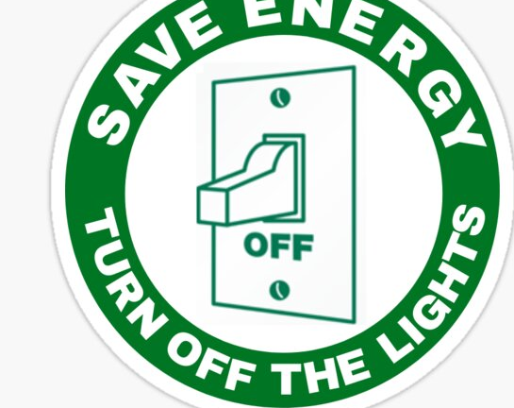
BASIC ENERGY SAVINGS CONTROL STRATEGIES

Slide 5
CONTROLS PROVIDE THE FOLLOWING FIVE BASIC FUNCTIONS
PRODUCE THE RIGHT AMOUNT OF LIGHT
BY CONTROLLING LIGHT OUTPUT INTENSITY
Manual Controls give occupants the ability to manually turn lights On/Off/Dim or Recall Scenes
Typ. Energy Savings
10-20%
High-End Trim sets an artificial maximum light level below 100%
Typ. Energy Savings
10-30%
WHERE THE LIGHT IS NEEDED
BY DECIDING ZONE vs. LUMINAIRE CONTROLS
WHEN THE LIGHT IS NEEDED
AUTOMATICALLY REDUCING ELECTRIC LIGHTS WHEN SPACE IS UNOCCUPIED OR WELL LIT
Know the Difference…
In Occupancy mode, fixtures automatically turn lights on and off as occupancy is detected
In Vacancy Mode, the user must physically turn the lights on using Manual Controls
Occupancy Sensors turn lights on/off automatically when occupants enter and leave a space
Typ. Energy Savings
20-60%
Daylight Harvesting dims electric lights when daylight is available to light the space
Typ. Energy Savings
25-60%
Scheduling/Timeclock provides changed in light levels based on time of the day/night
Typ. Energy Savings
10-20%
Notes:
The WHAT vs. the HOW…

Slide 6
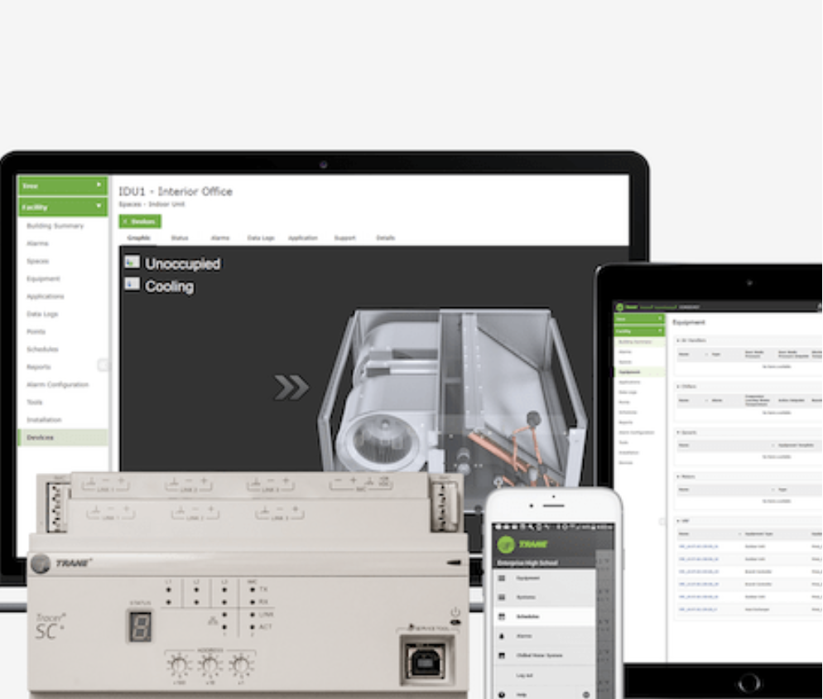
ADVANCED ENERGY SAVINGS CONTROL STRATEGIES

Slide 7
LIGHTING CONTROLS ARE EVOLVING TO PROVIDE ADVANCED FUNCTIONS
TELL YOU HOW YOUR LIGHTS ARE PERFORMING
INTELLIGENT CONTROL SYSTEMS WITH MEASURING AND MONITORING
Fun Facts…
Some Utility companies like Consumer Energy in MI offer higher rebates upon providing before/after energy data reports
Energy Monitoring provide real time energy data for each fixture or an entire circuit
SIMPLIFY & REDUCE EMERGENCY LIGHTING COST
FOLLOWING NEW UL 924-2022 CODE
Emergency Lighting Controls offer continuous detection of normal power and trigger Emergency mode upon power loss
Notes:
Lighting controls are evolving to provide advanced functions, which vary in availability depending on system type and application need
With the release of the May 2022 update to UL 924, UL has changed how emergency lighting works in significant ways. In the past, a circuit level device would detect turn-on of emergency power and trigger the lights to stay on at full for 90 minutes, non by-passable.
Now, UL 924 requires active and continuous detection of normal power. Emergency mode is now triggered by the loss of normal power, just for the duration of that loss, vs a specified time frame. Devices that passively detect either the presence of emergency power, or the interruption of normal power to trigger emergency mode are no longer allowed.

Slide 8
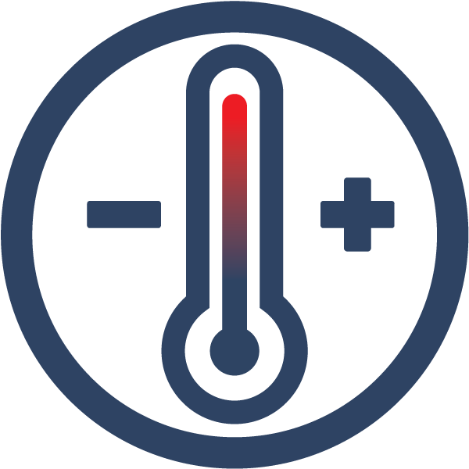
LIGHTING CONTROLS ARE EVOLVING TO PROVIDE ADVANCED FUNCTIONS
REDUCE PLUG LOADS & HVAC CONSUMPTION
LEVERAGING CONTROLS & SENSORS
Plug Load Controls automatically turn off controlled receptacles once occupants leave a space
BMS/HVAC integration
Load Shedding
HVAC/BMS Integration controls heating, ventilation, and air conditioning systems through contact closure, BACnet protocol or API integration
COMMUNICATE WITH UTILITY SERVERS
TO MINIMIZE PRESSURE ON THE GRID
Load Shedding/Demand Response automatically and temporarily reduces lighting loads during peak electricity usage times

Slide 9
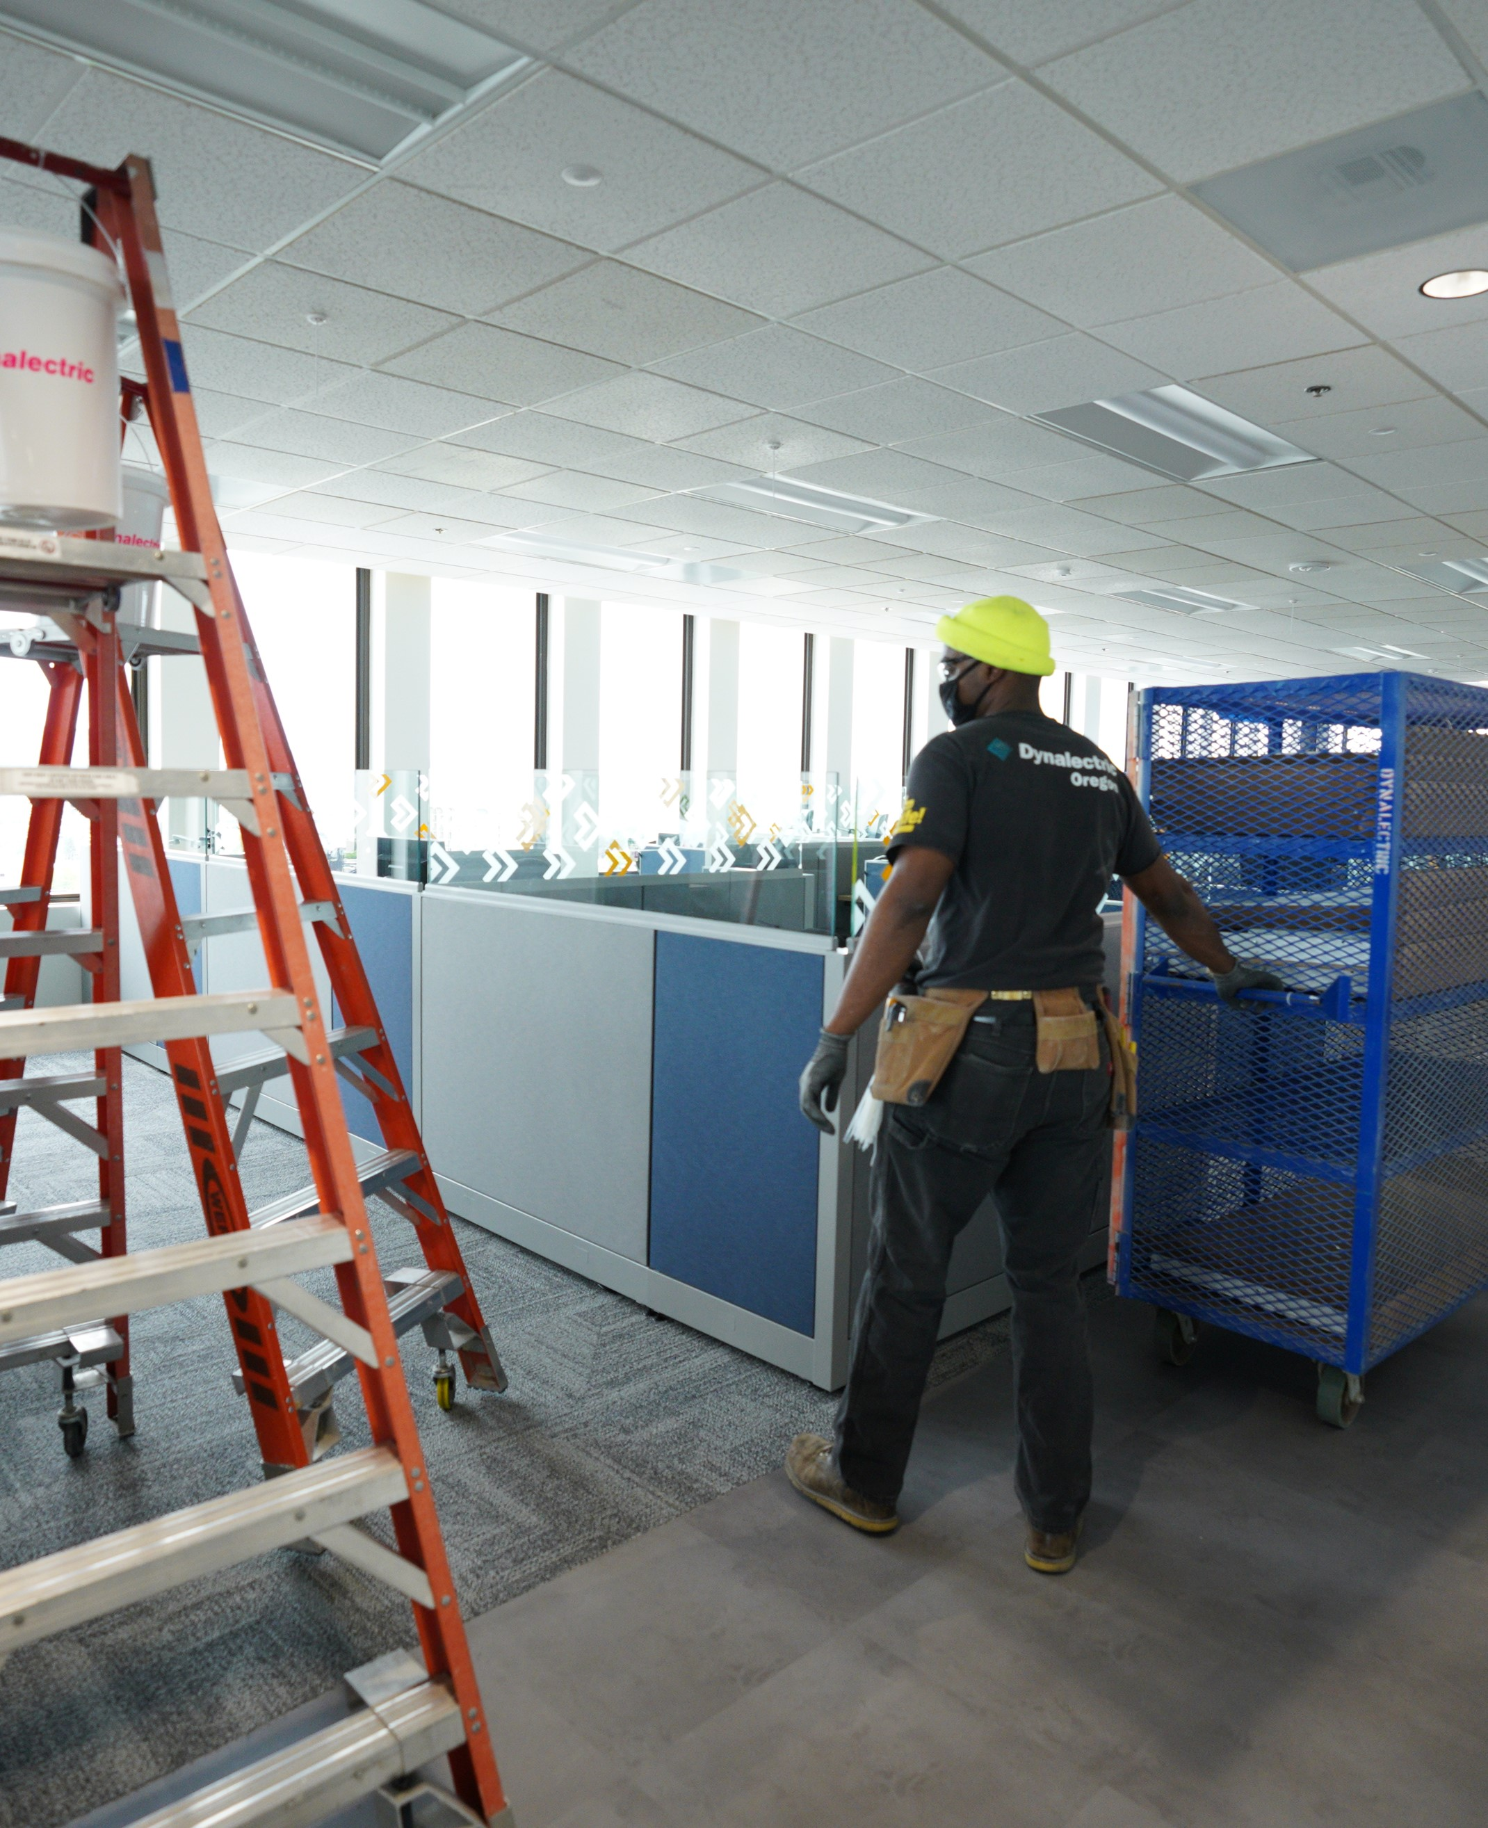
WHY INTEGRATING SYSTEMS
Lighting and HVAC consume more than half of building energy use
The meter is on the building – not on each system, so why are these systems designed and controlled in silos?
Control both HVAC and lighting systems using one platform – more functionality with smoother ease of operations
Integrating systems brings the most value and the deepest energy savings
BMS/HVAC integration
Load Shedding

Slide 10
LIGHTING & HVAC INTEGRATION
Controllable lighting offers increased energy savings, comfort and flexibility
Use BAS to control HVAC and lights with shared schedules
Use occupancy data to control the lighting and HVAC system through the BAS for additional savings
Aggregate HVAC and lighting energy reporting through BAS for one energy dashboard
Deploy demand response signals to both HVAC and lighting systems during an event
BMS/HVAC integration
Load Shedding

Slide 11
THEY ALLOW FOR REMOTE PROGRAMMING AND REMOTE ACCESS
Eliminate end-user disruption during programming
Increase flexibility for when to perform lighting and control upgrades
Reduce overall programming cost
Offer Faster response time
Deliver more effective diagnose & repair methods

Slide 12
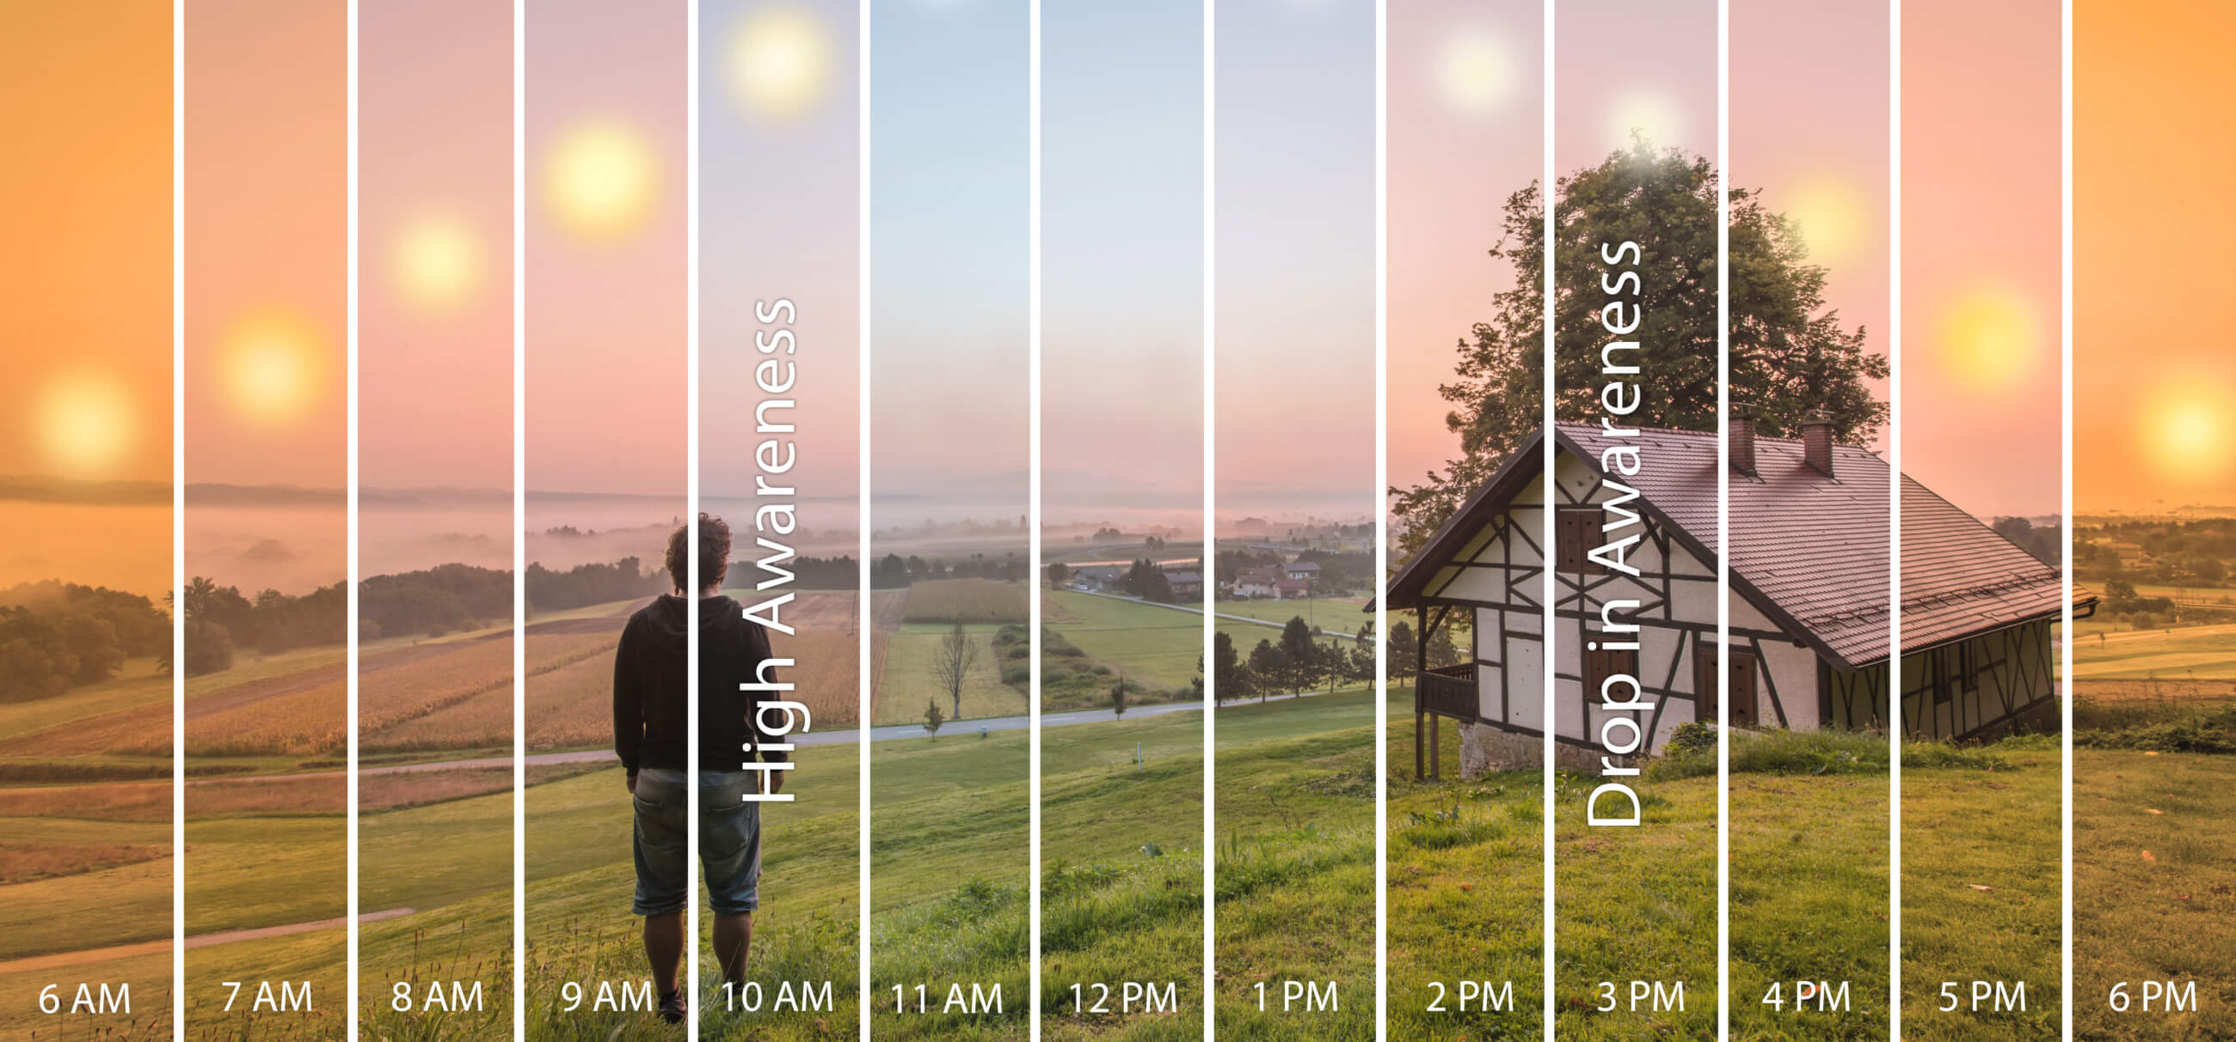
NON-ENERGY BENEFTIS (NEBs) CONTROL STRATEGIES

Slide 13
FOCUS ON THE BIG IMPACT and APPLY THE 3-30-300 RULE
$3…Utility
$30…Rent
$300… Employee Costs (Salary, Benefits, etc.)
Facility Mgr’ often focus on the 3 and 30 sections, while C-suites also value the importance of the 300
Happiness
Productivity
Wellness
Well lit space, ample daylight, etc.
Notes:
Study conducted by JLL
This rule provides a breakdown of what an organization pays per square foot in terms of total occupancy cost.

Slide 14
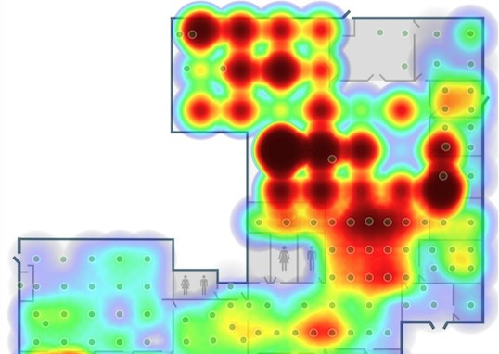
SMARTER BUILDINGS LEVERAGE DATA & FOCUS ON CUSTOMER EXPERIENCE
Understand how people use spaces to build better collaborative spaces
Right-size commercial buildings
Analyze occupant interaction with their smart lighting system and personal preferences

Slide 15
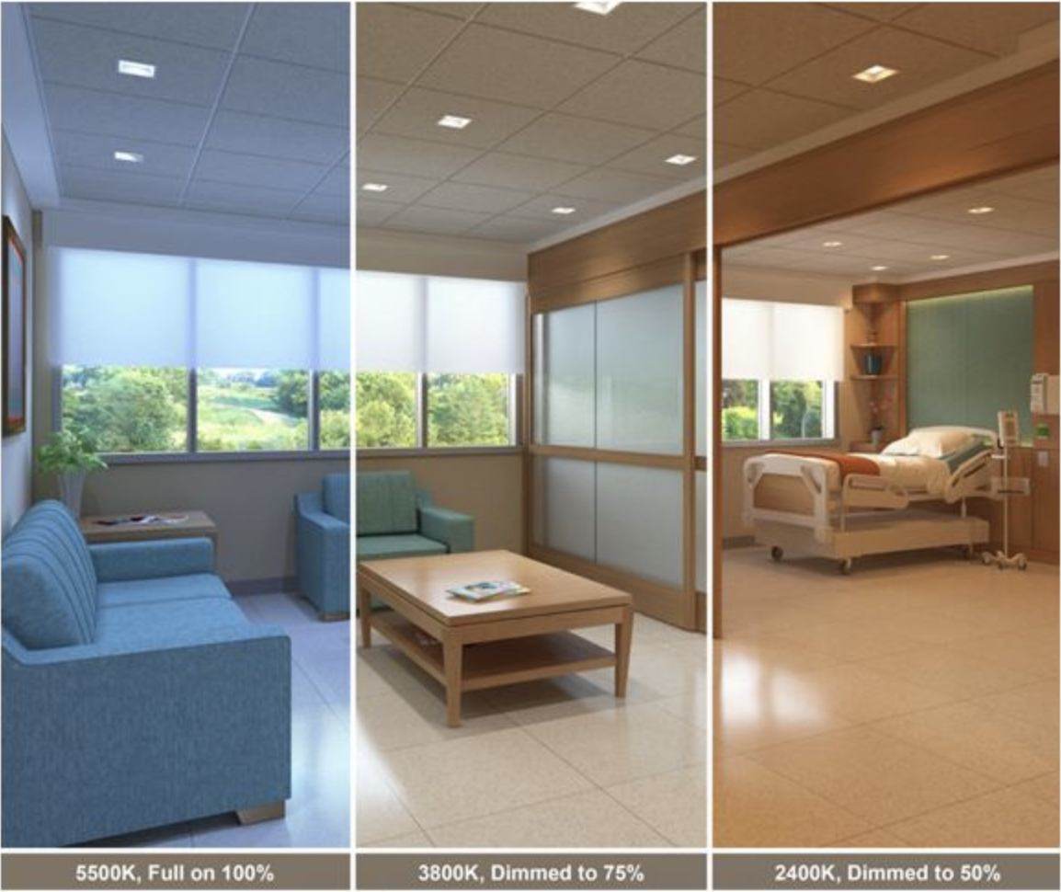
NON-ENERGY BENEFITS (NEB) CONTROL STRATEGIES
PRODUCE THE RIGHT COLOR OR SHADE OF LIGHT
BY SEPARATING LIGHT INTENSITY FROM COLOR TEMPERATURE (CCT)
Color Tuning/Tunable White manually or automatically adjust the color temperature based on space occupancy and/or time of the day
Know the Difference…
In Color Tuning, color temperature (CCT) is automatically programmed to change throughout day/night or is adjusted at any time using wall stations
In Color Selectable, the user must physically select the CCT directly on the fixture (usually via dip switch). Set & Forget operation

Slide 16
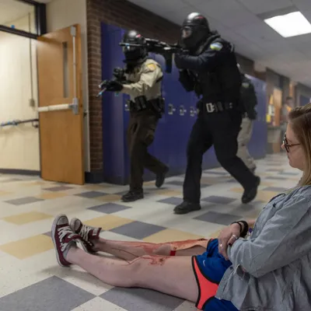
INCREASE IN SAFETY MEASURES
EMERGENCY LOCK DOWN MODE

Slide 17
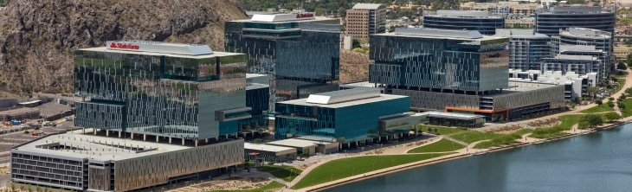
STATE FARM BUILDINGS - TEMPE, AZ
~ 6,200 fixtures controlled individually
23 floors, all common areas, private offices, conf. rooms and open offices
High End trim, occupancy sensors and manual controls
BACnet integration
CASE STUDY #1… BMS INTEGRATION

Slide 18
DOE ILC 2023 Award Winning Project
CASE STUDY #2…
TUNABLE WHITE
ORTEGA MIDDLE SCHOOL - ALAMOSA, CO
Largest school district in San Luis Valley ASD
Student achievement data fell into turnaround status for OMS
School had 2 classrooms with color tuning in special needs; they liked it and expanded it a year later to the entire school
When it came time to abate asbestos and a new ceiling grid would be installed, the project was designed around color tuning to provide opportunities for every student

Slide 19
CASE STUDY #3…
AUTOMATED CIRCADIAN LIGHTING
WSSB – WASHINGTON STATE SCHOOL FOR THE BLIND, WA
All classrooms
Fully automated CCT changing throughout the day with manual override capabilities impact kids’ ability to learn

Slide 20
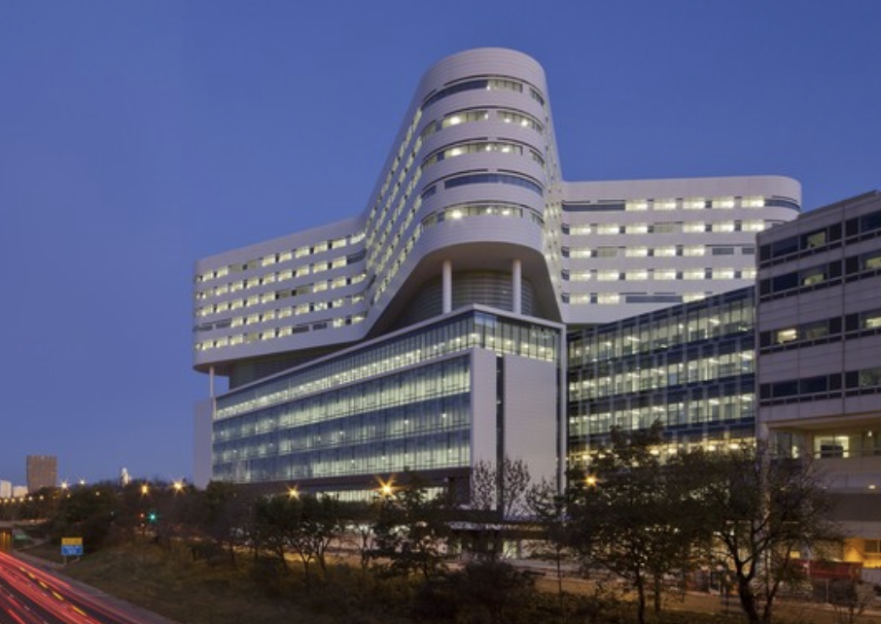
CASE STUDY #4… DIMMING, FLEXIBILITY AND DEMAND REPONSE
RUSH UNIVERSITY MEDICAL CENTER - CHICAGO, IL
10 floors, 8 fully controlled, ~ 2,000 fixtures retrofitted
Lights were too bright in classrooms and offices
Lighting Controls added to multiple lighting fixture brands
Controls needed to be “fixture agnostic” and non-proprietary to specific lighting brands
Cost effective, flexible, robust and future proof for Demand Response

Slide 21
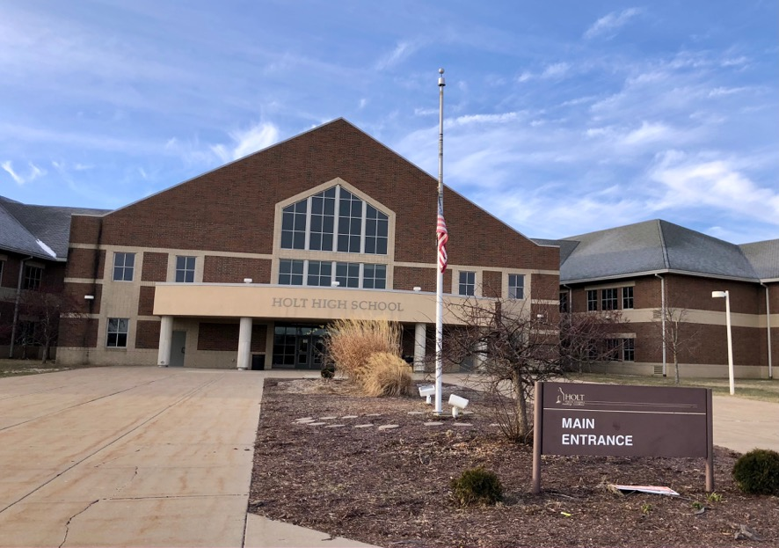
DOE ILC 2022 Award Winning Project
CASE STUDY #5…
SAFETY MEASURES
Project Location: Lansing, MI
K-12 Holt School District; 9 schools
340,000sqft High School only
10,000+ fixtures; ~8,000 Bluetooth Lighting Controls
School now considering smart door locks and wanting integration with Network Lighting Control system

Slide 22
QUESTIONS?
THANK YOU!
Doug White
Energy Services Product Manager, Lighting Commercial HVAC Americas
Doug.White@tranetechnologies.com
303.253.0496
Eric Fournier
VP Business Development
Eric.Fournier@avi-on.com
760.889.8151

