Slide 1
WCO Role in Illegal Transboundary Movements of Waste: Indonesia Experience
November 23, 2020
Notes:
Good afternoon, we are the team from Indonesia Customs. It’s been an honour for us to be here, presenting our paper about Customs fostering Sustainability for People, Prosperity and the Planet (Environmental sustainability). The title of our paper is WCO Role in Illegal Transboundary Movements of Waste: Indonesia Experience.

Slide 2
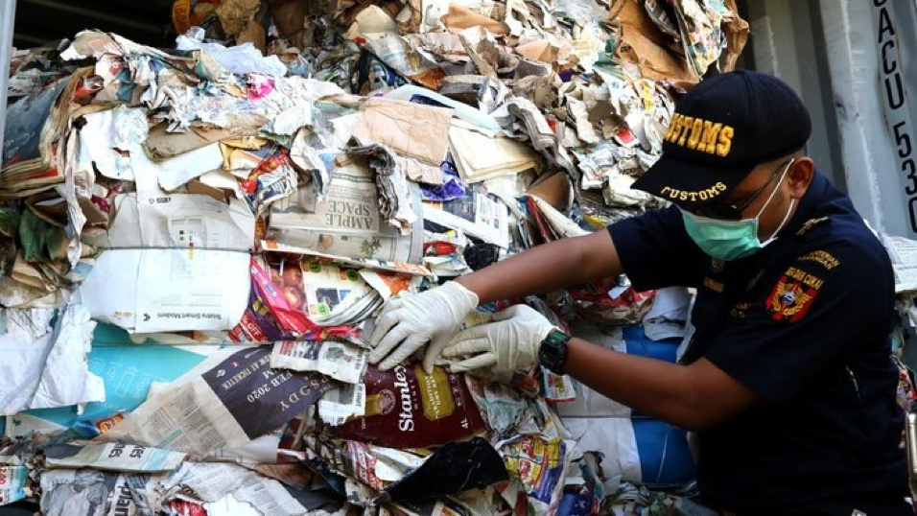
Overview
This paper depicts a current global issue related to Customs authority from the perspective of Southeast Asian countries. It’s an attempt to give recommendations for WCO to contribute more to the global waste transboundary movements. Related to the function of Customs as the community protector
Notes:
Our paper discusses the WCO Role in the Global Waste movement, one of the global problems that happened around the world. This topic is related to Customs Authority since waste is prohibited to be imported without permission of the destination country, based on Basel Convention. As one of the destination places for global waste movement, Indonesia’s perspective is interesting to be discussed.

Slide 3
Understanding the problem
Global Waste Destination
Southeast Asia, including Indonesia, is one of the destinations for global waste from Europe and America, especially after China prohibited the importation of plastic waste in July 2017, Greenpeace reported (Greenpeace Southeast Asia, 2019).
Import volume of plastic and paper scrap per year (UN COMTRADE)
Notes:
The high production of global waste and the inability to process this waste has triggered illegal transboundary movements of waste, especially to developing countries. After China stopped the importation of plastic waste in July 2017, Southeast Asia, including Indonesia received more imported waste. Since Indonesia cannot handle the recycling process completely, the waste also ends up in the ocean and goes back to developed countries

Slide 4
Understanding the Problem: Effect to Local Environment
Effect to Local Environment
A study from International Pollutants Elimination Network (IPEN) founded that eggs from some places in Sidoarjo are contaminated by dioxin, polybrominated diphenyl ethers (PBDEs), and short-chain chlorinated paraffins (SCCPs).
more than 10 tofu (‘tahu’) industries used plastic waste as a fuel substitution
Notes:
And it started to affect local food industries, in Sidoarjo, East Java, more than 10 tofu (‘tahu’) industries used plastic waste as a fuel substitution. While it is a cheap alternative, it created acute air pollution. A study from International Pollutants Elimination Network (IPEN) reported that the eggs from some places in Sidoarjo are contaminated by dioxin and some identical element from plastics.

Slide 5
Data
Indonesia Customs
To show the number of seizure cases reported monthly by the enforcement unit.
UN COMTRADE
Yearly import value of paper and plastic waste and where that waste came from.
Indonesia Statistics
Detail information on paper and plastic scrap importation divided by country of origin.
Notes:
In general we got the data from three resources: Indonesia Customs, Indonesia Statistics and UN COMTRADE. Data from Indonesia Customs shows the number of seizure cases reported monthly, while data from Indonesia Statistics shows detailed information of paper and plastic scrap importation, divided by country of origin. UN COMTRADE data shows the yearly import value of paper and plastic waste and where that waste originated. For inflation and exchange rates, monthly data from Central Bank of Indonesia was used

Slide 6
Legal Framework
Basel Convention.
Law Number 18 of 2008 concerning Waste Management.
Regulation of the Minister of Trade (Permendag) Number 31/M-DAG/PER/5/2016 concerning Imports of Non-Hazardous and Toxic Waste to Control Waste Import.
Regulation of the Minister of Trade (Permendag) Number 84/2019 concerning Provisions on the Import of Non-Hazardous and Toxic Waste as Industrial Materials.
Regulation of the Minister of Trade (Permendag) Number 92/2019 concerning Amendment of Provisions on the Import of Non-Hazardous and Toxic Waste as Industrial Raw Materials.
Import of waste in Indonesia is not prohibited as long as the waste is not contaminated by B3 and B3 waste, and homogeneous in nature.
Notes:
Basel Convention regulates that a country can export waste after obtaining approval from the destination country. We also have three regulation of related ministry. Based on regulations above the authors concluded that import of waste in Indonesia is not prohibited as long as the waste is not contaminated by B3 and B3 waste and is homogenous.

Slide 7
WCO Tools for Transboundary Waste Movement
RILO
Global Network Task Force
Eleven RILOs throughout six regions
CEN
Global network of data gathering For Intelligence purpose
DEMETER
DEMETER IV (75 Customs administrations)
Initiated by China Customs
ENVIRONET
Internet-based real time communication tool
Transmitted via encrypted and secured network
Notes:
To control transboundary movements of hazardous wastes and their disposal, The WCO has several enforcement tools. Regional Intelligence Liaison Offices (RILO’s), is a global network tasked with collecting, analysing, and supplementing supporting data, as well as trends, modus operandi, routes, and significant cases of fraud. The Customs Enforcement Network (CEN) is a global network for gathering data and information for intelligence purposes. ENVIRONET is an internet-based real-time communication tool to exchange information between Customs services, national agencies, international organisations, and other enforcement authorities with similar responsibilities in the area of environmental border protection.

Slide 8
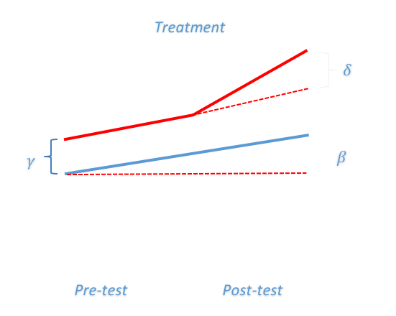
Model : Difference in difference (DD)
Notes:
The research presented in this paper used ‘difference in differences’ (DD), a quasi-experimental design that compares two groups before and after treatment is implemented.It relies on Operation Demeter IV from 5 June 2018 to 4 July 2018 as the treatment studied to identify the changes before and after that period. We also compare imported waste and other commodities to conclude whether participation in WCO enforcement tools like Demeter IV affect the number of enforcement cases in transboundary movement of waste

Slide 9
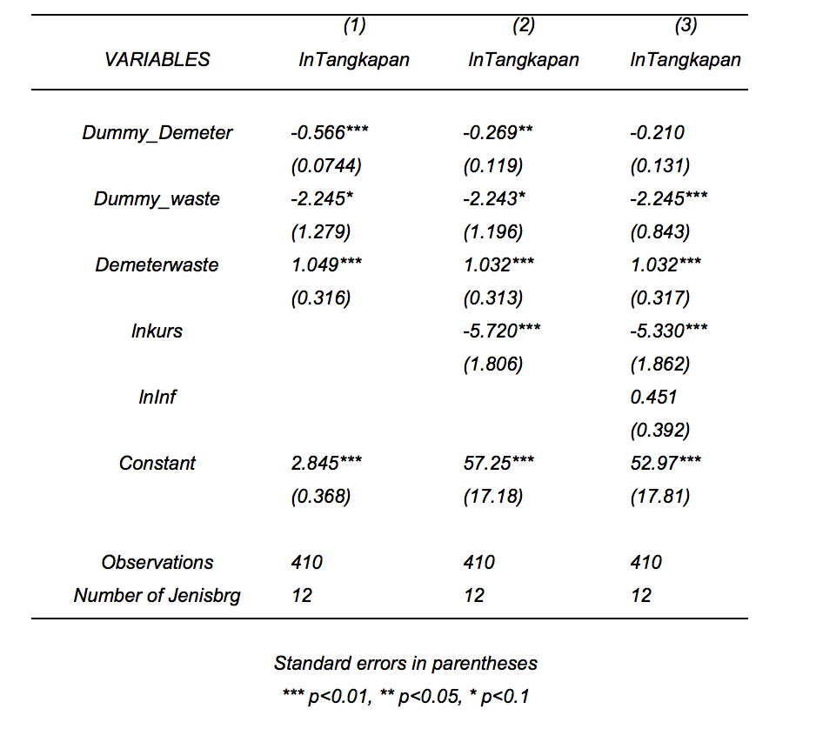
Result
T_{i} = Dummy_Demeter variable
t_{i} = Dummy_Waste variable
the true effect of treatment := Demeterwaste variable
(ln) inflation rate = lnInfis variable
(ln) exchange rate = lnkurs (control variables)
the outcome variable = lnTangkapan
Notes:
The result can be seen in the picture, we put variable Dummy_Demeter to represent the involvement of Indonesia in Demeter operation. In general, the total number of seizures in waste and scrap increases each year, as shown in Figure 3. Being involved in the global enforcement community enables Indonesia Customs to know more about the illegal transboundary waste movement, resulting in increased enforcement and seizures. The result show that DEMETER has had a positive impact on increasing the rate of imported waste enforcement, with coefficient 1.032 in standard error 0.01. The effect is consistently positive, despite control variables on the regression

Slide 10
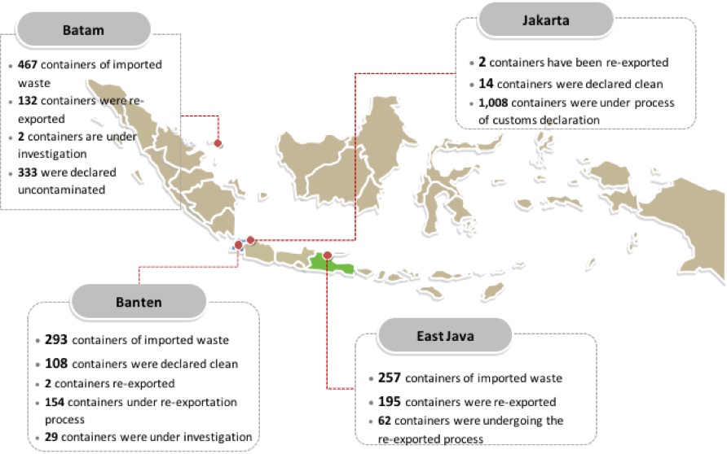
Current Situation
Notes:
Four ports are becoming destinations of waste: Banten, Tanjung Perak, Tanjung Priok Jakarta, and Batam Riau island, as illustrated in Figure 5. Until September 17, 2019, Customs handled the import of 2,041 containers of plastic waste, spread between Tanjung Perak Surabaya, Batam's Batu Ampar Port, Jakarta's Tanjung Priok Port, and Tangerang Banten. From that number, only 455 containers were eligible for the permit and test results (Indonesia Customs, 2019)

Slide 11
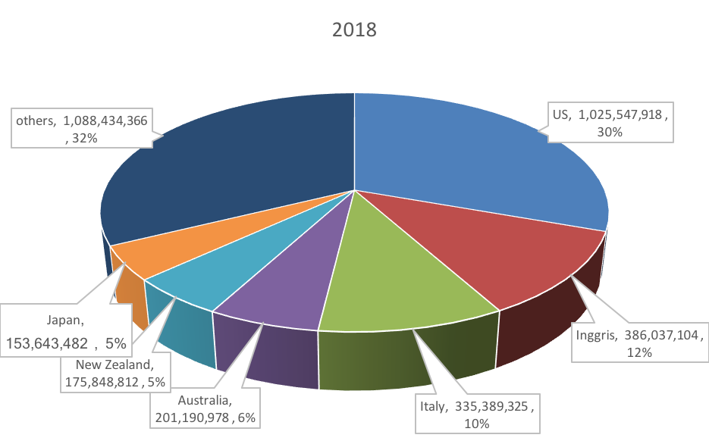
Discussion
Where Plastic and Paper Scrap came from?
(UN COMTRADE)
Notes:
Based on UN COMTRADE data for the AHTN code paper and plastic scrap that was imported to Indonesia in 2018 came from mostly America and Europe countries. According to the Basel Convention, ‘Parties to the Basel Convention have the overall obligation to ensure that such transboundary movements (TBM) are minimised and that any TBM is conducted in a manner which will protect human health and the environment’. So it become every parties interest to ensure the obligation is met.

Slide 12
Remaining Problems
Identifying procedure or detection of illegal waste
Re-Export Procedure
Lack of data on prohibited waste
35
25
22
15
Notes:
There are three remaining problems that we summarized are :
detection of illegal waste (how to effectively detect such shipment ?)
re-export procedure (who should be responsible ?)
lack of data on prohibited waste (how to improve information and data exchange related to waste ?)

Slide 13
Conclusion and Recommendations
Findings
WCO tools give some impacts in controlling transboundary movement of waste.
The effect of DEMETER:
Long term result to raise global awareness on the problem.
Raise commitment combating waste crime
Give psychological pressure to smuggler
Future Contributions
Data exchange to detect the route of containers that transport waste
Optimizing current WCO tools
Data standardization by WCO Data Model
More specific communication group of specialist who can focus more on transboundary waste movement
35
25
22
15
Notes:
The effect of DEMETER operation are, firstly it gives a long term result to raise global awareness. Secondly it also raises global commitment in combating waste crime. And last but not least, being involved in a global community like what the WCO initiated, will give psychological pressure to waste smuggler.

Slide 14
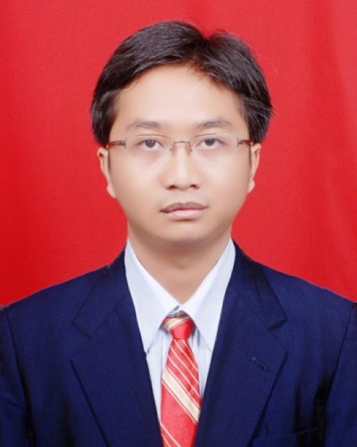
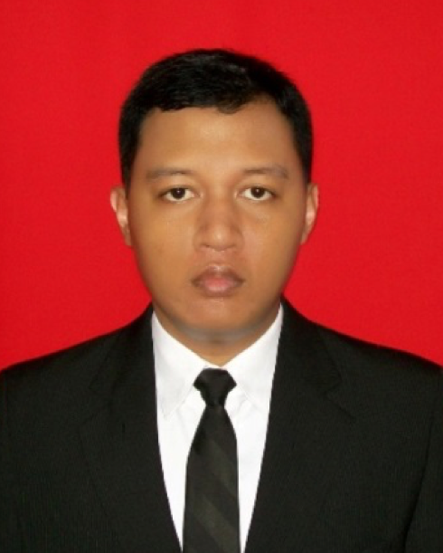
The Team
Yuafanda Kholfi
Setiyono Nugroho
Tagara Primadista
Tri Pambudiwidagdo
Currently working as a Senior Data Analyst as Directorate of Customs and Excise Information and Technology
Senior analyst at Directorate of Revenue and Strategic Planning Directorate General of Customs and Excise
WCO expert on National Single Window Environment, served as a Business Analyst at Directorate General of Customs and Excise
Head of Intelligence Subsection at Customs and Excise Branch Office Cilacap. Previously served as Senior Intelligence Analyst at DGCE Head Office
Notes:
In the end, global waste is not just Indonesia’s problem, developing countries’ problems, or developed countries’ problems. Global waste is our problem, we have to find a solution to solve this global issue. Yuafanda Kholfi, Setiyono Nugroho, Tagara Primadista, and Tri Pambudiwidagdo from Indonesia Customs.

