Slide 1
The World Customs Organisation as a knowledge-based organisation
Jenia PETEVA
Policy Officer, European Commission
PICARD 2020, 25 November 2020
Logo: World Customs Organisation Disclaimer: The views expressed during the presentation do not bind any institution or body of the EU

Slide 2
INTERNATIONAL ORGANISATIONS NOT AS WE KNOW THEM?
Global dialogue
« We are all in this together »
Ch. Lagarde
DATA ECOSYSTEM
« the need to know »
«the need to share »
Commission President
Standard setting
Convergence
Collaborative process management
Diverse stakeholders
The data analytics challenge
Competence
PICARD
Collaborative research methods
Logo: The World Customs Organisation

Slide 3
NEXT SLIDES ARE ABOUT
WCO
TRANSFORMATION
THE KNOWLEDGE ORGANISATION
CUSTOMS MODERNISATION
KNOWLEDGE DRIVEN CAPACITY TO ACT
WCO AS A KNOWLEDGE ORGANISATION?
PLEASE
SUBMIT QUESTIONS

Slide 4
TRANSFORMATION
KNOWLEDGE
WCO
“NETWORKED ECONOMY*
KNOWLEDGE
ORGANISATION
KNOWLEDGE ECONOMY
KNOWLEDGE -BASED
ORGANISATION
INTERNATIONAL ORGANISATIION
INDUSTRIAL ECONOMY
*Prof. Eric Tsui « Managing Knowledge in the Age of Digitalisation », 2020

Slide 5
THE KNOWLEDGE ORGANISATION
KM EMBEDDED IN TECHNOLOGY FRAMEWORKS
DYNAMIC CAPABILITIES
STAKEHOLDER
MANAGEMENT
ENGAGEMENT
COLLABO
-RATION
DATA
KNOWLEDGE
retention
sharing/use
KNOWLEDGE
ORGANISATION
KNOWLEDGE
MANAGEMENT
CULTURE
RELATION
SHIPS
ORGANISATIONS
DATA ECOSYSTEM
PROCESSUAL
RELATIONS

Slide 6
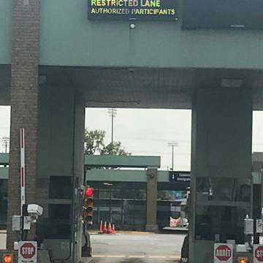
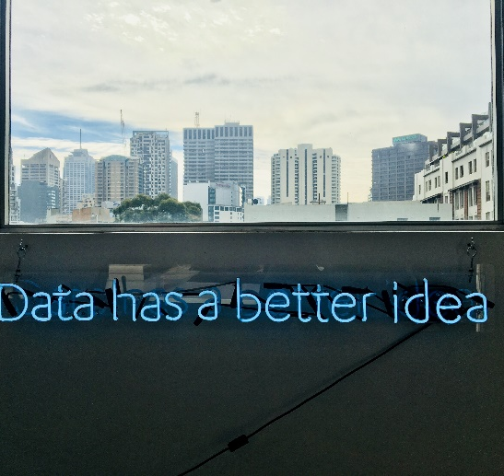
CUSTOMS MODERNISATION
Coordinated Border Management*
Integrated Border Management**
KNOWLEDGE
CO-CREATION
SMART
BORDERS
DATA
ANALYTICS
AI

Slide 7
KNOWLEDGE-DRIVEN CAPACITY TO ACT
DIGITALISATION
DATA
KNOWLEDGE
CAPABILITIES
collaboration and innovation
-embedded in systems
- embedded in practice
change management
strategy
data analytics
data sources
data driven decision-making
fostering
co-creation
collective thinking
knowledge creates knowledge
dynamic capabilities
service design
“networked customs”
networked customs communities
KNOWLEDGE
MANAGEMENT
ORGANISATION

Slide 8
WCO AS A KNOWLEDGE ORGANISATION
STRATEGY
TECHNOLOGY
INSTRUMENTS
COLLABORATIVE DESIGN
DATA
EXTERNAL KNOWLEDGE
MANAGEMENT
CUSTOMS COMMUNITIES
OF PRACTICE
PEOPLE
Logo: World Customs Organisation

Slide 9
jenia.peteva@ec.europa.eu

