Slide 1
Three EU H2020 Customs and Border Security Projects
Dr. Toni Männistö, Cross-border Research Association
Dr. Juha Hintsa, Cross-border Research Association
2020 WCO TECH-CON
11 November 2020, 13:50 – 14:50
Session II.1 – Inspection equipment and officers' safety

Slide 2


The three EU-funded customs and border security research, development and innovation projects
OVERVIEW
A novel customs innovation boosting network and online platform, with valuable innovation intermediary services
A project for upgrading data analytics capabilities and improving the use of risk-relevant data sources for customs risk management
A border guard centric project to strengthen situational awareness in the border security domain through augmented reality and unmanned vehicle technologies
TEAM
13 customs (17 partners in total)
5 customs (14 partners in total)
20 partners
START
1 September 2018
1 August 2018
1 May 2019
TIMELINE
60 months
36 months
36 months
The projects are funded under the EU’s Horizon2020 programme under grant agreement numbers 833805 (ARESIBO), 786748 (PROFILE) and (786773)
Notes:
leveraging Big Data and open data sources

Slide 3
PEN-CP: Customs Innovation Awards encourage sharing of novel ideas and innovative actions
PEN-CP Customs Innovation Award (PCIA)
Global Customs Innovation Award (GCIA)
Open for PEN-CP customs partners
UK Border Force won the 2019 award
  ”Using a human security radar screening passengers on the move”
Themes for 2020 Customs Innovation Award are
  Novel approaches to cope with the growing international e-commerce traffic
  Future opportunities with mobile laboratory capabilities
Data quality is the theme for 2021 edition
  Track 1: Best proven solution
  Track 2: Best solution idea
Examples on data quality dimensions
  Accuracy — Is data correct and how well does it represent reality?
  Completeness — Does a dataset include all critical data elements?
  Timeliness — Is data available when it is needed?
  Standardization — Is data in useful, standardized format?
Next steps are under discussions
See PEN-CP Magazines 9 and 8 for details on PCIA-2020 and -2019
www.pen-cp.net/download-pen-cp-magazine
Notes:
Share the outcomes of your innovative customs projects to claim a trophy of excellence
Customs Innovation Award 2019
UK Border Force wins
Customs Innovation Award 2020
Novel approaches to cope with the growing international e-commerce traffic
Future opportunities with mobile laboratory capabilities
Global Customs Innovation Award 200
Launch in December 2020
Theme is data quality

Slide 4
PROFILE: New training materials and exercises on customs data analytics and quantitative models
Plan for developing training material and exercises
We invite WCO to explore on options for training material co-operation in the future
PROFILE designs data analytics and quantitative exercises on realistic problems that customs officers face
Target audiences include: customs officers with data analytics backgound; and data analytics experts new to customs
We use Canvas as the Learning Management System
Development and piloting of PROFILE training materials takes place between 7/2020-12/2021
Identifying 1-2 tangible topics for developing and piloting joint training materials
Applying operations research and operations management principles and approaches in customs context
Exploiting data sources external to customs for risk management purposes
Other ideas may emerge during joint brainstorming sessions

Slide 5
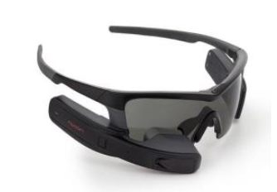
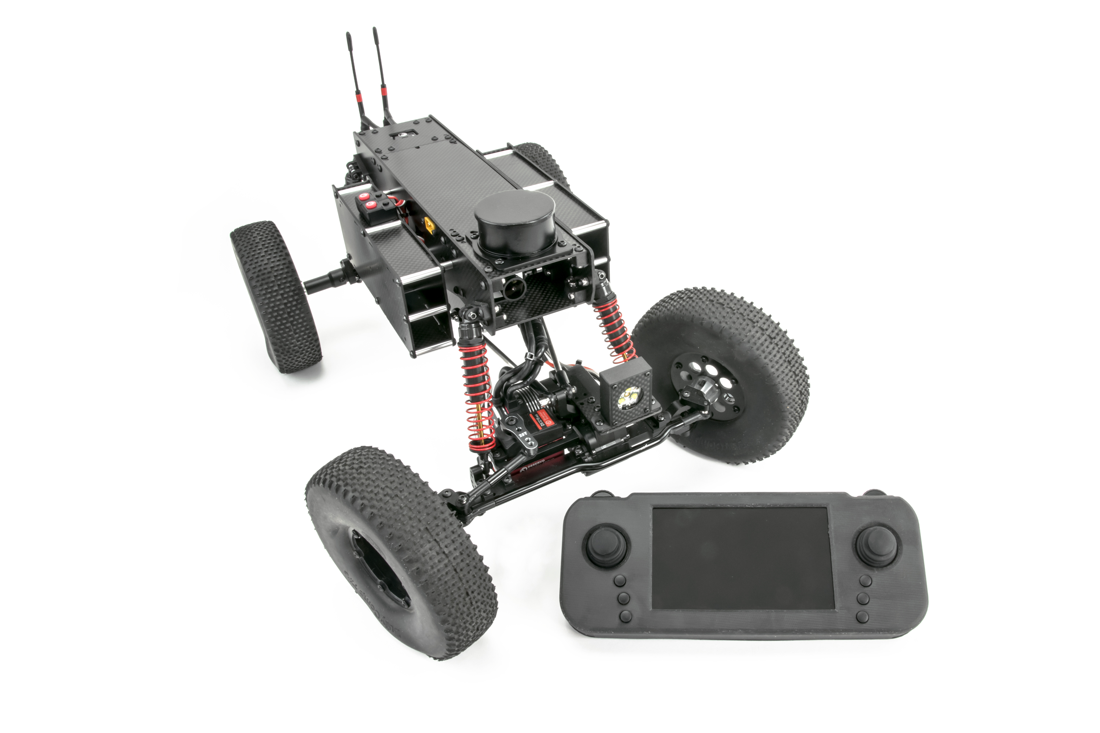
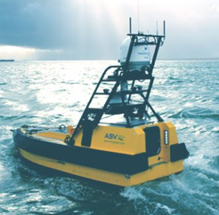
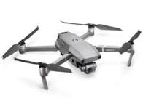

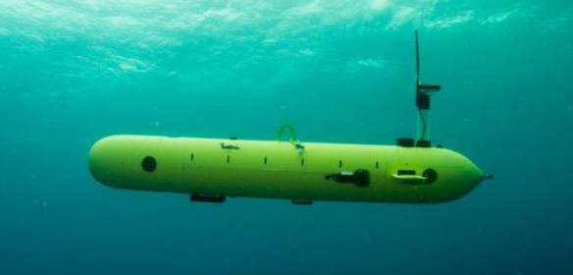
ARESIBO: How can augmented reality & unmanned vehicles contribute to border management & controls?
ARESIBO technologies
Future discussion points with customs
How can unmanned vehicles support customs border control activities?
How can advancements in augmented reality (AR) support customs border control activities?
How can customs capabilities contribute to the improved situational awareness of the border guard actitivies?
What about the other way round?
Notes:
ARESIBO considers the use of all types of unmanned systems, namely Unmanned Ground Vehicles (UGV), Unmanned Aerial Vehicles (UAVs), Unmanned Underwater Vehicles (UUVs), and Unmanned Surface Vehicles (USVs)
AR: smart glasses, training simulators, handheld devices

Slide 6
Please visit project websites or send email for more information
www.pen-cp.net
twitter.com/PENCP_NET
Keep your eyes open for the Global Customs Innovation Award 2021!
www.profile-project.eu
twitter.com/PROFILE_EU
Share with us your needs and ideas for future data analytics training materials!
https://aresibo.eu/
twitter.com/aresiboEU
Stay tuned for border surveillance technology updates and user need surveys!
Toni Männisto, Head of Research, toni@cross-border.org
Follow PEN-CP and PROFILE in LinkedIn: https://www.linkedin.com/groups/8183667/
Follow PEN-CP and PROFILE in YouTube: https://www.youtube.com/channel/UCVNREOilB1Doex4u9E6AHkw
Follow PEN-CP in Facebook: https://www.facebook.com/groups/pencp/
The projects are funded under the EU’s Horizon2020 programme under grant agreement numbers 833805 (ARESIBO), 786748 (PROFILE) and 786773 (PEN-CP)

