Slide 1
Effectiveness and efficiency of artificial intelligence in boosting customs performance: a case study of RECTS at Uganda Customs administration
Kugonza Julius & Mugalula Christabel

Slide 2
Introduction
Background of AI
Key facts about AI driven Economy
  It is projected that the worldwide market for AI solutions could be worth more than £GPB 30bn by 2024.
  In another estimate, ‘AI could contribute up to $ USD15.7 trillion to the global economy in 2030, more than the current output of China and India combined.
AI in Customs Perspective
RECTS as an AI powered system

Slide 3
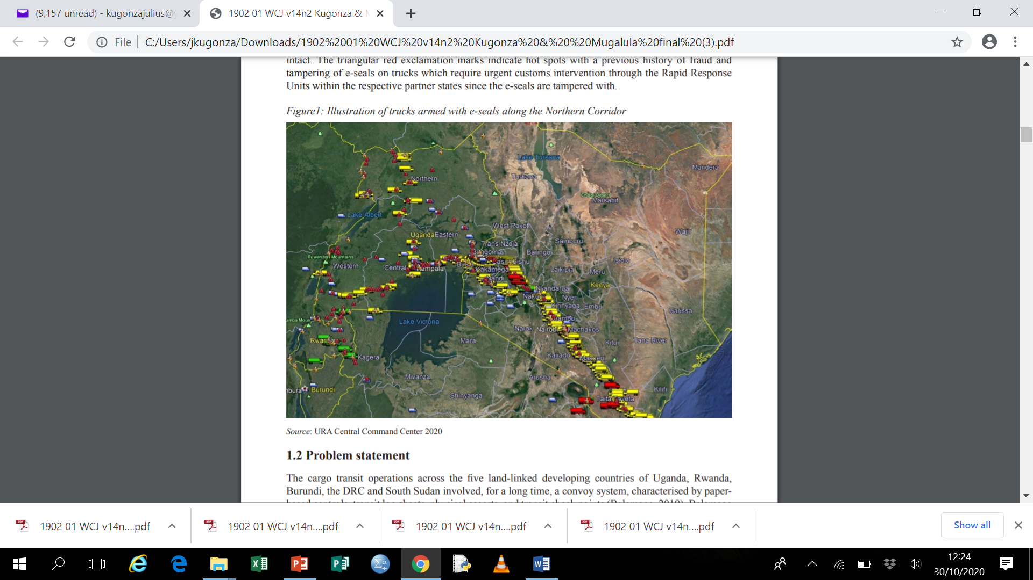
Figure1: Illustration of trucks armed with E-seals along the Northern Corridor
Source: URA Central Command Center 2020

Slide 4
Problem statement
The cargo transit operations across the five land-linked developing countries of Uganda, Rwanda, Burundi, the DRC and South Sudan involved, for a long time, a convoy system,
Transit was characterised by paper-based controls, transit log sheets, physical escorts, and transit check points (Balamaga, 2019). Balamaga (2019).
The transit system was overwhelmed by various impediments to the seamless flow of cargo that included;
  unnecessary delays.
  a high cost of doing business.
  non-tariff barriers.
  transit diversion.
  high administrative monitoring costs.
  information-sharing gaps between the partner states.

Slide 5
Global standards and actions in the uptake of AI
Adherence to existing human rights frameworks
Inclusive growth, sustainable development, and wellbeing.
Ensuring accountable and responsible design.
Transparent technology.
Privacy and data governance.
Robustness, security and safety.
Diversity, non-discrimination and fairness

Slide 6
Challenges in the uptake of AI in customs operations
Change management over anticipated job loss
Skills gap and a shortage of AI researchers
Capital investments in AI research and development needed
AI legislation and regulation
Better national coordination required geographically
Limited infrastructure

Slide 7
Regional electronic cargo tracking system case study in Uganda
Background
Why a Transit?
Transit inefficiencies in LDCs
ECTS to RECTS

Slide 8
Table 1: Total transits in Uganda 2014–2018
 | 2014 | 2015 | 2016 | 2017 | 2018
Total transits | 178,090 | 195,372 | 189,618 | 233,922 | 285,824
e-monitored | 11,459 | 17,226 | 15,094 | 42,845 | 60,066
% of E-monitored | 6.43% | 8.82% | 7.96% | 18.32% | 21.02%
Methodology

Slide 9
Findings
Table 2: Transit times
 | N | Mean | Std. Deviation | Std. Error | 95% Confidence Interval for Mean
 |  |  |  |  | Lower Bound | Upper Bound
Normal seal Transit | 16 | 12.1044 | 1.76266 | .44067 | 11.1651 | 13.0436
E-seal transit | 13 | 8.6923 | .96993 | .26901 | 8.1062 | 9.2784
Escorted transit | 11 | 12.4182 | 1.51249 | .45603 | 11.4021 | 13.4343
Total | 40 | 11.0818 | 2.21517 | .35025 | 10.3733 | 11.7902
Table 3: Analysis of variance of different transit times
 | Sum of squares | df | Mean square | F | Sig.
Between groups | 110.601 | 2 | 55.301 | 25.333 | .000
Within groups | 80.770 | 37 | 2.183
Total | 191.372 | 39

Slide 10
Table 4: Multiple comparisons of the different transit times
(I) Type | (J) Type | Mean Difference (I-J) | Std. Error | Sig. | 95% Confidence Interval
 |  |  |  |  | Lower Bound | Upper Bound
Normal seal transit | E-seal transit | 3.41207* | .55169 | .000 | 2.0651 | 4.7590
 | Escorted transit | -.31381 | .57870 | .851 | -1.7267 | 1.0991
E-seal transit | Normal seal Transit | -3.41207* | .55169 | .000 | -4.7590 | -2.0651
 | Escorted transit | -3.72587* | .60529 | .000 | -5.2037 | -2.2481
Escorted transit | Normal seal Transit | .31381 | .57870 | .851 | -1.0991 | 1.7267
 | E-seal transit | 3.72587* | .60529 | .000 | 2.2481 | 5.2037
Source: URA databases*. The mean difference is significant at the 0.05 level

Slide 11
Recommendations
Public–private partnership (PPP)
System Integration
A clear change management strategy
Accreditation of AI experts in Customs
Establishment of regional AI laboratories
Customs administrations must work co-operatively—as stipulated in the WCO SAFE Framework of Standards

