Slide 1
Sponsored by GCFA
Virtual Training Event
January 26-28, 2021

Slide 2
Discussion Topics
Financial Statement Audit Overview
JEO/CCEO Audit Guidelines/Requirements
Internal Control Considerations
Local Church Audit Guide

Slide 3
Financial Statement Audit Overview

Slide 4
External Audit Requirement
Book of Discipline ¶ 617: “The council shall have the following authority and responsibility with respect to the auditing of the financial records of the conference and its agencies:
To have the accounts of the conference treasurer for the preceding fiscal year audited by a certified public accountant within 150 days after the close of the conference fiscal year and to receive, review, and report such audit to the annual conference.”

Slide 5
External Auditor Selection
UMC agencies are audited by Cherry Bekaert, LLP.
The Annual and Central Conference Offices and Episcopal Offices are audited by whichever firm they hire to perform their audit.

Slide 6
External Audit Purpose
Per the American Institute of Certified Public Accountants: “The purpose of an audit is to provide financial statement users with an opinion by the auditor on whether the financial statements are presented fairly, in all material respects, in accordance with an applicable financial reporting framework, which enhances the degree of confidence that intended users can place in the financial statements.”

Slide 7
External Audit – Key Points
An unmodified opinion provides reasonable assurance that the financial statements are not materially misstated.
Internal control evaluations conducted as part of a financial statement audit are inconsistent.
Procedures are not designed for the purpose of detecting all fraud (only fraud that is material to the financial statements).

Slide 8
External Audit – Key Points (continued)
The Jurisdictional and Central Conference Episcopal Offices are responsible for ensuring the related Audit Guidelines are followed by the external auditor. The guidelines are provided by the Episcopal Services Department at GCFA.

Slide 9
JEO/CCEO Audit Guidelines

Slide 10
Audit Guidelines - Purpose
To outline the financial statement audit requirements for each JEO/CCEO.
To ensure audits are thorough and useful.
To ensure identified control deficiencies are remediated.
To provide audit consistency.
There are separate, but similar guidelines for JEOs and CCEOs.

Slide 11
Audit Guidelines - Consolidations
If the episcopal office financial statements are consolidated with the related annual conference, the following is required:
The report should be clear that the EO is consolidated with the annual conference.
Separate EO schedules are required. This may be in the form of a consolidating schedule.
A fixed asset schedule is required.
To facilitate the communication of required information, a checklist has been developed and must be completed by the EO or annual conference.

Slide 12
Internal Control Considerations

Slide 13
Purpose of Internal Controls
To help ensure an entity’s financial statements are not materially misstated.
To prevent or detect instances of fraud or other inappropriate use of Church assets.

Slide 14
Limitations of Internal Controls
Provide Only Reasonable Assurance that inappropriate transactions or fraud will be Prevented or Detected
Often Reliant Upon the Integrity of Key Personnel
Effectiveness is Lessened when Collusion Occurs

Slide 15
Control Design Considerations
Internal controls must be designed based on an entity’s available resources (e.g., personnel and systems).
A cost vs. benefit analysis must be performed when designing internal controls.

Slide 16
Control Design Considerations
Preventive
Detective
__________________________________
Automated
Manual

Slide 17
Preventive Controls
Generally More Effective
Often Require Less Ongoing Effort by Management

Slide 18
Detective Controls
Generally Less Effective
Often Require More Ongoing Effort by Management

Slide 19
Automated Controls
Require Less Ongoing Effort by Management
Generally Very Effective

Slide 20
Manual Controls
Require More Ongoing Effort by Management
More Subject to Human Error

Slide 21
Disclosure: Control Discussion Examples
The risks and related controls discussed in this presentation are examples for your general awareness, and not intended to be all-inclusive. I encourage you to discuss any questions about internal controls with me, GCFA management or your conference's accounting firm. I also suggest that you discuss risks and controls with other conferences to share best practices.

Slide 22
Common Accounting Close and Reporting Controls
Monthly Reconciliations of All Balance Sheet Accounts (reviewed by someone in a supervisory or independent position)
Budget to Actual Analysis
Financial Reporting Reviews

Slide 23
Common Areas for Fraud or Misuse of Funds
Cash Receipts
Payroll
Purchasing and Payables

Slide 24
Types of Cash Receipt Fraud
Skimming
Erroneous Write-offs

Slide 25
Preventive Cash Receipt Controls
Secure cash receipts until deposited
Restrictively endorse checks ASAP
Use a Lockbox or Payment Processor (with a system and organization control audit)
Segregate the cash receipt responsibility from the payment/write-off posting function

Slide 26
Detective Cash Receipt Controls
Review of Account Write-offs/Refunds
Follow-up of Aged Receivables
Statements

Slide 27
Types of Payroll Fraud
Ghost Employees
Erroneous Changes to Employee Pay Information
Falsification of Timecards/Time Records

Slide 28
Preventive Payroll Controls
Segregate the Ability to Set-up New Employees or Make Changes from the Time Entry and Disbursement Function
Require Management Approval to Setup New Employees or to Change Employee Information
Require Management Approval of Time Records
Direct Deposit

Slide 29
Detective Payroll Controls
Management Monitoring of New Employee/Change Reporting
Monitoring of Payroll Expenses
Timely Completion of Bank Reconciliations

Slide 30
Types of Disbursement Fraud
Fictitious Vendors/Programs
Collusion with Vendors
Fraudulent Expense Reports (esp. Travel Reimbursement and Small Expense Items)
Theft of Company Checks/Forgery
Fraudulent Wire Transfers
Defacement of Checks

Slide 31
Preventive Disbursement Controls
Segregate the Ability to Set-up or Change Vendor Information from the Invoice Processing Function
Require the Approval of All New Vendors
Proper Segregation of Duties within the RFP/Proposal Process
Require Management Approval of Invoices and Expense Reports
Safeguard Check Stock/Use Blank Stock

Slide 32
Preventive Disbursement Controls (cont’d)
Secure Signature Key/Stamp/Printer
Ensure Product Receipt Prior to Payment (i.e., a Three Way Match)
Return Signed Checks to Someone Independent of the Preparation Function for Payment
Use of Positive Pay
Segregate the Ability to Initiate/Approve Wire Transfers – BE CAUTIOUS IF YOUR BANK WILL NOT ENABLE THE VERIFICATION/ APPROVAL OF ALL WIRES.

Slide 33
Preventive Disbursement Controls (continued)
For wire transfers and ACH transactions, ensure that the “Administrator” role does not have too much unsupervised authority.

Slide 34
Detective Disbursement Controls
Management Monitoring of Vendor Changes
Check Signer Review of Bank Statements/Cancelled Checks
Timely Completion of Bank Reconciliations
Review of Check Registers
Monitoring of Expenses

Slide 35
Benefit Plan Related Controls
Wespath administers and is the trustee for the UMC retirement plans, including both the defined benefit plans and defined contributions plans.
The plans are designated as “church plans” which do not require a financial statement audit.
A System and Organization Control audit will be performed for the first time in 2021.
Conference management should implement certain controls to help ensure the accuracy and completeness of benefit plan transactions, including…….

Slide 36
Benefit Plan Related Controls (continued)
Reconcile contributions sent to Wespath to the actual amounts they received.
Request distribution reporting from Wespath and review it for reasonableness.
Employees should monitor their individual accounts for reasonableness based on their invested funds and expected rates of return (based on market performance).

Slide 37
Closing
Expect some fraud and misuse – Act to minimize the number and severity of occurrences.
Management must play an active role in identifying high risk areas and implementing the appropriate controls.
Stress to employees the importance of internal controls and why they are in place. Do not have a “rubber stamp” mentality.
Controls must be tested periodically to ensure that they are operating effectively.

Slide 38
Closing (continued)
Maintain a process/“hot line” for individuals to be able to report suspected instances of fraud and misuse of funds.

Slide 39
Local Church Audit Guide

Slide 40
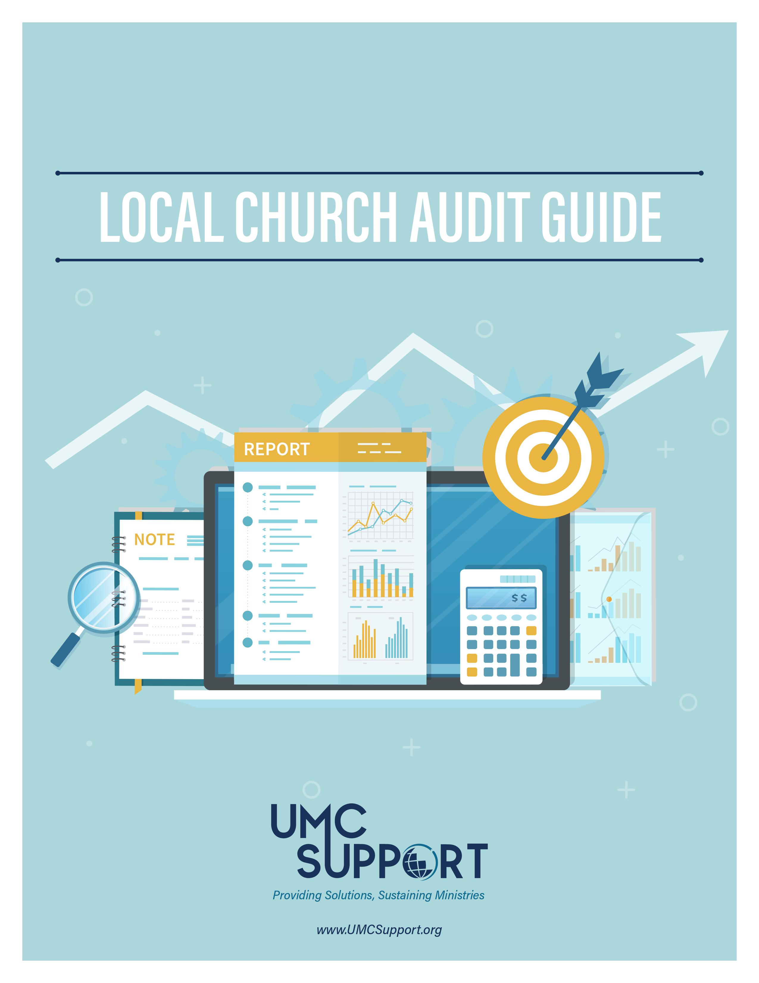
LCAG Purpose
The United Methodist Church Book of Discipline assigns the responsibility for the annual audit of financial records to the committee on finance at each local church. The committee “shall make provisions for an annual audit of the financial statements of the local church and all its organizations and accounts. The committee shall make a full and complete report to the annual charge conference” (258.4d). The purpose of the audit guide is to assist the committee in its work.

Slide 41
GCFA’s Role with LCAG
GCFA and the Committee on Audit & Review are not responsible for the conduct of local church audits, nor do they provide legal or financial advice to local churches through this booklet.
Local churches should seek assistance and advice from their local advisors when specific issues arise.
The LCAG is provided as a service; it should be used to increase the knowledge of auditing principles within the local church, including the understanding of why audits should be conducted and the uses to which they can be applied
to local church officials.

Slide 42
Recent LCAG Updates (2014 and 2020)
GCFA updated the LCAG in 2014 and 2020 to make it more “principles based” instead of specific “rules based.”
Added information regarding the Trust Clause.
Includes guidance for engagement types based on the size of the local church
Includes recommended procedures for both external and non-external audits
Located at: http://www.gcfa.org/forms

Slide 43
1 Music Circle North
Nashville, TN 37203
615-329-2393
ConnectionalRelations@gcfa.org
www.gcfa.org

