Slide 1
Sponsored by GCFA
Virtual Training Event
January 26-28, 2021

Slide 2
Overview of Financial Statement Audits Discussion Topics
Conference Level Financial Statement Audits
JEO/CCEO Audit Guidelines/Requirements
Local Church Audit Guide
Presented by:
Paul Demastus
LBMC, PC – GCFA Outsourced Internal Audit Provider
615-309-2229
pdemastus@lbmc.com

Slide 3
Conference Level Financial Statement Audits

Slide 4
External Audit Requirement
Book of Discipline ¶ 617: “The council shall have the following authority and responsibility with respect to the auditing of the financial records of the conference and its agencies:
To have the accounts of the conference treasurer for the preceding fiscal year audited by a certified public accountant within 150 days after the close of the conference fiscal year and to receive, review, and report such audit to the annual conference.”

Slide 5
External Auditor Selection
UMC agencies are audited by Cherry Bekaert, LLP.
The Annual and Central Conference Offices and Episcopal Offices are audited by whichever firm they hire to perform their audit.

Slide 6
External Audit Purpose
Per the American Institute of Certified Public Accountants: “The purpose of an audit is to provide financial statement users with an opinion by the auditor on whether the financial statements are presented fairly, in all material respects, in accordance with an applicable financial reporting framework, which enhances the degree of confidence that intended users can place in the financial statements.”

Slide 7
External Audit – Key Points
An unmodified opinion provides reasonable assurance that the financial statements are not materially misstated.
Internal control evaluations conducted as part of a financial statement audit are inconsistent.
Procedures are not designed for the purpose of detecting all fraud (only fraud that is material to the financial statements).

Slide 8
External Audit – Key Points (continued)
The Jurisdictional and Central Conference Episcopal Offices are responsible for ensuring the related Audit Guidelines are followed by the external auditor. The guidelines are provided by the Episcopal Services Department at GCFA.

Slide 9
JEO/CCEO Audit Guidelines/Requirements

Slide 10
Audit Guidelines - Purpose
To outline the financial statement audit requirements for each JEO/CCEO.
To ensure audits are thorough and useful.
To ensure identified control deficiencies are remediated.
To provide audit consistency.
There are separate, but similar guidelines for JEOs and CCEOs.

Slide 11
Audit Guidelines - Consolidations
If the episcopal office financial statements are consolidated with the related annual conference, the following is required:
The report should be clear that the EO is consolidated with the annual conference.
Separate EO schedules are required. This may be in the form of a consolidating schedule.
A fixed asset schedule is required.
To facilitate the communication of required information, a checklist has been developed and must be completed by the EO or annual conference.

Slide 12
Local Church Audit Guide

Slide 13
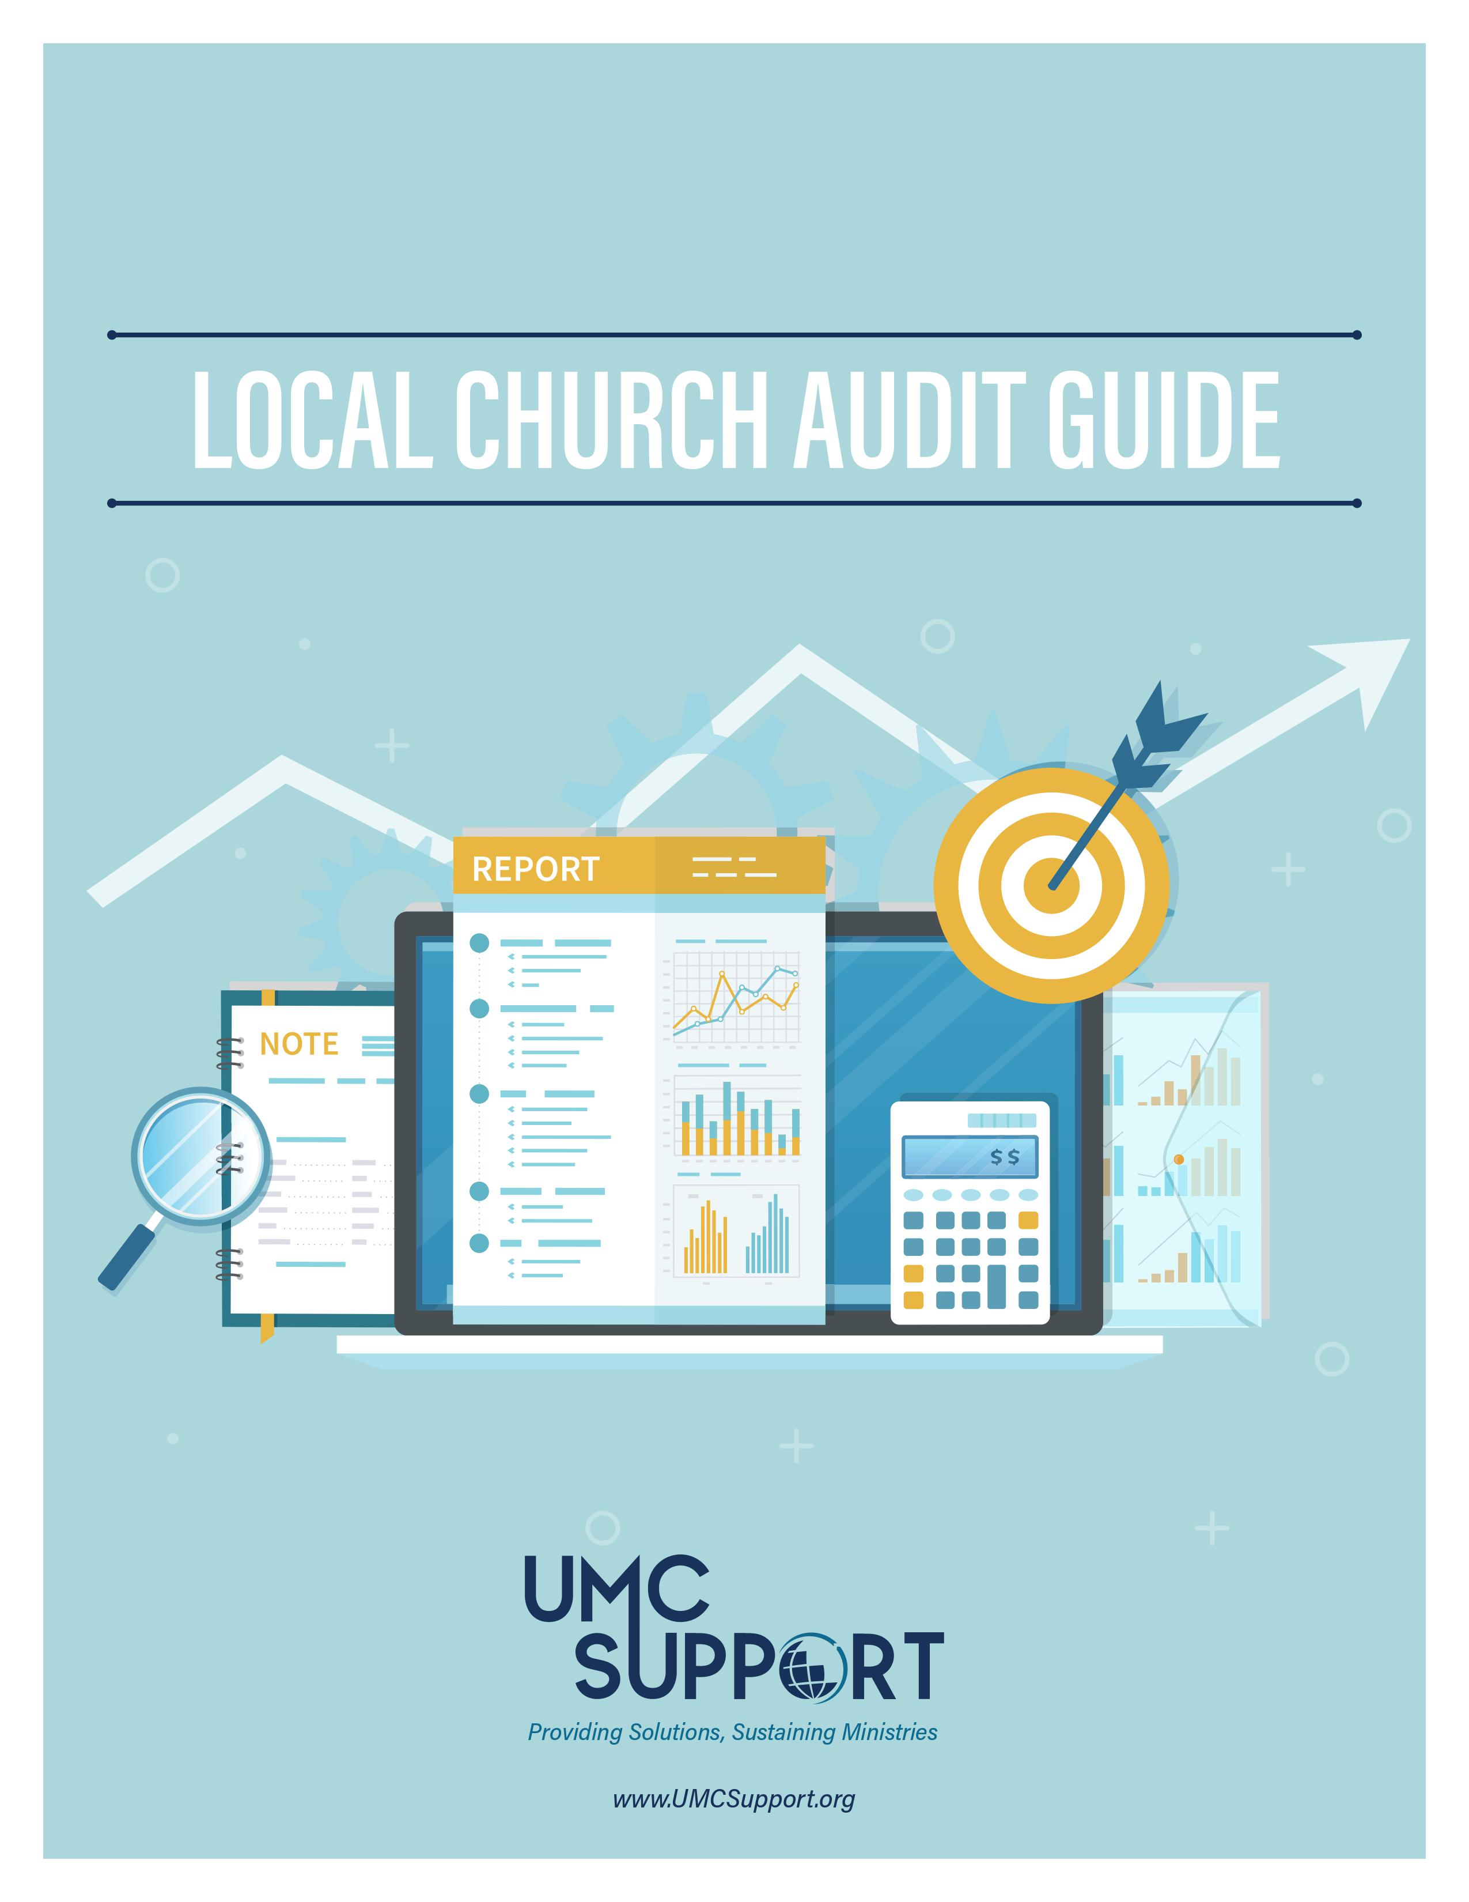
LCAG Purpose
The United Methodist Church Book of Discipline assigns the responsibility for the annual audit of financial records to the committee on finance at each local church. The committee “shall make provisions for an annual audit of the financial statements of the local church and all its organizations and accounts. The committee shall make a full and complete report to the annual charge conference” (258.4d). The purpose of the audit guide is to assist the committee in its work.

Slide 14
GCFA’s Role with LCAG
GCFA and the Committee on Audit & Review are not responsible for the conduct of local church audits, nor do they provide legal or financial advice to local churches through this booklet.
Local churches should seek assistance and advice from their local advisors when specific issues arise.
The LCAG is provided as a service; it should be used to increase the knowledge of auditing principles within the local church, including the understanding of why audits should be conducted and the uses to which they can be applied
to local church officials.

Slide 15
Recent LCAG Updates (2014 and 2020)
GCFA updated the LCAG in 2014 and 2020 to make it more “principles based” instead of specific “rules based.”
Added information regarding the Trust Clause.
Includes guidance for engagement types based on the size of the local church
Includes recommended procedures for both external and non-external audits
Located at: http://www.gcfa.org/forms

Slide 16
1 Music Circle North
Nashville, TN 37203
615-329-2393
ConnectionalRelations@gcfa.org
www.gcfa.org

