Slide 1
Sponsored by GCFA
Virtual Training Event
January 26-28, 2021

Slide 2
Book of Discipline & Related Topics
Rick King, CFO GCFA

Slide 3
How to Use the Book of Discipline

Slide 4
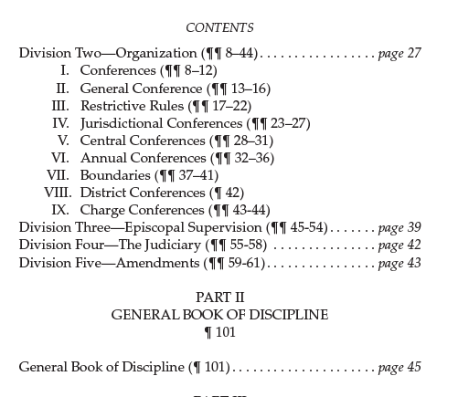
How to use the Book of Discipline
Use the Table of Contents
The paragraphs (¶) are numbered consecutively
within each chapter, or section.
The Page numbers for Main contents are provided.

Slide 5
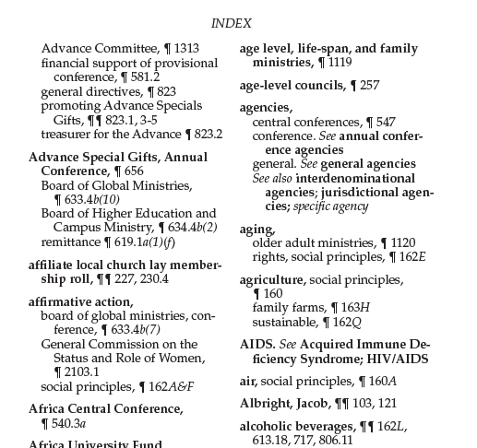
How to use the Book of Discipline
Use the Index:
Begins on Page 821
The numbers, unless otherwise
Indicated, refer to paragraphs (¶)
and to subparagraphs.
Subparagraphs are indicated by the
Numerals and/or letters following the
Decimal points.

Slide 6
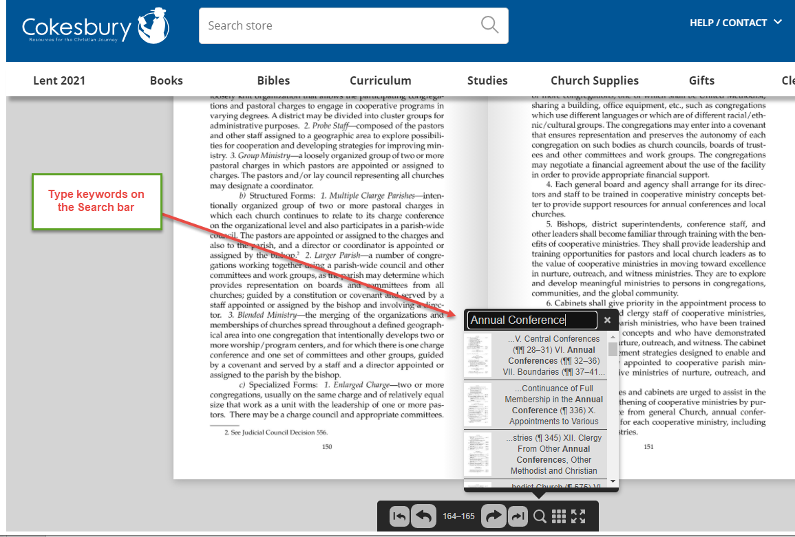
How to use the Book of Discipline
Use the free online version of the Book of Discipline
Cokesbury has made a free edition available online
https://www.cokesbury.com/book-of-discipline-book-of-resolutions-free-versions
Use the search bar below to
search for keywords

Slide 7
Book of Discipline & Conference Council on Finance & Administration (CCFA)

Slide 8
CCFA – What does the Book of Discipline Say?
Overview & membership
Para 611 & 612
Each conference shall have a council on finance and administration, and its overall purposes is to develop, maintain, and administer a comprehensive plan of fiscal / administrative policies, procedures and services for the annual conference.
Para 612.2
Ex officio members include:
Conference treasurer / Director of Administrative Services – Without Vote
Any members of GCFA that reside in the conference – With Vote
The presiding bishop – Without Vote
Director of Connectional Ministries – Without Vote
May include the Executive Director of the conference foundation - Without Vote

Slide 9
CCFA – What does the Book of Discipline Say?
Para 612.4
Members shall not vote or take part in deliberations in matters that directly or indirectly affect theirs or their families business, income or employment.
Amenability and Relationships
Para 612.6 & 612.7
Council reports directly to the annual conference
Must cooperate with the Council on ministries in development of conference benevolences budget
Act as a liaison with other conference agencies with responsibilities in fiscal management and administrative services.

Slide 10
CCFA – What does the Book of Discipline Say?
Responsibilities
Para 613
Recommend to the annual conference budgets for income and expenditures for all funds that provide for
Clergy support
Administrative expenses
Conference benevolence
Program causes
Recommend to the annual conference:
Proposals to raise capital funds
Funding considerations for any proposals that come before the conference
Any request for conference wide financial appeal

Slide 11
CCFA – What does the Book of Discipline Say?
Responsibilities (continued)
Recommend to the annual conference the local church apportionment formulas.
Work with the commission on communication to provide interpretive aids and materials to help leaders understand and support the conference budget and approved conference causes.
To develop policies governing the investment of conference funds (except for pensions).
Recommend to the annual conference procedures for funding local churches including the theology of giving.
Advise local churches on making their facilities and programs accessible.

Slide 12
CCFA – What does the Book of Discipline Say?
Responsibilities (continued)
Recommend to the annual conference procedures for situation for which approved budgeted funds are inadequate to meet emerging missional needs or unforeseen circumstances.
Review at least quarterly the disbursement of funds in accordance with the approved budget.
Recommend to the annual conference the conditions for borrowing funds.
Authority and supervision over the conference treasurer
Work with other conference agencies to implement a plan that designates the conference treasury as a central treasury for all conference agencies.

Slide 13
CCFA – What does the Book of Discipline Say?
Responsibilities (continued)
Establish policies and practices in the employment and compensation of personnel, unless the annual conference has designated another agency to carry this responsibility.
Cooperate with GCFA and the General Board of Discipleship Ministries in promoting and standardizing financial recording and reporting at the local churches.
Cooperate with GCFA in providing leadership and training in areas of church business administration.
Recommend actions to the annual conference regarding plans to initiate or organize a foundation or similar organization.

Slide 14
CCFA – What does the Book of Discipline Say?
Responsibilities (continued)
Perform other administrative and fiscal functions as the annual conference may assign.
Ensure no apportioned conference funds are spent on the use of alcoholic beverages.
Ensure no United Methodist funds are given to any gay caucus group or promote the acceptance of homosexuality. (Lots of proposed legislation addresses this specific paragraph)

Slide 15
CCFA – What does the Book of Discipline Say?
Budgeting
Para 614
Recommend to the annual conference budgets for income and expenditures for all funds that provide for
Clergy support
Administrative expenses
Conference benevolence
Program causes
Recommend to the annual conference:
Proposals to raise capital funds
Funding considerations for any proposals that come before the conference
Any request for conference wide financial appeal

Slide 16
CCFA – What does the Book of Discipline Say?
Budgeting (Continued0
Para 614.1
Clergy Support Budgets
District superintendents and related travel, staff, office, & salary
General Church apportionments for the Episcopal Fund
Conference’s share Episcopal residence
After consultation with the Board of Pensions, Pension and benefit programs of the conference
After consultation with the commission on equitable compensation, a schedule of equitable base compensation for pastors
Any other programs of clergy support the conference may adopt

Slide 17
CCFA – What does the Book of Discipline Say?
Budgeting (Continued)
Para 614.1
Administrative Budgets
Recommend to the annual conference the amounts needed for administrative expenses of the conference.
Shall consult with conference agencies and officers that are included in administrative expenses regarding the estimated budgets for their areas.
Include in its recommendation the conference’s share of an area expense fund and apportionments for administration made by the jurisdictional conference or the General Conference.

Slide 18
CCFA – What does the Book of Discipline Say?
Budgeting (Continued)
Para 614.1
Conference Benevolences Budget
Work with the council on ministries to ensure that all conference benevolence or service causes are not neglected, jeopardized or excluded.
Working with the council on ministries the council shall follow that preserve the following principles:
The council shall establish the total amount to be recommended to the annual conference and the allocation of the allocations to conference program agencies
The council on ministries is to study the budget requests and make recommendations to CCFA.
The CCFA should make the recommendation to the annual conference, but it should reflect agreement between the council and the council on ministries.

Slide 19
CCFA – What does the Book of Discipline Say?
Budgeting (Continued)
Para 614.1
Special Appeals
No annual conference agency or related organization shall make a special conference-wide appeal for funds without approval of the annual conference by way of recommendation from the CCFA.
Only exception is in case of extreme emergency and approval is in the form of a 2/3 vote of the combined district superintendents and the council acting jointly.

Slide 20
CCFA – What does the Book of Discipline Say?
Apportionments
Para 615
When a change in the apportionment is proposed, the council should provide a study of the effects of the proposed changes
After receiving the amount of general Church apportionments from as authorized by General Conference, the council shall apportion the same to districts, charges or churches by the method or formula the conference approves. The council shall make every effort for the full payment of these apportionments as part of the Church’s shared financial covenant.
If the council recommends combining two or more general apportioned funds together or with other non-general apportioned funds, the annual conference action shall include a statement of the amount and percentage of each general fund apportionment included in the combined apportioned fund.

Slide 21
CCFA – What does the Book of Discipline Say?
Depository
Para 616
The council shall designate a depository or depositories for conference funds.
Auditing – Authority & Responsibility
Para 617
The accounts of the conference treasurer for the preceding fiscal year be audited by a CPA within 150 days of the fiscal year end. It shall review and report such audit report to the annual conference.
Require and review annually audit reports from all agencies and organizations receiving conference funds.

Slide 22
CCFA – What does the Book of Discipline Say?
Auditing – Authority & Responsibility (Continued)
Para 617
Require and review annually audit reports from all districts or district agencies, including funds held or administered by treasurers other than the conference treasurer. Based upon the reviews, the council may make recommendations to the annual conference as it deems appropriate.

Slide 23
CCFA – What does the Book of Discipline Say?
Bonding
Para 618
The council shall provide fidelity bonding of the conference treasurer and staff under its authority in amounts it deems adequate.
Can require fidelity bonding for the treasurers of agencies, and organizations for the conference treasurer does not serve as treasurer.
May require any conference agency to provide directors’ and officers’ liability insurance in amounts it deems adequate.
Require compliance with this paragraph and report annually to the annual conference on such compliance.

Slide 24
Book of Discipline & The Annual Conference Treasurer

Slide 25
Responsibilities of the Annual Conference Treasurer – Para 619
Para 619.1
Shall Receive & disburse, in accordance with the actions of the annual conference and the provisions of the Book of Discipline, remittances from local church treasurers for all duly authorized General, jurisdictional, annual conference, and district causes.
Local churches shall remit monthly to the conference treasurer all amounts contributed for :
World Service Fund and Conferences Benevolences fund
All other funds authorized by the General Conference and apportioned by GCFA to the conference
All other jurisdictional, annual conference and district funds or causes that are apportioned

Slide 26
Responsibilities of the Annual Conference Treasurer – Para 619
Para 619.1.b(2)(a)
World Services & Conference Benevolences Funds
If apportioned as one fund, the total remitted to the annual conference shall be divided in the ratio established by the budget approved by the annual conference
Para 619.1.b(2)(c)
Whether apportioned separately or as one combined fund, the treasurer shall submit each month to GCFA the total share received during the month for World Service.
Para 619.1.b(2)(d)
If an annual conference combines 2 or more general funds or combines general Church funds with other conference apportionments, it shall allocate the receipts pro-rata as outlined in the conference budget. Amounts shall be remitted monthly to GCFA.

Slide 27
Responsibilities of the Annual Conference Treasurer – Para 619
Para 619.1.c
The treasurer shall prepare at regular intervals financial statement and reports that may be required by;
The bishop
District superintendents
The annual conference
The Council,
The agencies served by the conference treasuries
GCFA
Para 619.1.c(1)
The treasurer shall make each month a full report of all general funds handled to GCFA and the presiding Bishop.

Slide 28
Responsibilities of the Annual Conference Treasurer – Para 619
Para 619.1.c(2)
The treasurer shall prepare annual a report of all receipts, disbursements and balances of all funds under his or her direction. The report shall be printed in the conference journal.
Para 619.1.d
The treasurer may be authorized by the council to invest funds in accordance with policies and procedures established by the council.
Para 619.1.e
The treasurer shall provide counsel and guidance to local churches in the development of standardized reporting and reporting systems.

Slide 29
Responsibilities of the Annual Conference Treasurer – Para 619
Para 619.2
As Director of Administrative Services, may have responsibility in one or more of the following:
Office management
Payroll
Human Resources
Administrative services
Property management
Para 619 & 619.3
The Council on Finance and Administration shall have authority and supervision over the Treasurer / Director of Administration, and will determine the specific areas of responsibility

Slide 30
2021 Proposed Legislation Affects Paragraphs 611- 619 in the BOD

Slide 31
General Conference 2021 Legislations
Petition # 20653 - Amend ¶ ¶ 613 and 615 as follows:
¶613.3 To recommend to the annual or missionary conference for its action and decision the methods or formulas by which apportionments to churches, charges, or districts for duly authorized general, jurisdictional, conference, and district funds shall be determined (¶ 615.4). However, whether apportionments are directed toward churches, charges, or districts, no local church shall be apportioned more than 25 percent (25%) of the apportionable budget of the annual or missionary conference...
¶ 615.2. The council shall recommend to the annual or missionary conference for its action and determination whether the apportionments ... However, whether apportionments are directed toward churches, charges, or districts, no local church shall be apportioned more than 25 percent (25%) of the apportionable budget of the annual or missionary conference.
Rationale:
A conference that relies heavily on one church financially puts itself in a vulnerable state. A conference should be able to grow its budget only by growing vital congregations throughout the conference. Limiting any one local church’s share of the apportionable budget will move the conference in that direction.

Slide 32
General Conference 2021 Legislations
Petition # 20182 - Delete ¶ 613.19
¶613.19 To ensure that no annual conference board, agency, committee, commission, or council shall give United Methodist funds to any gay caucus or group, or otherwise use such funds to promote the acceptance of homosexuality or violate the expressed commitment of the UMC “not to reject or condemn lesbian and gay members and friends” (¶161G). The council shall have the right to stop such expenditures. The restriction shall not limit the Church’s ministry in response to the HIV epidemic, nor shall it preclude funding for dialogs or educational events where the Church’s official position is fairly and equally represented.
Substitute with:
¶613.19 To ensure that no annual conference board, agency, committee, commission, or council shall give United Methodist funds to any group, or otherwise use such funds to reject any LGBTQIA+ person or openly discriminate against LGBTQIA+ people, in order to follow to commitment of The UMC “not to reject or condemn lesbian or gay members and friends”(¶161.G), and to honor our commitment to the inclusion of all people in the life of the church “that enables all persons to participate in the life of the church, the community, and the world” (¶140). The council shall have the right to stop such expenditures. Funding shall not be provided for dialogs or educational events where rejection of LGBTQIA+ persons is promoted.
Rationale:
Whereas, ¶ 140 denes “inclusiveness” as "openness, acceptance, and support that enables all persons to participate in the life of the Church, the community, and the world; therefore, inclusiveness denies every semblance of discrimination" (The Book of Discipline, 2016).

Slide 33
General Conference 2021 Legislations
Petition # 20183 - Amend ¶ 613.19
¶613.19 To ensure that no annual conference board, agency, committee, commission, or council shall give United Methodist funds to any gay caucus or group, or otherwise use such funds to promote the acceptance of homosexuality or violate the expressed commitment of The UMC “not to reject or condemn lesbian and gay members and friends” (¶ 161G). The Council shall have the right to stop such expenditures. This restriction shall not limit the Church’s The church shall continue its ministry in response to the HIV epidemic, nor shall it preclude and will continue funding for dialogs or educational events where the church’s official position is fairly and equally represented.
Rationale:
Jesus commanded us to love our neighbors as ourselves. Not some neighbors, but all neighbors. The United Methodist Church’s denial of full membership to our LGBTQ siblings because of their gender identity, determined before birth, is antithetical to Christ’s teaching.

Slide 34
General Conference 2021 Legislations
Petition # 20184 - Amend ¶ 613.19 at its conclusion to state:
Every annual conference secretary shall certify to the General Council on Finance and Administration that the bishop has nominated only members of the Board of Ordained Ministry who will uphold, enforce, and maintain the Book of Discipline related to the duties of the Board of Ordained Ministry, including but not limited to all the qualifications for ordination (¶¶ 304, 330, 335, 336). Failure to do so shall result in the General Council on Finance and Administration neither receiving funds from nor sending funds to the annual conference and withdrawing the annual conference’s ability to use the denominational cross and flame logo.
Rationale:
Guarding against nonconforming boards of ordained ministry, this provides that the annual conference ensures that the bishop has complied with the requirement to nominate only persons who are committed to upholding the Discipline to the Board of Ordained Ministry, adding accountability for the annual conference as well.

Slide 35
General Conference 2021 Legislations
Petition # 20185 - Amend by Addition to ¶ 614 by insertion of a two-sentence paragraph:
¶ 614. Budgets—The council shall recommend . . . to the churches, charges, or districts.
The council shall prepare, as noted below, a budget for the annual conference that includes line items, that is, specific amounts for administration and program costs for every board, agency, cause, program, institution, mission, and conference benevolence. Line items shall be before the annual conference and subject to debate prior to its vote on the whole conference budget.
Rationale:
The current pattern of offering a general budget and trusting conference officers to take care of the “details” provides no protection from their neglecting, jeopardizing, and excluding ministries desired by the annual conference, contrary to ¶ 614.3a), which demands “that none may be neglected, jeopardized, or excluded.”

Slide 36
General Conference 2021 Legislations
Petition # 20652 - Amend four interrelated and interdependent paragraphs of the Book of Discipline:
Delete ¶ 615.5 as follows, and renumber subparagraphs as necessary. ¶ 615.
***
5. If an annual conference establishes an apportioned fund that combines funds subject to proportional payment under ¶ 622 with funds not subject to proportional payment, it shall establish procedures to ensure that the proportional payment provisions of ¶ 622 are observed.
Delete ¶ 622 as follows, and renumber subsequent paragraphs as necessary:
¶ 622. When the apportionments for bishops, district superintendents, conference claimants, and the Equitable Compensation Fund for the several districts and charges have been determined, payments made to the same in each pastoral charge shall be exactly proportional to the amount paid on the clergy base compensation (¶ 818.3). The treasurer or treasurers of each pastoral charge shall accordingly make proportional distribution of the funds raised in that charge for the support of the ordained ministry and shall remit monthly if practicable and quarterly at the latest the items for bishops, district superintendents, conference claimants, and the Equitable Compensation Fund to the proper treasurer or treasurers.

Slide 37
General Conference 2021 Legislations
Petition # 20652 (continued) Amend four interrelated and interdependent paragraphs of the Book of Discipline:
Amend ¶639.4 as follows:
¶ 639.
* * *
4. Proportional Payment by Churches and Charges— The board shall compare the records of the amounts paid by each pastoral charge for the support of pastors and for pension and benefit programs, computing the proportional distribution thereof and keeping a permanent record of defaults of the churches of the conference that have failed to observe the following provisions pertaining to make required proportional payments, and shall render annually to each church that is in default a statement of the amounts in default for that and preceding years.

Slide 38
General Conference 2021 Legislations
Petition # 20652 (continued) Amend four interrelated and interdependent paragraphs of the Book of Discipline:
¶ 639.4.
a) When the apportionment to the pastoral charges for the pension and benefit program of the annual conference has been determined, payments made thereon by each pastoral charge shall be exactly proportionate to payments made on the salary or salaries of the ordained minister or clergy serving it.
b) The treasurer of the pastoral charge shall be primarily responsible for the application of proportional payment; but in the event of the treasurer’s failure to apply it, the pastor shall adjust cash salary and payment according to the proper ratio, as provided above, before the pastor enters the respective amounts in the statistical report to the annual conference.
c) The conference statistical tables shall provide separate columns for reporting the amount apportioned to each pastoral charge for pension and benefit purposes and the amount paid thereon.
d) It shall not be permissible for a pastor to receive a bonus or other supplementary compensation tending to defeat proportional payment.

Slide 39
General Conference 2021 Legislations
Petition # 20652 (continued) Amend four interrelated and interdependent paragraphs of the Book of Discipline:
Amend ¶ 818 as follows:
¶ 818.
Purpose—1. The Episcopal Fund, raised in accordance with ¶ 818.3, shall provide for the salary and expenses of effective bishops from the date of their consecration and for the support of retired bishops ....
3. Proportionality—The amount apportioned to a charge for the Episcopal Fund shall be paid in the same proportion as the charge pays its pastor (see also ¶ 622).
Rationale:
Remove out-of-date language that requires a proportional relationship between conference apportionment of pension/benefits costs and pastors’ salaries, which does not comport with current practices. Flexibility for annual conferences reflected in ¶ 621 is clear and should not be limited.

Slide 40
How Does the Discipline Address the Number of Bishops?

Slide 41
The Number of Episcopal Areas
Para 404 (Provisions for Episcopal Areas)
Central Conferences (Para 404.1)
Recommendation comes from the Standing Committee on Central Conference Matters
Approval by General Conference
Jurisdictional Conferences
Formula driven (Para 404.2)
Exceptions to the formula (additional episcopal areas) are requested by the Jurisdictional Committee on Episcopacy to the Interjurisdictional Committee on Episcopacy. The Interjuridictional Committee can act on these requests or not. However, General Conference has the power to act in the absence of a recommendation.
Para 405 speaks to the election of Bishops. While the discipline does not directly address it in 404 or 405, a jurisdiction may elect fewer Bishops than approved by General Conference. SEJ has done this in the past.

Slide 42
1 Music Circle North
Nashville, TN 37203
615-329-2393
ConnectionalRelations@gcfa.org
www.gcfa.org

