Slide 1
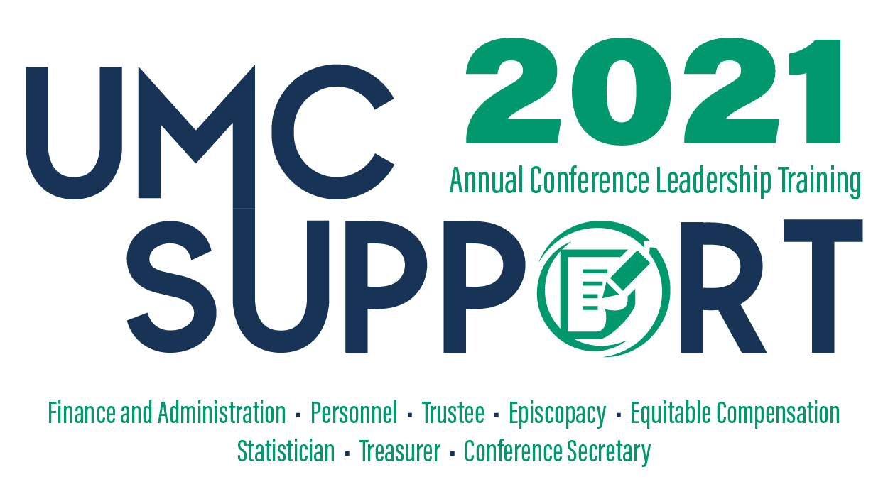
Sponsored by GCFA
Virtual Training Event
January 26-28, 2021

Slide 2
Reserves – Defining & Determining Appropriate Levels
Rick King, CFO GCFA

Slide 3
Definitions of Different Types of Reserves

Slide 4
Types & Definitions of Reserves
Donor Restricted
Unrestricted
Permanently Restricted Net Assets
Principal balance remains in tact
Income can be used for a purpose as specified the donor
Temporarily Restricted Net Assets
Principal & Income to be used for specific purpose as directed by the donor
Undesignated
Funds can be used for any purpose deemed necessary
Board Designated
Funds are not restricted by the donor
The Board designates the funds for a particular purpose
The Board can move these funds back to undesignated at any time if circumstances change or warrant

Slide 5
Types & Definitions of Reserves
Liquid Net Assets
Net Assets Not Readily Convertible to Cash
Cash
Investments & Securities
Receivables
Inventories
Fixed assets
Certain investments or holding that are not marketable
Long-Term Notes receivable

Slide 6
Types & Definitions of Reserves
Financial reserves = A subset of liquid net assets. They are a distinct pool of assets that an organization can access either to:
Mitigate the impact of unbudgeted or undesirable financial events
Pursue opportunities of strategic importance that may arise in the future

Slide 7
What Liquid Assets could be excluded from “Financial Reserves”?
Any Permanently or Temporarily Restricted Net Assets
Liquid assets required to cover working capital fluctuations throughout the year
Liquid assets required to cover known events over the course of the next year
Board Designated Unrestricted Net Assets?

Slide 8
Importance of Maintaining ‘Appropriate Reserves”

Slide 9
Be Prepared for Economic & Market Risks
Denominational issues & potential split
COVID-19
Lack of in-person worship
Increased unemployment reached 15% for first time since Great Depression
Stock market crash (i.e. 2008-2009)
S & P fell 50% & unemployment reached 10%
Declining U.S. attendance
Potential litigation costs

Slide 10
Be Prepared for Economic & Market Risks
Avoid making unplanned cost reduction measures in a knee-jerk manner.
If revenues fail to meet expectations, reserves can be used as a stop gap until:
Revenues reach target levels or
A more strategic approach can be planned to implement necessary cost reductions

Slide 11
What is an Appropriate Level of “Financial Reserves”
Rick King, CFO GCFA

Slide 12
How Much is Appropriate?
Many standards are used to establish reserve levels including months of operating expenses or even a set dollar amount
These standards are relatively arbitrary and not organization nor risk specific
Given todays economic realities, these approaches won’t be satisfactory going forward

Slide 13
How Much is Appropriate?
While there may be similarities, each Annual Conference, General Agency or Local Church is unique
What is appropriate for one organization, regardless of similarities may not be the same for another.
There are no easy answers!
One size does not fit all!
We have a lot of thoughtful work to be done!

Slide 14
Reserve Planning – Establishing Target Levels
As Outlined by Grant Thornton’s Advisory Practice

Slide 15
5 key Steps to Reserve Planning
Determine a baseline long-term financial forecast
Detailed analysis of potential risk and the potential magnitude of their impact on the organization
Quantify your projected average annual risk
Establish target reserve levels
Identify the funding plan / approach

Slide 16
Step 1: Develop Baseline Financial Forecast
If reserves are meant to mitigate adverse financial circumstances, it is critical that you understand the baseline you are insuring against.
Identify and measure key drivers of financial performance.
Develop a long term forecast of at least 4-5 years for all aspects of the organization. This will also identify cyclical trends that may not be evident in an annual budget.

Slide 17
Step 2: Detailed Analysis of potential risks and their impact
Identify your potential risks
Churches / members leaving the denomination
Major building repairs
Pension health liabilities
Lawsuits
Others?
Quantify the range of impact of each risk
Assign a likelihood of occurrence for each risk / range.

Slide 18
Step 2: Detailed Analysis of potential risks and their impact
Other potential risks facing all organizations
Governance
Personnel
Economic / Financial
Compliance
Technology
Fraud
Natural Disasters / Terrorism
Operational Process
Brand Loyalty

Slide 19
Step 2: Detailed Analysis of potential risks and their impact
Critical to collaborate with all leaders of the organization. Don’t do this in a silo.
Provides a more comprehensive and detailed analysis. Different perspectives are important to arriving at best estimate of a potential risk.
Builds buy-in throughout the organization and increases the integrity of the analysis
Creates a shared perspective on the long-term direction.

Slide 20
Step 3: Quantify Your Annual Risk
Calculate a probability adjusted outcome of potential risk and incorporate into the long-term forecast.
Impact should be done by year. The potential impact might be greater in one year vs. another. arriving at best estimate of a potential risk.
Scenario planning is also important. Have a range of long-term plans so that you are ready in case reality is worse than you predicted.

Slide 21
Step 4: Establish Your Target Reserve Levels
Factors to include in setting target reserve levels:
The calculated projected impact by year of the identified risks
The likelihood of these impacts being one-time vs. ongoing.
The organization’s ability to reduce expenses or increase revenues in the face of the realized risk
The organization’s appetite for risk

Slide 22
Benefits of Reserve Targets Using these Steps
Improved organizational understanding of the potential risk factors and their impact.
A more defensible rationale for the reserve levels
Development of a long-term strategic plan that provides a road-map for actions and decisions while contemplating the potential impact of key risk factors.

Slide 23
Other Things to Consider

Slide 24
Other Things to Consider
Your budgeting practices will impact reserve levels
Conservative approaches will likely lead to higher reserve levels or lower usage than planned
Aspirational budgets will likely lead to lower reserve levels & increased usage vs. the plan.
It is important to use an honest assessment when establishing your reserve targets!
Develop and document a reserve policy
Review the reserve targets and reserve policy regularly (preferably annually)

Slide 25
Questions?

Slide 26
1 Music Circle North
Nashville, TN 37203
615-329-2393
ConnectionalRelations@gcfa.org
www.gcfa.org

