Slide 1


Slide 2
Reshaping Data for Deeper Insights into Customer Retention
Stuart Henry
Director of Technology
DuMOL Winery
Notes:
Good morning, my name is Stuart Henry and I’m the Director of Technology for DuMOL Winery.
One of the things I spend a lot of my time on is designing reports and curating the data that is the basis of our reporting, and I wanted to share some techniques I’ve learned that help us understand our customer retention. Specifically I want to demonstrate what it means to reshape data, and how you can use data reshaping to get deeper insights into your customer retention.
The tools that I’m going to use in this presentation are Excel, Tableau Prep, and and Tableau Desktop, but you can get the job done with just Excel if needed.

Slide 3
Customer Retention
Goal: To categorize a customer in terms of their retention status by year (new, continuing, returning, lapsed); Calculate retention metrics
Notes:
In this example we will be starting with the sales data in our e-comm system. The goal, ultimately, is for our marketing people to be able to filter our list of customers to identify lapsed customers in order to try to recover them. To make this possible, I will need to be able to categorize each customer in terms of their retention status for each year since their first purchase. You could also calculate retention on a release-by-release basis, but for the sake of simplicity we’ll just look at year-over-year retention.
The retention statuses that we are interested in are if they are a new customer, a continuing customer, a returning customer, or a lapsed customer. While we’re at it let’s also calculate some retention metrics like acquisition rate, active retention rate, and churn rate. Let’s take a closer look at these retention statuses that we will track:

Slide 4
Customer Retention
Goal: To categorize a customer in terms of their retention status by year (new, continuing, returning, lapsed); Calculate retention metrics
Retention Status | Definition
New | Year of first purchase
Continuing | Purchased in prior year and current year
Returning | Did not purchase in prior year but purchased in current year
Lapsed | Purchased in prior year but not in current year
Notes:
Customers will be categorized by retention status depending on if they purchase or not between two consecutive periods. In order to track the history of each customer by year we will need a record in our data for each customer and each year, so that we can determine which retention status is applied to them. Here’s an example of how this might look:

Slide 5
Customer Retention
Goal: To categorize a customer in terms of their retention status by year (new, continuing, returning, lapsed); Calculate retention metrics
Notes:
This is what one customer’s journey might look like, starting in 2017 when they made their first purchase and were assigned the retention status “new” for that year. They purchased again in 2018 and therefore were classified as a “continuing” customer. They didn’t purchase in 2019, so in that year they were a ”lapsed” customer, and in 2020 they returned to purchase again, so we count them as a “returning” customer for 2020. The challenge with creating a table like this from our e-comm data is how to account or the “lapsed” records (>),

Slide 6
Customer Retention
Goal: To categorize a customer in terms of their retention status by year (new, continuing, returning, lapsed); Calculate retention metrics
Notes:
Since our e-comm system only records when customers purchase, there are no records in the system when a customer does not purchase. So for this customer would be no record for them in 2019. This is where we can use data reshaping to add these lapsed customers into our data set.

Slide 7
What does “data reshaping” mean?
Notes:
So, what does data reshaping mean, and how can we use it to account for the non-purchasing customers in our data set?

Slide 8
What does “data reshaping” mean?
Data reshaping is the process of changing the way data is organized into rows and columns (pivoting).
Rows to Columns
Columns to Rows
Notes:
Data reshaping is the process of changing the way data is organized into rows and columns, also known as pivoting. If you’ve ever created a pivot table in Excel then you have “reshaped data”. In Tableau Prep you can pivot two ways, from rows to columns, or columns to rows. In order to account for our lapsed customers (>)

Slide 9
What does “data reshaping” mean?
Data reshaping is the process of changing the way data is organized into rows and columns (pivoting).
Rows to Columns
Columns to Rows
Notes:
We will do both pivots, we will first pivot rows to columns, and then de-pivot those columns back to rows. This double-pivoting will allow us to pad our data with zeroes for every year that a customer does not have a sale in our system. This might be hard to picture so let me illustrate this double pivoting with an example:

Slide 10
Data reshaping example
Notes:
Here we have three years of sales data for three customers – I’ve color coded the rows by customer, hopefully the colors are legible on your screen. What we want to do is pivot the on year, and we will be pivoting from rows to columns. (>)

Slide 11
Data reshaping example
Rows to columns
Notes:
This means we take the “Year” field, and each value in the year field becomes a column in the data table. This data table extends from 2018 to 2020, so each year appears as a column, and the customer spend for that year appears in the intersecting cell. We have three customer rows, and three year columns, so there are a total of nine cells now in this pivoted table. When do our second pivoting, our “de-pivoting”, each one of these nine cells will be a row in the data table (>)

Slide 12
Data reshaping example
Rows to columns
Columns to rows
Notes:
Giving us a row for each year that was unaccounted for in our original data. Note that there are equal numbers of rows for each customer, since we created a row for each combination of customer and year in our data set. We have a blank cell for customer 1 in 2019, and also customer 2 in 2020, but notice that we also have blank cells for customer 3 in 2018 and 2019, which were prior to his first purchase.
We will need to clean up this data table and remove the years prior to someone’s first purchase, and to make our lives easier we can also replace the blank cells with a zero value (>)

Slide 13
Data reshaping example
Rows to columns
Columns to rows
Notes:
This last table on the bottom right represents what our finished data set would look like, with the retention status applied. From this data set we’ll be able to calculate those retention metrics, but also since we have a record in the data set for our lapsed customers, we can easily use this list to segment them for additional followup marketing, or further analyze that segment by joining with your CRM data.
Ok, there’s a lot of steps to go from the raw DTC data to this “reshaped” data set, and that is where Tableau Prep will help us by letting us automate it.

Slide 14
How do we automate this with Tableau Prep?
Notes:
Tableau Prep is software that allows you to quickly and easily analyze your data and apply cleaning and transformation steps to the data to prepare it for reporting. The way this works in Tableau Prep is you create what is called a “FLOW”, which is a step-by-step process you put your data through to clean or reshape it. I don’t have time to dive into Tableau Prep in this presentation, but if you work with a lot of data it is an excellent compliment to Excel, I can’t recommend it enough. So let’s take a look at what Tableau Prep is doing -

Slide 15
How do we automate this with Tableau Prep?
Input File (raw data from e-comm system)
Output File
Tableau Prep
Notes:
On the left hand side is the raw data from the e-comm system that we put into our Tableau Prep flow, and on the right is the output that is generated by the Tableau Prep flow. We can see the DTC sales data on the left that at the customer, sku, and invoice level is aggregated to the customer and year level by Tableau prep, with inactive years accounted for because of the data reshaping.
The benefit of putting these steps into a program like Tableau Prep is that you can make a new download from the e-commerce system, process the report through the flow, and then generate the output report in seconds, without having to manually process the data yourself.
Now we are almost done - we have two more steps we need to do outside of Tableau Prep. Tableau Prep doesn’t respect any sorting in the output, so we will need to sort the data so that for each customer the rows go in consecutive years so that we can calculate their retention.

Slide 16


Two more steps: sort and calculate
We need to sort the data by Customer ID and Year, so that adjacent rows are adjacent periods of time. This will simplify the retention cohort calculation.
sort
Notes:
Opening up the output file from Tableau Prep in Excel, we sort the table on Contact ID and Year ASCENDING, so that consecutive rows represent consecutive years for a customer, starting with their year of first purchase. So we sort the data then (>)

Slide 17
Two more steps: sort and calculate
We need to sort the data by Customer ID and Year, so that adjacent rows are adjacent periods of time. This will simplify the retention cohort calculation.
calculate
sort
Notes:
Apply a formula in Excel to calculate if the customer is new, continuing, returning, or lapsing based on their revenue value from one row to the next. Now we are ready to report! In the next slides the screenshots I’m showing you are from Tableau Desktop

Slide 18
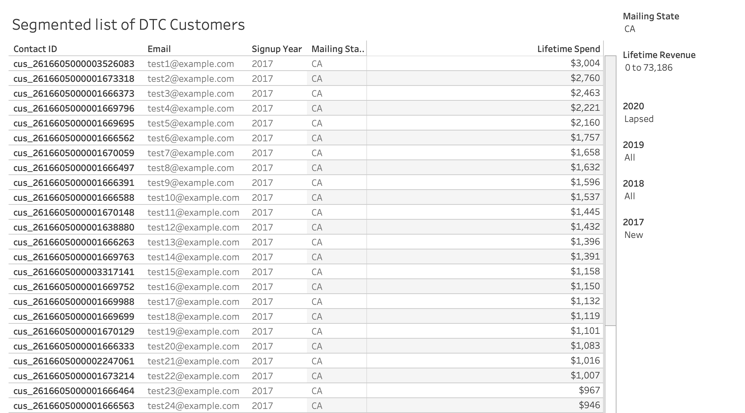
Visualize!
Notes:
Here’s an example of a filterable report that marketing could use to segment customers by their year-over-year behavior. It is a list of all customers, filterable by the filter options on the right hand side. In this case it is filtered to customers in CA who signed up in 2017 (“New” cohort in 2017) and who lapsed in 2020. This could be a starting point in terms of identifying an audience for a marketing campaign to try to recover them, or further analysis into their pre-lapse behavior.
By joining this retention data set with data from your CRM you can enrich your data set with the demographic or marketing data stored in CRM, such as email campaign open/click stats.

Slide 19
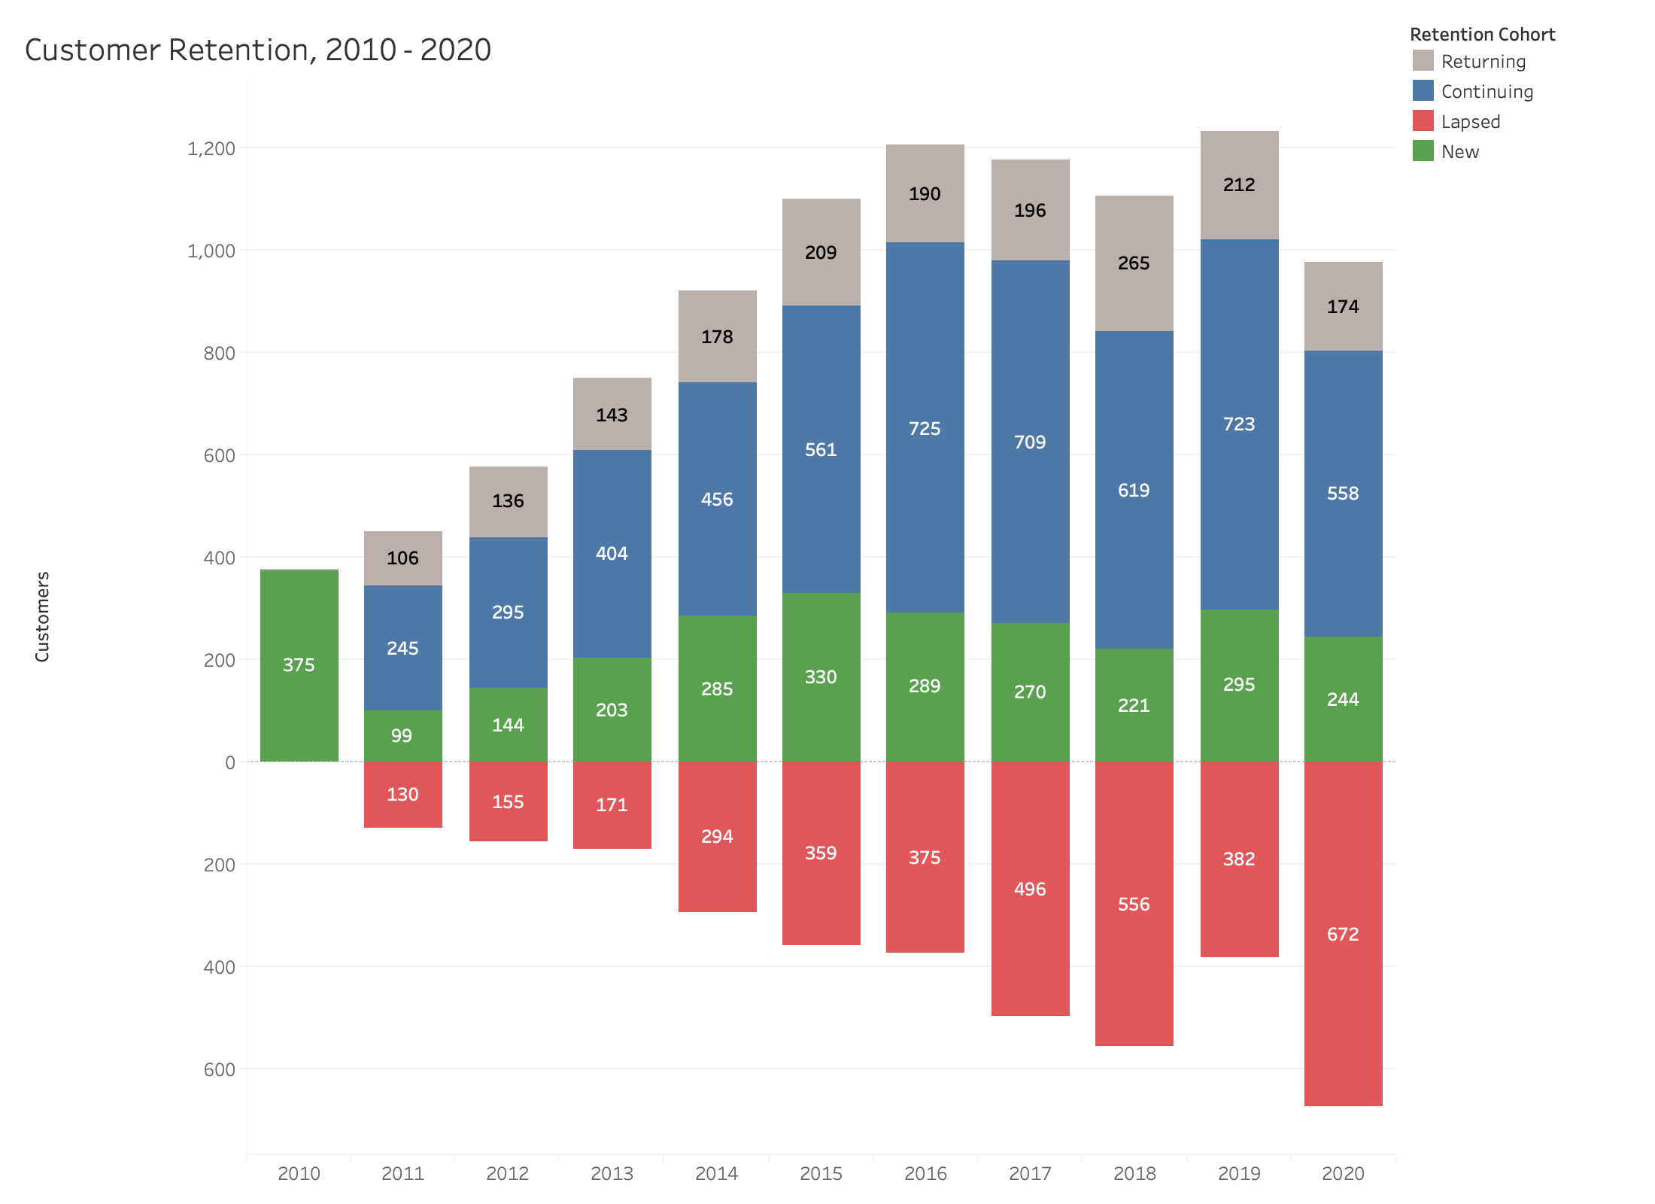
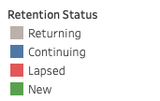
Visualize!
Notes:
In addition to the filterable list of customers we can visualize our active and lapsed customers together now that they are all in the same data set, here’s one way to do it with a stacked bar graph, where the lapsed customers appear as an inverted bar graph below the x axis.
One of the cool things about Tableau is you can put a chart within the tooltip of another chart, so if we were to hover over the lapsed segment in 2017, for example (>)

Slide 20
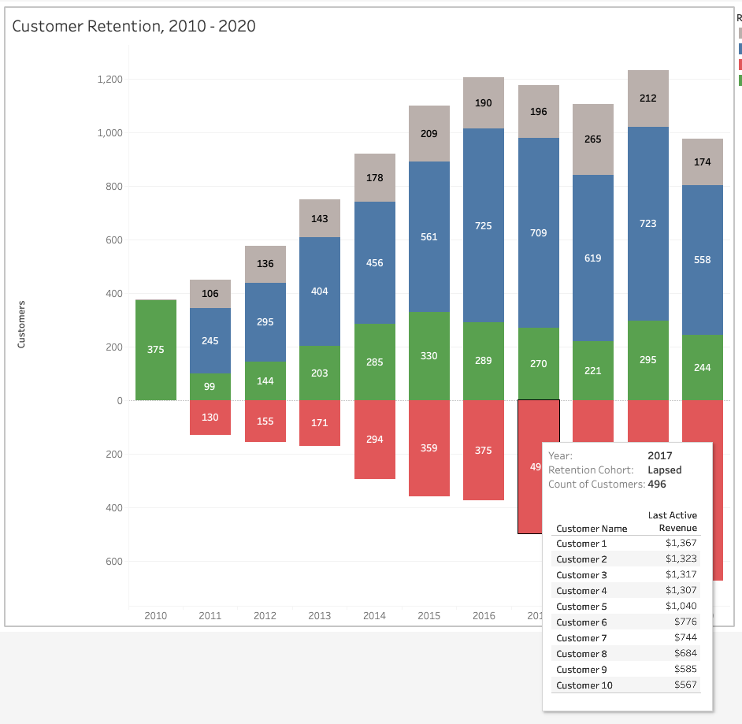
Visualize!
Notes:
We could drill down into the top 10 lapsed customers, ranked by their spend in the prior year.

Slide 21
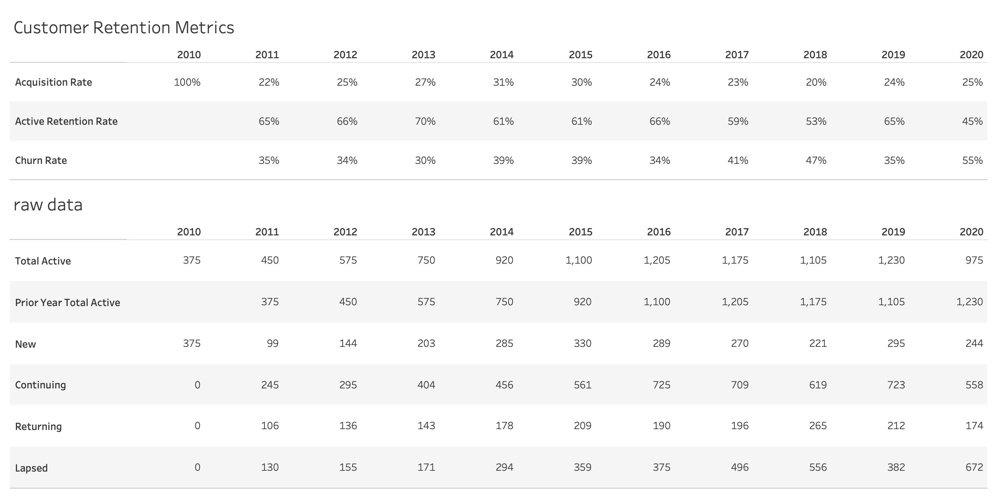
Visualize!
Notes:
And finally we can report on retention KPIs, acquisition rate, active retention rate, and churn rate as well. I’ve included the raw data below just to make sure the math checked out.
I hope I’ve given you an idea of what you gain by reshaping your sales data to track lapsed or inactive customers. Note that this same technique can be applied to depletion data to track on or off premise accounts by the same retention metrics of new, continuing, lapsed, etc.

Slide 22
Conclusion
Notes:
In conclusion, I hope the take-away is that depending on the analysis or question being asked of the data (>)

Slide 23
Conclusion
Raw data isn’t always enough
Notes:
The raw data isn’t always enough, depending on what question you are asking of the data. In our example of understanding customer retention, the e-comm data only told us part of the story.

Slide 24
Conclusion
Raw data isn’t always enough
Raw data can be augmented by reshaping (pivoting)
Notes:
Raw data can be augmented by reshaping in order to pad the data with missing records

Slide 25
Conclusion
Raw data isn’t always enough
Raw data can be augmented by reshaping (pivoting)
We can use the reshaped DTC sales data to target retention efforts at lapsing customers
Notes:
We can use the reshaped data to identify and target our lapsed customers

Slide 26
Conclusion
Raw data isn’t always enough
Raw data can be augmented by reshaping (pivoting)
We can use the reshaped DTC sales data to target retention efforts at lapsing customers
Questions?
stuart@dumol.com
Notes:
Any questions?

