Slide 2
Panel: There’s no place like home
William Aldridge, MBA, CFA Senior VP, Portfolio Manager
Tim Johal, CFA VP, Portfolio Manager
Notes:
This presentation provides an overview of the tax rules that small business owners should be aware of when transitioning their business to a family member, including an update on the recent tax changes.

Slide 3
William Aldridge, MBA, CFA
Mackenzie Canadian Equity Fund
Senior VP, Portfolio Manager

Slide 4
Time to reconsider Canada
S&P TSX vs S&P 500
Canada outperforming
Canada underperforming
Source: Bloomberg, June 30, 1990 to June 30, 2022

Slide 5
Why Mackenzie Canadian Equity Fund?
Canadian portfolio for all markets
We pursue outperformance in all market conditions. A portfolio that represents the best of Canada.
Disciplined portfolio construction
Focused on managing risk relative to the benchmark.
Rigorous fundamental analysis
Stock selection and position sizing determined by relative returns to intrinsic value – focused on upside potential and downside risk.
An all-cap strategy
Employed as a key tool to manage market valuation and sentiment over the cycle.

Slide 6
Built for success
1
2
Nail the fundamentals
Rigorous analysis Cash(Flow) is King ESG from the start
Build for success
Focus on price we pay Key in on intrinsic value Diversify across sectors
3
4
Patience is a virtue
Timing is everything Constant oversight Filter out the noise
Ready to act
Stay humble Thoughtfully opportunistic Low turnover

Slide 7
Performance
 | YTD | 1 Yr | 2 Yr | 3 Yr | 5 Yr | 10 Yr
Mackenzie Canadian Equity Fund – Series F | -1.9% | 4.8% | 17.0% | 12.0% | 9.4% | 9.4%
S&P/TSX composite TR | -7.2% | -3.4% | 11.3% | 8.7% | 8.1% | 8.1%
Morningstar Canadian Equity Peer Group | -6.0% | -2.2% | 12.2% | 7.8% | 6.9% | 7.9%
Percentage of peers beaten | 85 | 89 | 88 | 94 | 95 | 86
Portfolio vs. peer group
Below
At
Above
Portfolio vs. peer group
Below
At
Above
3-year return
3-year volatility
5-year return
5-year volatility
10-year return
10-year volatility
Source: Mackenzie Investments. As of August 31, 2022, in CAD (periods over 1 year are annualized),

Slide 8
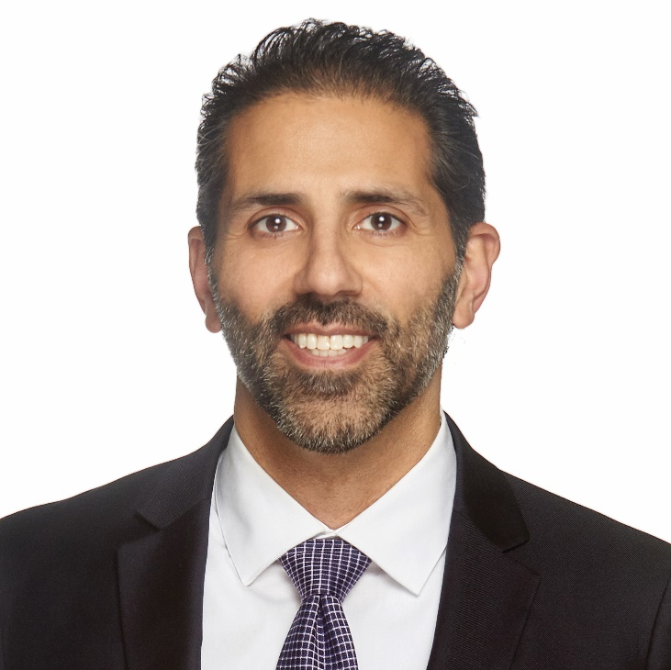
Tim Johal, CFA
Mackenzie Canadian Dividend Fund
VP, Portfolio Manager

Slide 9
We have conviction in dividend investing…
We believe that investing in quality, dividend-paying companies with an attractive margin of safety will deliver strong, risk-adjusted returns over a market cycle.

Slide 10
Mackenzie Canadian Dividend Fund Style & philosophy that drives outperformance
Value-oriented
Quality focused
Dividend paying
Demand margin of safety
Rigorous bottom-up process with economic and secular considerations
Return relative to risk is key
Reduce risk of value trap
Greater probability of return to long-term average valuation
Improved risk management as less volatile and more predictable
ESG Considerations
Companies that pay and grow dividends have delivered better returns over longer term
Evaluate dividend-level, sustainability and growth

Slide 11
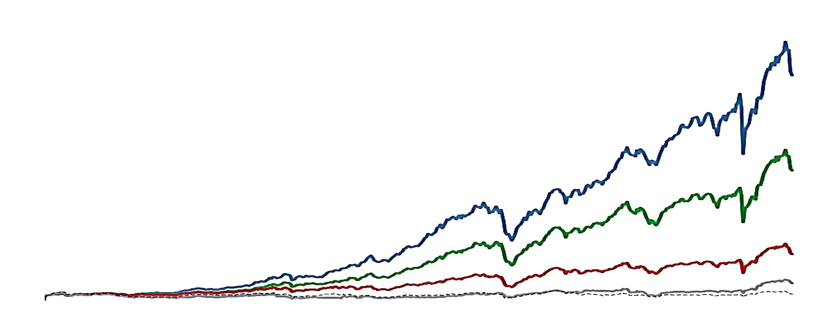
Dividend growers offer the best long-term performance
Canadian dividend performance
48,000
CAGR
Dividend growers
44,000
Dividend payers
40,000
10.7%
TSX composite
36,000
Dividend cutters
32,000
Non-payers
28,000
24,000
9.0%
20,000
16,000
12,000
*Equal weighted equity only. Total return indexes. Oct 1986 = 1,000.
8,000
6.0%
4,000
3.2%
0
0.5%
Oct-86
Oct-91
Oct-96
Oct-01
Oct-06
Oct-11
Oct-16
Oct-21
Source: RBC Capital Markets Quantitative Research, Mackenzie Investments

Slide 12
…and with the lowest volatility
Canadian dividend annualized volatility
Source: RBC Capital Markets Quantitative Research, Mackenzie Investments

Slide 13
Dividends likely to be significant part of total returns again
S&P/TSX dividend contribution to total return
Average = 55%
Source: RBC Capital Markets Quantitative Research, Mackenzie Investments. Analysis begins Jan 31, 1956.

Slide 14
Performance
 | YTD | 1 Yr | 2 Yr | 3 Yr | 5 Yr | 10 Yr
Mackenzie Canadian Dividend Fund – Series F |  | 4.3% | 16.4% | 9.1% | 7.9% | 8.8%
80% TSX Div + 20% MSCI World Performance | -3.9% | 1.9% | 13.9% | 10.0% | 9.0% | 9.7%
Morningstar Canadian Equity Peer Group | -2.8% | 2.3% | 15.1% | 8.2% | 6.8% | 7.5%
Percentage of peers beaten | 72 | 70 | 60 | 61 | 70 | 76
Portfolio vs. peer group
Below
At
Above
Portfolio vs. peer group
Below
At
Above
3-year return
3-year volatility
5-year return
5-year volatility
10-year return
10-year volatility
Source: Mackenzie Investments. As of August 31, 2022, in CAD (periods over 1 year are annualized),

Slide 15
Appendix

Slide 16
Mackenzie Canadian Equity Fund
Appendix

Slide 17
Our philosophy for durable performance
We believe that we can achieve consistent returns by investing at a discount to intrinsic value, focusing on relative value and seeking sustainable cash flow
Value is relative
Value is in the eye of the beholder
All cap strategy
Tactically allocating across the market cap spectrum
Diversified portfolio
Diversified across sectors and styles
Low turnover
Patient entry and exit minimizes timing risk
ESG integration & engagement from beginning to end

Slide 18
Finding relative value in all markets
Source: Morningstar April 30, 2022 represents holdings from February 28, 2022 with two-month reporting lag

Slide 19
Disciplined and diversified
Sector | Mackenzie Canadian Equity (%) | S&P/TSX Composite Index (%) | Relative weight (%)
Consumer Staples | 8.8 | 4.1
Consumer Discretionary | 5.9 | 3.3
Real Estate | 3.4 | 2.7
Health Care | 0.5 | 0.4
Utilities | 4.6 | 5.2
Industrials | 10.9 | 12.0
Financials | 30.5 | 31.8
Information Technology | 4.1 | 5.4
Materials | 9.2 | 11.6
Communication Serv. | 2.1 | 5.2
Energy | 13.1 | 18.4
Cash | 2.7 | –
ETFs | 4.8 | –
Source: Mackenzie Investments. As of August 31st, 2022

Slide 20
Major holdings
Security | Industry | Weight
Royal Bank of Canada | Diversified Banks | 6.5%
Toronto-Dominion Bank/The | Diversified Banks | 6.2%
Mackenzie US Large Cap Equity Index ETF | ETFs | 4.2%
Canadian National Railway Co | Railroads | 3.9%
Canadian Pacific Railway Ltd | Railroads | 3.8%
Canadian Natural Resources Ltd | Oil & Gas Exploration & Prod. | 3.8%
Bank of Montreal | Diversified Banks | 3.4%
Alimentation Couche-Tard Inc | Food Retail | 3.1%
Suncor Energy Inc | Integrated Oil & Gas | 2.7%
Brookfield Asset Management Inc | Asset Mgmnt & Custody Banks | 2.5%
Source: Mackenzie Analytics, as of August 31, 2022. Note: The major holdings of the Fund may, but do not necessarily, represent the largest holdings of the Fund. Rather, the major holdings are selected for their overall significance in evaluating the investment portfolio.

Slide 21
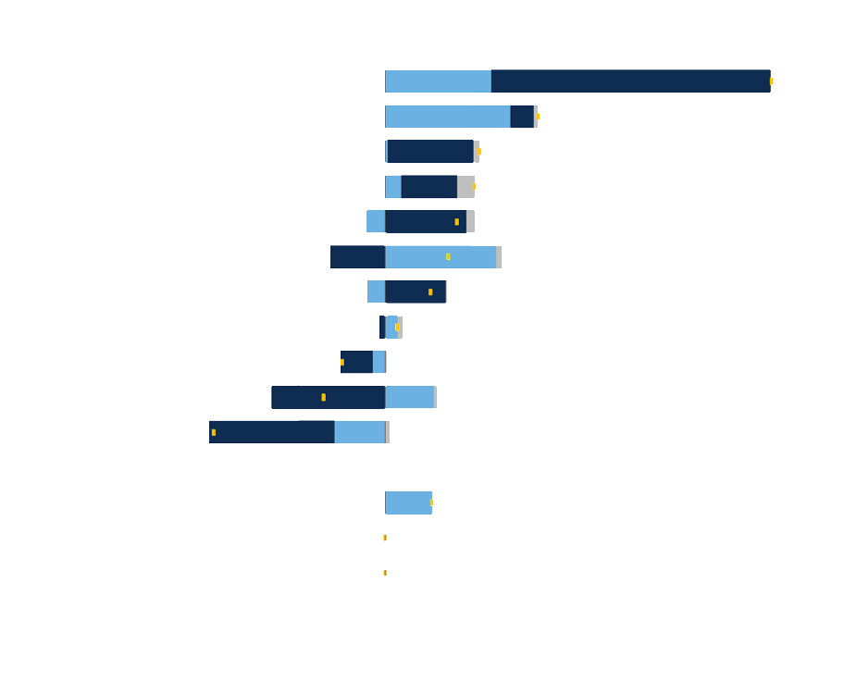
Sector attribution 3-months
Average relative weight
Portfolio attribution
Allocation (0.86)
Selection + Interaction (0.59)
Currency (0.14)
Total effect (1.59)
Source: Mackenzie Analytics, as of August 31, 2022. Benchmark: S&P/TSX Composite TR

Slide 22
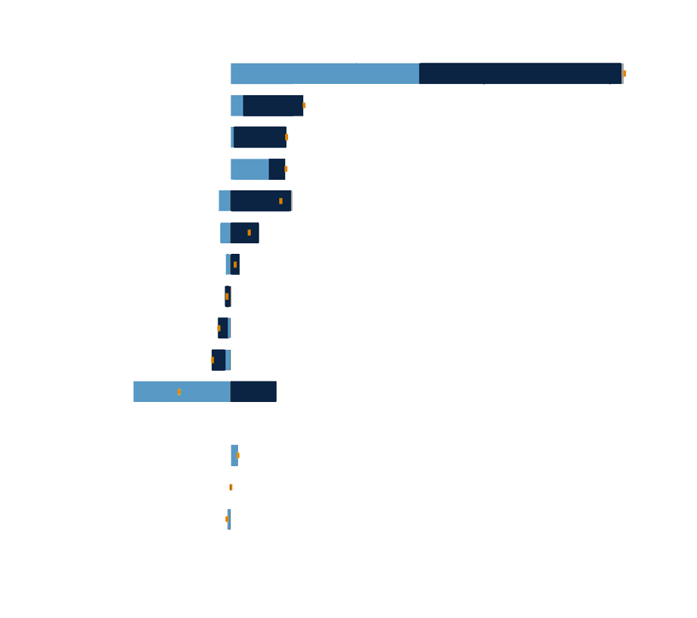
Sector attribution 1-year
Average relative weight
Portfolio attribution
Allocation (1.84)
Selection + Interaction (7.05)
Currency (0.18)
Total effect (9.07)
)
Source: Mackenzie Analytics, as of August 31, 2022. Benchmark: S&P/TSX Composite TR

Slide 23
Employing value discipline: CCL Industries
80
70
Added position
60
50
Decreased position
40
Price ($)
30
Initiated position
20
CCL Industries (CCL>B)
10
0
Jan-19
Apr-19
Jul-19
Oct-19
Jan-20
Apr-20
Jul-20
Oct-20
Jan-21
Apr-21
Jul-21
Oct-21
Jan-22
Apr-22
Jul-22
Source: Mackenzie Analytics, as of August 31, 2022.

Slide 24
Employing value discipline: Gildan Activewear
60
50
Added position
40
Initiated position
30
Price ($)
20
Gildan Activewear (GIL)
10
0
Jan-19
Apr-19
Jul-19
Oct-19
Jan-20
Apr-20
Jul-20
Oct-20
Jan-21
Apr-21
Jul-21
Oct-21
Jan-22
Apr-22
Jul-22
Source: Mackenzie Analytics, as of August 31, 2022.

Slide 25
Employing value discipline: Sleep Country
45
Decreased position
40
35
Initiated position
30
Added position
25
Price ($)
20
15
10
Sleep Country Canada Holding Ink (ZZZ)
5
0
Jan-18
Jul-18
Jan-19
Jul-19
Jan-20
Jul-20
Jan-21
Jul-21
Jan-22
Jul-22
Source: Mackenzie Analytics, as of August 31, 2022.

Slide 26
Bios
William Aldridge, MBA, CFA Senior Vice President, Investment Management
William Aldridge, Senior Vice President, is a Portfolio Manager and Team Co-Lead on the Mackenzie North American Equities Team. William’s career in the investment industry began in 2002. He joined Howson Tattersall Investment Counsel in 2006, and the company became part of Mackenzie Investments in 2008. Prior to 2006, William was an Equity Analyst at a Canadian independent broker-dealer covering real estate, transportation and special situations. William has a BSc from the University of British Columbia, an MBA from the Richard Ivey School of Business and is a CFA charterholder.

Slide 27
Bios
Anthony Del Vecchio, CFA, CIPM Director, Investment Research
Anthony Del Vecchio is an Investment Analyst for the Mackenzie North American Equities Team. Anthony brings nine years of finance and investment management experience to the team. Prior to joining Mackenzie Investments, he worked as an Investment Analyst for a leading Canadian Financial services company, focusing on Canadian small cap equities. Anthony received his Bachelor of Commerce (Honours) degree with majors in Finance and Marketing from the University of Manitoba. He is a CFA charterholder and holds the Certificate in Investment Performance Measurement (CIPM) designation.

Slide 28
Mackenzie Canadian Dividend Fund
Appendix

Slide 29
Investment style & philosophy
1
2
3
Bottom-up focus
Time horizon 1-3 years
Adjust for Risk
Company and stock specific
Macro factors
Secular factors
Advantage over increasingly short-term focused market
Length of time horizon measured against margin of safety
Portfolio weights adjusted based on return relative to risk
Consideration of ESG Factors

Slide 30
Investment process
Canadian investment universe
Dividend-Paying, >$1B cap
Large Caps + Mid Caps
200+ Companies
Selection process: 30-50 stocks
Absolute and relative valuations
Macro & Secular considerations
PE, EV/EBITDA, P/FCF, Dividend Yield
Discounted Cash Flow and Dividend Discount Modeling
Assessment of quality & ESG factors
Expected return adjusted for risk
Portfolio construction objectives
1
3
Initial screening
Apply valuation metrics
Focus on free cashflow
Screen for quality
Evaluate margin of safety
Monitoring
Company management meetings
Valuation models updated regularly
Daily meetings
Sell discipline
Quarterly CIO portfolio review:
Performance, risk, factor analysis
2
4

Slide 31
Risk management
PORTFOLIO CONSTRUCTION
Position sizing limits allocation to individual holdings: 10% max weight & active risk of 5%
Position size is relative to quality and risk versus reward assessment
Diversify and monitor sector exposures relative to benchmark and peers
Review portfolio characteristics such as relative valuation, dividend yield, market capitalization, active risk, factor exposures and largest contributors to risk
Consider company level risk: balance sheet, FCF, management quality, competitive positioning
Primarily bottom up but do consider macro and secular risks
DAILY / WEEKLY MONITORING
Morning meetings – ideas shared and challenged, recent developments
Valuation screens run on watch list to determine buy or sell opportunities
Compliance monitoring of portfolio guidelines & pre-trade clearance for all trades
Sell discipline
Ongoing assessment of ESG factors
QUARTERLY MONITORING
CIO review of risk report from the Risk Management & Quantitative Analysis team
Review includes holdings-based factor exposures, style bias, sector/country/factor attribution

Slide 32
ESG integration
Integration
Engagement
Inputs
We believe that integration of ESG factors into the investment process plays a role in portfolio risk-reduction. ESG factors are considered in valuation and analysis.
Assessment of total portfolio ESG and GHG emissions characteristics and risks.
Broader market adoption of ESG factors increasingly leading to alpha opportunities
May invest in companies that do not have attractive ESG ratings due to timelines and quality of the ratings.
May invest in companies with lower ratings that are on material path to improvement.
Active engagement with Company boards and management teams encouraging appropriate disclosure and consideration of ESG issues into the governance, strategy and management of the Company.
Focus on climate risks, diversity goals and governance.
Team logs all ESG engagements, discussions and developments
Two team members sit on Climate Champions committee
Team research including financial modelling , determination of intrinsic value, modelling of future regulations, review of company disclosure and meetings with company management
Sustainalytics ESG ratings and controversy scores/reports are reviewed for prospective investments and to assess portfolio ESG characteristics
SASB Materiality Map – identify key risks
GHG emission data from Bloomberg and company disclosures
Proxy voting based on team’s research and Glass Lewis’ sustainable voting framework
UN Principles for Responsible Investment

Slide 33
Sector weights
Sector | Mackenzie Canadian Dividend Fund (%) | 80% TSX Div + 20% MSCI World (%) | Relative weight (%)
Basic Materials | 6.5 | 11.1
Energy | 15.3 | 18.9
Industrials | 9.1 | 12.1
Consumer Defensive | 4.4 | 4.4
Financial Services | 34.1 | 34.0
Other | 3.3 | 2.9
Other | 3.3 | 2.9
Communication Services | 6.1 | 5.6
Utilities | 6.3 | 5.6
Technology | 5.5 | 2.1
Healthcare | 3.6 | 0.1
Cash | 2.1 | --
Source: Mackenzie Portfolio Analytics, August 31, 2022

Slide 34
Portfolio positioning
Fund geographic exposure
 | Mackenzie Canadian Dividend Fund | S&P / TSX Composite Dividend Index
Portfolio Indicated Yield | 3.24% | 2.96%
Canada Indicated Yield | 3.53% | 2.96%
Source: Mackenzie Portfolio Analytics, July 31, 2022. Geographic exposures excluding cash and cash equivalents.

Slide 35
3 months – Sector attribution
Average relative weight
Portfolio attribution
Source: Mackenzie Portfolio Analytics. As of August 31, 2022. In CAD, Gross of Fees. Benchmark: 80% S&P/TSX Dividend+20% MSCI World

Slide 36
3 months – Country attribution
Average relative weight
Portfolio attribution
Source: Mackenzie Portfolio Analytics. As of August 31, 2022. In CAD, Gross of Fees. Benchmark: 80% S&P/TSX Dividend+20% MSCI World

Slide 37
1 year – Sector attribution
Average relative weight
Portfolio attribution
Source: Mackenzie Portfolio Analytics. As of August 31, 2022. In CAD, Gross of Fees. Benchmark: 80% S&P/TSX Dividend+20% MSCI World

Slide 38
1 year – Country attribution
Average relative weight
Portfolio attribution
Source: Mackenzie Portfolio Analytics. As of August 31, 2022. In CAD, Gross of Fees. Benchmark: 80% S&P/TSX Dividend+20% MSCI World

Slide 39
Top 10 positions
Security | Sector | Country | Portfolio ending weight
Royal Bank of Canada | Financials | Canada | 6.64
Toronto-Dominion Bank | Financials | Canada | 5.07
Sun Life Financial Inc. | Financials | Canada | 3.60
Bank of Montreal | Financials | Canada | 3.49
TC Energy Corporation | Energy | Canada | 3.43
Bank of Nova Scotia | Financials | Canada | 3.24
Intact Financial Corporation | Financials | Canada | 3.16
Enbridge Inc. | Energy | Canada | 2.97
Canadian National Railway Company | Industrials | Canada | 2.74
Manulife Financial Corporation | Financials | Canada | 2.68
Total |  |  | 37.02
Source: Mackenzie Portfolio Analytics. As of August 31, 2022.

Slide 40
Top 10 overweight positions
Security | Sector | Country | Portfolio ending weight
Sun Life Financial Inc. | Financials | Canada | 3.60
Intact Financial Corporation | Financials | Canada | 3.16
CCL Industries Inc. Class B | Materials | Canada | 1.88
TC Energy Corporation | Energy | Canada | 3.43
TELUS Corporation | Communication Services | Canada | 2.68
Manulife Financial Corporation | Financials | Canada | 2.68
Royal Bank of Canada | Financials | Canada | 6.64
Open Text Corporation | Information Technology | Canada | 1.40
CAE Inc. | Industrials | Canada | 1.03
ARC Resources Ltd. | Energy | Canada | 1.36
Total |  |  | 27.87
Source: Mackenzie Portfolio Analytics. As of August 31, 2022.

Slide 41
Top 10 underweight positions
Security | Sector | Country | Portfolio ending weight
Canadian Imperial Bank of Commerce | Financials | Canada | –
Waste Connections, Inc. | Industrials | Canada | –
BCE Inc. | Communication Services | Canada | 0.39
Constellation Software Inc. | Information Technology | Canada | –
Cenovus Energy Inc. | Energy | Canada | –
Franco-Nevada Corporation | Materials | Canada | –
National Bank of Canada | Financials | Canada | –
Brookfield Asset Management Inc. Class A | Financials | Canada | 2.03
Tourmaline Oil Corp. | Energy | Canada | –
Apple Inc. | Information Technology | United States | 0.28
Total |  |  | 2.71
Source: Mackenzie Portfolio Analytics. As of August 31, 2022.

Slide 42
Bios
Tim Johal, CFA Vice President, Portfolio Manager
Tim Johal, Vice President, Investment Management is a Portfolio Manager on the Mackenzie North American Equities Team. Tim’s career in the investment management industry began in 2000. Prior to joining Mackenzie Investments, Tim held a Portfolio Manager role at a leading Canadian Financial services company with a focus on North American equity investing. Over his 21 years of experience in the industry, Tim has developed deep understanding of the Canadian equity market, particularly within the financial services sector. Tim has a Bachelor of Commerce (Honors) degree, with a major in Finance, from the University of Manitoba. He is also a CFA charterholder.
Dean Highmoor, CFA, CMT AVP, Investment Research
Dean Highmoor brings 18 years of finance and investment management experience to our North American Equity Team. Dean currently provides analyst coverage for the Material, Canadian Financial Services, Energy, Pipelines and Utilities sectors. Prior to joining Investors Group, Dean was a mid-cap analyst at Great-West Life Investment Management for 3 years and a Commercial Banker with TD for 4 years in credit and relationship management roles. Dean grew up on a family farm in rural Manitoba and is a graduate of the University of Saskatchewan with a Bachelor of Commerce degree. He also holds the Chartered Financial Analyst and Chartered Market Technician designations.

Slide 43
Bios
Scott Fletcher, CFA, MBA Director, Investment Research
Scott Fletcher brings 9 years of investment industry experience and 5 years of investment management experience to the North American Equities Team. Scott is currently a provides analyst coverage for the Communication Services, Consumer Discretionary, Consumer Staples, Industrials, Technology and Real Estate sectors. Prior to joining Investors group in 2016, Scott’s previous industry experience includes working for a mutual fund dealer, holding roles in compliance, product development, and investment advice. Scott has earned a Masters of Business Administration (MBA) from the Rotman School of Management at the University of Toronto and has a Bachelor of Commerce (Honours) from McMaster University. Scott is also a CFA charterholder.

Slide 44
Disclaimer
FOR ADVISOR USE ONLY. No portion of this communication may be reproduced or distributed to the public as it does not comply with investor sales communication rules. Mackenzie disclaims any responsibility for any advisor sharing this with investor. Commissions, trailing commissions, management fees, and expenses all may be associated with mutual fund investments. Please read the prospectus before investing. The indicated rates of return are the historical annual compounded total returns as of August 31, 2022 including changes in or value and reinvestment of all distributions and do not take into account sales, redemption, distribution, or optional charges or income taxes payable by any security holder that would have reduced returns. Mutual funds are not guaranteed, their values change frequently and past performance may not be repeated.
Index performance does not include the impact of fees, commissions, and expenses that would be payable by investors in the investment products that seek to track an index.
The contents of this document are provided for illustrative and marketing purposes and do not constitute specific advice regarding your personal investment situation or provide specific individual advice about investment, insurance, financial, legal, accounting, tax or similar matters. Certain information contained in this document is obtained from third parties. Mackenzie Investments believes such information to be accurate and reliable as at the date hereof, however, we cannot guarantee that it is accurate or complete or current at all times. The information provided is subject to change without notice and Mackenzie Investments cannot be held liable for any loss arising from any use of or reliance on the information contained in this document. No portion of this communication may be reproduced or distributed to anyone without the express permission of Mackenzie Investments.
This document includes forward-looking information that is based on forecasts of future events as of August 31, 2022. Mackenzie Financial Corporation will not necessarily update the information to reflect changes after that date. Forward-looking statements are not guarantees of future performance and risks and uncertainties often cause actual results to differ materially from forward-looking information or expectations. Some of these risks are changes to or volatility in the economy, politics, securities markets, interest rates, currency exchange rates, business competition, capital markets, technology, laws, or when catastrophic events occur. Do not place undue reliance on forward-looking information. In addition, any statement about companies is not an endorsement or recommendation to buy or sell any security.

