Slide 1
Welcome! We’ll begin the meeting shortly.
CalAIM Foster Care Model of Care Workgroup 8-21-20
9:00 am-1:45 pm Meeting
1:45 pm - 2:00 pm Public Comment

Slide 2
Workgroup Members
If using phone to call in, ensure video and phone are linked. Otherwise disconnect, and reconnect audio with option for Zoom to call you.
Introduce yourself via chat with name, title, role, & a hope you have for today.
Please add *Member* after your name.
Connect your video & phone if unconnected.

Slide 3
Public
Thank you for joining.
You’ll be placed on mute & your video turned off until the comment portion.
Please email CalAIMFoster@dhcs.ca.gov with comments during the meeting and reference the agenda item. Email will be checked after the meeting.

Slide 4
Welcome
Will Lightbourne, DHCS Director
Kim Johnson, DSS Director
Jacey Cooper, Chief Deputy Director of Health Care Programs/ State Medicaid Director

Slide 5
Data Follow-Up
Presentations on Managed Care programs in Arizona and Washington
Reflection and Discussion
Behavioral Health Vision for Child Welfare
Wrap Up & Next Steps
Public Comment
We will take a 10-minute break at 10:15am and a 40-minute lunch break at 11:50am

Slide 20
Break
Just arriving (or rejoining)?
We’re on a 10-minute break.
We will resume the meeting shortly.

Slide 21
Supporting better care for children and youth in foster care: Washington State’s Integrated FC Program
Presentation to the CA Foster Care Model of Care Workgroup

Slide 22
Who we serve
24,000+ members
Children/youth in out-of-home placement
Adoption Support
Extended foster care (18-21)
Alumni of foster care (18-26)
Children/youth reunited with their parents, one year post dependency*
Average age 10
Notes:
All of Washington State
Automatic Enrollment
AI/AN must opt in and are not automatically enrolled
Adoption Support and Alumni may opt out to fee for service
Child welfare population by race:
20% Hispanic Latino
5% American Indian
2% Asian/Native Hawaiian
8% Black
16% multi race
49% White
Source: 2018 KidsCount.org

Slide 23
Description
Statewide Sole Source Trauma Informed Integrated Model
Dental and a few other services carved out
4/01/2016 medical, pharmacy, vision, low to moderate behavioral health
01/1/2019 intensive behavioral health included
Legislatively mandated and funded through $$Medicaid and Block Grant/Wrap Around
Notes:
Brief description of model (e.g., statewide fully integrated managed care plan, including medical, behavioral and dental care, one plan or many plans, do plans compete for business, and how often)
Timing (when launched, was there a phased approach?)
Included services
Funding mechanisms
Road map 10 year visit texas legislative RFP, MICP

Slide 24
Timeline to Sole Source Managed Care
2008 interview TX Superior Star Health
2017 Role in MICP population into AHFC
2019
AHFC Integrated Managed Care and change to Single PDL
1997
managed care multiple plans and back to fee for service
2012-2013 Stakeholder feedback development of RFP
2014-2015 AHFC RFPS
Roadshows prior to launch
2016 Launch AHFC

Slide 25
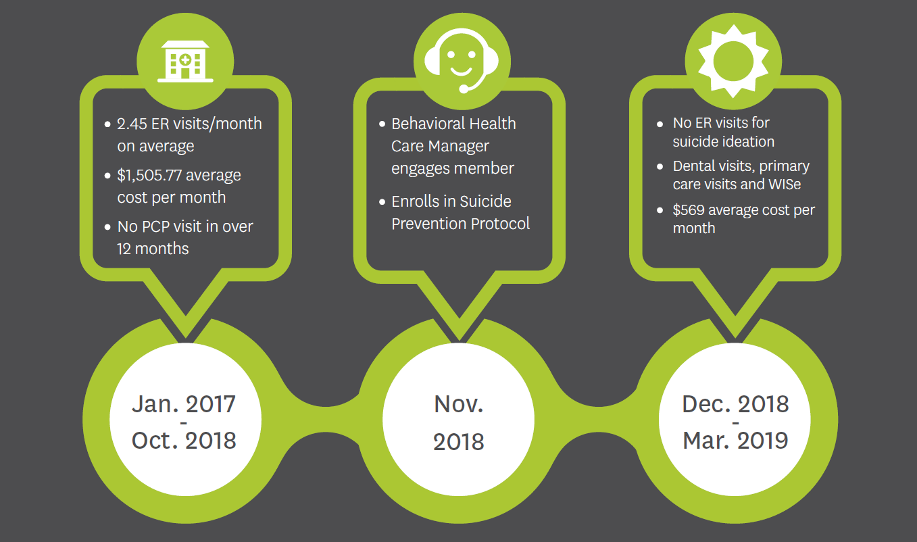
Why we do what we do
Notes:
19 years old at first outreach, now 21
Member identified through repeated visits to Emergency Room for Suicidal Ideation (self-harm behaviors including cutting)
Member had intensive physical and behavioral health needs
PCP, Dentist, Behavioral Health (WISe)
Connection is key: Four different care managers attempted to engage member with services
Once member was in the correct level of care, member was interested in engaging with Care Management
Now working full-time job, able to access outpatient BH care as needed, still in touch with Care Manager to check in

Slide 26
Challenges and Success: Key lessons learned planning & pre-launch
Communication
Strong state agency partnership
Good data
Limit carve outs
Notes:
Key lessons learned during the planning and pre-launch phases?
Key lessons learned during early implementation?
What challenges did you see?
Who supported and who opposed?
What would you have done differently?

Slide 27
Challenges and Success: Key lessons learned early implementation
Partner with state agency for training and development of program, statewide roadshows
Team Design: balance of child welfare experience and health care delivery system experience.
Focus on behavioral health care
Data risk stratification with child welfare data
Zero Suicide: Protocols, Columbia Suicide Screening
Screen for social determinants of health
Develop screening process with the state
Notes:
Key lessons learned during the planning and pre-launch phases?
Key lessons learned during early implementation?
What challenges did you see?
Who supported and who opposed?
What would you have done differently?

Slide 28
Challenges and Success: Challenges
Length of time to get things done with multiple agencies and stakeholders
Data agreements and data sharing
Contract language intent didn’t match with reality
Getting people to call us, shifting view that MCO is helpful
Role clarity with stakeholders
Notes:
Key lessons learned during the planning and pre-launch phases?
Key lessons learned during early implementation?
What challenges did you see?
Who supported and who opposed?
What would you have done differently?

Slide 29
Who Supported, Who Opposed
Bipartisan legislature support
Child welfare agency support
Medicaid agency support
Stakeholder communication and opportunities for feedback
Minimal opposition but there was some
Initial fear of managed care
Union concerns over scope of work
Regional Service Areas/County based system
Notes:
Key lessons learned during the planning and pre-launch phases?
Key lessons learned during early implementation?
What challenges did you see?
Who supported and who opposed?
What would you have done differently?

Slide 30
Challenges and Success: What would you have done differently
Data sharing implementation pre-go live
Phased in approach worked for this type of implementation
Design fully integrated program – Dental, transportation, behavioral health
Equity framework, culturally responsive programs
Staffing and leadership
Notes:
Key lessons learned during the planning and pre-launch phases?
Key lessons learned during early implementation?
What challenges did you see?
Who supported and who opposed?
What would you have done differently?

Slide 31
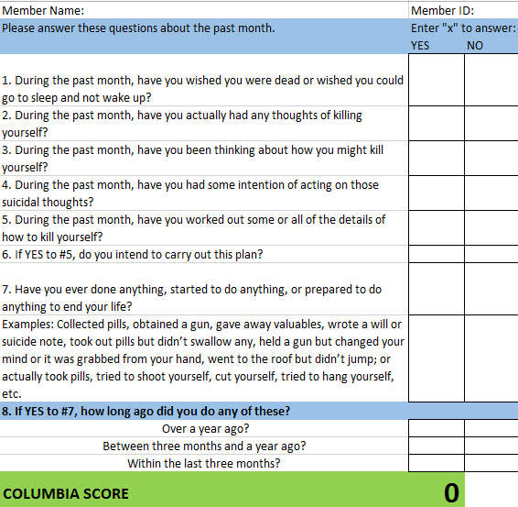
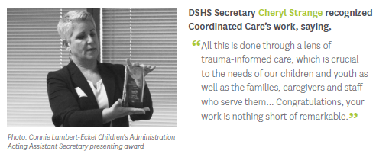
Customized Program
Notes:
A2a
SOGIE
Zero suicide
Community Education team

Slide 32
Data and outcomes
HEDIS Measures
Emergency Room Diversion
Access to Care
Number of youth receiving health care coordination
Connection to intensive BH out patient services
Notes:
What did you measure?
What outcomes have you seen to date?

Slide 33
Data and outcomes
Notes:
What did you measure?
What outcomes have you seen to date?

Slide 34
Data and outcomes
46% decrease preventable ER visits
Notes:
What did you measure?
What outcomes have you seen to date?

Slide 35
Data and outcomes
Notes:
What did you measure?
What outcomes have you seen to date?

Slide 36
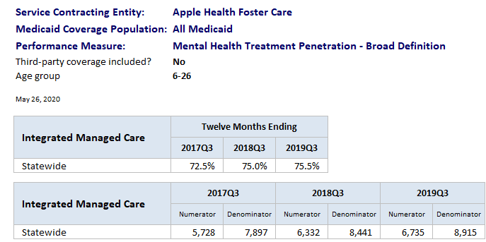
Data and outcomes
Notes:
The percentage of members with a mental health service need who received mental health services in the measurement year, including RSN/BHO services, MCO services and Medicare-paid services for dual eligibles.

Slide 37
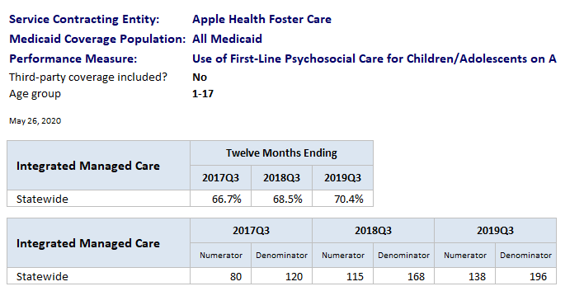
Data and outcomes
Notes:
The percentage of members with a mental health service need who received mental health services in the measurement year, including RSN/BHO services, MCO services and Medicare-paid services for dual eligibles.

Slide 38
Data and outcomes
1,379 care management
7,924 care coordination
In 2019
over 30% received Health Care Coordination

Slide 39
Data and outcomes

Slide 40
Next steps: 1 to 3 years
Building population health specific programs
Integrating into more child welfare processes
Equity

Slide 41
Next steps: Recommendations for California
Avoid carve outs
Standardization if you don’t go with statewide model
Integration medical and behavioral health
Full integration in a region at a time
Include Tribal from the beginning

Slide 42
Questions?

Slide 43
What did you see in the presentations of WA and AZ that informed your opinion about the value (or lack thereof) of a single statewide plan or “model of care?”
What are your thoughts about the value of an integrated behavioral, physical and oral health model of care?
Were there examples from WA and AZ that demonstrate a strong connection between the model of care and the needs identified by the child welfare system of children in foster care?

Slide 44
Identified Problems
Interruption of continuity and stability
Poorly defined outcomes and little accountability
Lack of data
Difficult to navigate systems
Need more coordination and integration of services for youth
Lack of capacity to meet the unique needs of foster youth: trauma, separation, and loss
Need more timely and appropriate levels of care
Inadequate focus on ensuring equity and equitable outcomes
…What else?

Slide 45
Break
Just arriving (or rejoining)?
We’re on a 40-minute break.
We will resume the meeting shortly.

Slide 46
County Behavioral Health Directors Association of California (CBHDA) County Welfare Directors Association of California (CWDA)
Joint Behavioral Health Vision for Child Welfare
Presentation to the FOSTER CARE MODEL OF CARE WORKGROUP
August 21, 2020

Slide 47
Presentation Overview
Context setting - Michelle Cabrera, CBHDA and
Cathy Senderling McDonald, CWDA
Proposal Overview - Diana Boyer, CWDA
Eligibility and Teaming - Diana Boyer, CWDA
Services - Molly Kholos, CBHDA
Additional Considerations – Molly Kholos, CBHDA
Summary/Discussion/Questions - All

Slide 48
Context Setting
CBHDA/CWDA Proposal:
A visionary document for serving children, youth and families who are impacted by abuse, neglect and exploitation.
Informed by growing body of research on the impacts of childhood trauma and exposure to toxic stress.
Maps out a full continuum of services from prevention to intensive intervention. Services follow the child/family from “start to end”.
Necessary if we are to achieve Continuum of Care Reform goals and improve child, youth and family outcomes.

Slide 49
Proposal Overview
Addresses:
The “who”: Eligibility and who should receive services
The “what”: What services should individuals have access to.
The “how”: Manner that we identify services to deliver and reduce barriers to those services.
CWDA and CBHDA propose:
“Automatic eligibility for child welfare system-involved children and youth and their families to a minimum, mandatory set of behavioral health services.”

Slide 50
Eligibility
Automatic eligibility for children/youth served by the child welfare system to receive Specialty Mental Health Services (SMHS) and Substance Use Disorder (SUD) Services.
This would include:
Children/youth who come into foster care (under juvenile court order) and who are served by a child welfare or probation agency.
Children/youth 6 months post-permanency (reunification, guardianship or adoption).
“Candidates” for foster care under the “imminent risk” definition per FFPSA*
*Families First Prevention Services Act (FFPSA) – Federal legislation approved in 2018 that permits states to serve children and their families who are at risk of foster care using foster care funding for direct services designed to prevent foster care entry.

Slide 51
Eligibility
Candidacy definition (pending definition under FFPSA):
A child who is identified as being at imminent risk of entering foster care, but who can remain safely at home as long as prevention services are provided.
“Imminent Risk” may be determined by the caseworker based upon an in-person assessment and includes one or more of the following criteria:
The child’s risk assessment score is high or very high or the child’ safety assessment indicates the presence of at least one safety threat.
The child has one or more siblings or half-siblings placed into foster care.
The child’s adoption or guardianship arrangement is at risk of a disruption or dissolution that would result in a foster care placement.
The youth is a nonminor under the age of 21 who is eligible for extended foster care, and their living arrangement is at risk of a disruption that would result in the youth re-entering foster care.
Other criteria includes referral from a tribe if the child is an Indian child, if the child is under the supervision of a juvenile court pursuant to a Section 300 petition and under a family maintenance plan, and if the probation department has determined that a child subject to a Section 602 petition needs prevention services to prevent the child’s entry into foster care.

Slide 52
Eligibility
“Family” also entitled to behavioral health services. Family includes:
Resource parents (including relative caregivers)
Birth families (including siblings and half-siblings)
Other caring adult who is a significant support to the foster child/youth, and
Any other non-related persons with an established relationship that is reasonably considered family by the person served.
Because Medi-Cal is a provider of last resort, any privately insured individual will not be automatically eligible for Medi-Cal services covered by their private insurance. Service and payment alignment will require further discussion.

Slide 53
Eligibility
“Automatic Eligibility”
Child/youth/NMD is eligible for services no matter what - a “diagnosis” of impairment is not a pre-condition to eligibility.
Recognizes that every child who is served by the child welfare services system has experienced a significant enough degree of trauma that they meet the new standard for medical necessity, as proposed under CalAIM.
A diagnosis will still be determined to inform clinical treatment needs, but it is not the precursor to obtaining services.
All children will receive some type/level of services based on a more complete, team-based assessment that will be described next.

Slide 54
Services
Broadest range of services based on individualized needs.
A continuum of services that includes:
resiliency building and wellness-oriented services to prevent the onset of behavioral health issues later
primary intervention services that include clinical therapies
embraces “full-service partnership” efforts that embody a “do-whatever-it-takes” approach to child safety, permanency and well-being.

Slide 55
Services
Model builds upon work underway:
Integrated Core Practice Model
Katie A. Settlement Agreement/Continuum of Care Reform Efforts
Strengthening Families/Youth Thrive Frameworks
AB 2083 Interagency Coordination
Team-based services begin immediately upon “entry” to CWS services.
For timely identification of service needs and access to services.
Not waiting for behaviors to manifest first.
Reduces likelihood of more intensive, higher cost interventions later.

Slide 56
Services
Team-Based services through a broadened ICC (Intensive Care Coordination) effort:
Team includes both CWS social worker and a behavioral health specialist/case manager
BH specialist/case manager can serve as the ICC coordinator to work with the Child and Family Team to coordinate services.

Slide 57
Services
Team Responsibilities:
BH/CWS “team” engages with the family within 30 days of coming to CWS attention via the CPS Hotline.
Provides immediate and on-going engagement of the youth and caregivers throughout the life of the case & “on demand” clinical or supportive services as warranted in home-based settings.
Continuous screening and joint assessments to inform the CANS as part of the CFT discussions and link to clinical and resiliency-building services.
Assist CWS social workers in case plan development.
Ensuring linkage to clinical and non-clinical services/supports.

Slide 58
Resiliency Building / Wellness Oriented Services and Support
Trauma Informed-Resiliency Building Therapeutic Services
Programs must be trauma informed, culturally responsive and evidence based
Examples: 3-5-7 Model, Parent/Child Interactive Therapy, Trauma-Focused Cognitive Behavioral Therapy, Functional Family Therapy, Multi-Systemic Therapy, etc.

Slide 59
Expansion of Medi-Cal Specialty Mental Health Services (SMHS)
Individual Child and Family Therapy
Provide within the home/community (if client is comfortable with the setting)
Create flexibilities to deliver this services to the caregivers, parents and family members, with or without the child/client present.
Therapeutic Behavioral Services (TBS)
Expand eligibility criteria
Include less intensive, coaching services within TBS
Intensive Home-Based Services (IHBS)
Expand eligibility criteria, such as for “candidates” of foster care
Z & V Billing Codes

Slide 60
Program Models / Best Practices
Therapeutic Relationship- Building Services for Families
Provided to a parent or caregiver who needs interventions to strengthen their ability to engage and respond to their child
Family Reunification Partnership (FRP) Program
Fully integrated Behavioral Health and Child Welfare approach targeted for children, youth and families in reunification
Adopt Full -Service Partnerships and Wraparound Programs for Child-Welfare Linked Populations
Increase Peer Support – Youth and Parent Partners

Slide 61
Substance Use Disorder (SUD)
SUD Evaluation
Ensure that CFT/CANS includes SUD evaluation at the forefront for the child/youth, caregiver and parent
Increase integration and coordination for those children, youth and caregivers with mental health, SUD and, co-occurring MH and SUD treatment needs
Additional funds should be allocated to build out this system of care to provide all necessary SUD services to child welfare linked populations

Slide 62
Intensive Needs Youth – Acute Care Delivery
Explore alternate funding and program models for high needs children/youth
Ensure suitable treatment and facility types are available for those with acute needs such as, Commercially Sexually Exploited Children (CSEC), those with SUD treatment needs and those with co-occurring developmental delays and mental health needs

Slide 63
Additional Considerations
Workforce, Training and Funding:
Workforce:
Prioritize capacity building in partnership with counties.
Must be culturally-responsive and reflective of the diversity of the population.
Include para-professionals including peer advocates.
Training: Support cross-training of CWS and BH staff.
Funding: Additional investments will be necessary to support staffing and services envisioned in this proposal. Further discussion needed to quantify.

Slide 64
Summary/Discussion/Questions
Summary of Key Elements:
Automatic eligibility to SMHS for child-welfare involved children, youth and caregivers
Teaming between CWS and BH from ‘start to end’
Full continuum of services, including resiliency-building prevention services to more intensive services
Commitment to build workforce and capacity and funding for services
Builds toward full realization of CCR goals to reduce congregate care use and increase support for placements with relatives and in the most family like settings possible.
Discussion & Questions

Slide 65
What would it take for individual county plans to achieve the state-wideness and continuity of care potentially achieved under a single statewide plan?

Slide 66
Next Steps

Slide 67
Transition to Public Comment Period

Slide 68
Thank you for joining the Public Comment Period
Please raise hand to be put in comment queue
We will call on you and you will have 2 minutes to comment. Please unmute yourself only when commenting to eliminate noise.
You may also comment via chat or by emailing CalAIMFoster@dhcs.ca.gov

Slide 69
2 Minute Timer

