Slide 1


Slide 2
Converting Vineyards to Mechanical Management
S. Kaan Kurtural, Associate Specialist, Cooperative Extension Viticulture, UC Davis Dept of Viticulture & Enology
Greg Gonzalez, Director of Vineyard Operations, Scheid Family Wines

Slide 3
S. Kaan Kurtural
Associate Specialist, Cooperative Extension Viticulture, UC Davis Dept of Viticulture & Enology

Slide 4
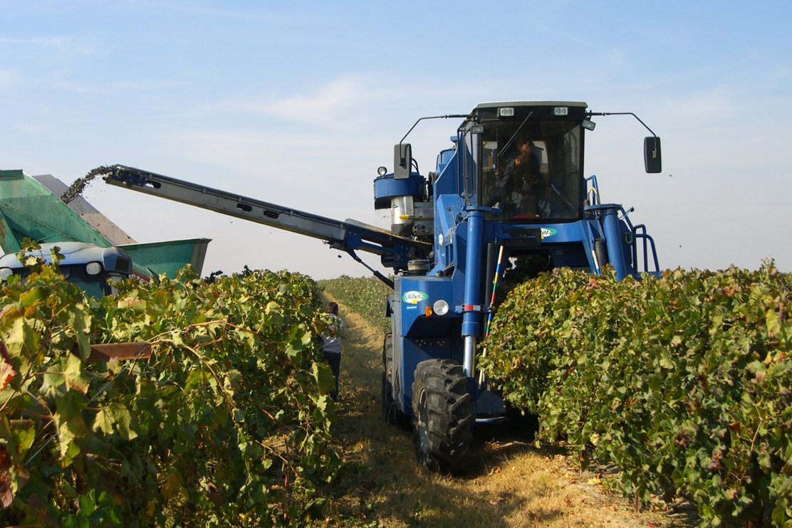

Driving Factors for Mechanization and Mechanical Management
Mechanization
  Timeliness of cultural practices
  Willing labor force
  Cost of labor ($15/h)
  Quality of life socioeconomic factors
  Proximity to population centers
  Land availability and cost
  Foreign competition

Slide 5
Evolution towards spatio-temporal management of vineyards
Uniform
vineyard and
soil management
Zone
vineyard and
soil management
Site-specific
vineyard and
soil management
Bulk or composite
vine and
soil sampling
Stratified random
sampling within
zone
Fine grid
sampling or
sensing/scanning

Slide 6
What can we do in vineyards mechanically?
 | Wine | Raisin | Table
Harvesting | 90 | 35 | -
Pruning
Pre-prune | 65 | 5 | 30
Box-hedge | 12 | - | -
Canopy Mgt
Leaf removal | 45 | - | 10
Shoot thinning | 7 | - | -
Hedging | 100 | 100 | 100
Shoot positioning | 2 | - | -
Crop load Mgt
Fruit removal | 7 | - | -
Dormant pruning *
Suckering
Shoot thinning *
Leaf removal *
Berry/cluster thinning *
Harvest

Slide 7
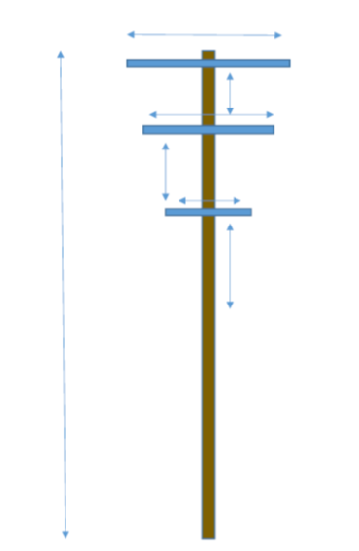
Shift towards non-positioned conduction systems
The UCDavis60 Trellis

Slide 8
Mechanical cultural practices and trellis type adaptability
 | California sprawl | VSP | Quadrilateral | Single high wire | Head-trained
Pre-pruning | +++ | ++++ | +++ | ++++ | -
Final pruning | ++ | ++ | +++ | ++++ | -
Shoot thinning | ++ | ++ | ++ | ++++ | -
Leaf removal | ++ | ++++ | ++ | ++++ | ++
Berry/cluster thinning | ++ | ++ | + | ++++ | +
Trunk suckering | +++ | +++ | ++ | ++++ | +
Harvest | +++ | ++++ | +++ | ++++ | -

Slide 9
Trellis Systems used in California for High Efficiency Mechanical Production
Singe high wire system
62 to 66 inch tall
Single canopy
Non-shoot positioned
~35% exposed leaf area
Production in 18 months
11 to 24 t/A in 7 ft x 10 ft plant density
High Quadrilateral System
68 inch tall
Divided canopy
  36 to 48 inch cross-arm
Non-shoot positioned
~70% exposed leaf area
Production in 18 months
14 to 32 t/A in 6 ft x 11 ft plant density

Slide 10
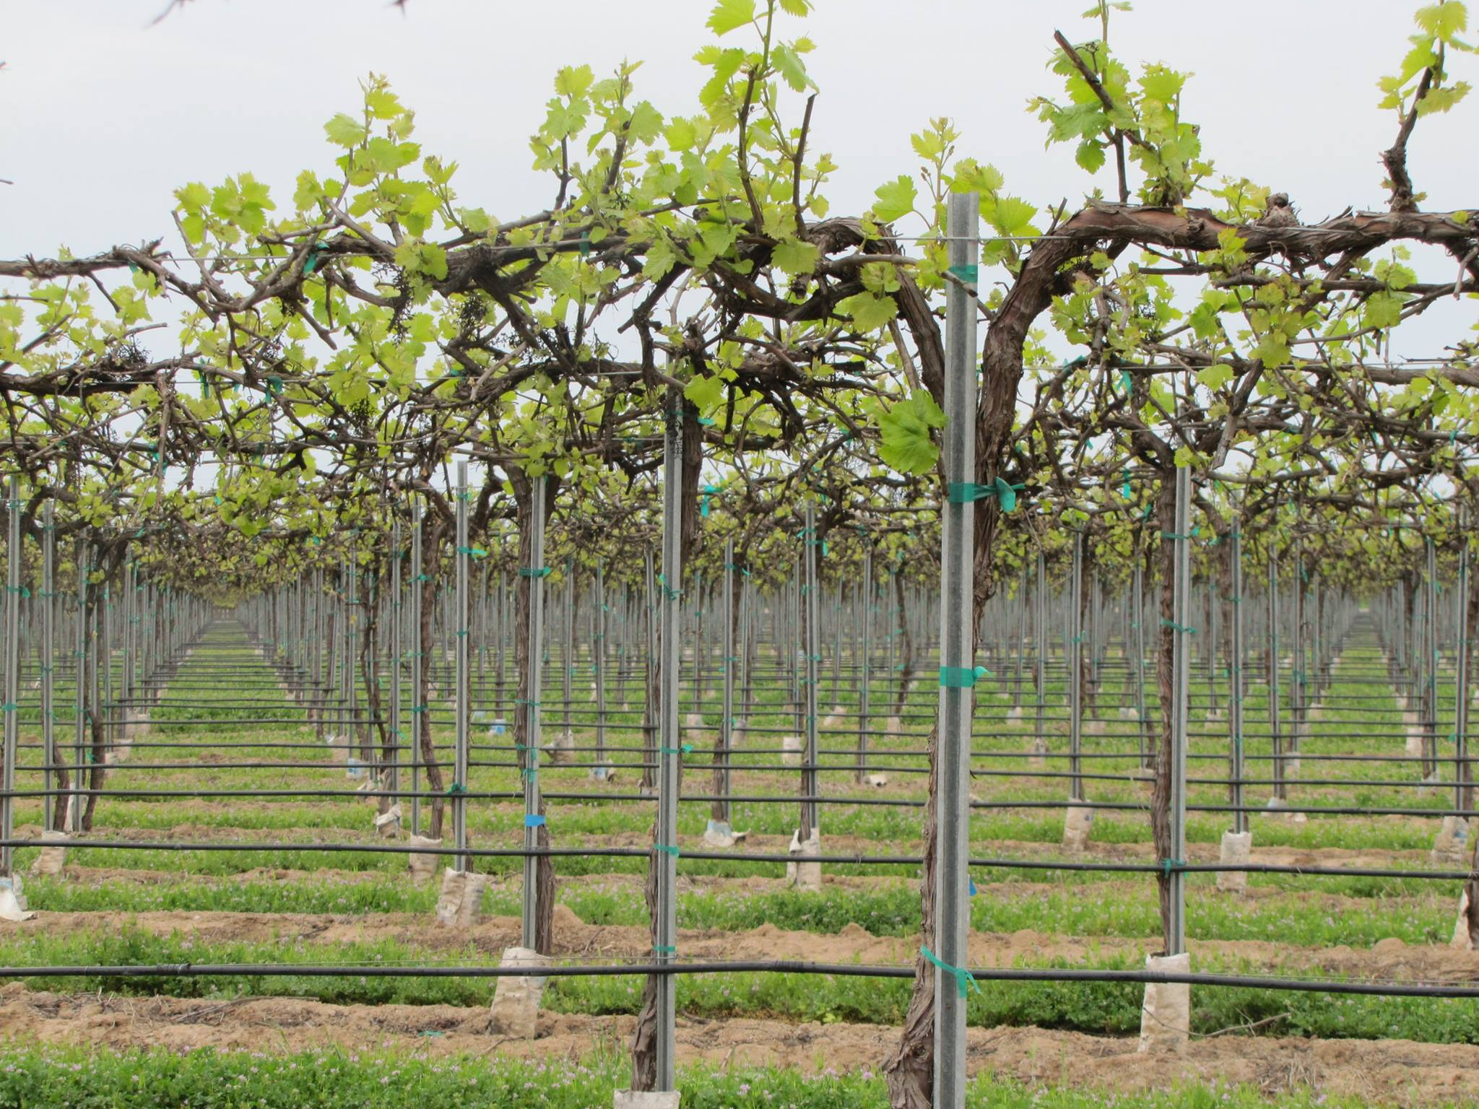
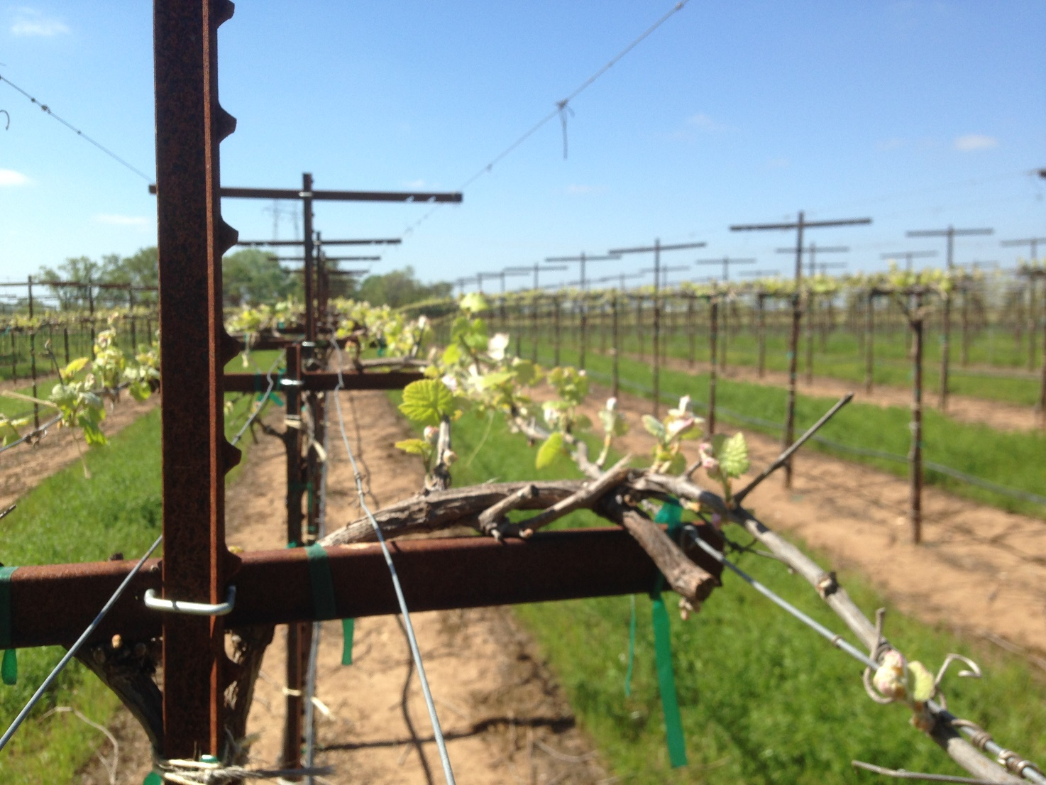
High efficiencyproduction systems
Single high-wire
High quadrilateral

Slide 11
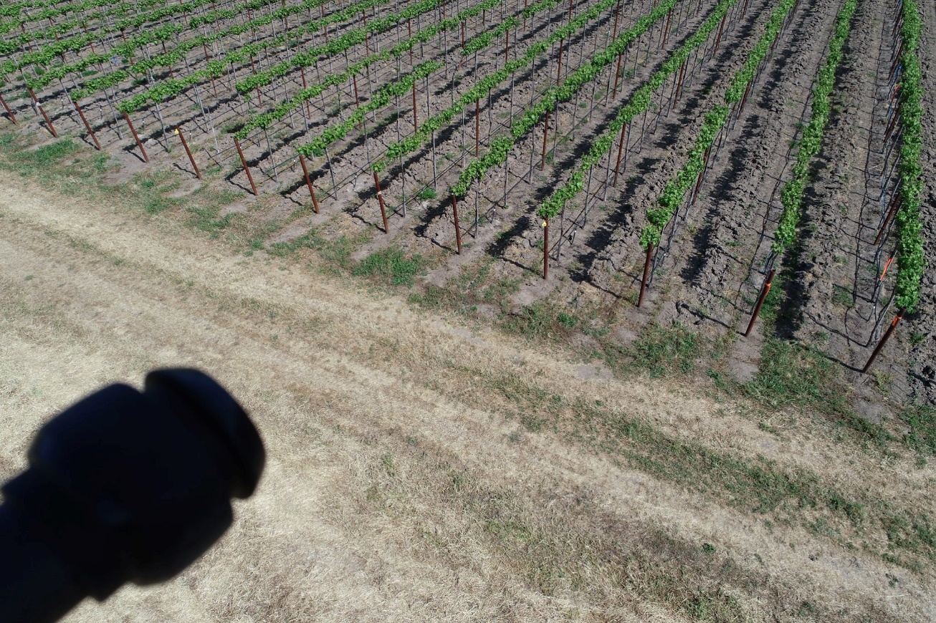
No-touch vineyard at Oakville
Planted 2016
First crop in 2018
Single high wire system
100% mechanically managed
5 ft x 6 ft 4” spacing
Cabernet Sauvignon/C3309

Slide 12
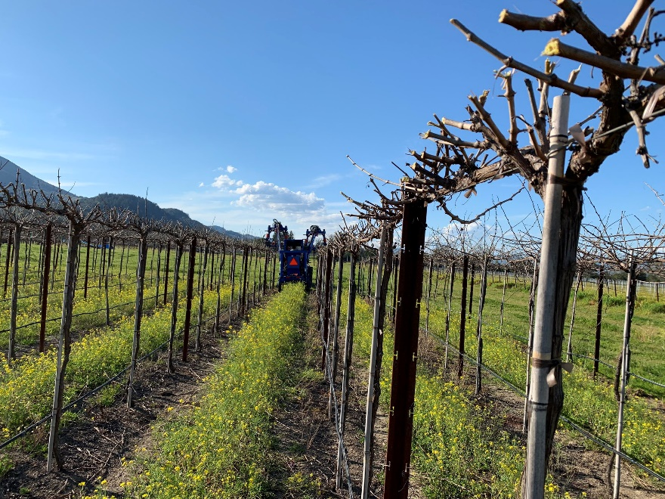
Dormant Pruning
Achieved mechanically
4-inch hedge
One-pass, final pruning
Bearing height based on previous year crop load (~ 8 lbs fruit/1lbs pruning wt)

Slide 13
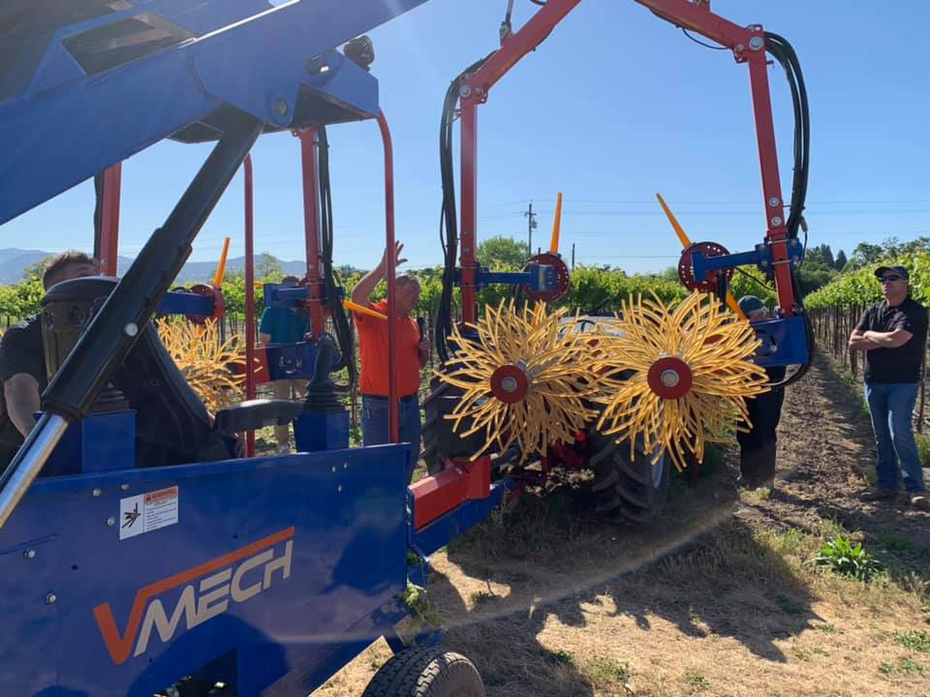
Shoot removal
Achieved mechanically
Applied at 6 inch to 8 inch stage
Main goal to control cropping
About 30% of shoots removed mechanically

Slide 14
Yield averages 2009-2011 (Syrah/1103 P)
Canopy Management | Berry wt(g) | Cluster wt (g) | Yield (T/A)
HP | 1.33 a | 189 a | 7.0 b
5 shoots/ft | 1.30 ab | 151ab | 8.3 c
7 shoots/ft | 1.26 b | 148 c | 12.1 ab
15 shoots/ft | 1.20 c | 137 d | 15.0 a
P | 0.0191 | 0.0008 | 0.0006
RDI
SDI | 1.35 a | 172 a | 14.0 a
RDIE | 1.13 b | 126 b | 12.1 b
RDIL | 1.33 b | 172 a | 13.9 a
P | 0.0001 | 0.0001 | 0.0001
CM x RDI | 0.0802 | 0.0499 | 0.6897

Slide 15
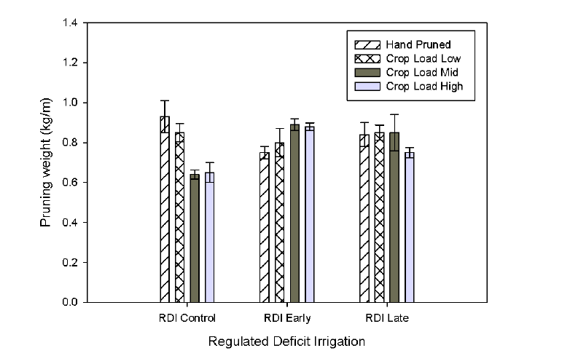
Pruning weights
Terry and Kurtural 2011

Slide 16
Effects of shoot density on berry chemistry of Syrah/1103P
Terry and Kurtural 2011

Slide 17
Red Wine Flavor Indicators
IBMP (green flavor)
B-damascenone (jammy, fruity flavor)
Brillante et al. 2018

Slide 18
Three year cost and net farm income of converting a Merlot vineyard to complete mechanization in California
Kurtural et al. 2019
https://journals.ashs.org/horttech/view/journals/horttech/29/2/article-p128.xml?rskey=NsLScA

Slide 19
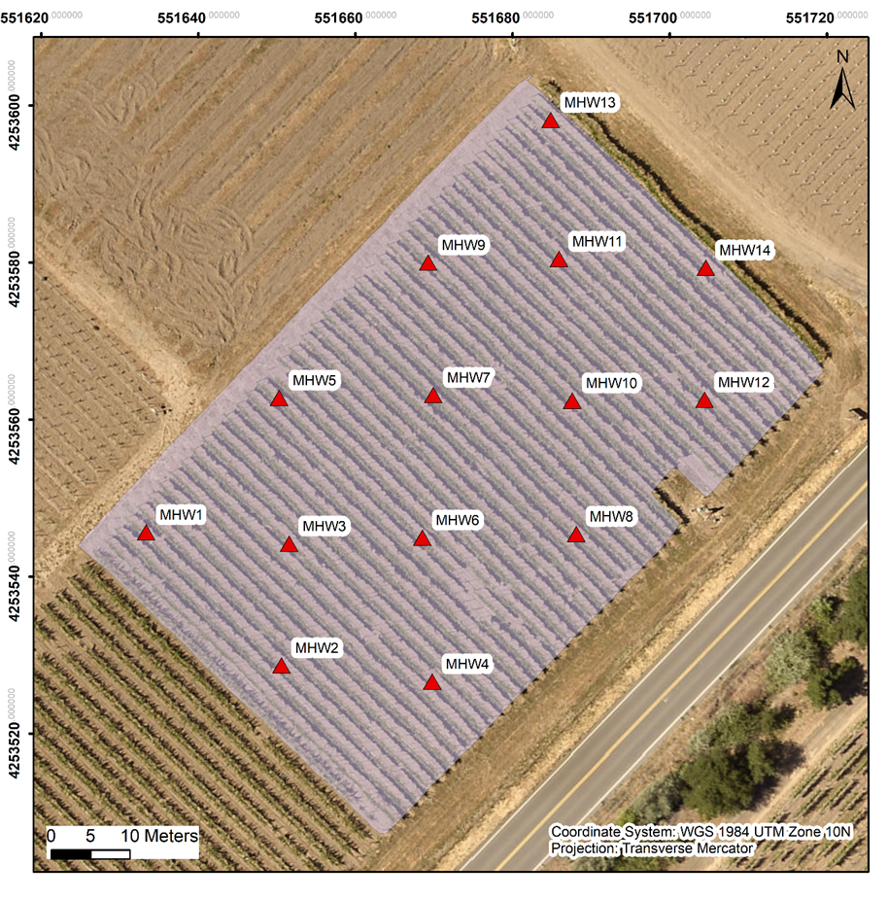
No-touch vineyard at UC Davis- Experimental design and on-site measurements
An equidistant 30 m × 30 m grid to sample and collect on-site measurements (14 experimental units, and 3 vines in each unit).
Soil pedology
Plant physiology
  Plant water status by Ѱ_{stem}
  Leaf gas exchange
  Yield components at harvest
Berry primary metabolism
  Total soluble solids, titratable acidity, pH
Berry secondary metabolism
  Berry skin flavonoids
Notes:
An equidistant 30 m × 30 m grid was used to sample and collect on-site measurements. There are 14 experimental units, 3 vines in each experimental unit included in this study.
Soil pedology samples, plant water status, leaf gas exchange, yield components, berry primary and secondary metabolisms were all taken from these 14 experimental units.

Slide 20
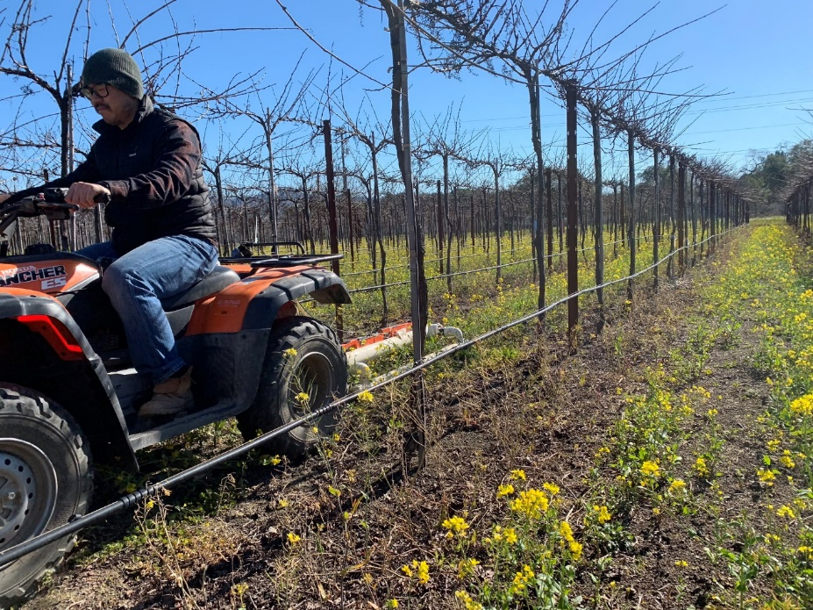
Materials and methods - Soil spatial variability assessment
Geonics EM38 was used in both vertical dipole mode and horizontal dipole mode to assess two depths:
  0.75 - 1.50 m - Deep EC
  0 - 0.75 m - Shallow EC
Geospatial analysis in R, including packages:
  gstat 1.1-6
  automap package 1.0-14
  NbClust, v3.0
Notes:
For the soil proximal sensing, we used device Geonics EM38 to measure soil EC in both shallow soil (from 0 to 0.75 m) and deep soil (from 0.75 to 1.5 m).
The instrument was placed on a PVC sled at an about 15 cm height above the ground, and pulled by an ATV along the inter-rows. The data was recorded by a datalogger, it made it possible to measure the whole vineyard continuously.
Then, these data will be processed by the geospatial tools in R, including gstat, automap, and NbClust to perform variogram fitting, kriging, and k-means clustering all those good stuff.

Slide 21
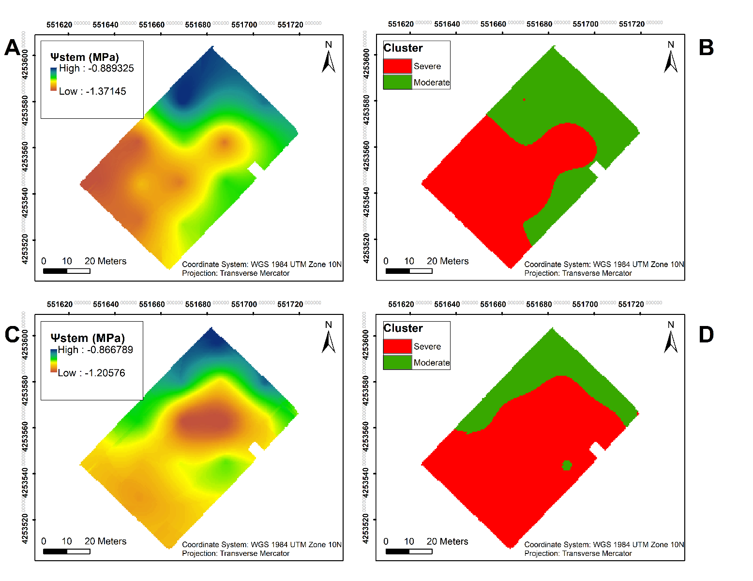
Results - Vineyard zoning by plant water status
The vineyard was delineated into two clusters by k-means clustering based on Ψ_{stem} integrals, including a severely water stressed zone and a moderately water stressed zone.
The separation described 70.8% in 2018 and 67.8% in 2019 of the variability in the plant water status according to the result of between sum of squares/total sum of squares.
73.2%
(A) Ψstem kriging map in 2018; (B) k-means clustering of stem water potential integrals in 2018; (C) Ψstem kriging map in 2019; (D) k-means clustering of stem water potential integrals in 2019.
Notes:
The vineyard was delineated into two clusters by k-means clustering on the interpolation maps from Ψ_{stem} integrals for the each season.
There were two zones generated, including a severely water stressed zone and a moderately water stressed zone.
The separation described 70.8% in 2018 and 67.8% in 2019 of the variability in the plant water status.
A clear pattern was evident in 2018, where most of the southwestern section showed more negative Ψ_{stem} values than the rest of the vineyard. In 2019, a larger area in the central section of the vineyard had more negative Ψ_{stem} values.
Comparing the clusters of both years, there was a 73.2% similarity between 2018 and 2019.

Slide 22
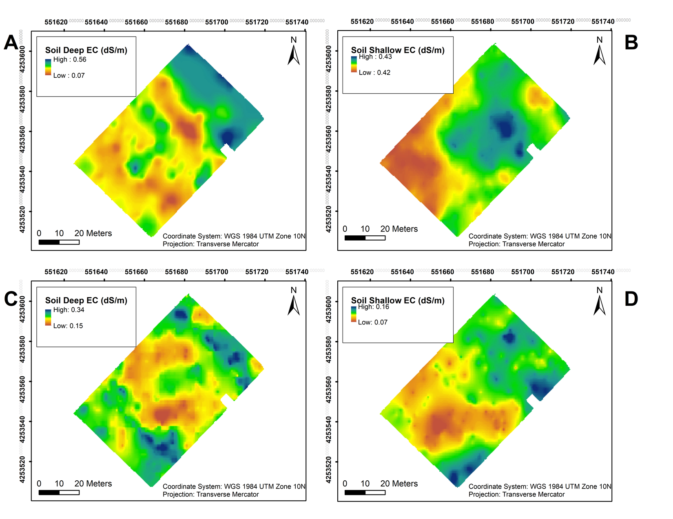
Results - Soil EC
In 2018
  Deep soil: EC values in were lower in the southwestern section as well as the central section of the vineyard.
  Shallow soil: lower EC values in the southwestern section of the vineyard .
In 2019
  Deep soil: EC values were lower only in the central section of the vineyard.
  Shallow soil: lower EC values were observed in the southwestern section of the vineyard.
(A) Deep EC in 2018, (B) shallow EC in 2018, (C) deep EC in 2019, (D) shallow EC in 2019.
Notes:
For soil EC. In 2018, EC values in deep soil were lower in the southwestern section as well as the central section of the vineyard. Shallow soil showed lower EC values in the southwestern section in 2018.
However, EC values in deep soil were lower only in the central section of the vineyard in 2019. A similar trend was evident in the shallow soil in 2019 as observed in 2018, where lower EC values were measured in the southwestern section of the vineyard.

Slide 23
Results - Yield components
Table 2. Yield components at harvest of Cabernet Sauvignon as separated by plant water status zoning in Oakville, CA in 2018 and 2019 ª
 |  | Cluster no. per vine | Cluster weight (g) | Yield per vine (kg) | Berry weight (g) | Skin weight (g) | Berry no. | Leaf area (m²) | Leaf area/fruit (m²/kg)
2018 | Severe Water Stress ± SD | 110.22 ± 19.32 | 80.03 ± 16.69 | 8.45 ± 1.08 | 1.14 ± 0.07 b | 0.05 ± 0.00 b | 7387.6 ± 894.48 | 4.51 ± 1.09 | 0.55 ± 0.19
 | Moderate Water Stress ± SD | 98.57 ±26.78 | 90.71 ± 9.88 | 8.82 ± 2.15 | 1.29 ± 0.05 a | 0.06 ± 0.01 a | 6930.9 ± 1783.45 | 4.33 ± 0.59 | 0.51 ± 0.10
 | p value | ns | ns | ns | 0.001 | 0.014 | ns | ns | ns
2019 | Severe Water Stress ± SD | 78.19 ± 17.02 | 61.35 ± 9.04 | 4.77 ± 1.18 | 0.98 ± 0.09 | 0.07 ± 0.01 | 5058.34 ± 1304.35 | 5.72 ± 0.93 | 1.26 ± 0.36
 | Moderate Water Stress ± SD | 89.53 ± 21.95 | 67.01 ± 5.45 | 5.96 ± 1.31 | 1.03 ± 0.06 | 0.07 ± 0.01 | 5825.56 ± 1549.39 | 5.86 ± 0.62 | 1.01 ± 0.14
 | p value | ns | ns | ns | ns | ns | ns | ns | ns
Year |  | 0.01571 | < 0.0001 | < 0.0001 | < 0.0001 | < 0.0001 | < 0.0001 | ns | < 0.0001
Year × Zoning |  | ns | ns | ns | ns | ns | ns | ns | ns
ª ANOVA to compare data (p value indicated); Letters within columns indicate significant mean separation according to Tukey's HSD test.
Notes:
As for yield components between the two zones, there were very few differences observed.
Only berry weight and berry skin weight were greater in the moderately water stressed zone were observed in 2018.
Although there was no difference between the two zones, cluster number per vine, cluster weight and yield per vine was lower in the second season compared to the first, and leaf area to fruit ratio was higher.

Slide 24
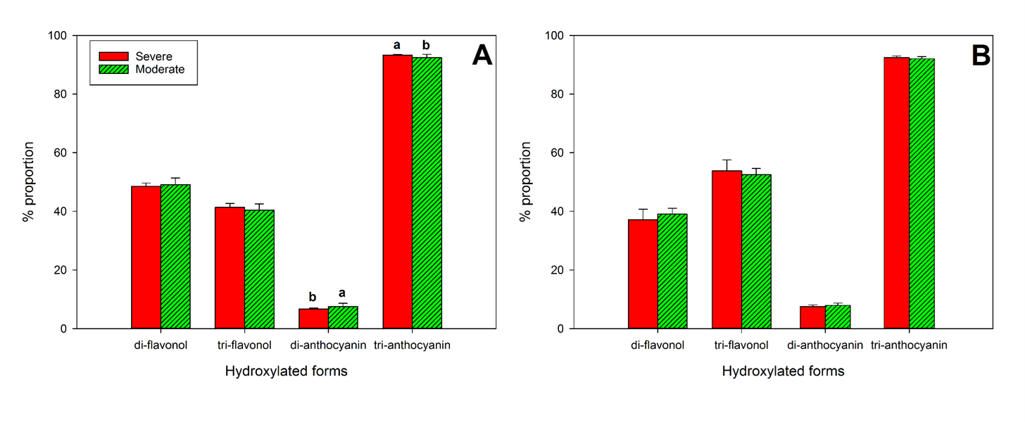
Flavonol and anthocyanins
2018
2019
Notes:
In 2018, there was no difference in di-, tri- hydroxylated flavonols.
There was higher proportion of tri-hydroxylated anthocyanins in the severely water stressed zone compared to the other zone, di-hydroxylated anthocyanin proportion was lower.
In 2019, there were no differences between the two water status zones in either flavonol or anthocyanin hydroxylated forms.

Slide 25
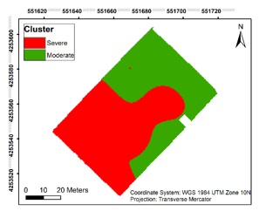
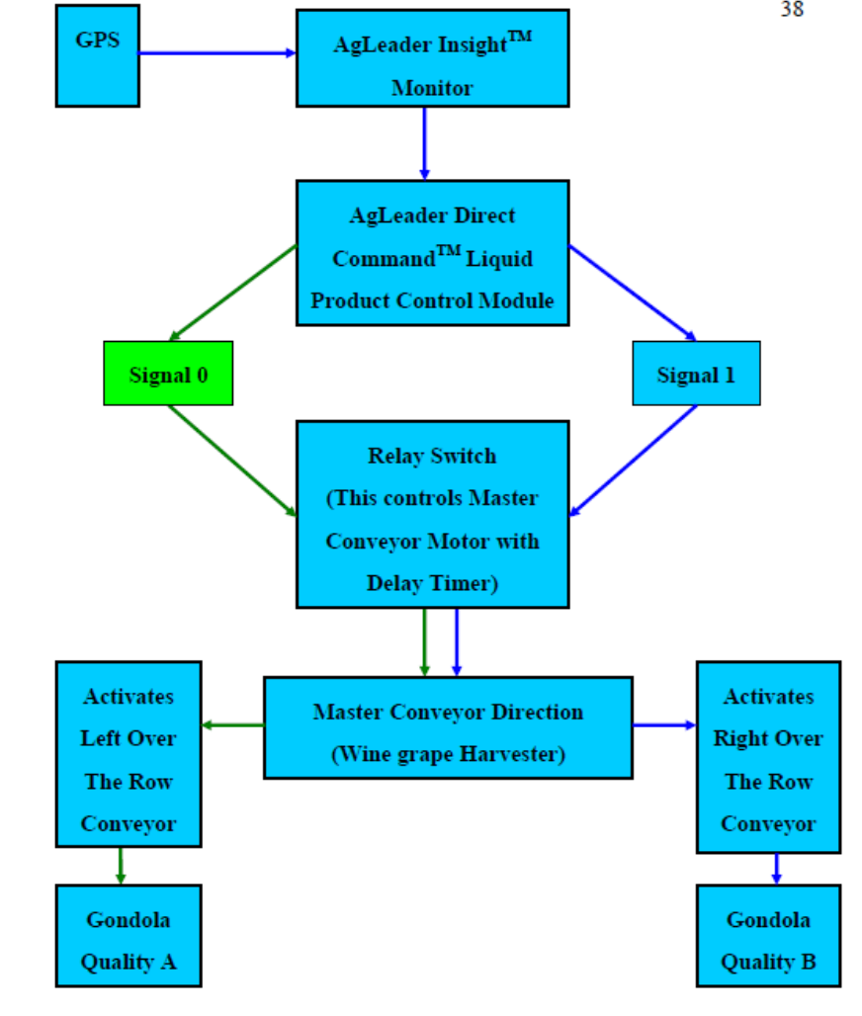
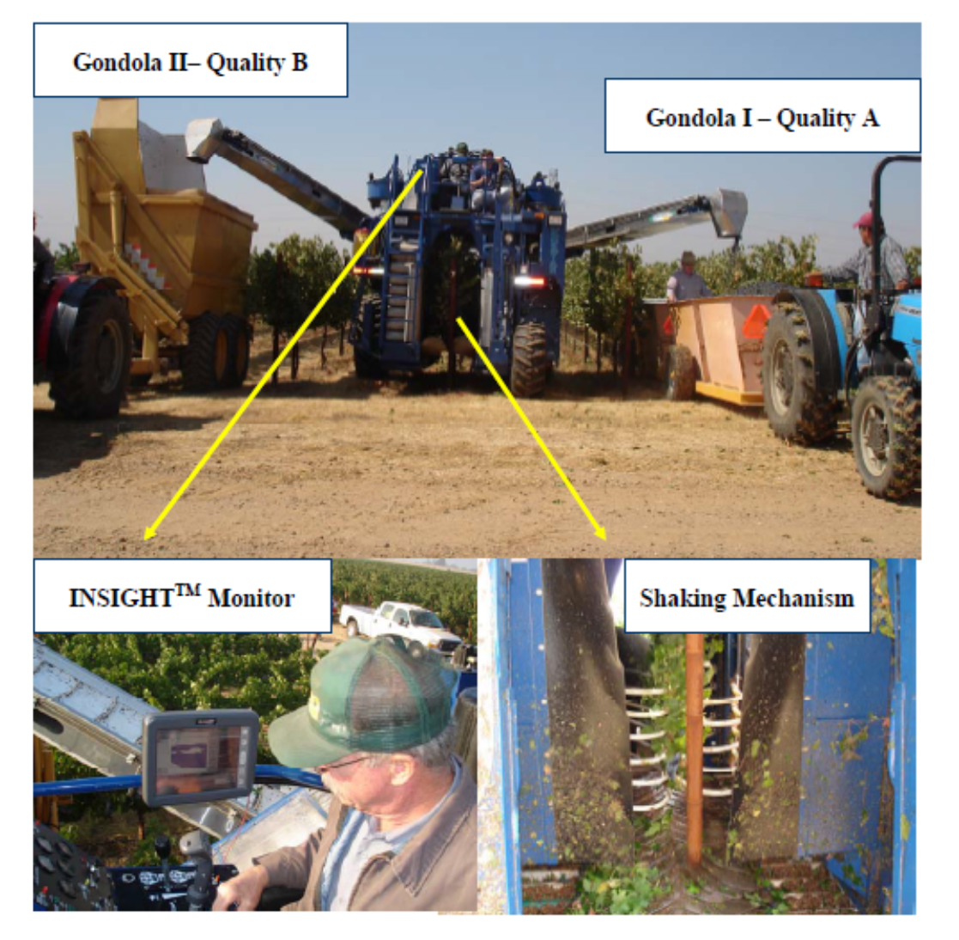
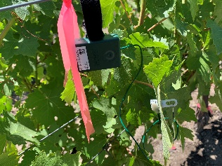
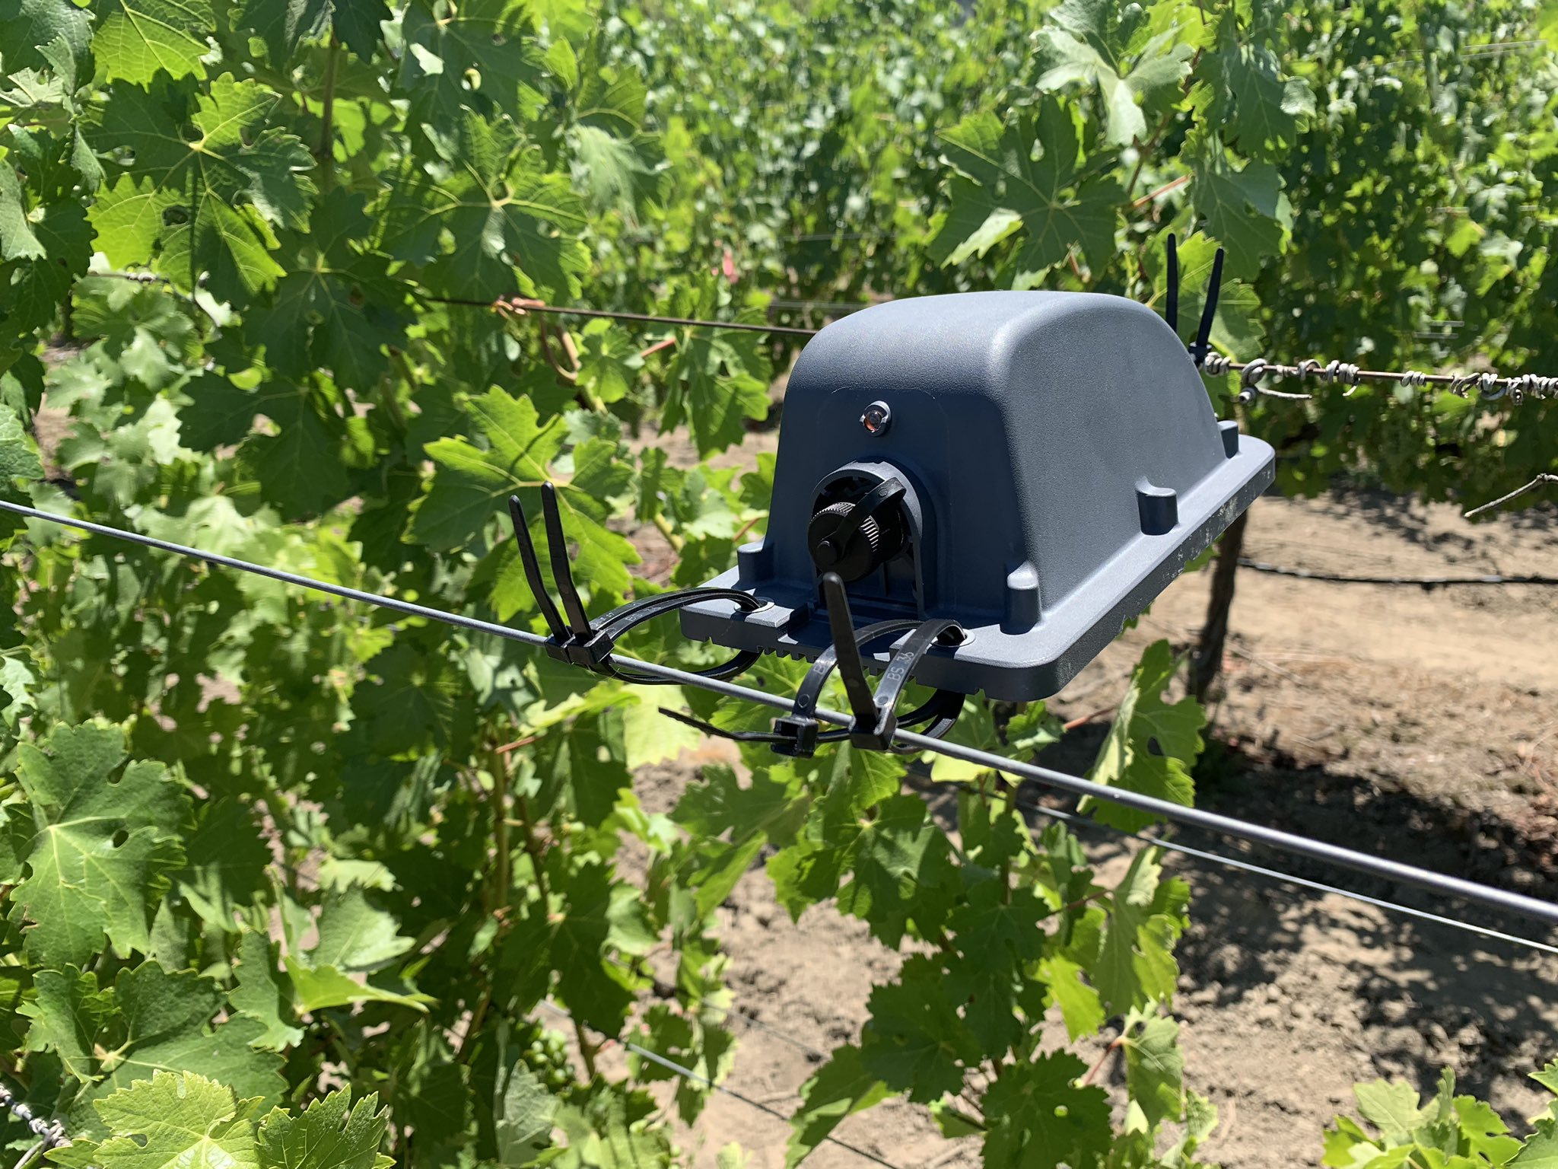
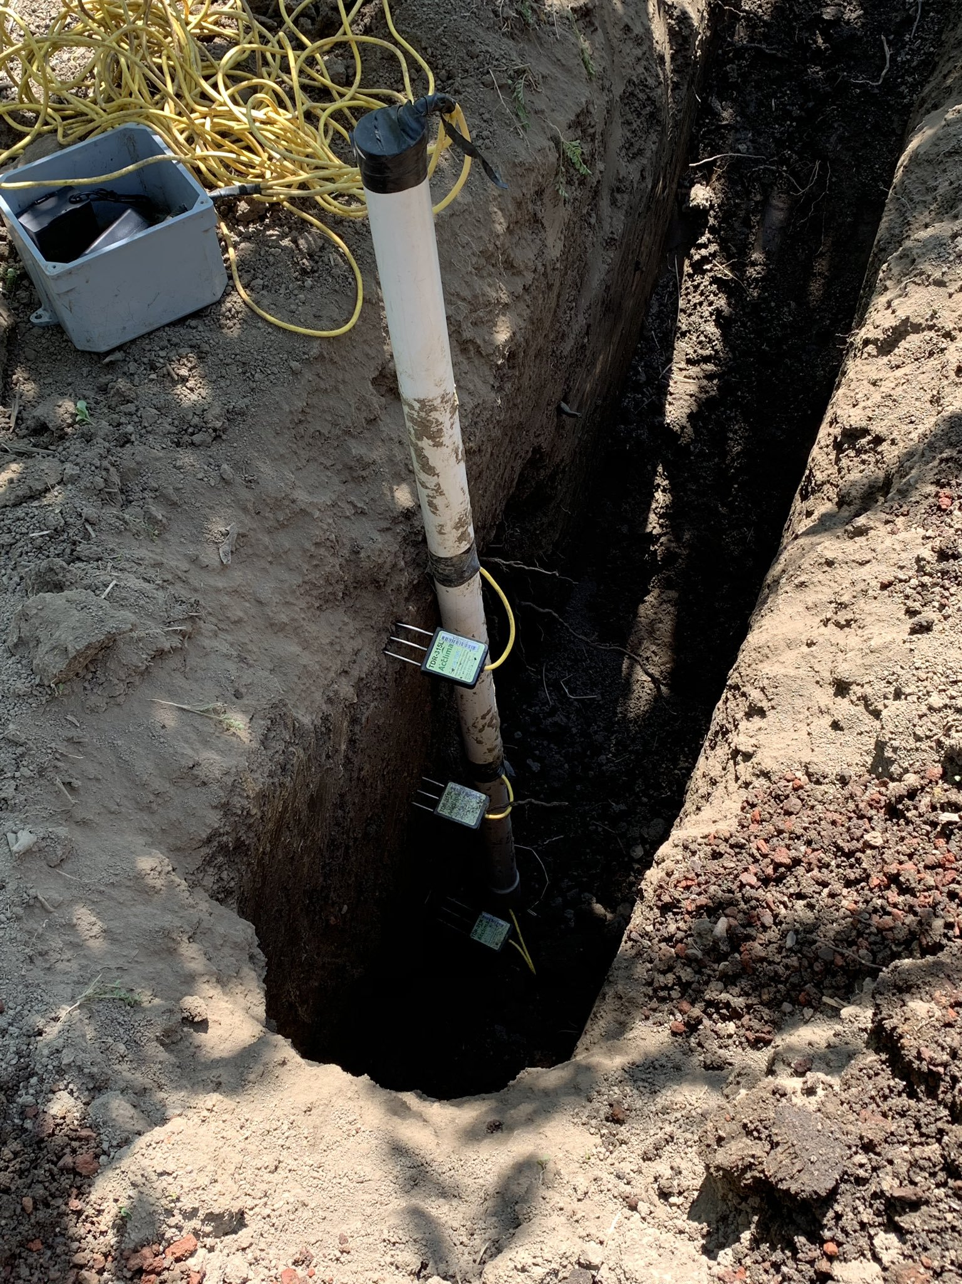
Perspective and future work
Selective harvest by mechanical means
Variable irrigation delivery
Continuously monitoring soil water/salinity by TDR sensors
Smart point monitoring via wireless mesh networks
Notes:
Based on this study, we can apply selective harvest prior to winemaking to minimize the difference in berry chemistry.
Or, based on the difference in plant water status, variable irrigation regimes can be applied to different sections of the vineyard to homogenize water availability to plants.
Also, for the variability we observed in soil, we hypothesized that soil water content is the main factor affecting soil bulk EC. So we are currently ground-truthing this in order to explain what is exactly happening in our vineyard soil in terms of linking plant available water to bulk EC.
By that, it might be possible to choose just a few smart points for bulk EC and soil water content monitoring once the delineation is established to have a good estimation of plant water status.

Slide 26
Thank you for your attention
S. Kaan Kurtural
University of California Davis
skkurtural@ucdavis.edu

Slide 27
Greg Gonzalez
Director of Vineyard Operations, Scheid Family Wines

Slide 28
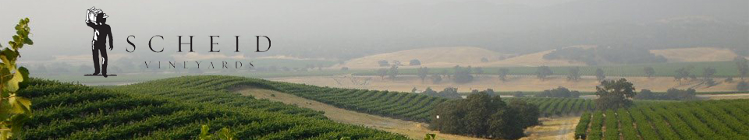
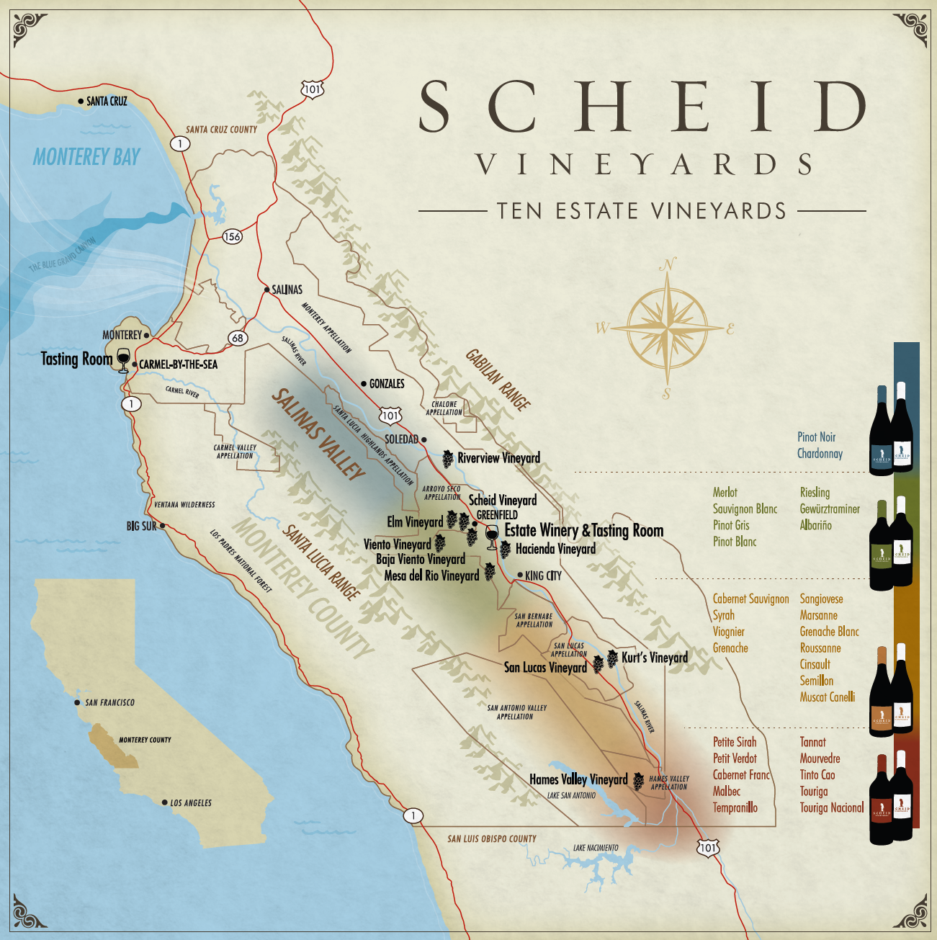
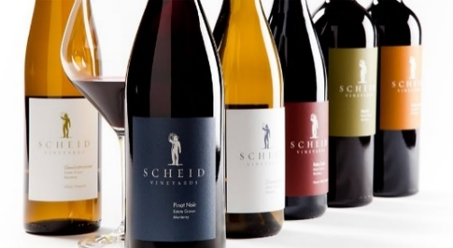
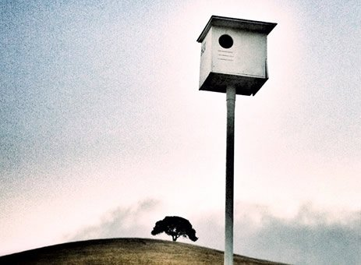
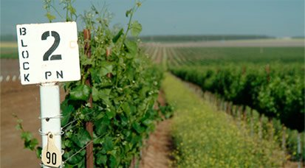
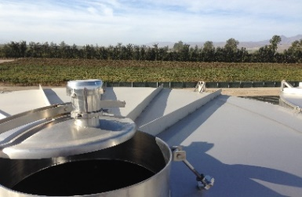
Who We Are
SCHEID BY THE NUMBERS:
Estate Vineyards | 10
Acres | 4,000
Distance from North to South (in miles) | 70
AVAs | 4
Varietals Planted | 39
Clones of Pinot Noir | 20

Slide 29
Continuous improvement through the modernization of traditional viticulture fundamentals by the implementation and use of technologies to maximize operational efficiencies while enhancing vine production and quality.​
Sustainable Vision

Slide 30
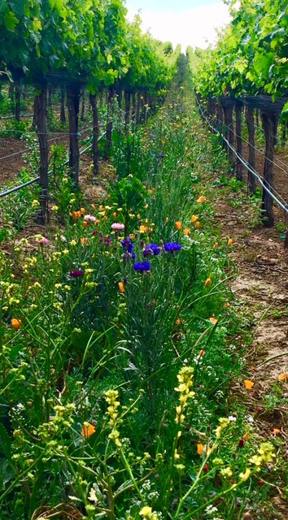

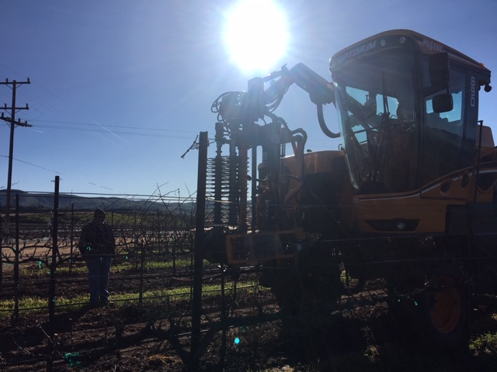
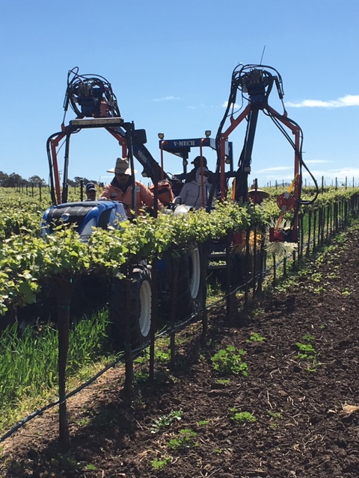
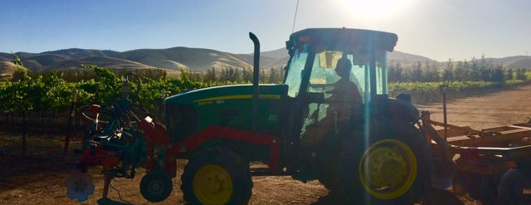
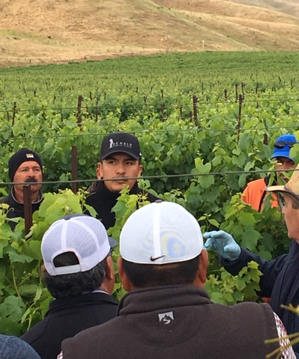
Sustainability = Precision Agriculture

Slide 31
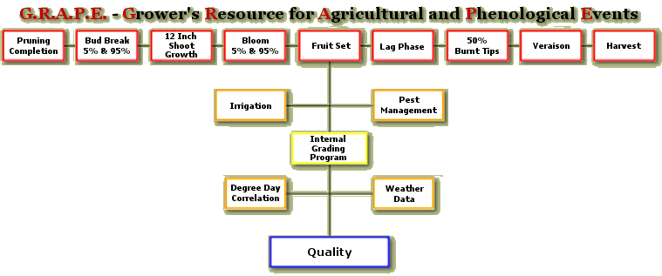
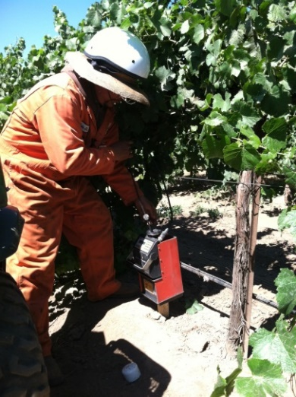
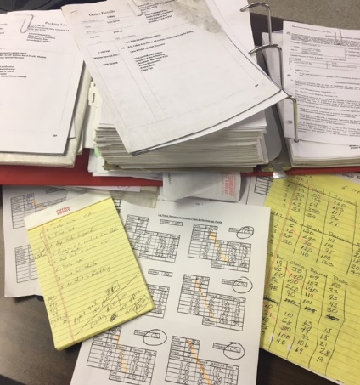
Identify Core

Slide 32
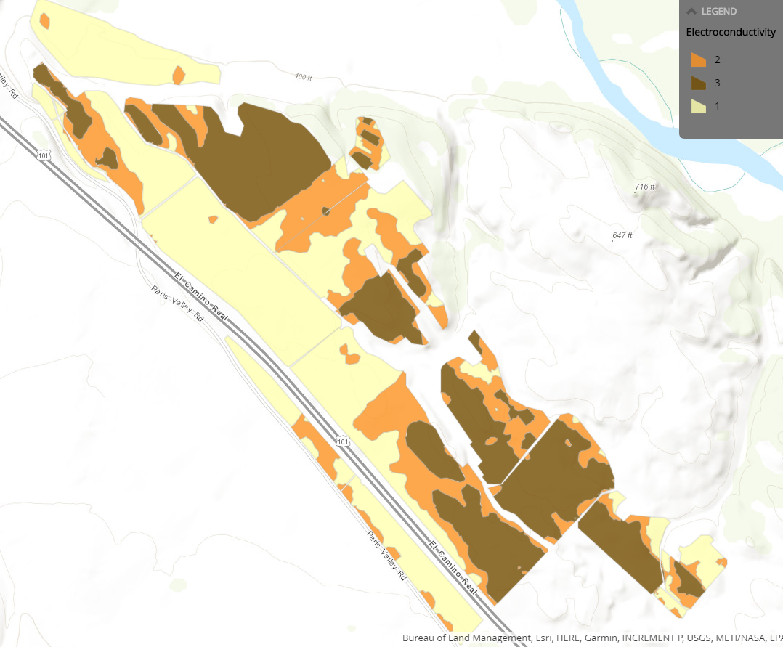
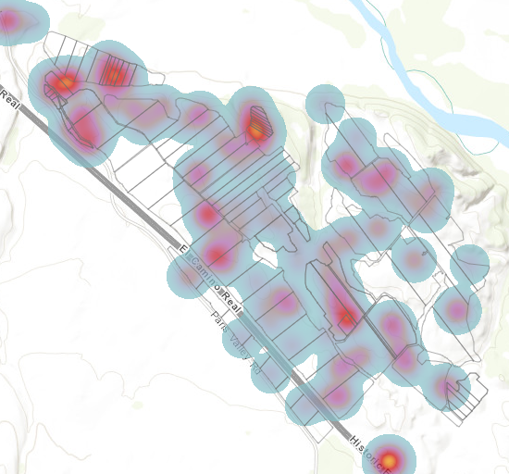
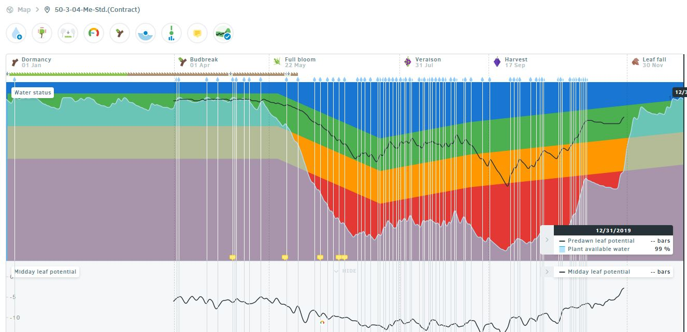
Precision Farming
Multiple measures
Geography
Actionable Data
Analysis & Prediction
Near Real Time
Preventative Action

Slide 33
Mechanization and adapting the labor force for precision agriculture
Notes:
Labor tends shows that although the #of hours needed to farm is relatively the same, the amount of people doing the work is less. Mechanization at minimum allows you to continue performing the “normal” farming tasks.

Slide 34
SVI and Ag Workforce
It takes the same out of hours to farm independent of how many people you have.
Adaptation of our current workforce into Mechanically Rooted, Data Driven Precision Agriculture will continue to decrease or dependency on Field Labor Contractors
Increase mechanically farmed acres, transition traditional labor into roles that support Precision Farming methods and Mechanization

Slide 35
What can be Mechanized?
Pruning
Shoot Thinning
Suckering
Weed Control
Leaf Removal*
Harvest*

Slide 36
Key’s to Mechanization
Must have Data!
  Historical, Programs, Quality – You must have a TARGET!
  Seamline acquisition, analysis, information
Identify Budget Capabilities
  How much can you afford to invest
    200k for Vmech – can you replace 200K worth of labor & how long.
    1 mile per hour avg. production
What’s the largest labor strain on your business?
  Quantity Issue? Quality? Timing?
  2 jobs, 1 pass

Slide 37
Pruning by the Numbers
Mechanical Pruning Acres: 1,159 acres using 2 machines
    85 day pruning window to prune 927,861 vines = 10,916/day
    10,916 vines/day /300 vines/day/person = 37 people manually
      300 vines/day/person
    10,916 vines/day /1,365 vines/day/person = 8 people mechanized (2 machines with 4 crew members/machine)
      1,365 vines/day/person
    37 people * $0.46/vine*300 vines/day =$138/day/person * 85 days = $434,010 * 38% burden = $598,934
    8 people running machines * $15/hour * 8.5 hours = $1020/day * 85 days = $86,700 * 38% burden = $119,646 mechanized pruning
    Hand Follow-Up- $.05/vine/piece rate*927861 vines *%38 =$64,022
    $119,646 machine pruning cost+$64,022 hand follow-up cost= $183,668 final prune cost
    $598,934- $183,668 = $415,266 total labor savings
    General machine cost/acre = $12 * 1,159 acres = $13908 + $183,668 = $197,576
    $598,934 - $197,576 = $401,358 total labor and operation savings

Slide 38
Shoot Thinning by the numbers
Mechanical Shoot Thinning Acres: 1,517 acres
    19 day shoot thinning window to complete 1,104,503 vines = 58,132
    58,132 vines/day /833 vines/day/person = 70 people manually
      833 vines/day/person
    58,132 vines/day /2125 vines/day/person = 27 people mechanized (typical crew was ~16 people)
      2125 vines/day/person
    70 people * $13/hour = $910/hour, $7,735/day * 19 days = $146,965 * 38% burden = $202,811.70
    $202,811.70 - $146,965 = $55,846.70 hand shoot thinning overhead only
    16 people running machines * $15/hour * 8.5 hours = $2040/day * 19 days = $38,760/day * 38% burden = $53,488.80 mechanized shoot thinning TOTAL labor costs
    $202811.70 - $53,488.80 = $149,322.90 total labor savings
    General machine cost/acre = $12 * 1,517 acres = $18,204 + $53,488.80 = $71,692.80
    $202,811.70 - $71,692.80 = $131,118.90 total labor and operation savings

Slide 39


Mechanization, Sustainability
&
The Bottom Line
Vineyard Production Operations YTD = $2 Million Savings
Mechanical Pruning:
    1,159 acres Pruned
    Supplemented over 37 people (8 employees used)
    Savings of over $400K
Mechanical Shoot Thinning
    1,517 acres Thinned
    Supplemented over 70 people (16 employees used)
    Savings of over $130K
Integrated Pest Management and Applied Technologies
    Herbicide YTD Savings = $160K
    Fungicide YTD Savings = $280K
    Insecticide YTD Savings = $142K
    Nutrition YTD Savings = $200K
Notes:
Integrated Pest Management and Applied Technologies has lead to precision farming implementation. We are farming higher quality fruit, at a sustainable yield with far less inputs. Utilizing real time observations and reporting, we can better manage our assets and forcast/respond to the vines needs based on continuous sensor, and human observation.

Slide 40
Harvest - Machine vs Hand and the Bottom Line
Cost/acre MH | Cost/acre HH
$ 101.64 | $ 1,145.84
$ 281,742.97 | $ 438,887.04
88% | 12%
Budget MH | Budget HH
$ 287,970.00 | $ 629,222.00
$ 281,742.97 | $ 438,887.04
$ 6,227.03 | $ 190,334.96
Adjusting HH by 3% of acres equated into $190,334.96 in Labor Savings. $63,444 per %

Slide 41


