Slide 2
RE-LED LED to LED Lighting Retrofits
Dan Magee Keith Williams
D.Magee@ledvance.com Keith.Williams@ledvance.com

Slide 3
Why LED to LED
Lighting Maintenance (End of Life)
Reduced Light Levels
Color Shift
Inconsistency
Failures
Energy Efficiency – Additional Savings
New Facility Use Requirements
Sub-par Existing Retrofit

Slide 4
Historical DLC Requirements
DLC Efficacy (lm/W) Requirements
Version | Year | Area Light Standard | Area Light Premium | 2x2 Luminaires (Troffer) Standard | 2x2 Luminaires (Troffer) Premium | High Bay Standard | High Bay Premium
Version 1.5 | 2010 | 50 | - | 55 | - | 60 | -
V1.6 | 2011 | 60 | - | 60 | - | 60 | -
V2.0 | 2012 | 70 | - | 85 | - | 80 | -
V3.0 | 2015 | 75 | 110 | 85 | 110 | 80 | 110
Version 4.0 | 2016 | 100 | 120 | 100 | 125 | 105 | 130
Version 5.0/5.1 | 2022 | 105 | 120 | 110 | 125 | 120 | 135

Slide 5
US DOE LED Roadmap
PC – Phosphor Conversion CM – Color Mixed

Slide 6
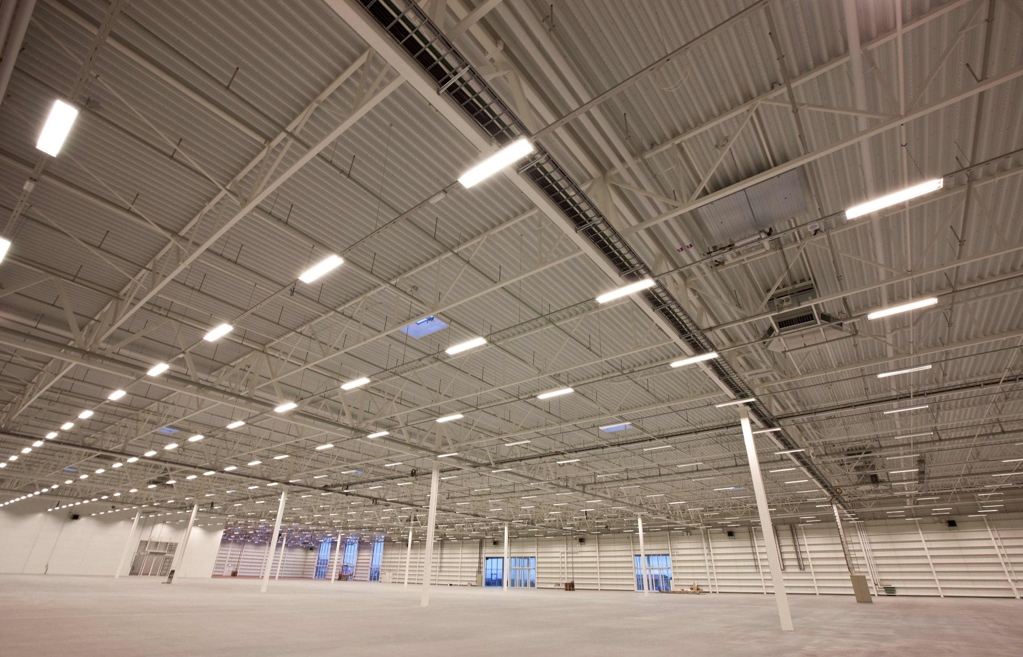
Existing Building Conditions
Light Levels
Existing
Requirements for the space
Controls
Fixture Level
Room Level
Building Level
Condition
Luminaire
Wiring
Code/Compliance Issues
Retrofit Work

Slide 7
Re-Lamp vs Fixture Replacement
Re-Lamping
Lower material cost
Lower labor cost
Ease of maintenance
Lower Efficiency
25-35% of the generated lumens are absorbed in a fixture
Fixture Replacement
Integral control capability
Fixture Level & Network Options
Updated look
Higher efficiency

Slide 8
Incentive Opportunities
If there is an opportunity to reduce kW and kWH many incentive programs will find a way to incentivize a project!
On-peak demand reduction, long operational hours and advanced controls make a project more attractive from an incentive perspective.
Additional Engineering & Site Review may be needed to get approval.
Measurement and verification of existing lighting (wattage, light levels, etc)
Datalogging for operational hours & control savings potential

Slide 9
LED to LED Economics
2012 Retrofit Type A TLED | Fixture Quantity | Type | Watts/Fixture | Operational Hours | Energy Cost ($/kWH) | Existing kWH
Office Building | 1000 | Troffer 3 x 15W LED T8 Type A | 50 System Watts | 3600 | $0.16 | 180000
Retrofit | Wattage | Control Savings | Retrofit kWH | Incentive ($0.30/kWH Controlled) | Savings ($) / yr | Install Cost | ROI (yr)
3 x 9.5W LED T8 Type B | 28.5 | 0% | 102,600 | $0.00 | $12,384.00 | $35,000.00 | 2.8
3 x 10W LED T8 Type C | 34.5 | 0% | 124,200 | $0.00 | $8,928.00 | $55,000.00 | 6.2
3 x 10W LED T8 Type C with Network Controls | 34.5 | 30% | 86,940 | $27,918.00 | $14,899.60 | $80,000.00 | 3.5
LED Troffer | 20 | 0% | 72,000 | $0.00 | $17,280.00 | $90,000.00 | 5.2
LED Troffer with Network Controls | 20 | 30% | 50,400 | $38,880.00 | $20,736.00 | $120,000.00 | 3.9

Slide 10
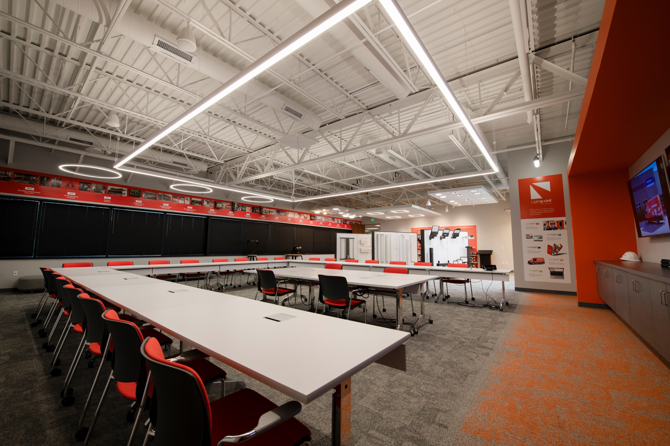
What does this mean for us?
Existing LED can be an opportunity!
Knowledge will become more important as we move forward!
Educating your team – Online and In-Person training opportunities.
Retrofit Strategy
Explore multiple options.
LED to LED Checklist - Handout

Slide 11
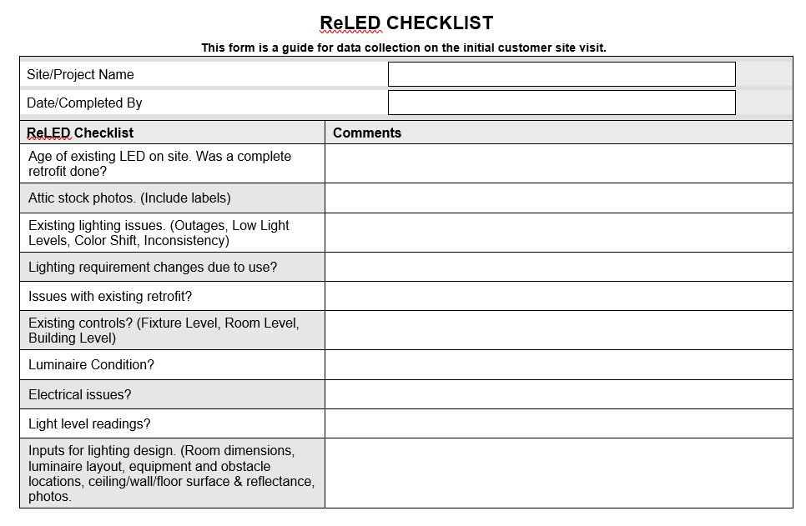
Checklist
ReLED CHECKLIST
This form is a guide for data collection on the initial customer site visit.

Slide 12
Questions & Discussion

