Slide 2
Anchor Bolts: How to Repair & When to Replace
March 6, 2024
Notes:
Brief overview of who we are as a company and what we do.
Specialize in light pole solutions. Starting in the exterior lighting militance industry as a contractor and helping our customers repair poles today and anchor bolts today.
ABA
ULHHC PRK-CBC/DBC
Poles and accessories
With those we see and hear about a lot of damaged anchor bolts. This comes from our experience repairing/replacing anchor bolts back in the day as a contractor and today suppling parts and expertise to our customers.
If you do a lot with poles, this may be old news. If you don’t do poles, my goal here is to answer common quesotnis and show that its not that complicated can be

Slide 3
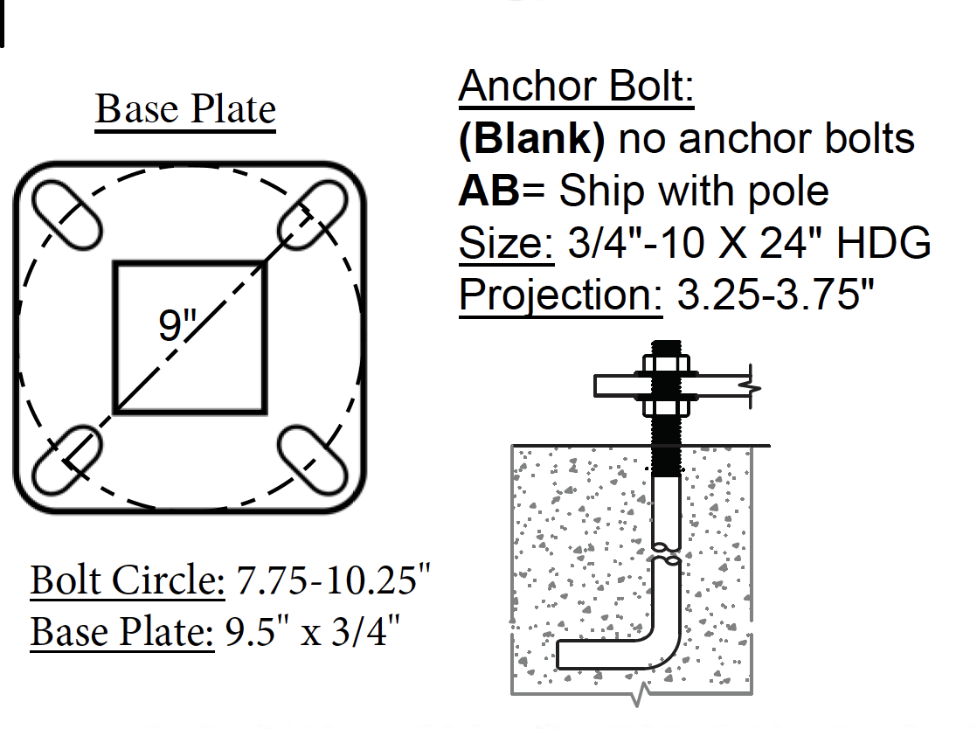
Anchor Bolt Overview
Sizes
¾” for up to 4” round/square steel and 5” round steel and most aluminum poles
1” for 5”+ square steel and round tapered steel poles
Grade
ASTM F1554 is specific for anchor bolts in concrete footings
Grade 36. standard poles
Grade 55. engineered projects
Grade 105 is uncommon for our industry
Notes:
ASTM F1554 bolts have a stretch test that standard bolts of the same yield do not have to undergo.
You can use a higher grade than specified, but not a lower grade.
The other common grade is A307 but that is not technically for anchor bolts.
Colors, not all bolts are painted on the end. Blue 36, Yellow 55, Red 105
Grade 36 is the most common. Engineering will often specify grade 55 and pole manufactures are starting to use Grade 55 as the standard.
The grade listed in detail about the anchor base and size is in the table with anchor bolt pattern info.

Slide 4
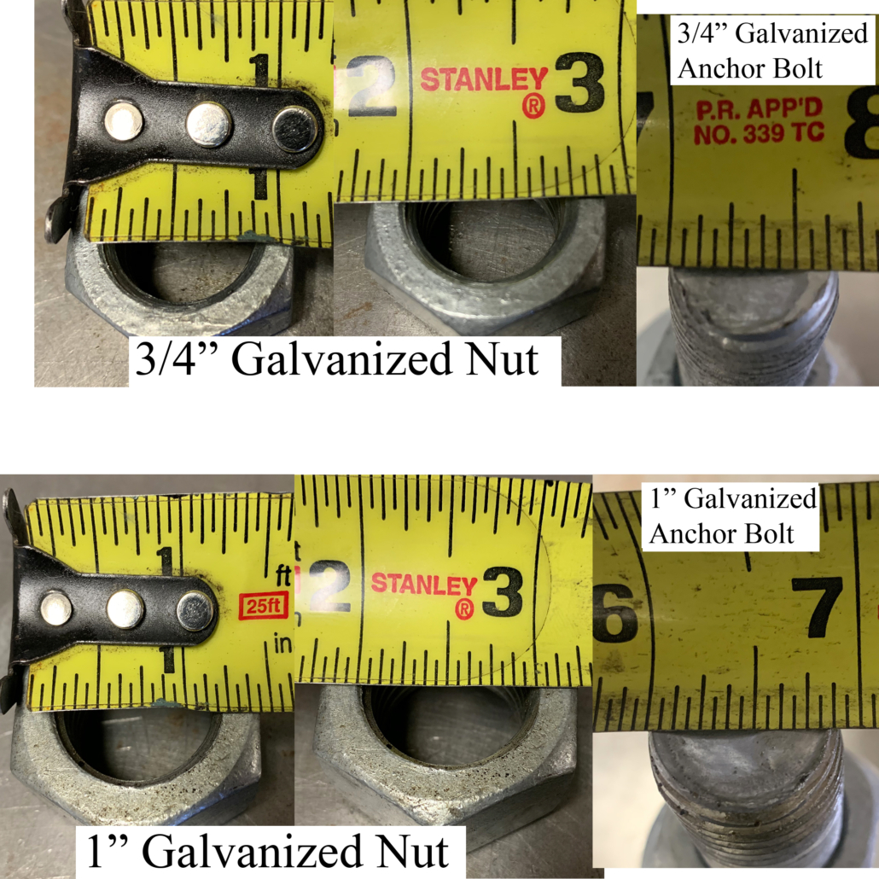
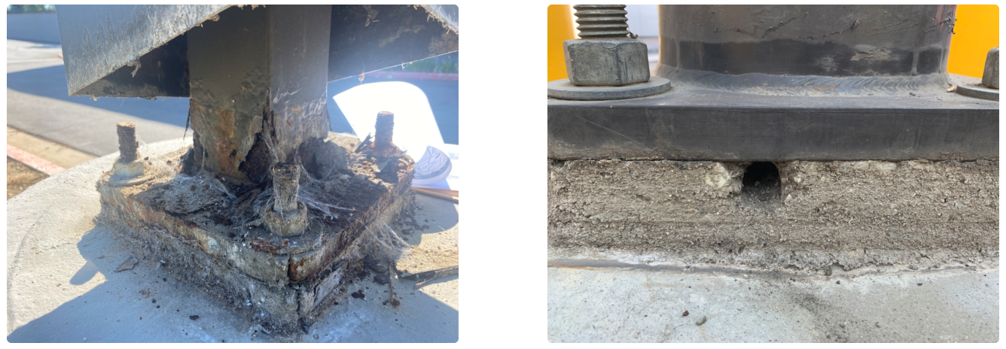
Anchor Bolt Overview and Common Misconceptions
Galvanized steel “L” bolts set in concrete to support the pole
Zinc coated bolts are uncommon
Stainless steel is not used
¾” and 1” are common for parking lot sized poles
The Anchor Bolts will measure smaller than they are
Anchor Bolts DO NOT need dry-pack/non-shrink grout under the base plate
Anchor Bolts can be repaired or replaced without replacing the footing
Notes:
“L” shaped bolts are commonly called “J” bolts.
Headed bolts with plates are used on larger sizes
Zinc is uncommon but is seen sometimes, especially in hardware that was purchased from a local hardware store.
HDG nuts are cut with a slightly larger sized thread than standard Zinc so the matching nut should be used. A Zinc nut will not thread onto the HDG bolt. a HDG bolt will be loose on a zinc bolt.
Some lower quality bolts have dirty galvanizing with burs on the thread making the nuts difficult to thread on. We will discuss this later when talking about reparis.
Common sizes for parking lot sized poles are ¾” and 1’.
½” is seen for small post lights and bollards. 1-1/4”-1-1/2” is seen in sport lights and utility poles.
5/8” and 7/8” do exist but are Highly uncommon for our industry. Almost all the calls we get for these sizes are actually ¾” and 1”
The actual size of an anchor bolt is slightly smaller than its nominal size, hence the confusion.

Slide 5
Overview of Issues and Solutions
Incorrect Bolt Size:
Too large: Thread Extenders, Anchor Bolt Adapters, Drill the base plate
Too Small: Drill and Epoxy or replace footing pending footing size
Misaligned Bolts:
Anchor Bolt Adapters, Adapter Plates
Drill and Epoxy new anchor bolts
Bent Bolts:
Straightened, Thread Extender, Drill and Epoxy
Rusted Bolts and Nuts:
Rusted nuts will break bolts if not properly treated
Surface rust can be cleaned
Wire wheel and rust encapsulating/converting paint
Rust deeper than the depth of the threads is a problem
Thread Extenders or Drill and Epoxy
Broken Bolts:
Thread Extenders or Drill and Epoxy
Notes:
Overview of common anchor bolt problems that we will go over more in this presentation.

Slide 6
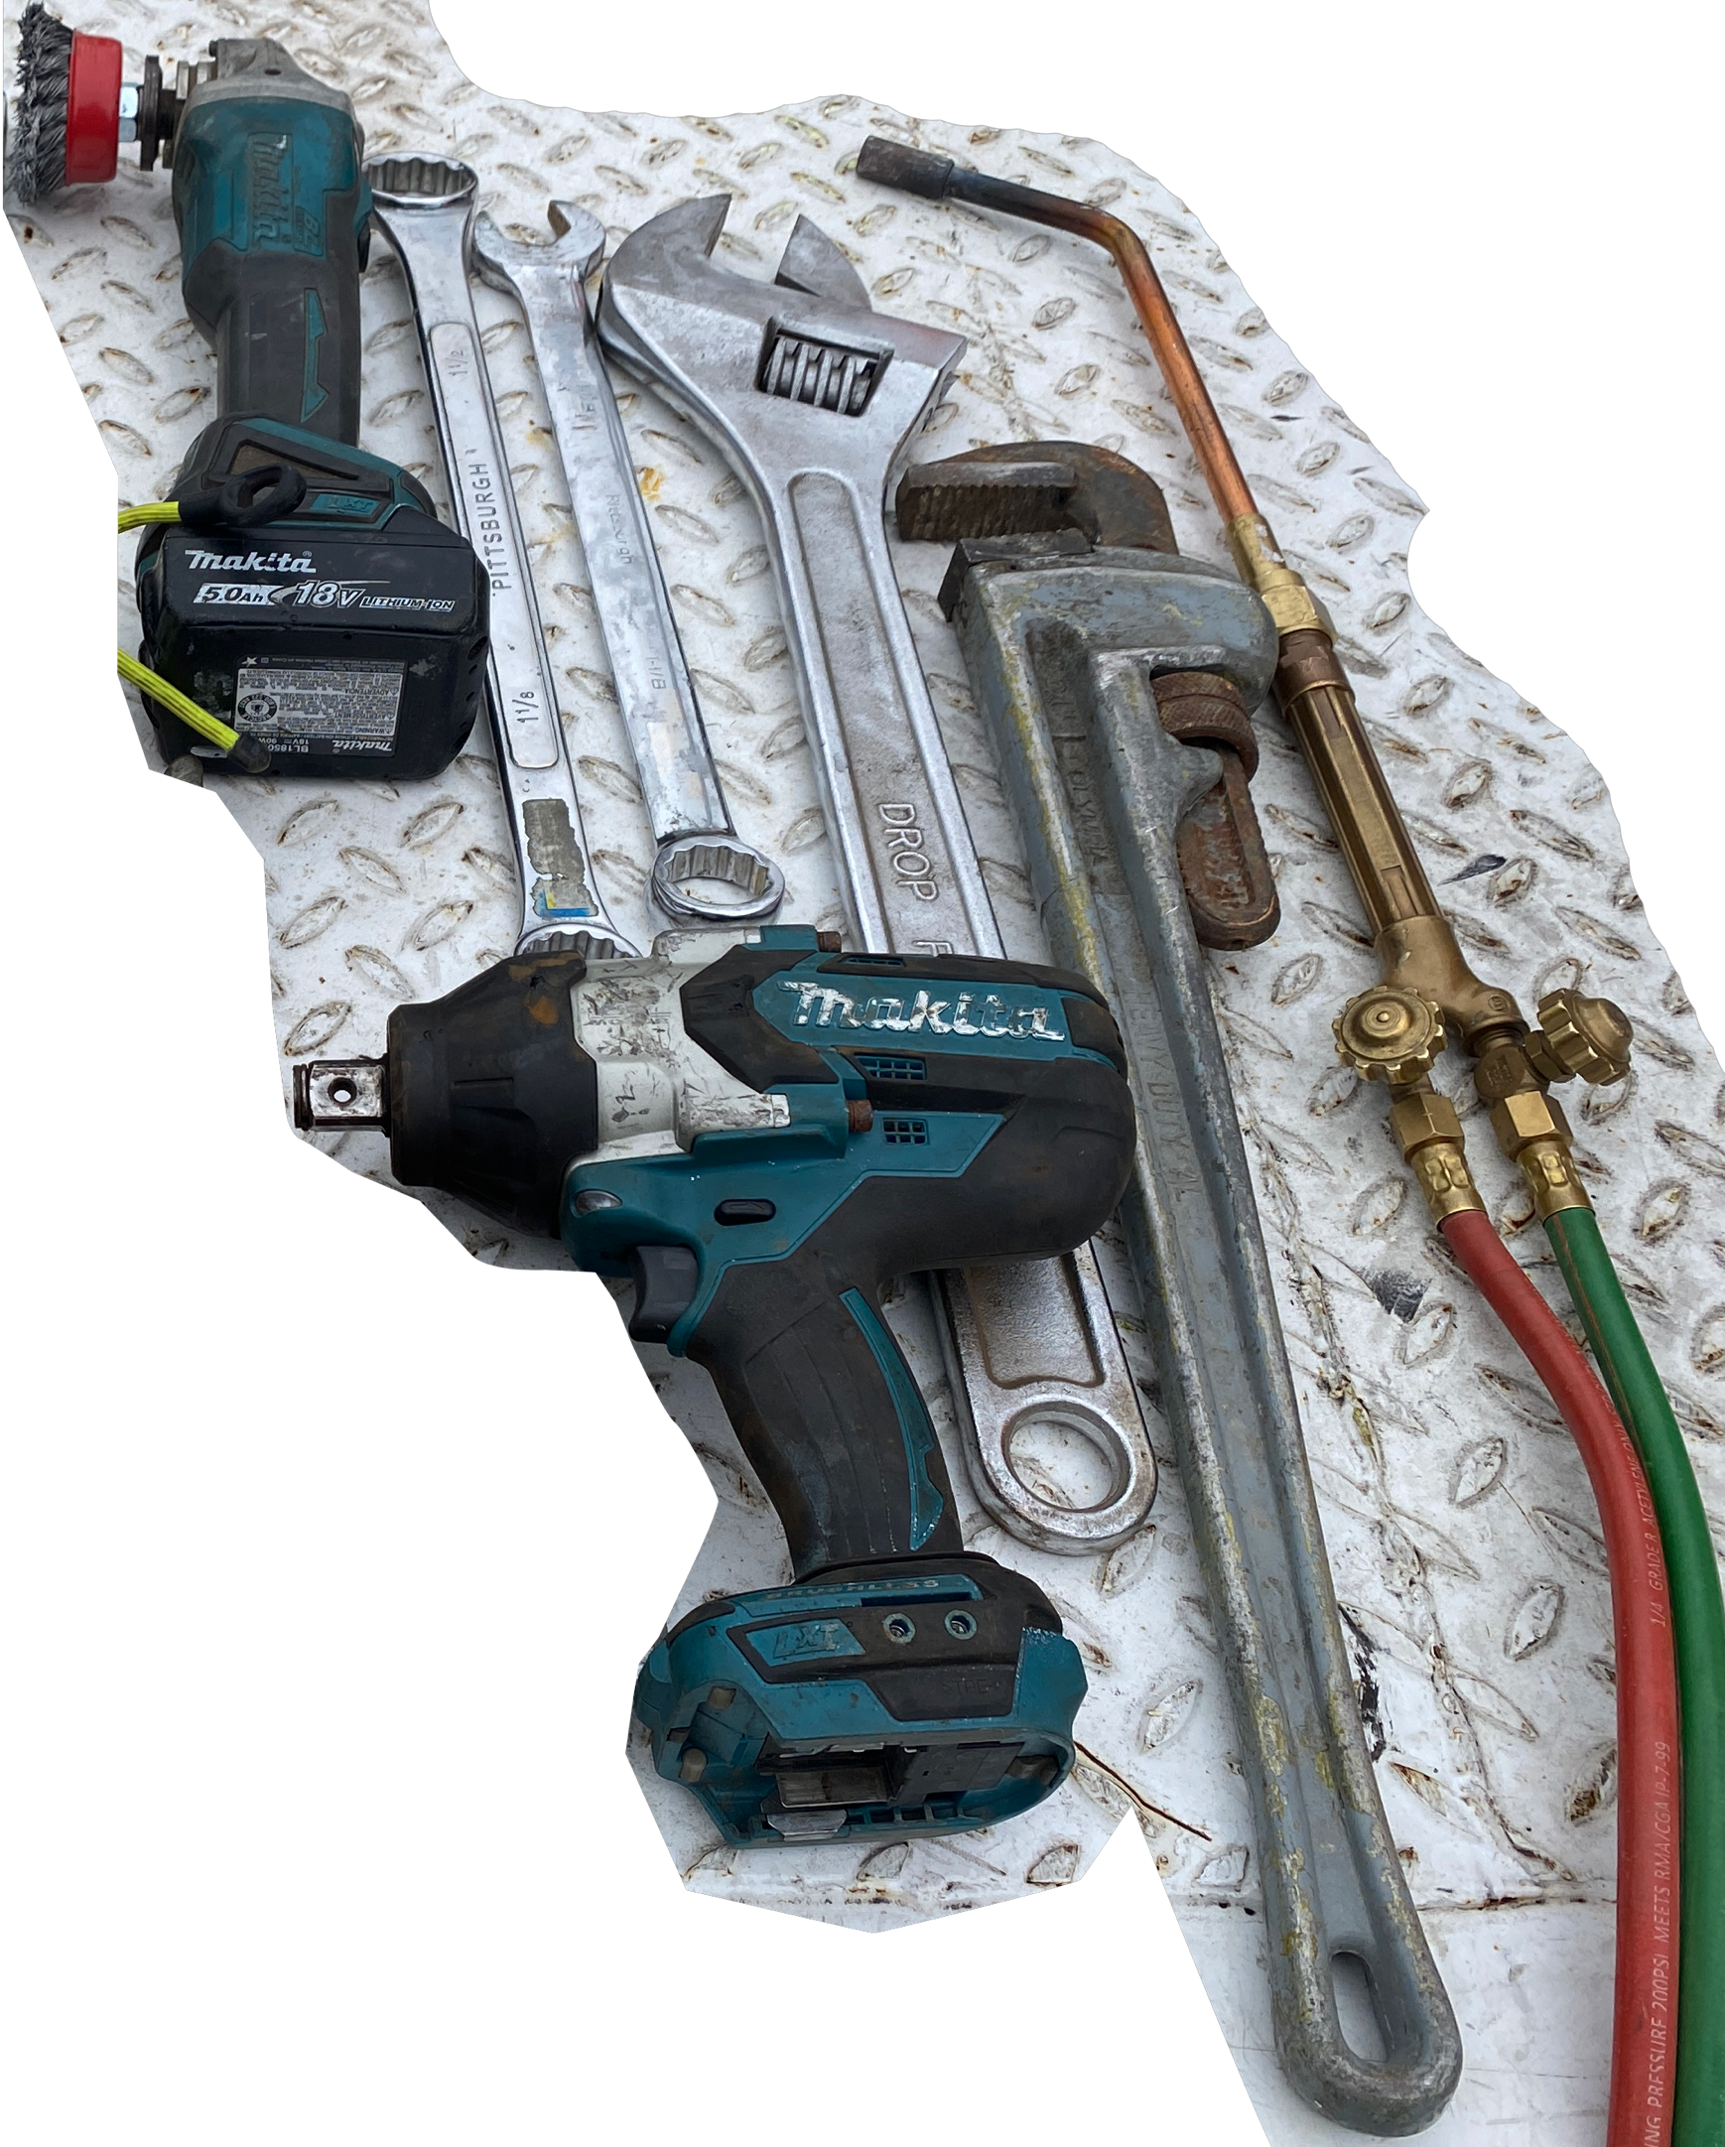
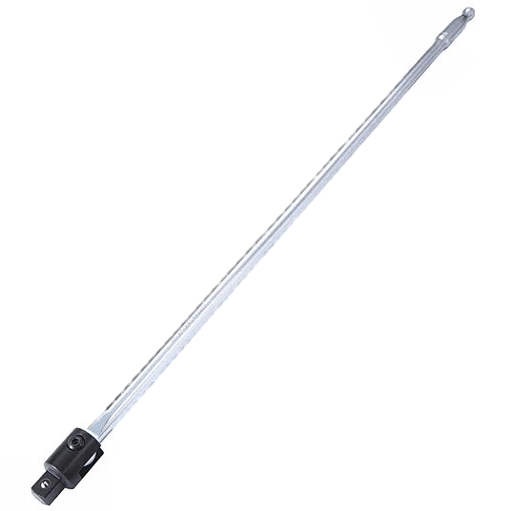
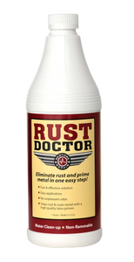
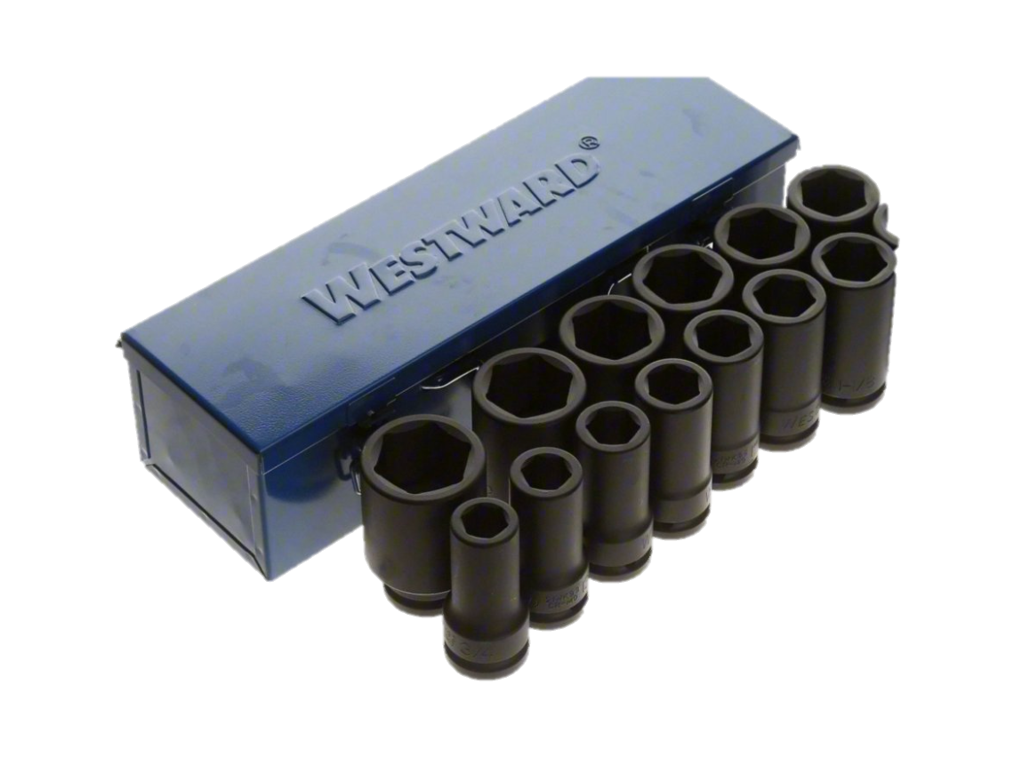
Helpful Tools
Wire Wheel for Angle Grinder
Oxygen-Acetylene Torch with Rosebud Tip
Large Pipe Wrench
6-point Deep Sockets: ¾” to 1-1/2”
3/4” Drive Impact
¾” Breaker Bar
Rust Dr rust encapsulating pain
Notes:
On top of the common tools, these are ones that can make the following jobs go much easier.

Slide 7
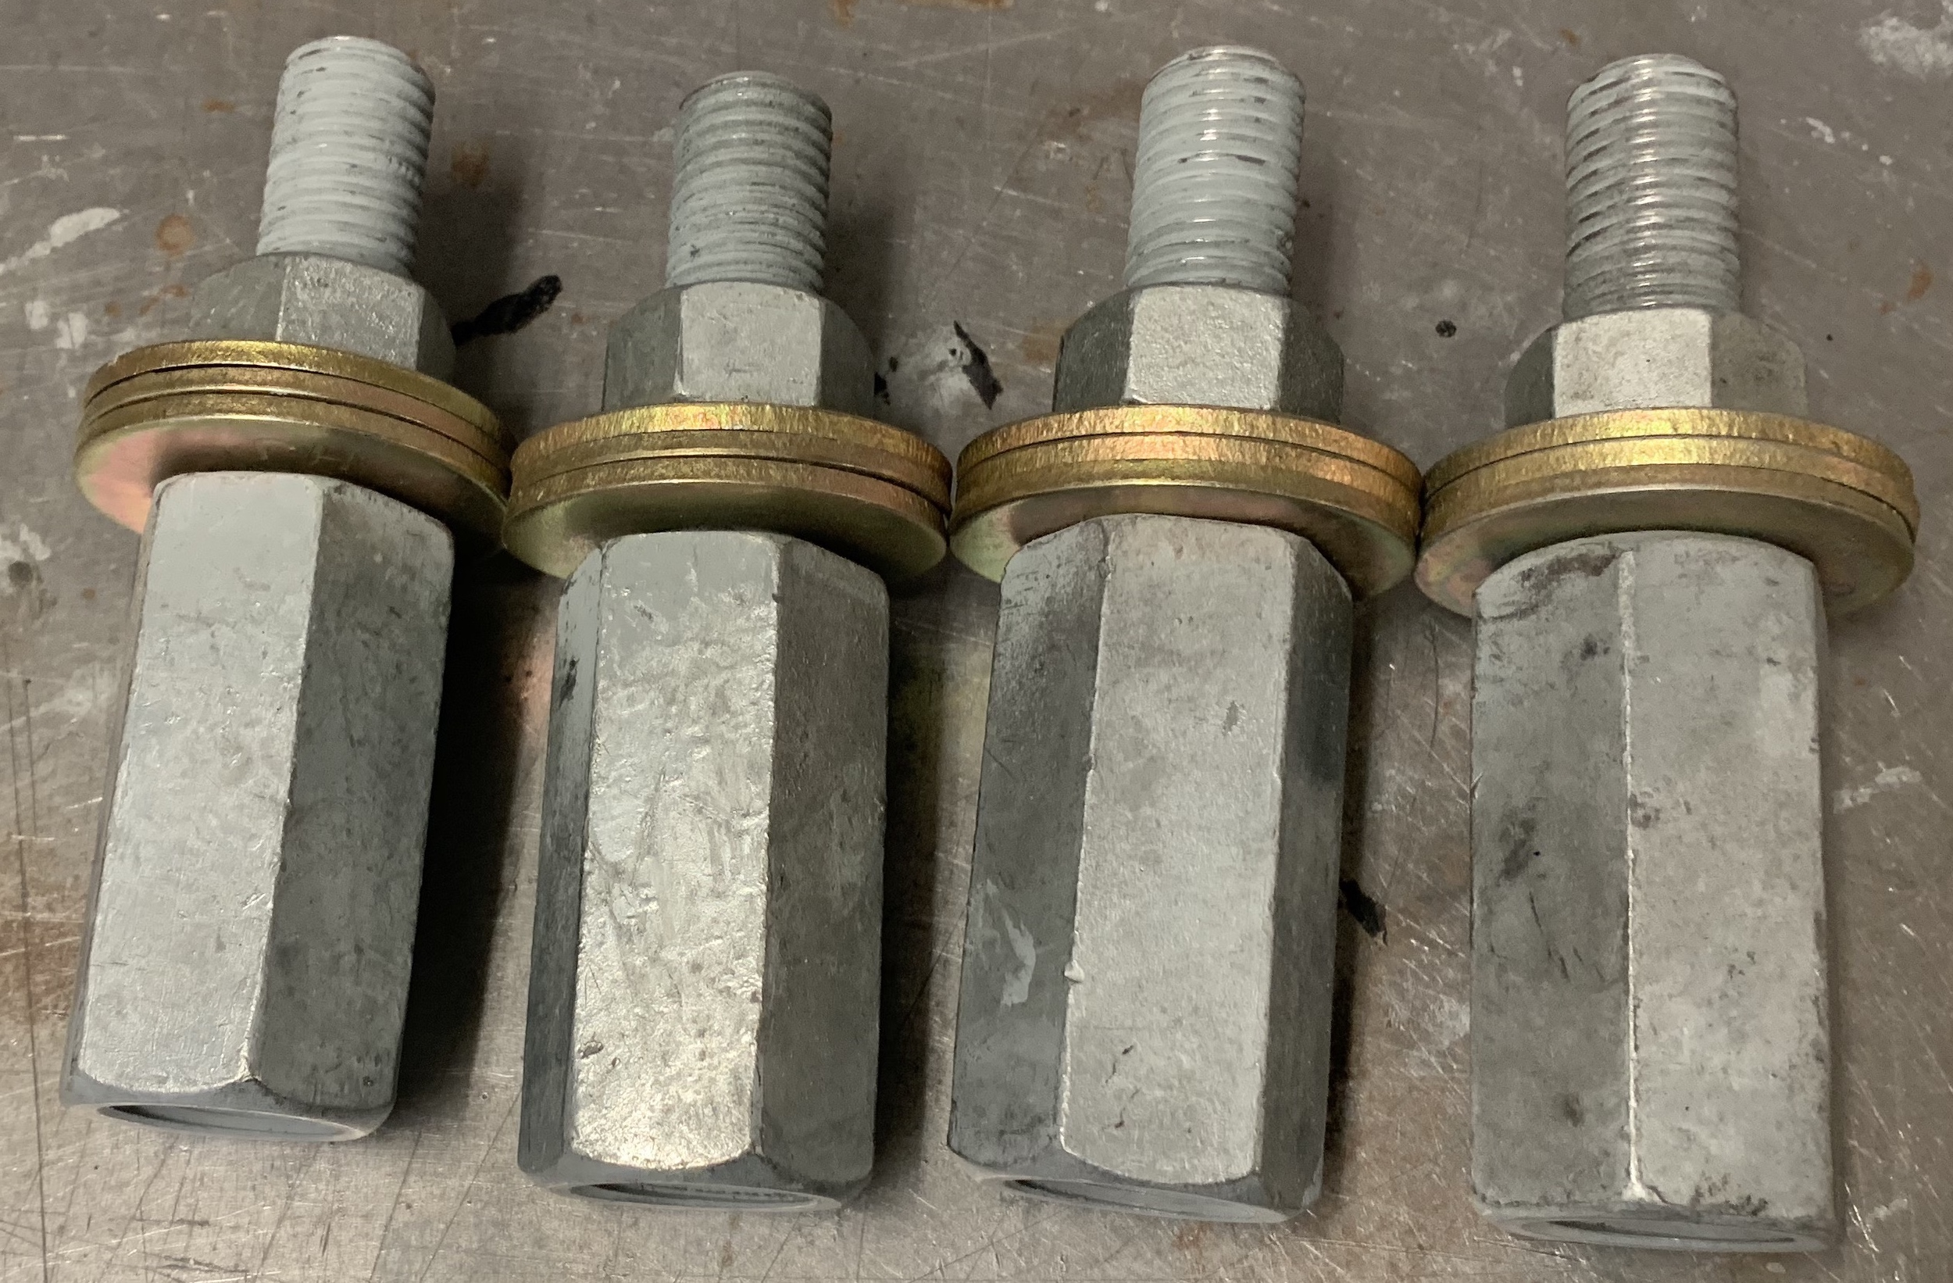
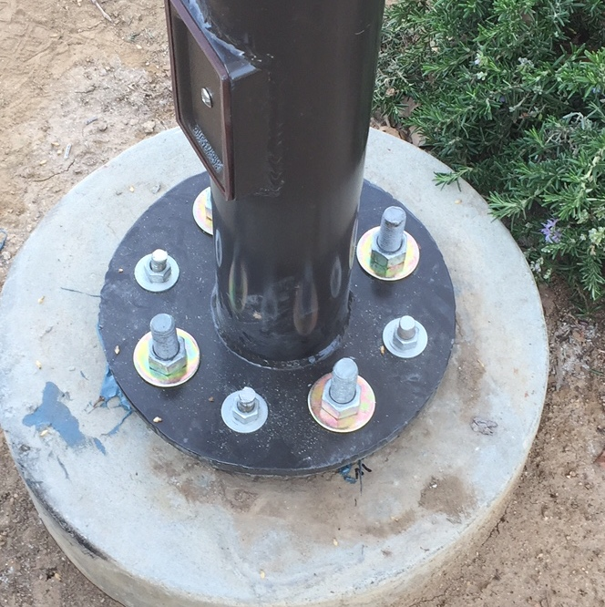
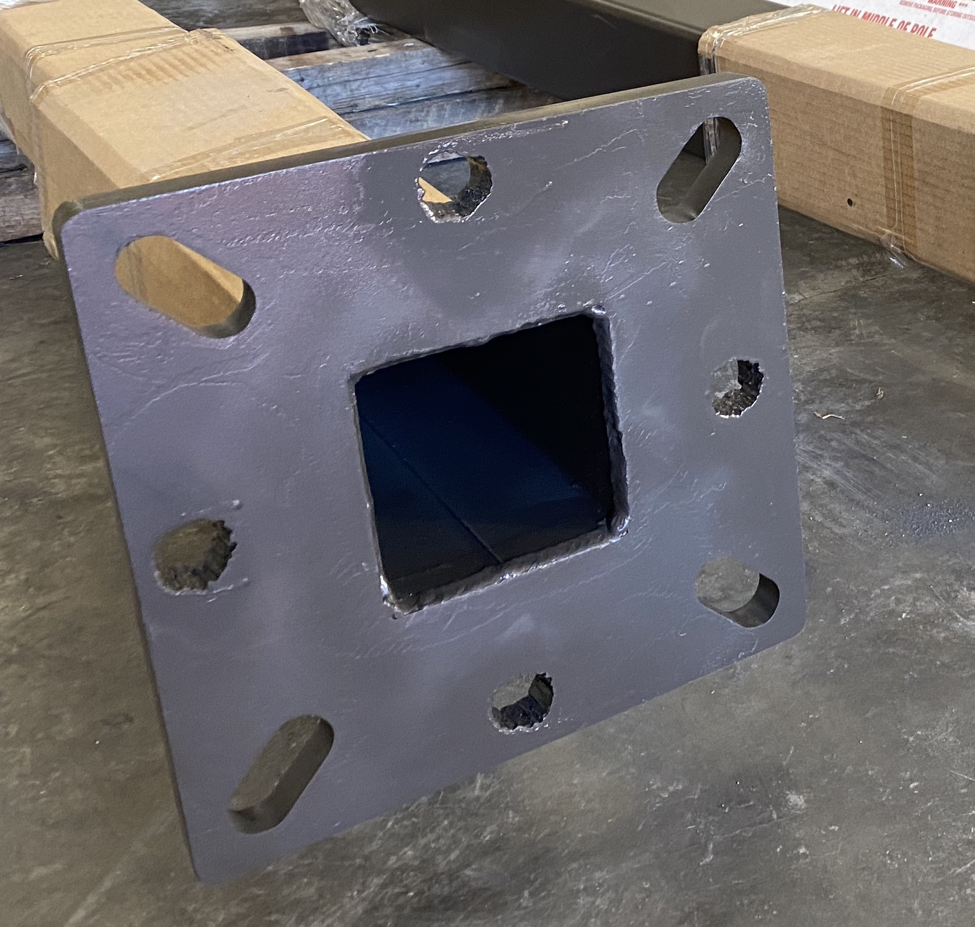
Incorrect Bolt Size
Bolt is too large:
Thread Extender Reducer
Anchor Bolt Adapters
Adapter Plates
Drill and Epoxy
Drill out pole base
Bolt is too small:
Engineering will be required to confirm the solution and footing is strong enough to support the load
Adapter Plate
Drill and Epoxy
Notes:
Simple product install.
More details on more involved later.

Slide 8
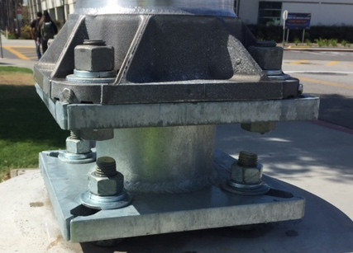
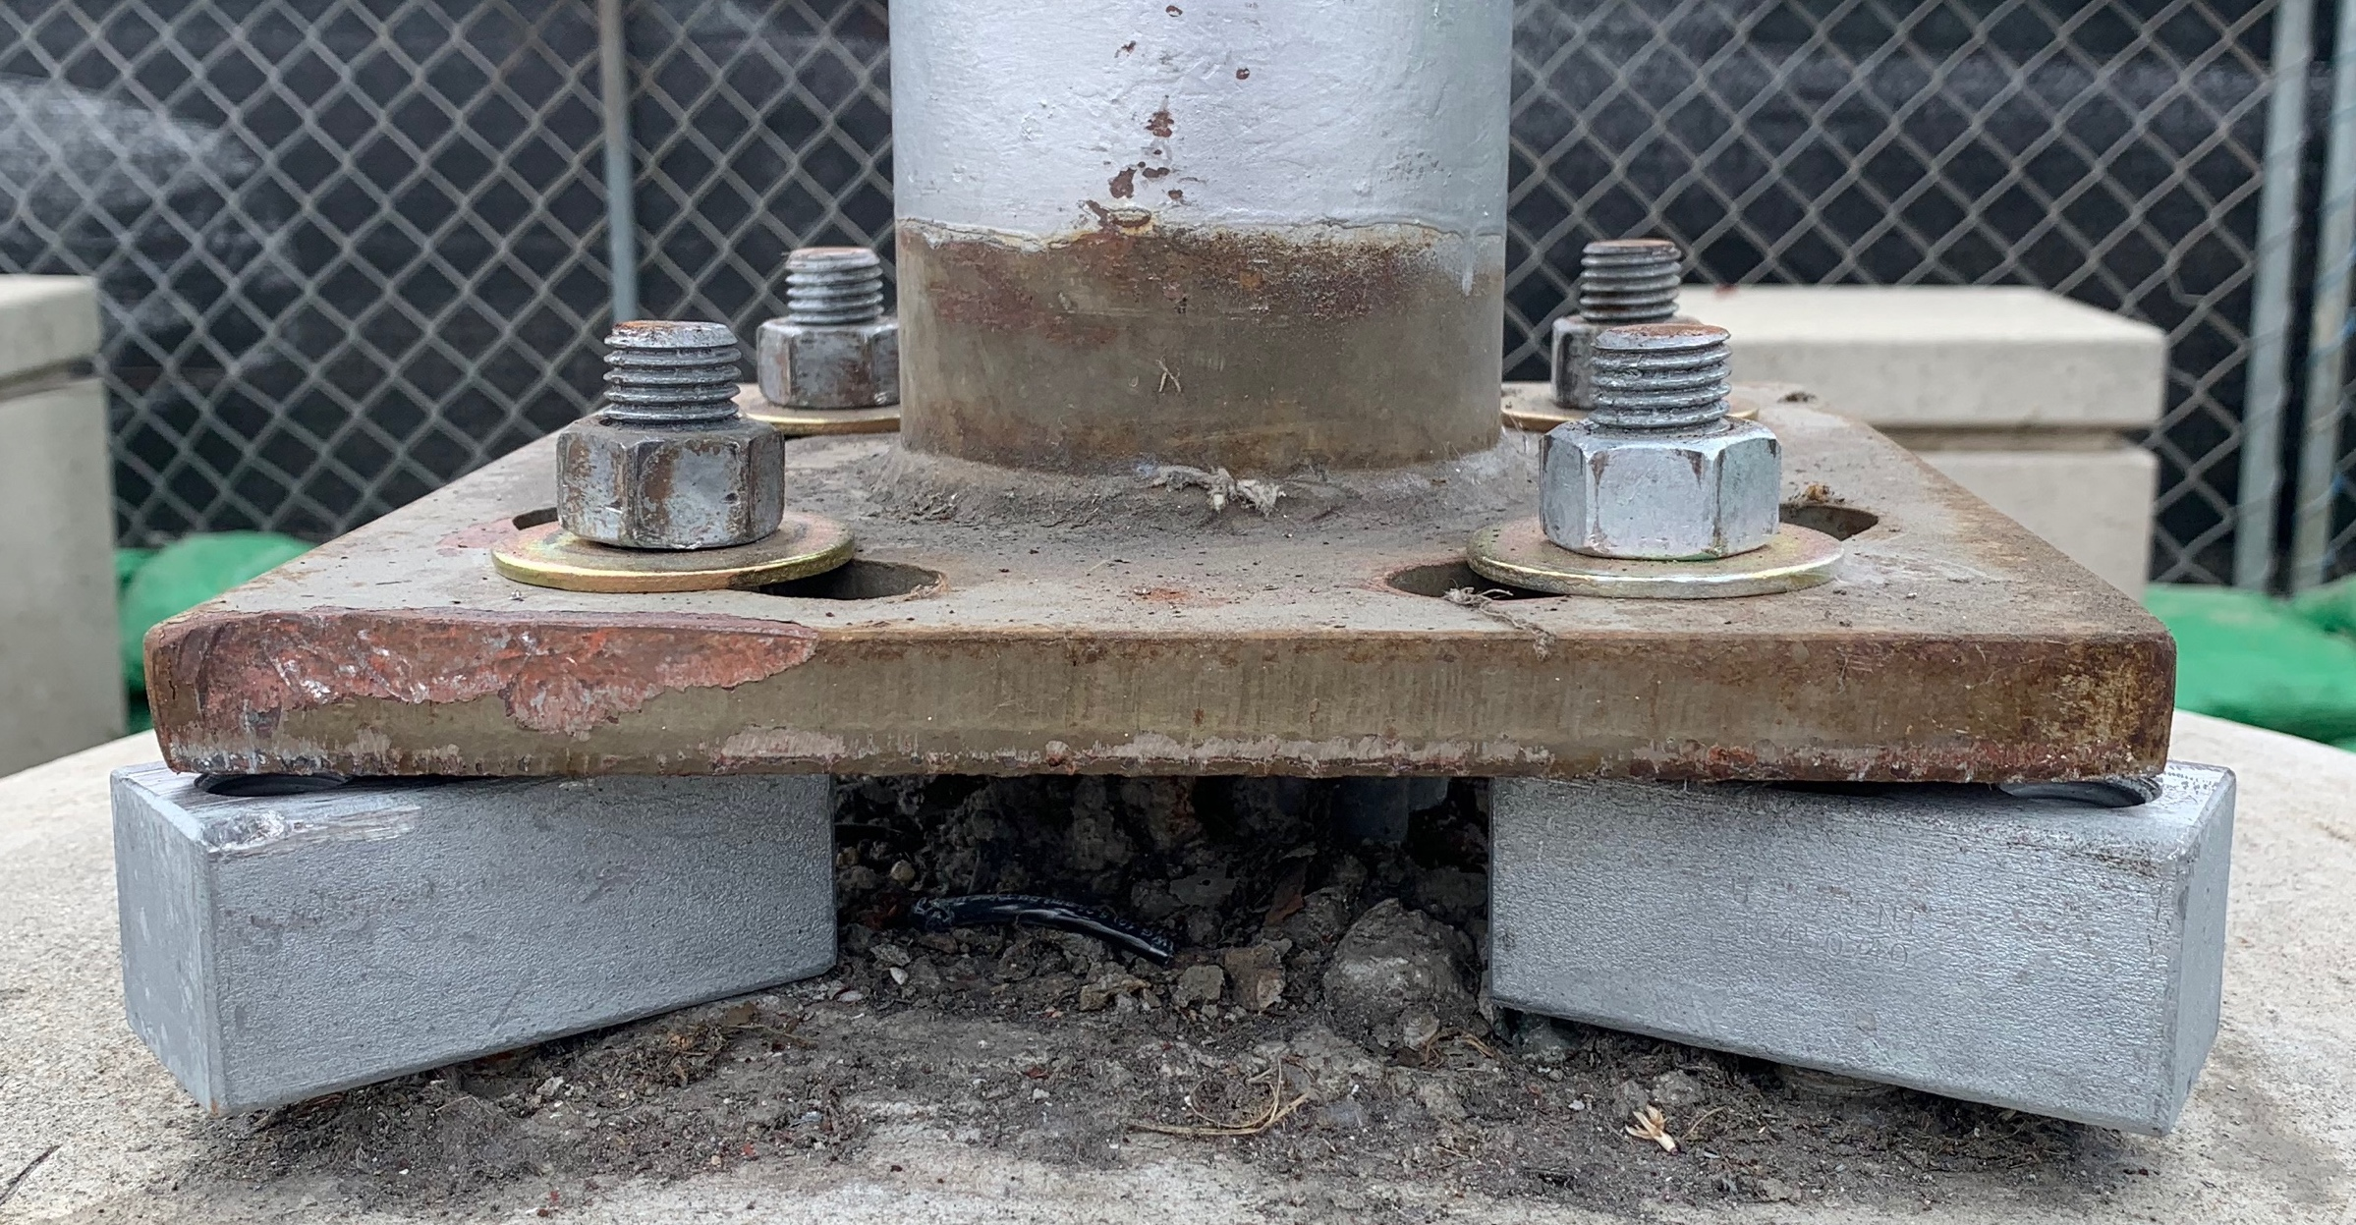
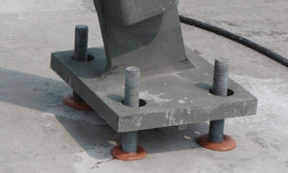
Misaligned Bolts
Anchor Bolt Adapters
Adapter Plate
Drill and Epoxy
Drill out the pole base

Slide 9
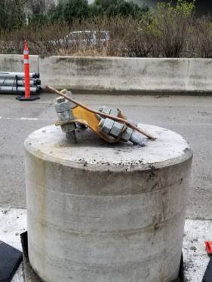
Bent Bolts
Straighten
Only grade 36, 45º max per ASTM F1554
Grade 55 bolts can not be bent
Inspect root of threads for signs of cracks
Cut off and install Thread Extender
Cut off and drill and epoxy
Notes:
Bending grade 36 only, 45º max depending on the engineer you talk to
Head to cold. Heating the bolt is best. Use a tool like a cheater bar or something that fits well over the bolt.
This is less common but does happen from time to time. in areas with semi trailer parking.

Slide 10
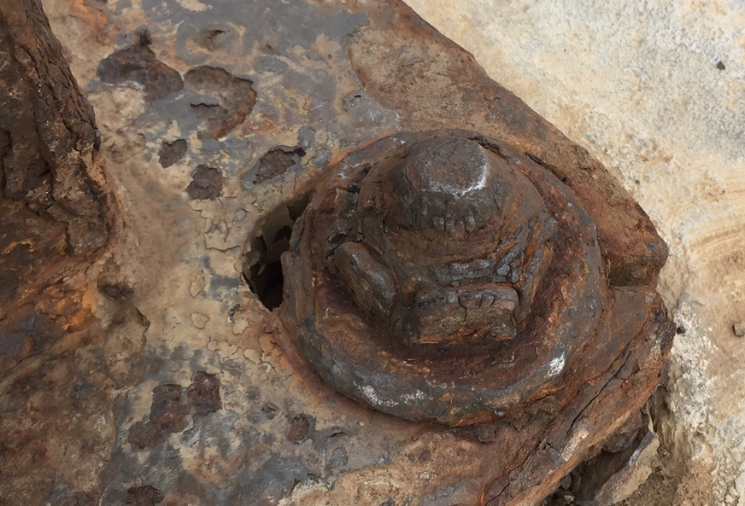
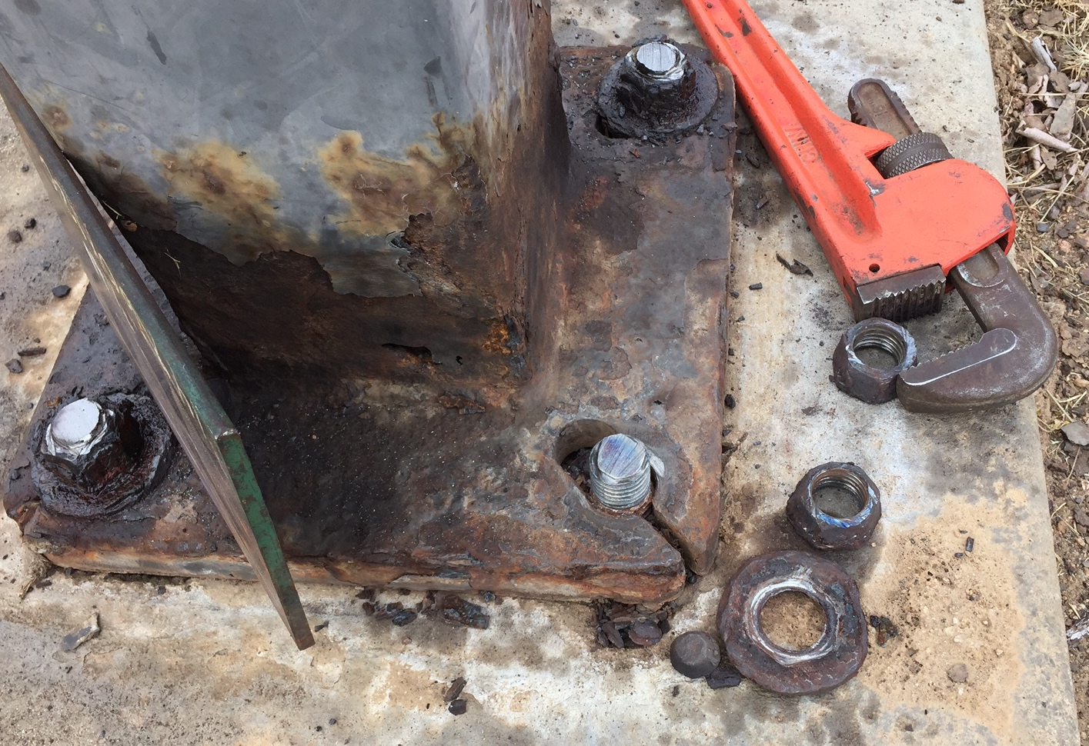
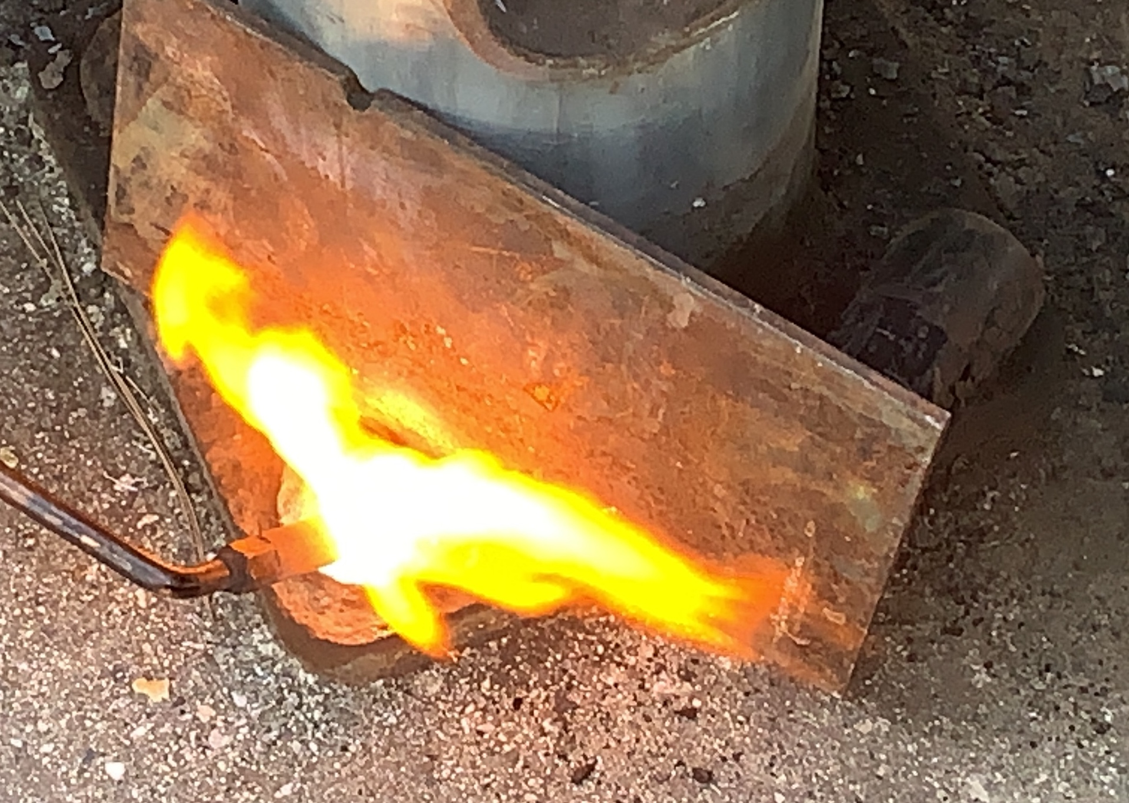
Rusted Nuts: Removal
Often overlooked
Clean or cut off un-used bolts
Apply penetrating oil ahead of time
Heat the nut with rosebud until red hot
Be sure to protect the pole
Hammer on correct size socket or use a pipe wrench
Notes:
Rusted nuts are often overlooked during original survey.
This can make an easy pole replacement takt much longer. Often the bolt is good under the nut.
Be sure to check bolt between the nuts and under leveling nut.

Slide 11
Rusted Nuts
Notes:
For surface rust no deeper than the threads.
Clean with wire brush or wheel on angle grinder.

Slide 12
Rusted or Broken Bolts: Thread Extenders
If useable thread under leveling nuts/concrete
Notes:
Used when the structure is ok under a leveling nut or just below the surface of concrete.
Remove hardware and chip out concrete if needed.
Cut off bolt. clean and paint.
Install TE.
Install pole.

Slide 13
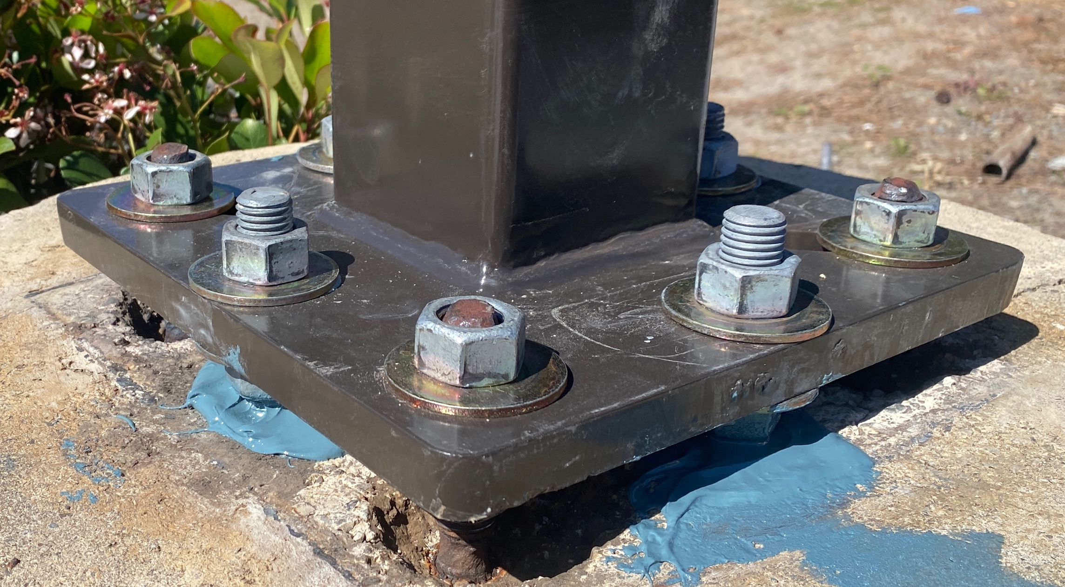
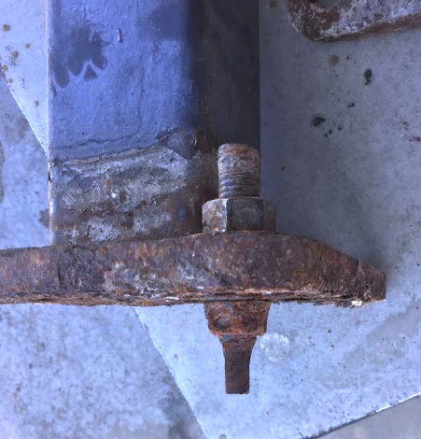
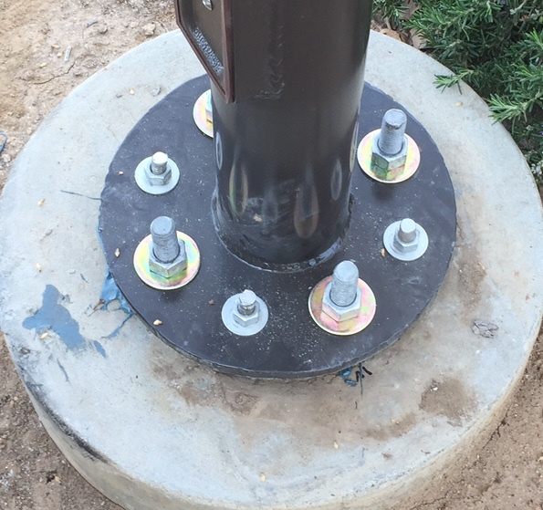
Rusted or Broken Bolts: Drill and Epoxy
If no useable threads on anchor bolts
Notes:
Use if footing is ok but no useable threads on anchor bolts.
If bolts are ok to hold pole for 24-36 hours leave them.
If really bad cut off, dril and epoxy, come back install pole.

Slide 14
Install of Most Common Fixes
Anchor Bolt Adapters
Adapter Plates
Thread Extenders
Drill and epoxy
Notes:
Anchor bolt Adapters and adapter plates are simple. We will go through them quickly
Thread extenders and drill and epoxy will be more detailed.

Slide 15
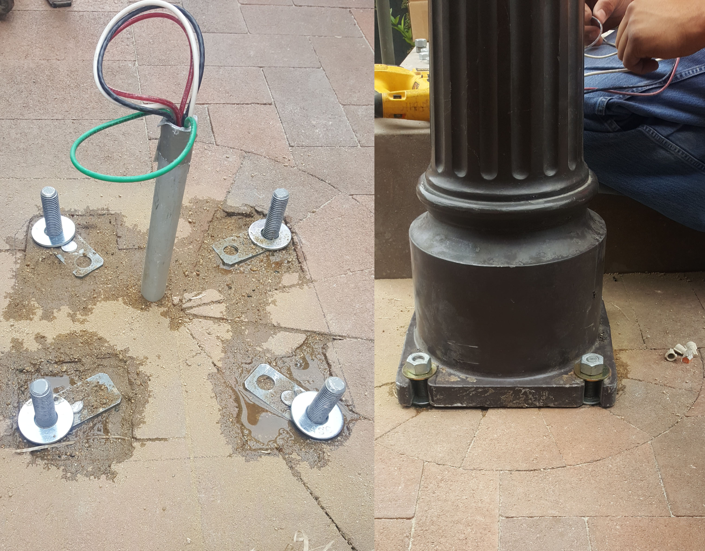
Anchor Bolt Adapters
Remove all existing hardware
Clean debris from threads
Thread ABA block onto bolt as close to footing as possible
Cut off excess bolt as needed
Adjust blocks to match pole
Install pole
Notes:
Anchor Bolt Adapter are used to correct misaligned anchor boltw

Slide 16
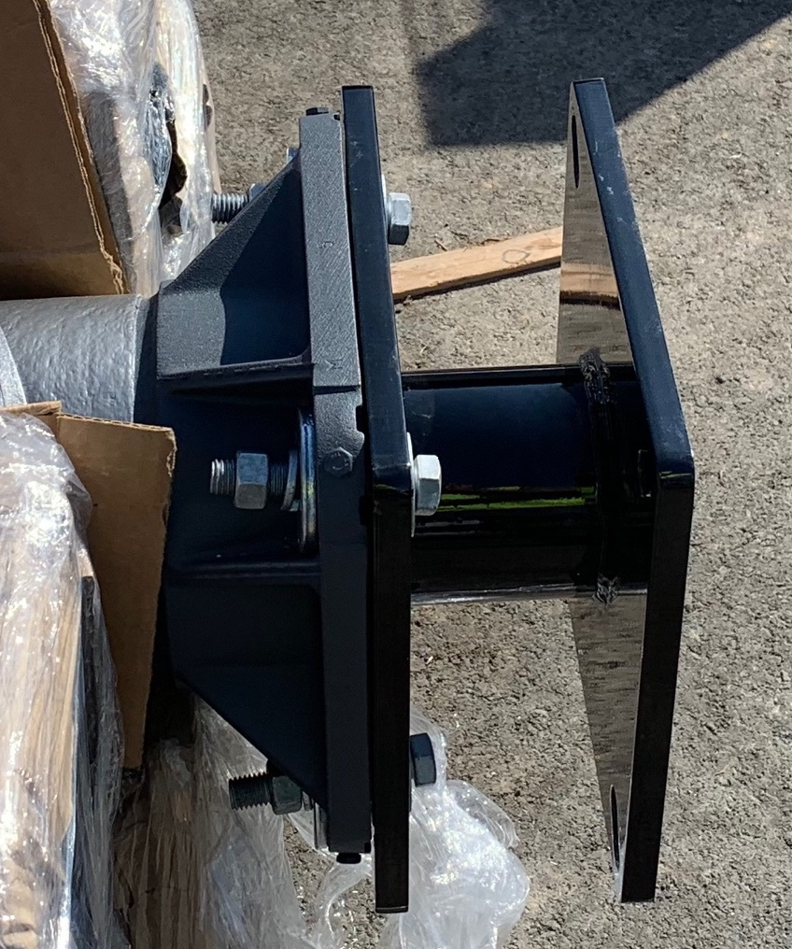
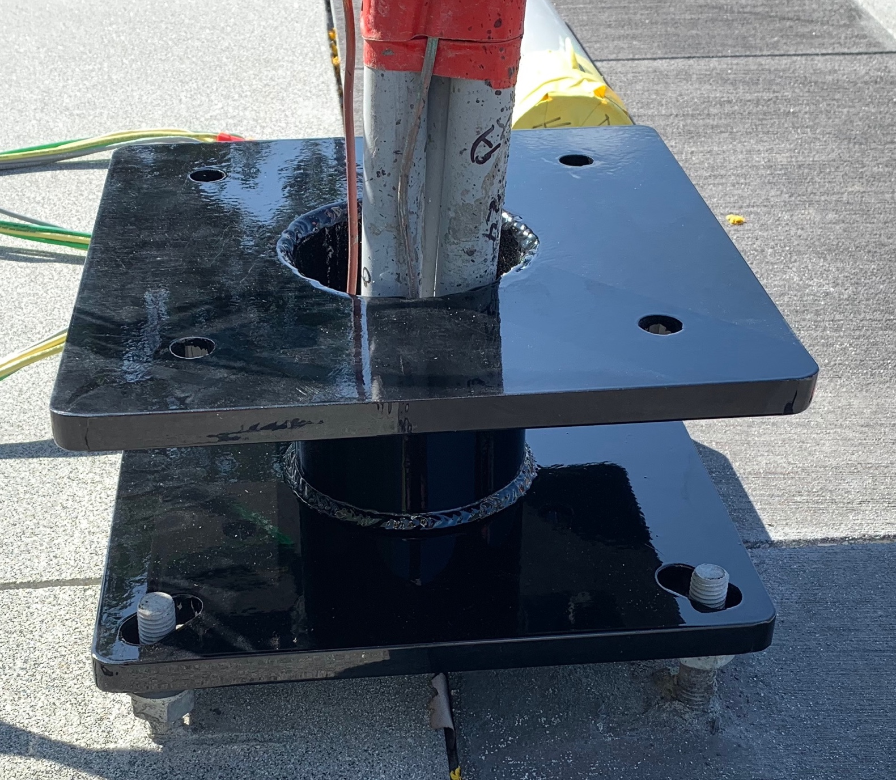
Adapter Plates
Bolt Adapter Plate to pole using included hardware
Bolt plate to footing using existing hardware
Plate can be bolted to pole then stood OR bolted to footing then pole set
**Adapter Plates are CUSTOM MADE for each order**

Slide 17
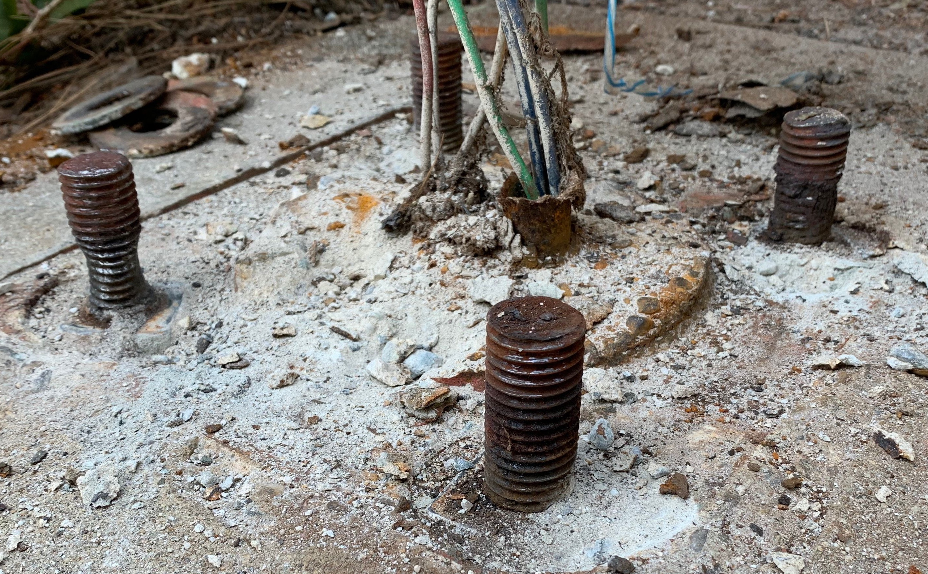
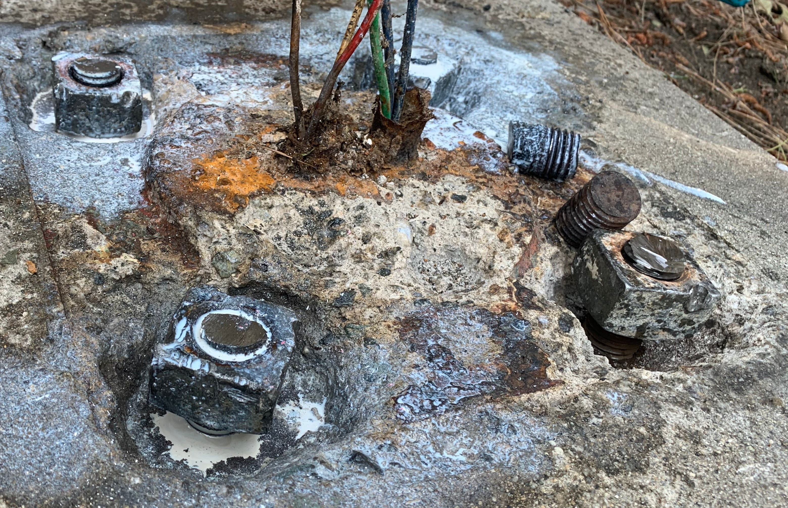
Thread Extenders
Check threads under leveling nut for dry pack
Chip concrete out around the bolt to expose useable threads
Prep Bolts:
Remove all the existing nuts and washers
Clean the threads with a wire wheel on an angle grinder
Chip away concrete if needed to expose threads
Cut any long bolts level with others
Paint with a rust encapsulating/converting paint
Notes:
Thread extenders can be used if the exiting bolt is structurally ok
Made using F1554 Grade 36 Hot Dip Galvanized or similar hardware
Often the dry pack or leveling nuts protect the threads.
Often threads extend into the footing and can be exposed by chipping away concrete around the anchor bolt. sometimes the threads stop, if that is the case, then not much can be done.
You will be amazed the deterioration of nuts we have removed with out damaging the threads. Use a rosebud tip rather than a cutting head.
Its best to have all bolts level so extenders are level.

Slide 18
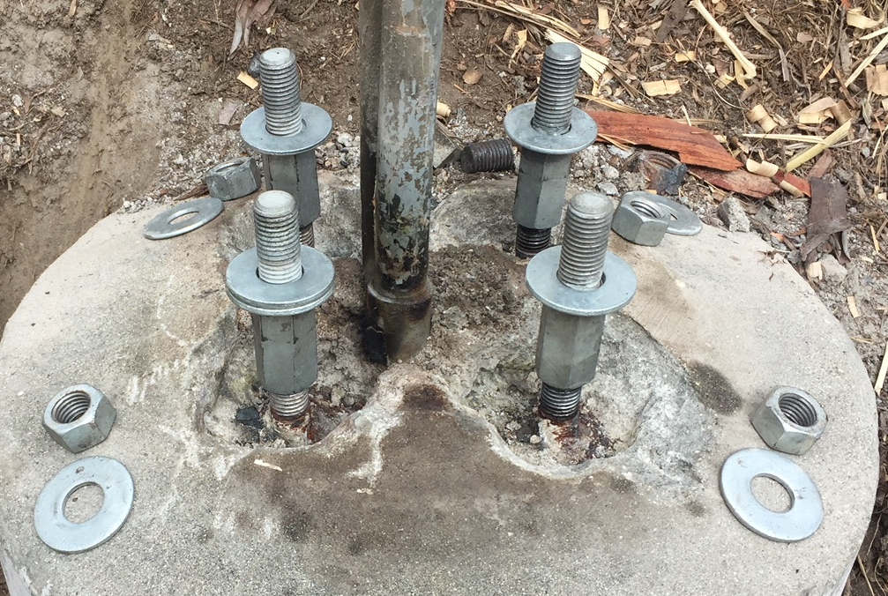
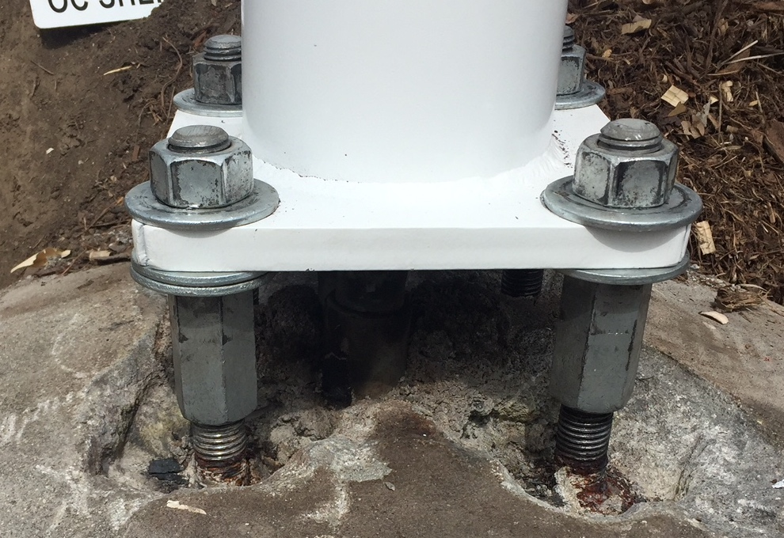
Thread Extenders Cont.
Install extenders on all bolts
Thread on until bottomed out
TE can be adjusted like leveling nut
Backfill concrete pockets with epoxy to prevent water pooling
Install the Light Pole
Use additional washers as needed to level the pole
Add top washer and nut
Tighten like normal
Notes:
When tightening, be sure to hold TE, just like leveling nut

Slide 19
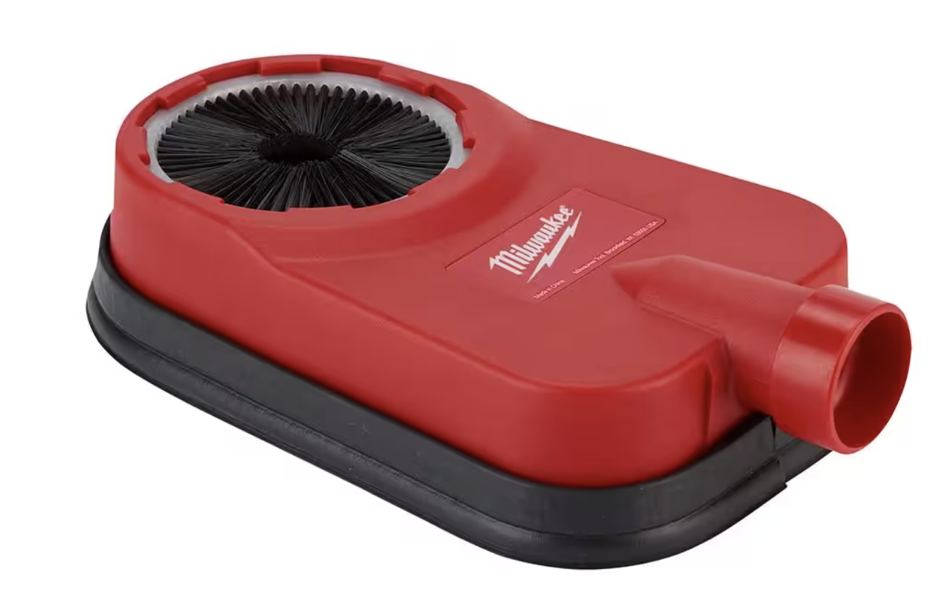
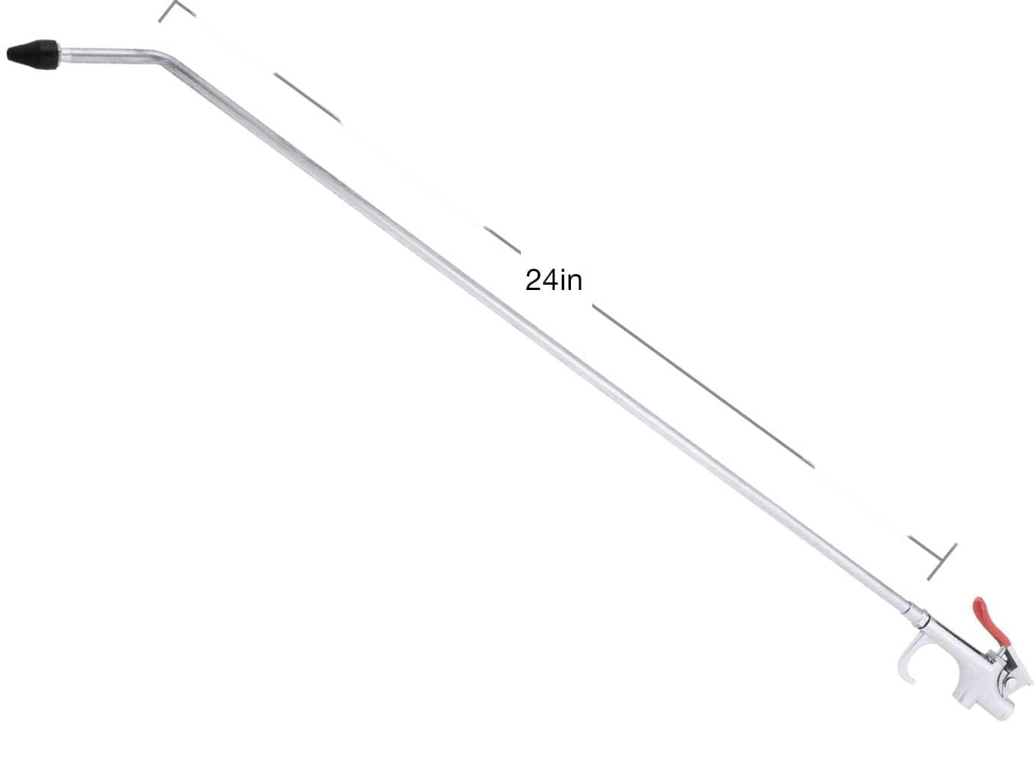
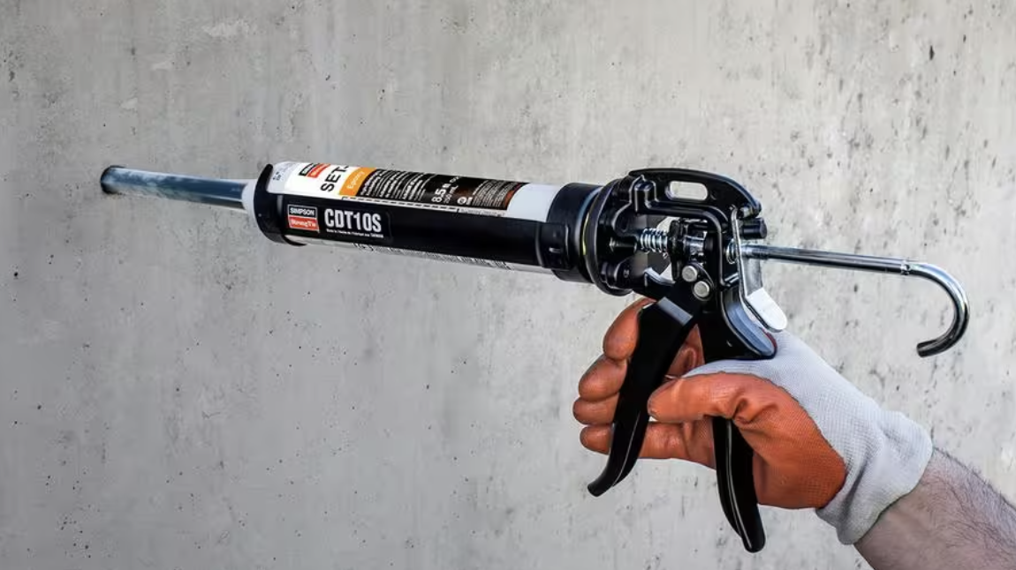
Helpful Tools
Shop-vac with dust extractor
Long air nozzle, bent straight
16” long nylon hole-cleaning brush
Epoxy dispensing tool
Notes:
On top of the common tools, these are ones that can make the following jobs go much easier.
Bend the nozzle straight.
A higher volume air compressor helps.

Slide 20
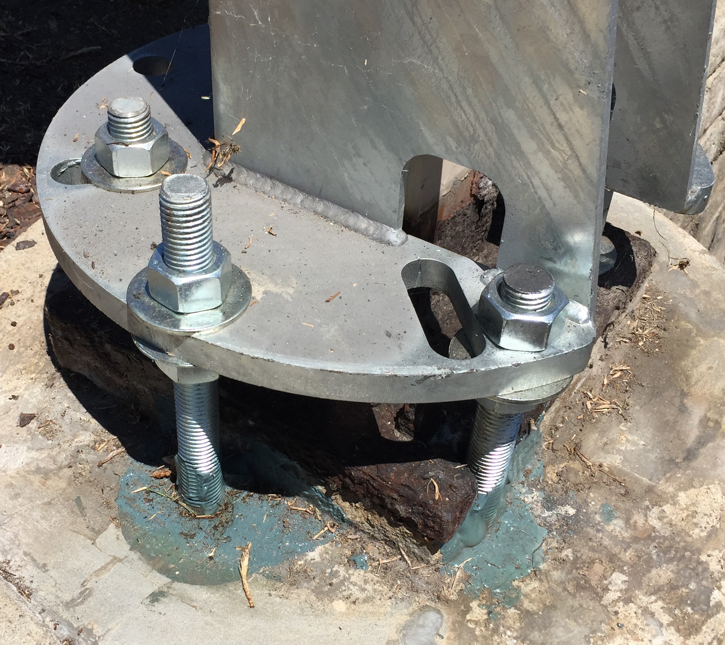
Epoxy Anchor Bolts
Depth calculations done by epoxy manufactures
Pending local code, Engineering and deputy inspection may be required
Simpson Strong Tie SET-XP is our favorite for its cost and availability
Follow install info for threaded rod and rebar
Often engineers will use Hilti specification due to good advertising
Most engineers will accept alternatives when properly proposed

Slide 21
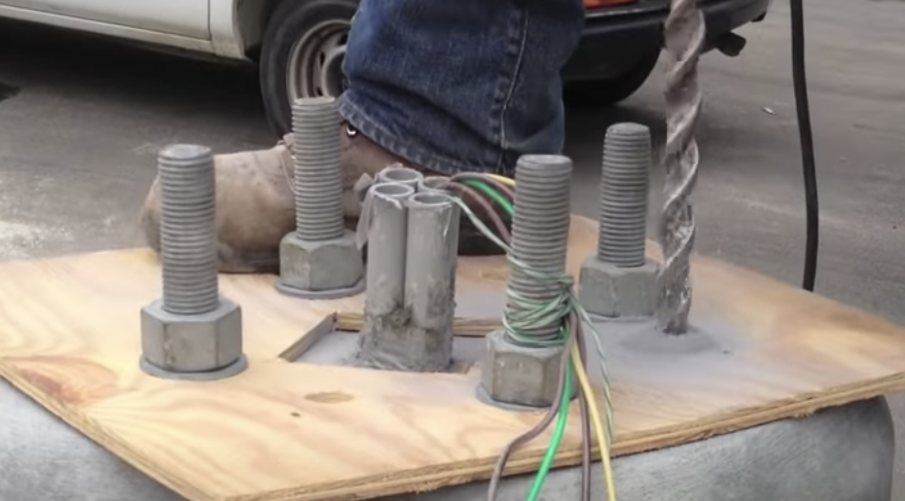
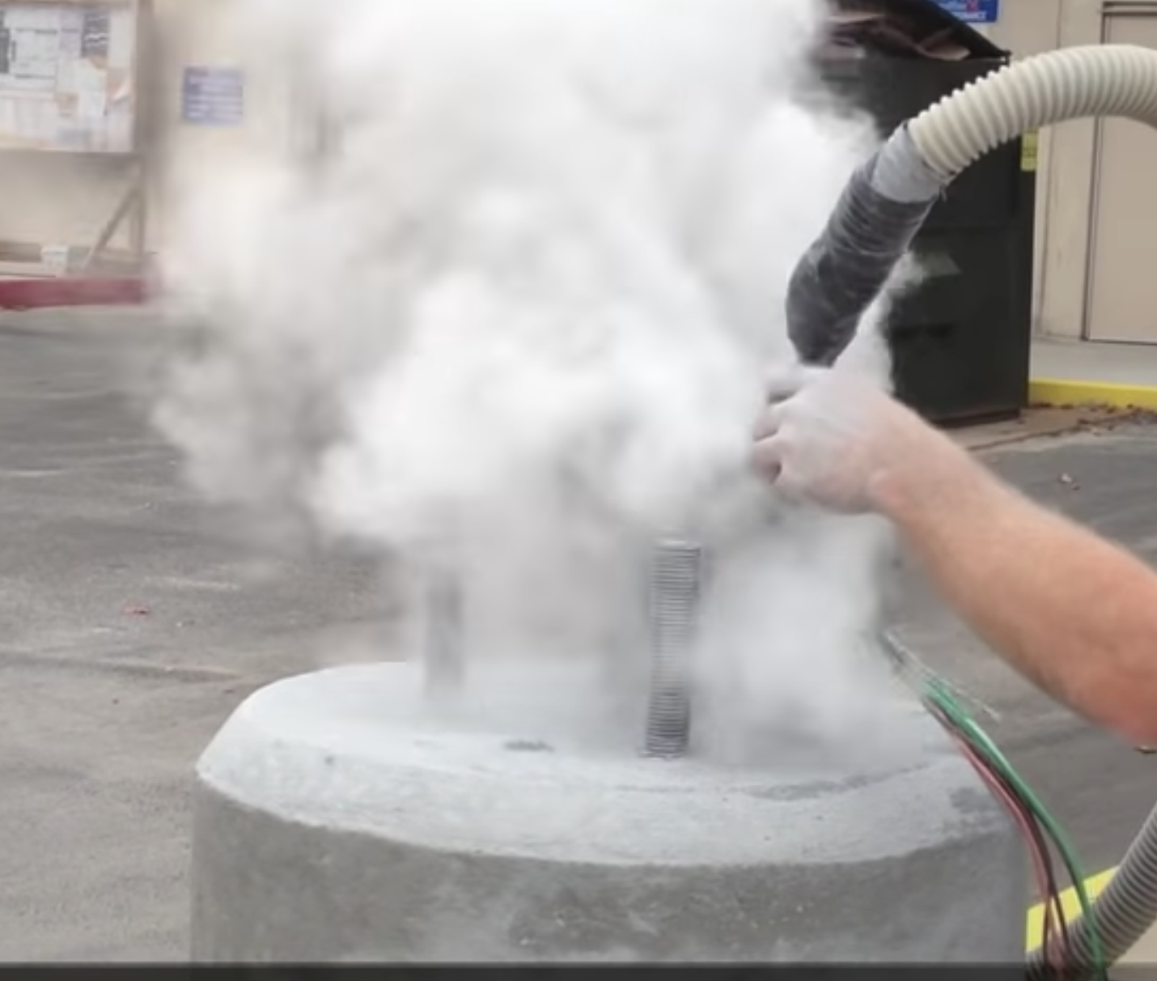
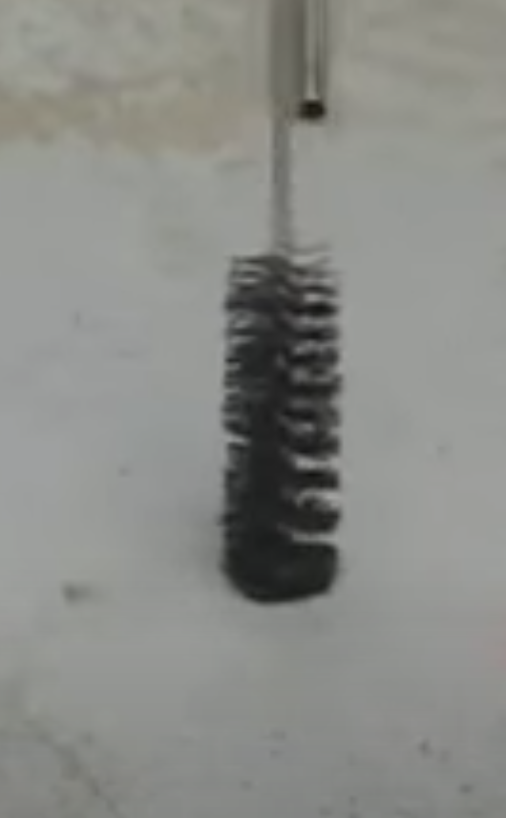
Epoxy Anchor Bolts Cont.
Drill Hole
Use concrete drill bit 1/8” larger than bolt size
7/8” for ¾”
1-1/8” for 1”
We drill about 12” deep
Recommended pattern is the same as existing to avoid rebar
Clean Hole
Alternate between compressed air and Nylon Hole-Cleaning Brush
Repeat at least 3 times, until no more dust comes out of hole
Recheck all holes
Notes:
Depth per Simpson Strong-Tie SET-XP. ¾” is 3.5-15”. 1” is 4-20”. Not as deep as you think. In a correct install the only forces on the bolt is tenson and compression, pull out and push in. its strongest force.
If possible use existing pattern.
Good clean holes ensures good epoxy adhesion to the concrete
Use the correct size brush to match hole size.
A shop vac and dust extractor is a good tool
Hilti makes a product that does not require cleaning, however i have not used it.

Slide 22
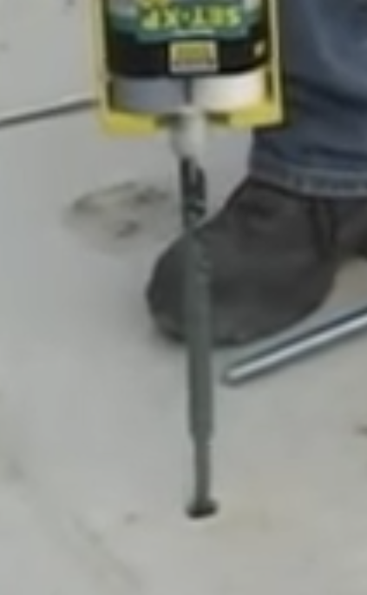
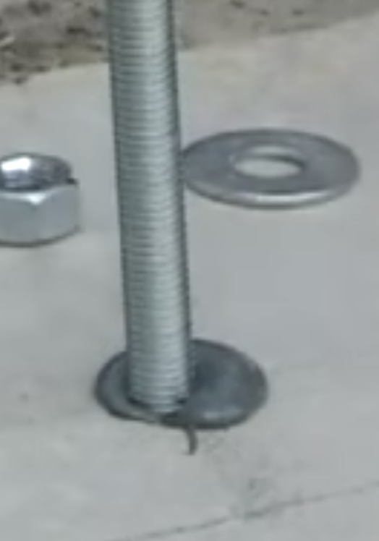
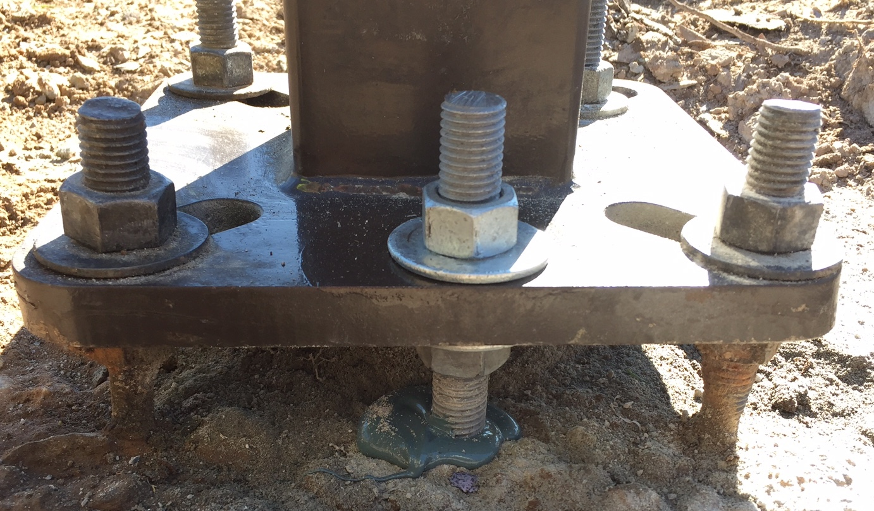
Install Epoxy and Bolt
Pump epoxy into hole starting from the bottom
Insert bolt into hole, twisting counterclockwise
Small amount of epoxy will come out of hole
Ensure epoxy is cure before cutting bolt or installing pole
Install pole like normal.
Notes:
More epoxy is better than not enough. For ¾” bolt hole, 12” deep about ½ standard tube. For 1” bolt hole 12” deep, ¾ standard tube.
We like the smaller 8.5oz tube. There is less waste and the cost is not much better than the larger tubes.
If the bolt is pressed into the hole to fast, the epoxy will build up pressure and push the bolt out slightly. Twisting the bolt counterclockwise and holding it in the bottom will help this.
Cure time depends on temperature. 24-72 hours.
Critical to let the epoxy cure before cutting the bolt. or test fit and cut before epoxy
Hold leveling nut when tightening top bolt.
Bolts should be even, not being pulled out or pressed in, same as normal bolts.

Slide 23
Questions?
For more info visit our website www.lightpolesystems.com
Follow us on our socials: Facebook, Instagram, LinkedIn and YouTube

