Slide 2

Controls Project Development - Troubleshooting Before the Trouble, Presented by Linmore LED
NALMCO SPRING SEMINAR
Wayne Callham
Controls Project Development
Troubleshooting Before the Trouble
March 1, 2023

Slide 3
Controls Project Development - Troubleshooting Before the Trouble
Lighting controls continue to gain market share because…
  Energy codes expand requirements
  Utility programs offer increased incentives
  End-use customers discover their value.
Proven solutions to simplify lighting controls implementation…
  Factory-assisted system design
  Factory pre-activation of controls component
A case study demonstrating…
  Value of a properly developed sequence of operation
  Use of pre-activated control devices installed by a turn-key lighting contractor
  Resulting in a seamless user experience.

Slide 4
Challenges Faced by Lighting Contractors When Installing Lighting Controls
Greater scope may increase payback period.
Pricing improvements are lessening that issue, sometimes reducing the payback period.
End-use clients may have unclear expectations.
May have been told of capabilities, but some of those capabilities were left out of scope.
There may be conflicts within the design team.
Selecting the best approach to meet savings and operational requirements.
Economic requirements may force scope reductions.
The design documents may not clearly express intent.
Vague or incomplete Sequences of Operation result in poor building performance.
Installation errors.
    Lack of training
    Un-tested devices
    Jobs left un-commissioned
    Lack of calibration
    Lack of mesh optimization
…all of which can result in dissatisfied end users.

Slide 5

Review the Proper Development of the Written Controls Narrative
Written Controls Narrative
Supports contract and specification preparation.
Provides clear direction to contractors and manufacturers.
Identifies criteria for testing and acceptance of the control system.
Serves as a general reference for the owner detailing how the control system operates.
The party responsible for performance testing knows what to test, how to test it and provides the criteria for acceptance.
Owner is more likely to receive a quality product that satisfies its requirements.
Increases the likelihood of acceptance by the owner and system users.

Slide 6
Development of the Written Controls Narrative – Project View
ORGANIZE YOUR PROJECT - Site Overview
Project
Includes all areas within contiguous proximity.
Example: All buildings on the school campus, not a school district.
Areas
Individual sections of the overall project.
Zones
Interior may be individual rooms or easily defined sections.
Exterior may be divided by direction or description.

Slide 7
Development of the Written Controls Narrative
LCA suggests should include at least two main elements:
General description of the project goals and control strategies intended to satisfy these goals.
Description of the lighting controls in each space and a sequence of operations for these controls which describes how the controls relate to each other and how they respond to various inputs, such as whether occupancy is detected.

Slide 8
Development of the Written Controls Narrative
Examples of Strategies and Features to be Included in Controls Narrative
DIMMING STRATEGIES
    Scheduling
    Scenes
    Occupancy Sensing
    Lighting Zones / Grouping
    High-End and Low-End Trim
    Manual Control
    Timer Switch Control
    Vacancy sensing
    Per Zone Daylight Control
    Per Fixture Daylight Control
FUNCTIONALITY
    Energy Dashboard
    Heat Mapping by Occupancy
    Heat Mapping by Energy
    Zone linking
    ON power up behavior
    UL 924 Compliant Functionality

Slide 10
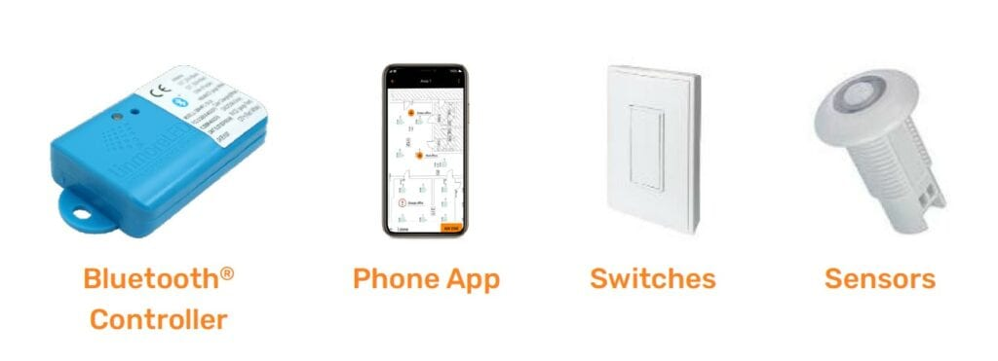

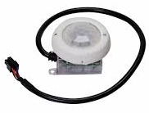
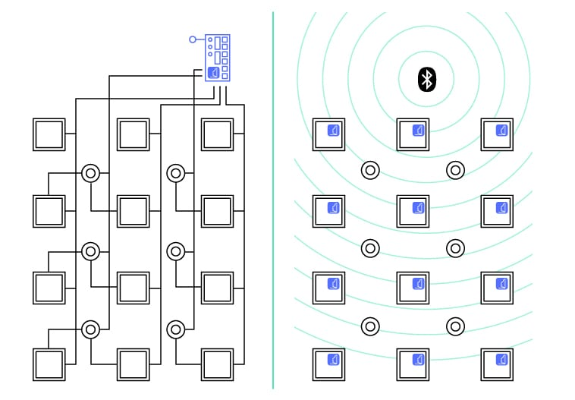
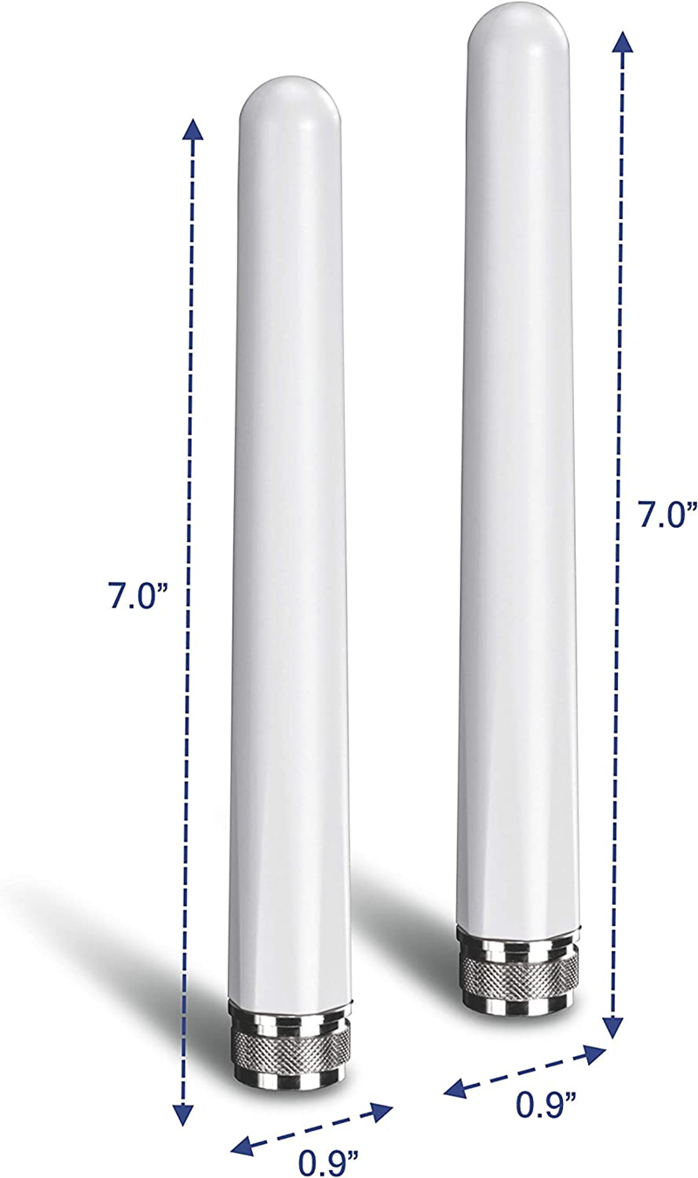
Proper Development of the Written Controls Narrative
System Hardware
Wireless fixture controller in each fixture.
Occupancy Sensors control fixtures by zones.
Daylight sensor controls light level offset by daylight.
Gateways (optional) provide system access when not onsite.
Energy meter measures energy consumption of a sample or all fixtures.
Wireless switches for controlling lighting by zones.

Slide 11
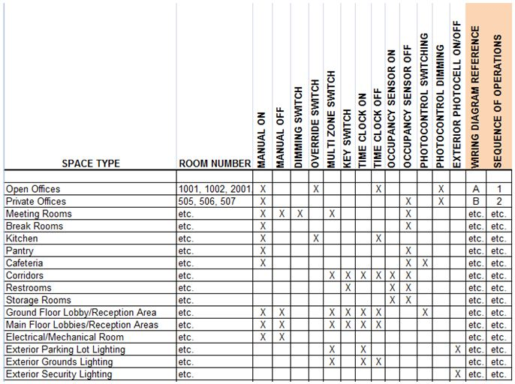
Review the Proper Development of the Written Controls Narrative

Slide 12
Development of the Written Controls Narrative - Hardware

Slide 13
Controls Project Development - Troubleshooting Before the Trouble
Developing the controls bill-of-material…
Select components for each strategy and function.
  First by zone
  Add the total number of each hardware device by areas and zones for full BOM.
Consider Including Factory Assisted Design and Factory Pre-Activation in Proposal.
  Design including BOM selections, placement, web application completion, and drawings.
  Devices brought into pre-designed zones at the factory.
  Luminaires and packaging are labeled to match design drawings.
  Installers place luminaires in predetermined locations per labeling.
  Final site optimization can be done by a lighting contractor or manufacturer for a fee.

Slide 14
Installation - Troubleshooting Before the Trouble
Area and Zone Operations Testing and Mesh Optimization
Test from luminaire to zone to area when testing.
Check the connectivity of each fixture in a zone once the power has been switched on.
Flash fixtures individually.
Check that each fixture is in the correct zone.
Switch and dim each zone when testing.
Look for fixtures that react outside the zone being tested.
Test for proper occupancy or vacancy response in each zone.
Check that all zone settings match those programmed in the application.
Time outs, fade rates, light levels, trim settings, override switches etc.

Slide 15
Review
Understand the building user’s needs and requirements.
Create a plan by developing a Controls Narrative resulting in a Sequence of Operations.
Understand the topology and placement of devices and antennas.
Determine if the required functionality will require a gateway.
If so, how many are required?
Review bill-of-materials with the manufacturer and installing technicians before ordering.
Confirm that all technicians have been properly trained and understand the sequence of operation.
Reduce programming time in the field – consider factory design and pre-activation.
Calibrate exterior photocontrol settings near dusk.
Test before leaving a zone to avoid unexpected hardware issues and re-mobilization expenses.
Enjoy better profit margins by avoiding common mistakes that require “go-backs”.

